Slide 1

Unit 7:
Saving Energy
Language Focus

Slide 2
1. Connectives
Complete the sentences. Use the correct connectives
a) Mrs. Quyen bought corn, potatoes …………. cabbages at the market. ( / )
b) I’d love to play volleyball …………… I have to complete an assignment. ( / )
c) Nam got wet …………… he forgot his umbrella. ( / )
d) Hoa failed her math test. …………. , she has to do the test again. ( / )
and
or
and
but
so
because
However
Therefore
and
or
e) Do you want Vietnamese tea ……… milk tea? ( / )
f) It’s raining, …………. I can’t go to the beach. ( / )
g) Ba’s hobbies are playing football………….. collecting stamps. ( / )
h) Na is very tired. ……………, she has to finish her homework before she goes to bed. ( / )
so
however
and
or
However
Therefore

Slide 3
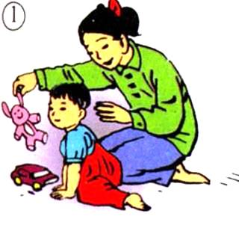
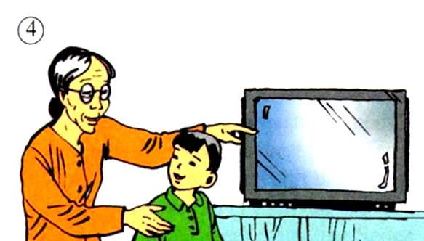
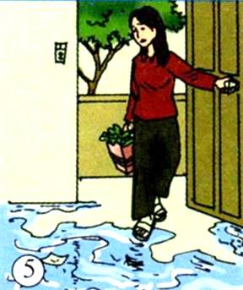
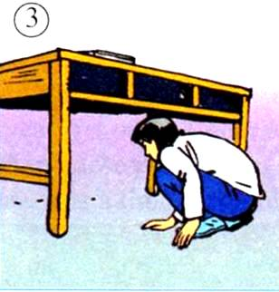
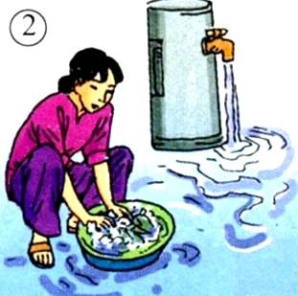
UNIT 7: SAVING ENERGY
LANGUAGE FOCUS
2.Phrasal verbs:
Look after
Turn on
Turn off
Look for
Go on

Slide 4
Complete the sentences. Use the right tense form of the phrasal verbs and the right pictures
turn on - turn off - look for - look after - go on
Hanh can’t go to the movies with us tonight. She will have to ………….. her little sister.
look after
go on
b) If we …….. wasting water, there will be a shortage of fresh water in a few decades.
Turn on
d) “ ………… the TV for me, will you? I want to watch the weather forecast.”
c) “I think I’ve lost my pen. I’ve ………….. it everywhere but I can’t find it anywhere.”
e) Mrs Yen forgot to …………… the faucet when she left for work.
looked for
turn off

Slide 5
UNIT 7: SAVING ENERGY
LANGUAGE FOCUS
3. Make suggestions:
S + suggest(s/ed) + V-ing …
a) Your class wants to help the poor in the neighborhood of your school. The following ideas may help you.
- collect unused clothes
- organize a show to raise money
- give lessons to poor children
- help elderly people and war invalids with their chores
→ I suggest collecting unused clothes
→ I suggest organizing a show to raise money
→ I suggest giving lessons to poor children
→ I suggest helping elderly people and war invalids with their chores

Slide 6
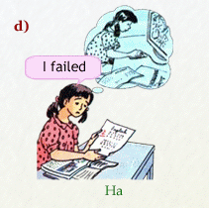
UNIT 7: SAVING ENERGY
LANGUAGE FOCUS
3. Make suggestions:
English
2
Ex: I suggest that you should work harder
S + suggest + (that) + S + should + V1 …

Slide 7
UNIT 7: SAVING ENERGY
LANGUAGE FOCUS
3. Make suggestions:
b) Your friend wants to improve his/ her English. The following ideas may help you.
* write sentences with new words
* speak English in class
* buy a good dictionary
* do some reading everyday
I suggest (that) you should write sentences with new words.
I suggest (that) you should speak English in class.
I suggest (that) you should buy a good dictionary.
I suggest (that) you should do some reading every day.

Slide 8
Homework
Do the exercises into your workbook.
Review Unit 6, 7 for preparing test 45m .

