Slide 1

EXERCISES
I. Choose the best option:
6. Mr. Brown, ________ is a retired teacher, does volunteer work at the hospital.
A. who B. whom C. which
7. Hawaii, ________ consists of 8 principal islands, is a favourite vacation spot.
A. whom B. who C. which
8. I thanked the woman ________ helped me.
A. which B. who C. whom
9. The movie _______ we saw last night wasn’t very good.
A. which B. whom C. who
10. She is the woman about _______ I told you.
A. who B. whom C. which

Slide 2
EXERCISES
II. Combine the two sentences into one. Using who, whom or which:
1. I liked the composition. You wrote it.
→ I like the composition
2. These people were very kind. They gave me some good books.
→ These people,
3. Mr. Lee teaches English. I met him yesterday.
→ Mr. Lee,
4. This is the woman. I talked to the woman last Sunday.
→ This is the woman to
5. The novels have been lost. You gave them to me on my birthday.
→ The novels
which
you wrote.
who
gave me some good books,
were very kind.
who/whom
I met yesterday,
teaches English.
whom
I talked last Sunday.
which
you gave to me on my birthday
have been lost.

Slide 3
EXERCISES
II. Combine the two sentences into one. Using who, whom or which:
6. The taxi driver was friendly. The taxi driver took me to the airport.
The taxi driver
7. The music was good. We listened to music last night.
The music to
8. The students are from China. I meet the students in the meeting.
The students
9. I had many friends. They visited my grandparents last summer.
I had many friends
10. Sydney is a big city. It has a population of over 3 million.
Sydney,
who
took me to the airport
was friendly.
which
we listened last night
was good.
who/whom
I meet in the meeting
are from China.
who
visited my grandparents last summer.
which
has a population of over 3 million,
is a big city.

Slide 4
CÓ 2 LOẠI MỆNH ĐỀ QUAN HỆ:
Mệnh đề quan hệ xác định (defining relative clause)
Mệnh đề quan hệ không xác định (non-defining relative clause)
BẢNG TÓM TẮT CÁC ĐẠI TỪ QUAN HỆ
 | Subjects | Objects
For people | WHO | WHO / WHOM
For things / animals | WHICH | WHICH

Slide 14


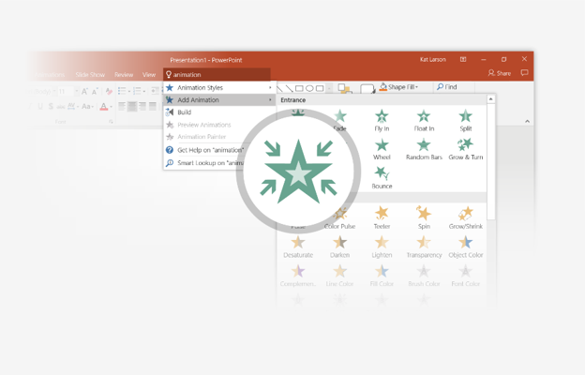
You’re an expert with Tell Me
The Tell Me box finds the right command when you need it, so you can save time and focus on your work. Try it:
SELECT ME
1
Select the Robot picture on the right.
2
Type animation in the Tell Me box, and then choose Add Animation.
3
Choose an animation effect, like Zoom, and watch what happens.

Slide 15
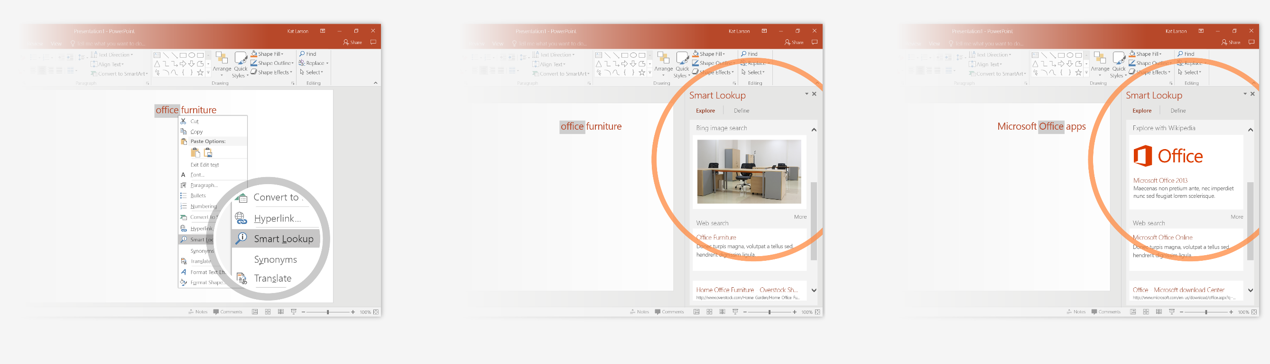
Explore without leaving your slides
Smart Lookup brings research directly in to PowerPoint. Try it:
1
Right-click in the word office in the following phrase: office furniture
2
Choose Smart Lookup, and notice that results are contextual for that phrase, not Microsoft Office apps.
3
Just for fun, try Smart Lookup again by right-clicking in the word Office in Step 2.

Slide 16

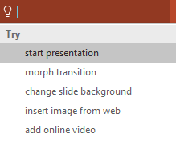

More questions about PowerPoint?
Select the Tell Me button and type what you want to know.
Visit the PowerPoint team blog
Go to free PowerPoint training
Give feedback about this tour
SELECT THE ARROW WHEN IN SLIDE SHOW MODE
Notes:
In Slide Show mode, select the arrows to visit links.

