Slide 1
THEME 2: TEENAGERS
Lesson 1
Lesson 3
Lesson 5
Lesson 2
Lesson 4

Slide 2
i-Learn Smart World – Theme 2
Page 14

Slide 3
i-Learn Smart World – Theme 2
?
2
?
5
1
?
?
3
?
6
Page 14
Notes:
Step 1: Teach the new vocabularies
Step 2: Listen, choose the answers and check
Step 3: Discuss in pairs and tell the class

Slide 4
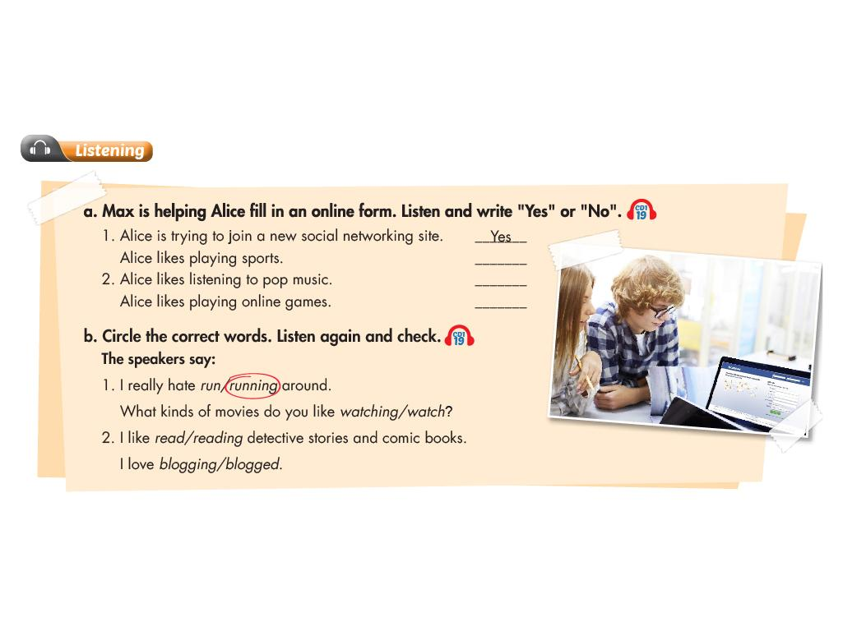
i-Learn Smart World – Theme 2
No
?
No
?
No
?
Page 14
Notes:
Step 1: Teach the new vocabularies
Step 2: Listen, write “Yes” or “No” and check
Step 3: Practice in pairs and tell the class

Slide 5
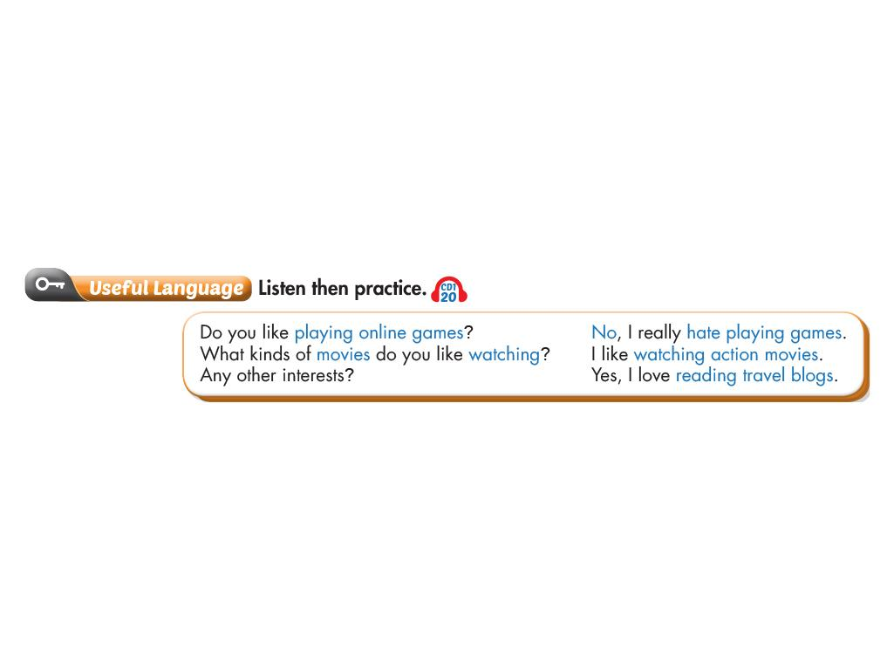
i-Learn Smart World – Theme 2
Page 14
Notes:
Step 1: Pre-teach
Step 2: Listen for the answers
Step 3: Practice in pairs

Slide 6
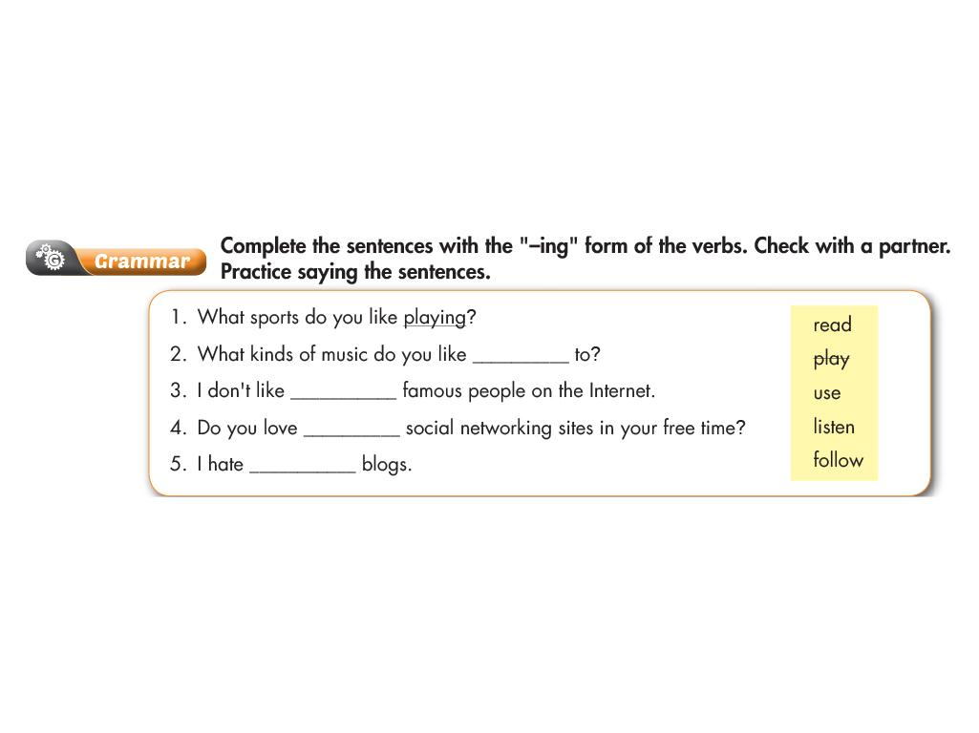
i-Learn Smart World – Theme 2
?
listening
?
following
using
?
reading
?
Page 15
Notes:
Step 1: Review the vocabularies and grammar
Step 2: Do the exercise
Step 3: Check the answers

Slide 7
i-Learn Smart World – Theme 2
Page 15
Notes:
Step 1: Teach the vocabularies
Step 2: Practice intonation
Step 3: Listen, repeat and check

Slide 8
i-Learn Smart World – Theme 2
Page 15
Notes:
Step 1: Teach the necessary language
Step 2: Demonstrate one time
Step 3: Role-play

Slide 9
i-Learn Smart World – Theme 2
Page 16

Slide 10
i-Learn Smart World – Theme 2
?
2
4
?
?
3
?
6
5
?
Page 16
Notes:
Step 1: Teach the vocabularies
Step 2: Listen and write the answers
Step 3: Listen again, check and repeat

Slide 11
i-Learn Smart World – Theme 2
True
?
True
?
False
?
Page 16
Notes:
Step 1: Pre-teach the situation
Step 2: Listen and write “True” or “False”
Step 3: Listen again, check and repeat

Slide 12
i-Learn Smart World – Theme 2
Page 16
Notes:
Step 1: Teach the sentences
Step 2: Listen and notice the useful language
Step 3: Listen again and repeat

Slide 13
i-Learn Smart World – Theme 2
I’m really worried that I’m going to fail my test
?
I’m very disappointed that my vacation was boring
?
I’m very scared that pollution is going to get worse
?
?
I’m really sure that I’m going to make new friends
I’m very pleased that my dad bought me a cellphone
?
Page 17
Notes:
Step 1: Review the grammar
Step 2: Do the exercise
Step 3: Check the answers and practice with friends

Slide 14
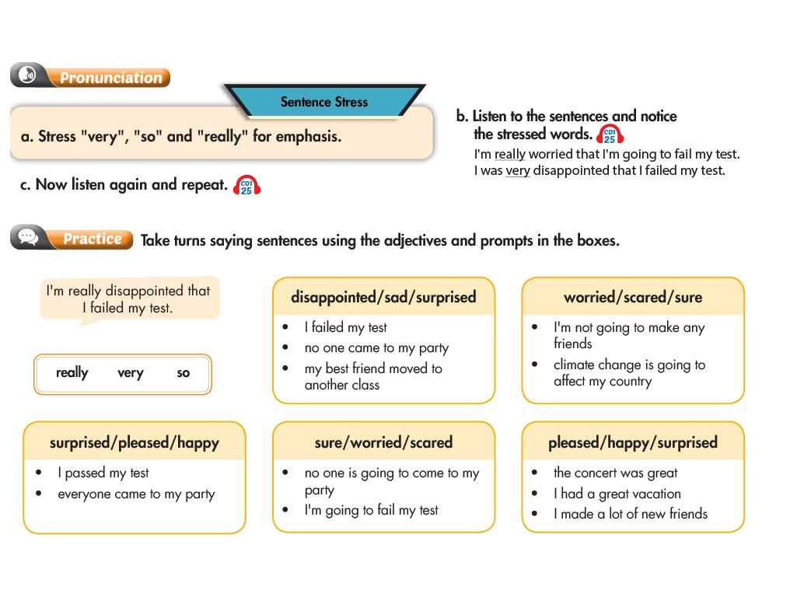
i-Learn Smart World – Theme 2
Page 17
Notes:
Step 1: Teach the intonation
Step 2: Listen and mark the stress words
Step 3: Listen again and practice in pairs

Slide 15
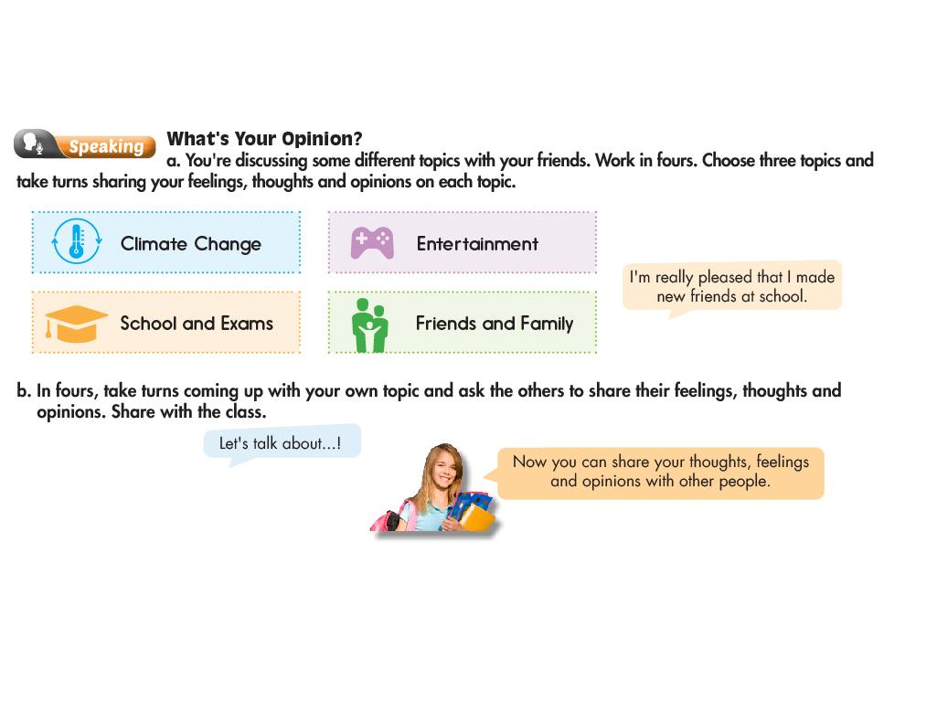
i-Learn Smart World – Theme 2
Page 17
Notes:
Step 1: Talk about opinion
Step 2: Practice in pairs
Step 3: Present to the class

Slide 16
i-Learn Smart World – Theme 2
?
4
?
2
5
3
?
?
Page 18
Notes:
Step 1: Teach the vocabularies
Step 2: Listen and write the answers
Step 3: Listen again, check and practice with friends

Slide 17
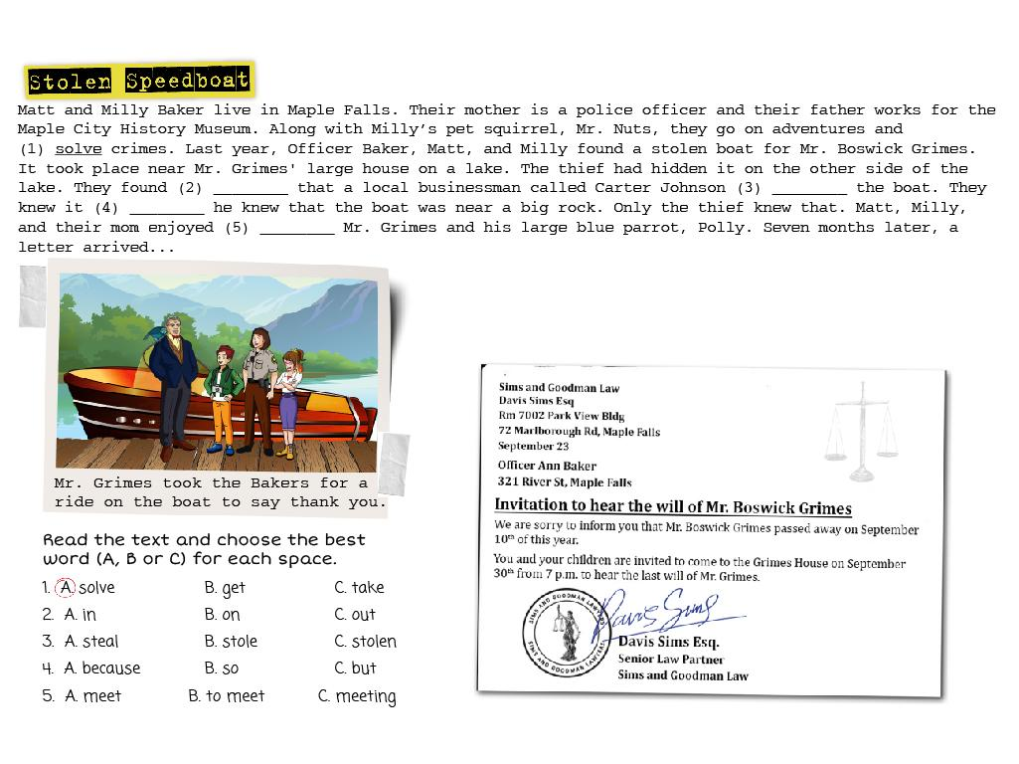
i-Learn Smart World – Theme 2
Page 18
Notes:
Step 1: Teach the vocabularies
Step 2: Practice reading skills
Step 3: Choose the answers and check

Slide 18
i-Learn Smart World – Theme 2
Page 18
Notes:
Step 1: Pre-teach the situation
Step 2: Listen and choose the answers
Step 3: Listen again and check

Slide 19
i-Learn Smart World – Theme 2
It’s stormy
?
It’s nighttime
?
Page 19
Notes:
Step 1: Pre-teach the situation
Step 2: Discuss in pairs
Step 3: Listen, choose the answers and check

Slide 20
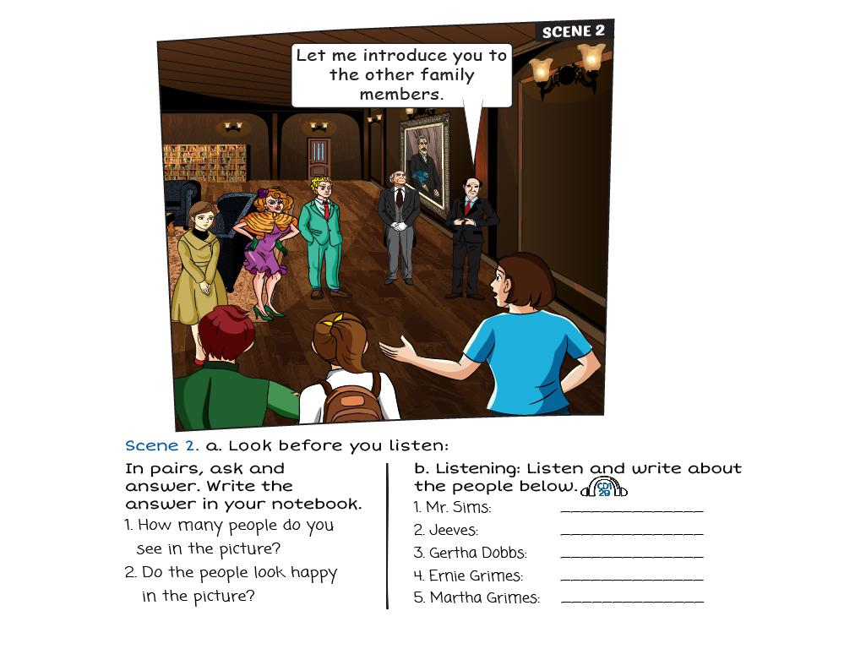
i-Learn Smart World – Theme 2
The family lawyer
?
Mr.Grimes’s butler
?
8
Mr.Grimes’s sister
?
?
Mr.Grimes’s nephew
?
Mr.Grimes’s niece
?
?
They look unhappy
Page 19
Notes:
Step 1: Pre-teach the situation
Step 2: Discuss in groups
Step 3: Listen, choose the answers and check

Slide 21
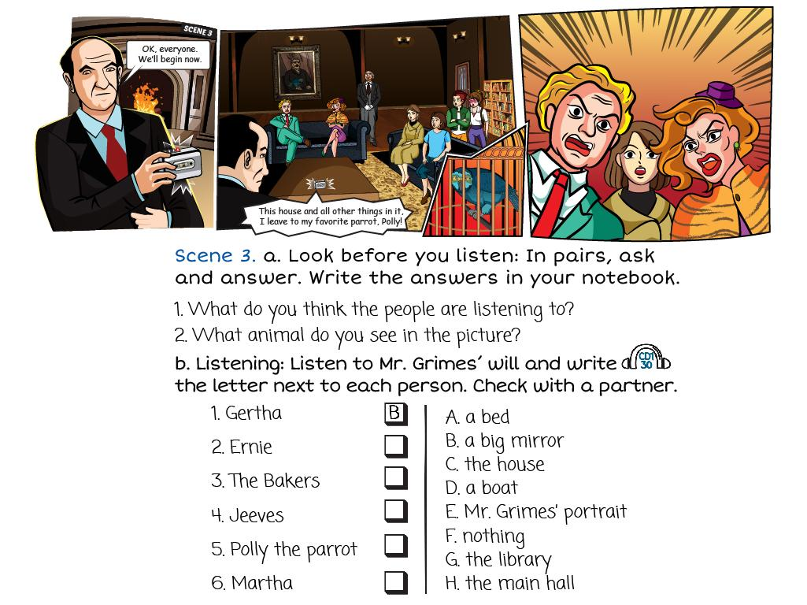
i-Learn Smart World – Theme 2
A recording of Mr.Grimes reading his will
?
?
A parrot
A
?
?
D
E
?
?
C
F
?
Page 19
Notes:
Step 1: Pre-teach the situation
Step 2: Discuss in class
Step 3: Listen, choose the answers and check

Slide 22
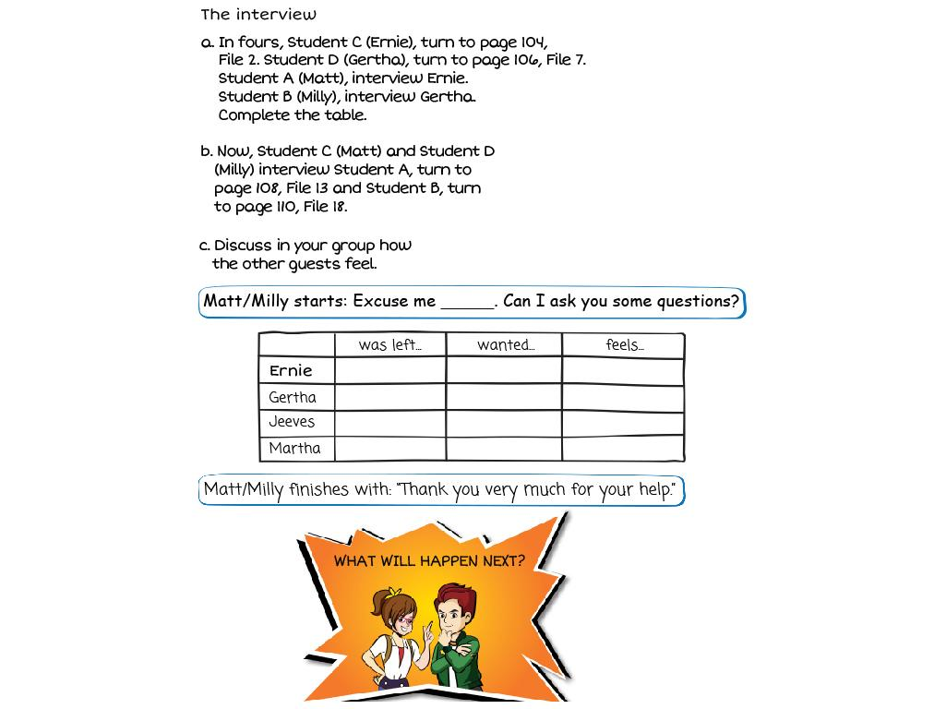
i-Learn Smart World – Theme 2
?
?
?
a bed
some money
very angry
a large mirror
?
?
the house
very upset and angry
?
?
?
?
Mr.Grimes’ portrait
some money
very disappointed
?
Nothing but can live in the house with Polly
?
very suprised
nothing
?
Page 19
Notes:
Step 1: Pre-teach the situation
Step 2: Practice in groups
Step 3: Demonstrate to the class

Slide 23
i-Learn Smart World – Theme 2
Page 20

Slide 24
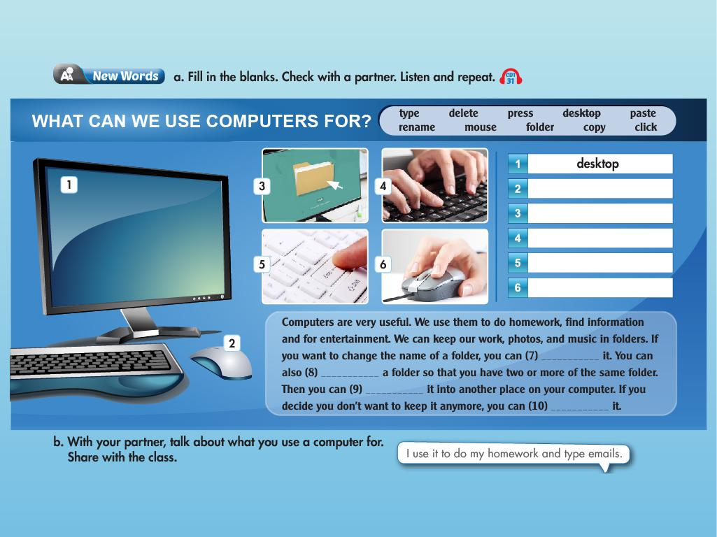
i-Learn Smart World – Theme 2
?
mouse
?
folder
?
type
press
?
?
click
rename
copy
?
?
paste
?
delete
?
Page 20
Notes:
Step 1: Teach the vocabularies
Step 2: Listen and write the answers
Step 3: Listen again, check the answers and practice

Slide 25
i-Learn Smart World – Theme 2
Folder
?
?
Rename
type
?
Page 20
Notes:
Step 1: Teach the vocabularies
Step 2: Listen and write the answers
Step 3: Listen again and check the answers

Slide 26
i-Learn Smart World – Theme 2
Page 20
Notes:
Step 1: Talk about computer commands
Step 2: Listen and learn useful sentences
Step 3: Practice in pairs

Slide 27
i-Learn Smart World – Theme 2
Page 21
Notes:
Step 1: Talk about editing on computers
Step 2: Practice reading skills
Step 3: Circle “True” or “False” and check

Slide 28
i-Learn Smart World – Theme 2
4
3
2
?
?
?
click
Copy
folder
Right-click
Paste
Paste
?
?
?
Page 21
Notes:
Step 1: Talk about computer using
Step 2: Role-play in pairs and fill in the blanks
Step 3: Check the answers

Slide 29
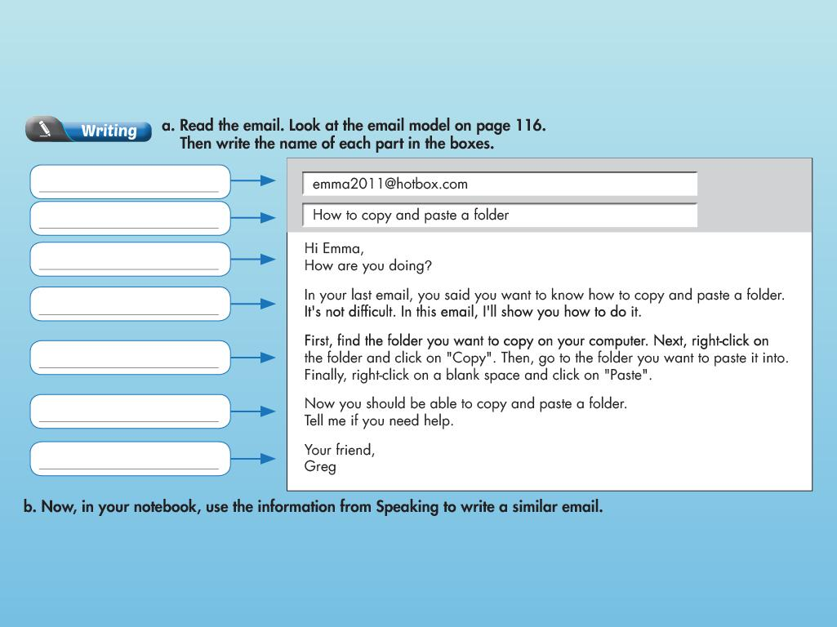
i-Learn Smart World – Theme 2
?
To
Subject
?
Greeting
?
Purpose
?
Body
?
Closing
?
Signature
?
Page 21
Notes:
Step 1: Teach email structure
Step 2: Fill in the blanks and check
Step 3: Write an email

Slide 30
i-Learn Smart World – Theme 2
Page 22

Slide 31
i-Learn Smart World – Theme 2
Page 22
Notes:
Step 1: Review the language
Step 2: Explain the rules
Step 3: Play the game

Slide 32
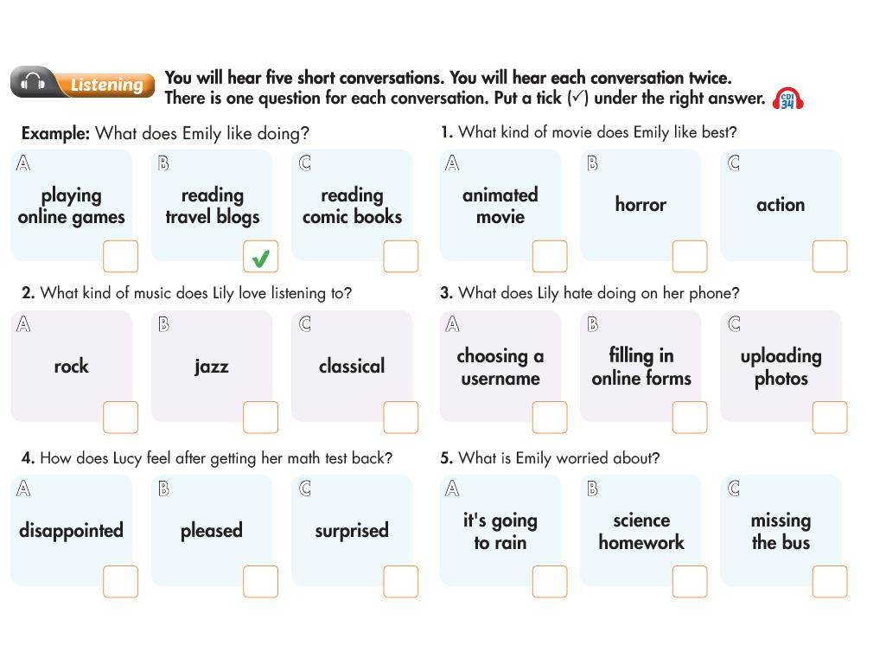
i-Learn Smart World – Theme 2
Page 22
Notes:
Step 1: Discuss the activities
Step 2: Listen and tick the correct box
Step 3: Listen again and check

Slide 33
i-Learn Smart World – Theme 2
e
n
a
m
e
?
e
l
e
t
e
?
?
l
i
c
k
a
s
t
e
?
e
s
?
r
s
Page 22
Notes:
Step 1: Discuss the topic
Step 2: Review the vocabularies
Step 3: Write the answers and check

Slide 34
i-Learn Smart World – Theme 2
Page 23
Notes:
Step 1: Explain the rules
Step 2: Demonstrate the game
Step 3: Play in groups

Slide 35
i-Learn Smart World – Theme 2
Page 23
Notes:
Step 1: Practice reading skills
Step 2: Write a paragraph
Step 3: Tell the class

Slide 36
i-Learn Smart World – Theme 2
?
mouse
right-click
?
?
?
New
Folder
type
?
press
?
2
4
1
3
Page 105

Slide 37
i-Learn Smart World – Theme 2
Page 104

Slide 38
i-Learn Smart World – Theme 2
Page 106

Slide 39
i-Learn Smart World – Theme 2
Page 108

Slide 40
i-Learn Smart World – Theme 2
Page 110

Slide 41
i-Learn Smart World – Theme 2
Page 112

Slide 42
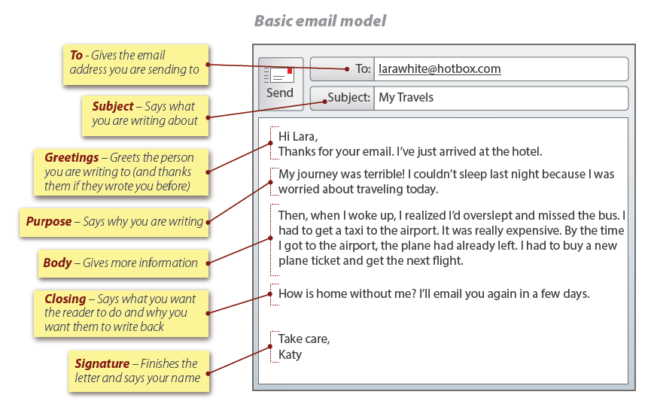
i-Learn Smart World – Theme 2
Page 116

Slide 43
i-Learn Smart World – Theme 2
Page 117

