Slide 1
THEME 7: ROBOTS
Lesson 1
Lesson 3
Lesson 5
Lesson 2
Lesson 4

Slide 2
Theme 7 – Lesson 1
Page 64

Slide 3
Theme 7 – Lesson 1
Page 64
Notes:
Explain new words
Review how to pronounce plural nouns

Slide 4
Theme 7 – Lesson 1
?
make
on
?
?
also
Page 64
Notes:
Teach students how to use “can” and “can’t” to talk about abilities
Review Present simple
Make sure students use correct phrases / collocations they have learnt

Slide 5
Theme 7 – Lesson 1
Page 64
Notes:
How to use “what else…” to ask for information
Using “can” and “can’t” to express abilities

Slide 6
Theme 7 – Lesson 1
?
They can work in hospitals.
What can they do there?
?
They can operate on sick people..
?
Page 65
Notes:
Review present simple
How to make questions with “can”
Check vocabularies students have learnt in the lesson

Slide 7
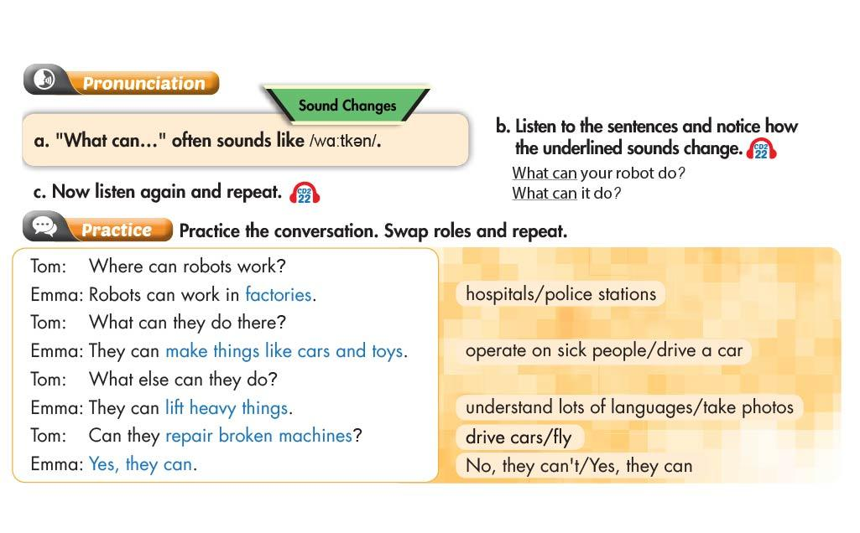
Theme 7 – Lesson 1
Page 65
Notes:
Introduce linking in pronunciation
Make and answer questions with “can”
Review how to use “what else…” to ask for information
Check vocabularies students have learnt in the lesson

Slide 8
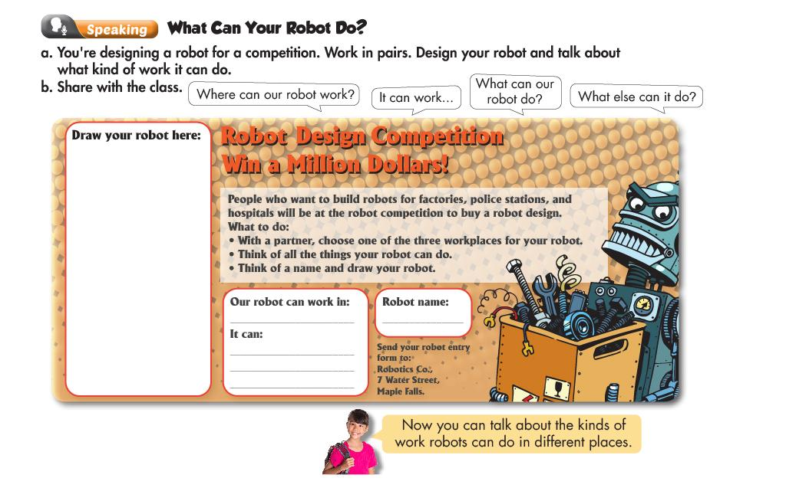
Theme 7 – Lesson 1
Page 65
Notes:
Using “can” and “can’t” to talk about abilities
Check vocabularies students have learnt in the lesson
Make sure students use linking (“what can….”) when possible

Slide 9
Theme 7 – Lesson 2
Page 66

Slide 10
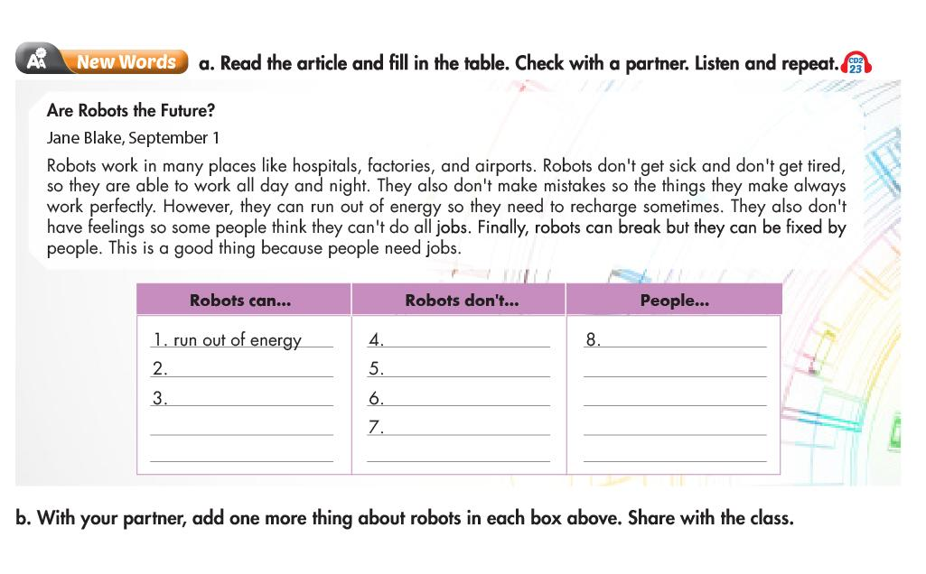
Theme 7 – Lesson 2
?
?
get sick
need jobs
?
?
break
get tired
?
be fixed
make mistakes
?
have feelings
?
Page 66
Notes:
Explain new words
Review how to use “can” and “can’t” to talk about abilities

Slide 11
Theme 7 – Lesson 2
?
No
?
Yes
?
No
Page 66
Notes:
How to use “because” to give reason
Students remember new words / phrases they have learnt in the lesson

Slide 12
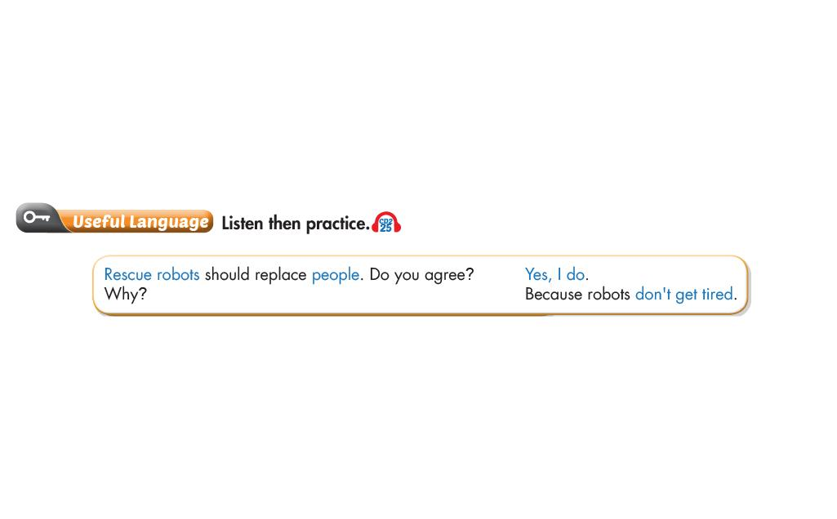
Theme 7 – Lesson 2
Page 66
Notes:
How to express agreement / disagreement
Using “because” to give reason

Slide 13
Theme 7 – Lesson 2
run
?
make
?
have
?
get
?
Page 67
Notes:
Check vocabularies students have learnt in the lesson
Using “can” and “can’t” to talk about abilities

Slide 14
Theme 7 – Lesson 2
Page 67
Notes:
Teach students how to stress for emphasis
Using “because” to give reasons
Using “can” and “can’t” to express abilities

Slide 15
Theme 7 – Lesson 2
Page 67
Notes:
Students know how to agree / disagree while discussing
Note the use of “because” to give reasons
Students use “can” and “can’t” to express abilities

Slide 16
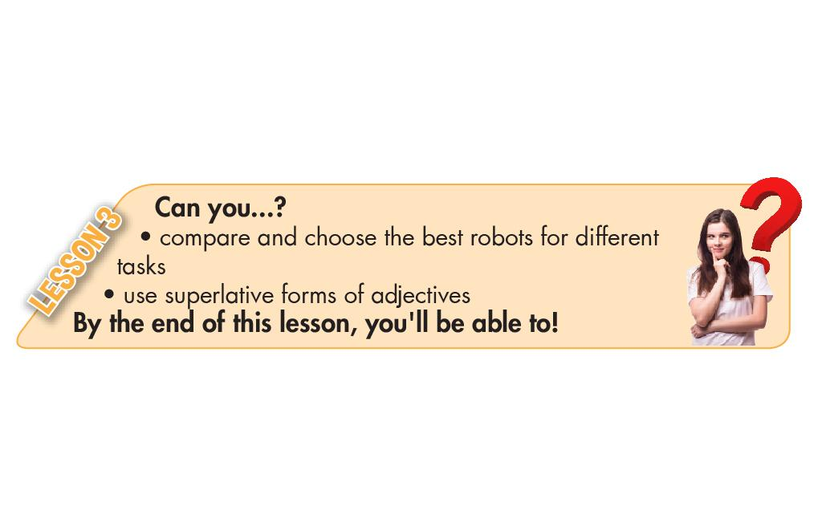
Theme 7 – Lesson 3
Page 68

Slide 17
Theme 7 – Lesson 3
?
quiet
fast
?
loud
?
?
?
weak
intelligent
Page 68
Notes:
Explain new adjectives
Note the use of present simple to describe a person

Slide 18
Theme 7 – Lesson 3
strongest
?
?
most intelligent
quietest
?
Page 68
Notes:
Introduce the superlative form of adjective
Note the use of “would”

Slide 19
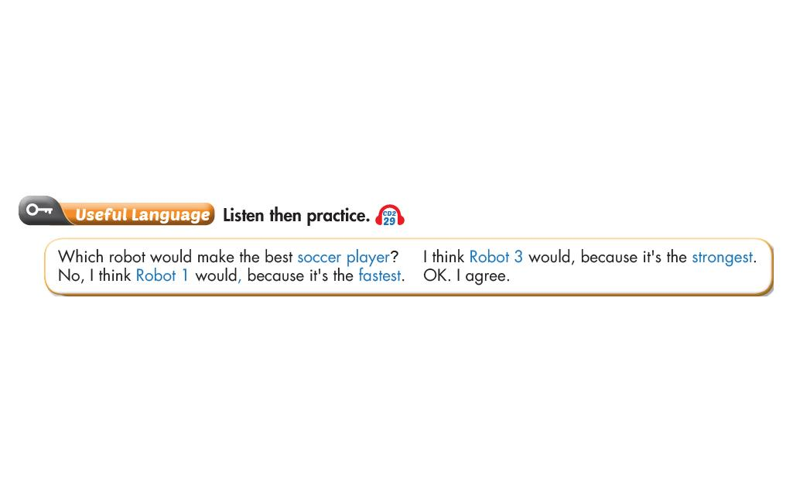
Theme 7 – Lesson 3
Page 68
Notes:
Review the superlative form of adjective
How to express agreement / disagreement

Slide 20
Theme 7 – Lesson 3
?
fastest
most intelligent
?
?
weakest
best
?
Page 69
Notes:
Review the superlative form of adjective
Students know how to stress in the sentence for emphasis (agree / disagree)

Slide 21
Theme 7 – Lesson 3
Page 69
Notes:
Check new adjectives students have learnt
Students know how to make superlative form of adjective
Practice asking and using “because” to give reasons
Remind students of stressing to show agreement / disagreement

Slide 22
Theme 7 – Lesson 4
Page 70

Slide 23
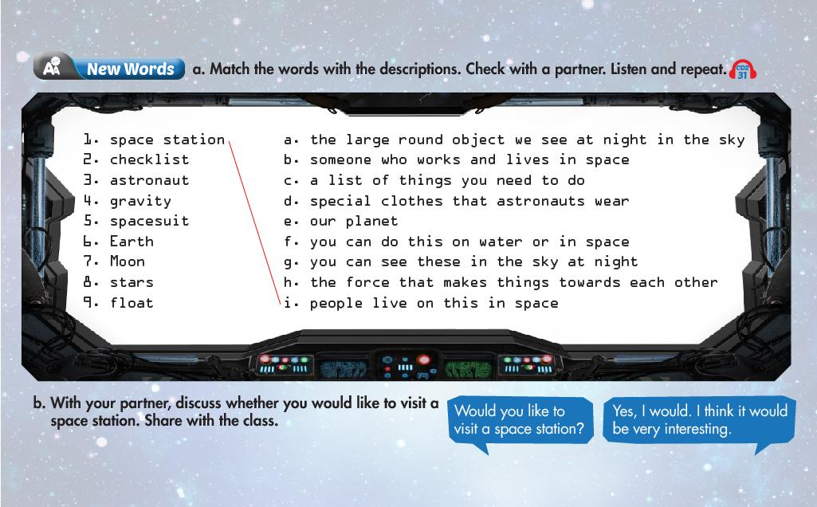
Theme 7 – Lesson 4
Page 70
Notes:
Explain new words
Asking and answering with “would like”

Slide 24
Theme 7 – Lesson 4
?
?
?
3
2
4
Page 70
Notes:
Review words about life on a space station
Review present simple
How to use “during” and “for”

Slide 25
Theme 7 – Lesson 4
Page 70
Notes:
Note the use of “have to” to express obligation
Review how to use “because” to give reasons

Slide 26
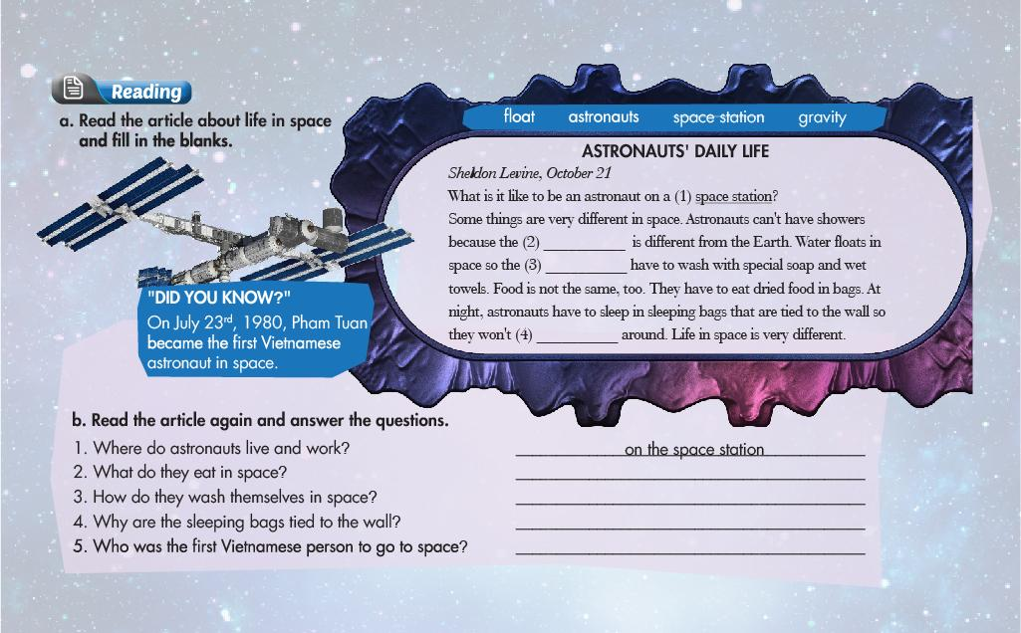
Theme 7 – Lesson 4
?
gravity
astronauts
?
float
?
?
dried food
?
with special soap and wet towels
So they don’t float around
?
Pham Tuan
?
Page 71
Notes:
Review present simple for repeated actions
Review past simple
Using “can”, “can’t” and “have to” to talk about abilities
Using “because” to give reasons

Slide 27
Theme 7 – Lesson 4
Page 71
Notes:
Review the words about life on a space station
Students use “because” to give reasons
Remember to use intonation for WH- and Yes / No questions

Slide 28
Theme 7 – Lesson 4
Page 71
Notes:
Review Present simple to talk about repeated actions
Note the use of “the same as” , “different from” to make comparison
Using “have to” to describe obligation

Slide 29
Theme 7 – Lesson 5
Page 72

Slide 30
Theme 7 – Lesson 5
Page 72

Slide 31
Theme 7 – Lesson 5
?
H
?
A
?
E
?
D
?
F
Page 72
Notes:
Review vocabularies about what robots can do
Using “can” and “can’t” to talk about abilities

Slide 32
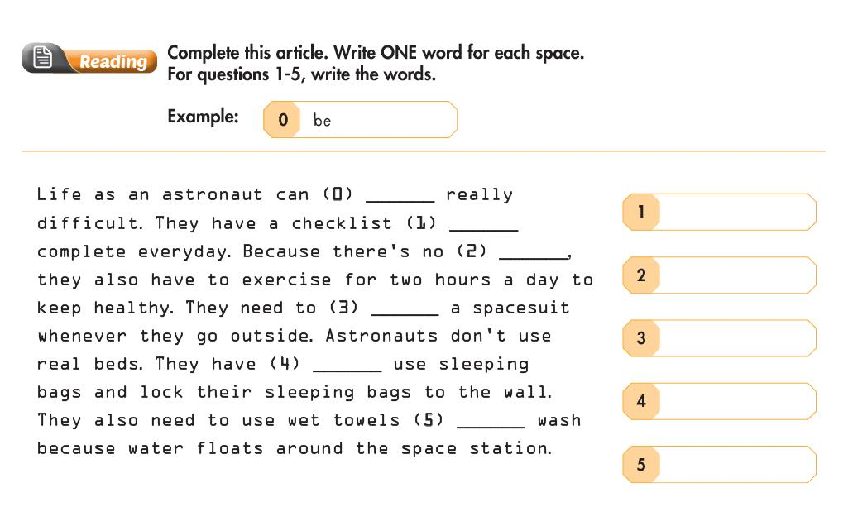
Theme 7 – Lesson 5
to
?
gravity
?
?
wear
to
?
to
?
Page 72
Notes:
Review using Present simple for repeated actions
Check vocabularies to talk about life on a space station
Using “to” to express purpose / intention

Slide 33
Theme 7 – Lesson 5
Page 73
Notes:
Using “because” to give reason
Note how to use “can” and “can’t” to talk about abilities
Review vocabularies to describe life on a space station
How to use superlative form of adjective

Slide 34
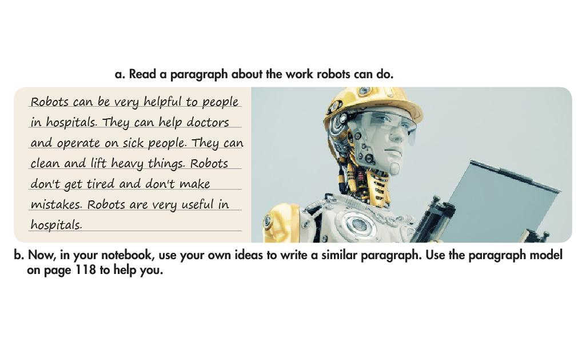
Theme 7 – Lesson 5
Page 73
Notes:
Introduce different parts of a paragraph
Using “can” and “can’t” to talk about abilities
Review vocabularies students have learnt about what robots can do

Slide 35
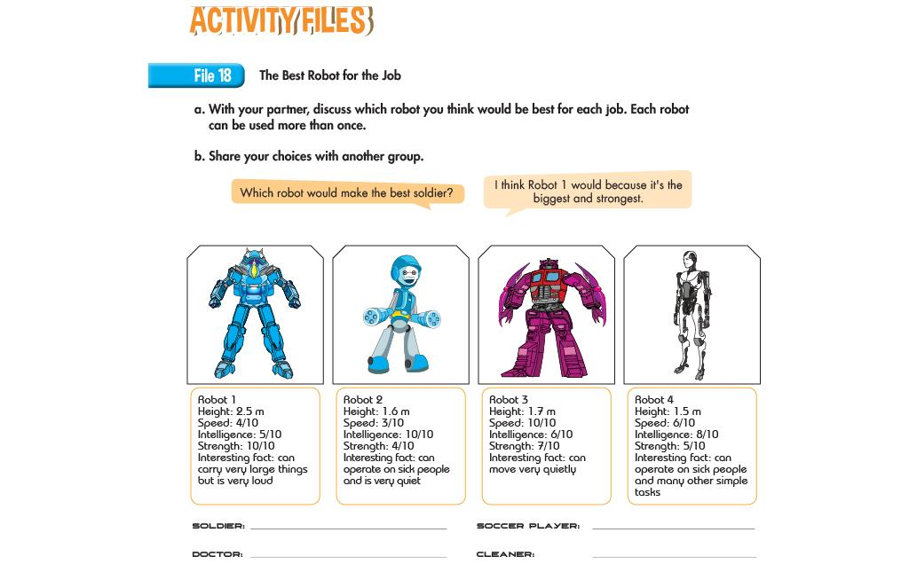
Theme 7 – Lesson 3
Page 112
Notes:
Check new adjectives students have learnt
Students know how to make superlative form of adjective
Practice asking and using “because” to give reasons
Remind students of stressing to show agreement / disagreement

Slide 36
Theme 7 – Lesson 5
Page 113

Slide 37
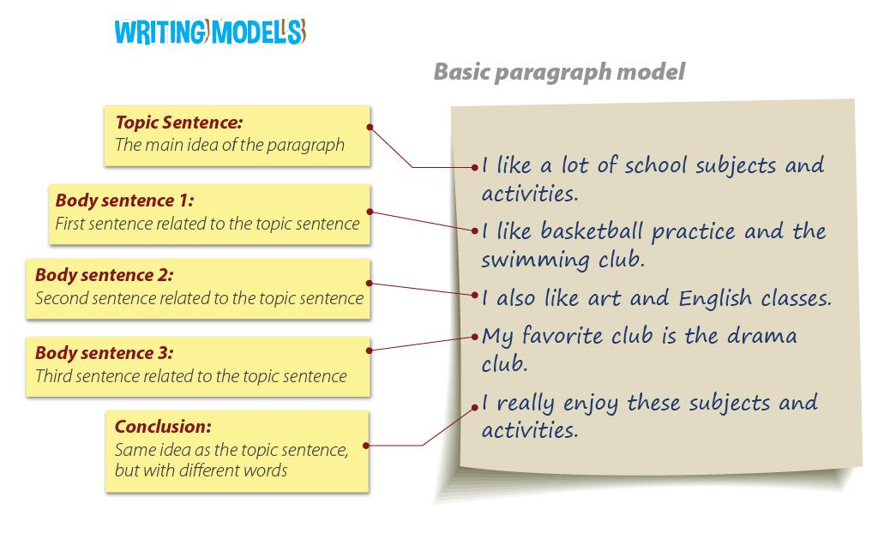
Theme 7 – Lesson 5
Page 118
Notes:
Introduce different parts of a paragraph
Using “can” and “can’t” to talk about abilities
Review vocabularies students have learnt about what robots can do

