Slide 1
THEME 6: RECREATION
Lesson 1
Lesson 3
Lesson 5
Lesson 2
Lesson 4

Slide 2
Theme 6 – Lesson 1
Page 54

Slide 3
Theme 6 – Lesson 1
surfing
yoga
?
?
rock climbing
martial arts
hide and seek
?
?
?
Page 54
Notes:
Explain new words
Remind students that these activities need to go with suitable verbs

Slide 4
Theme 6 – Lesson 1
Page 54
Notes:
Review Present Continuous and Past Simple
Review the use of “would like”
Introduce Present Perfect

Slide 5
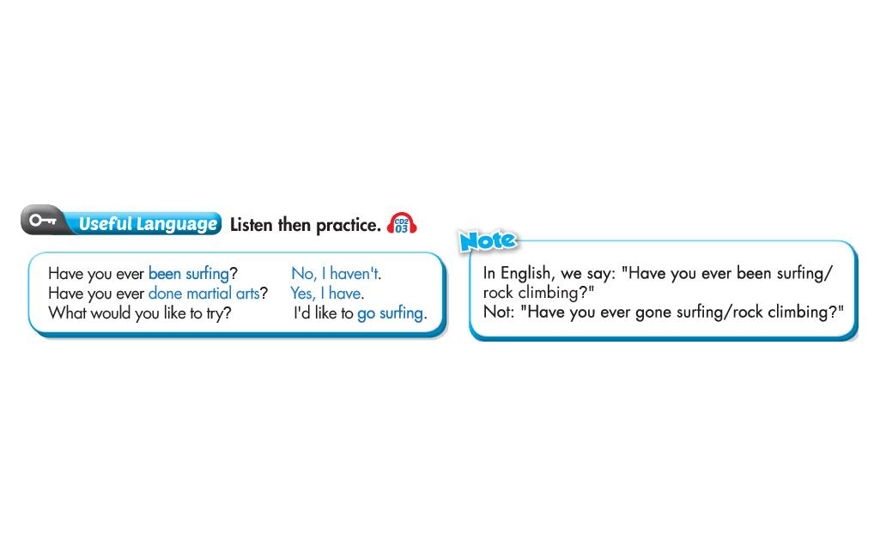
Theme 6 – Lesson 1
Page 54
Notes:
Note the difference of “be” and “go” in Present Perfect
Practice asking and answering questions using Present Perfect and “would like”

Slide 6
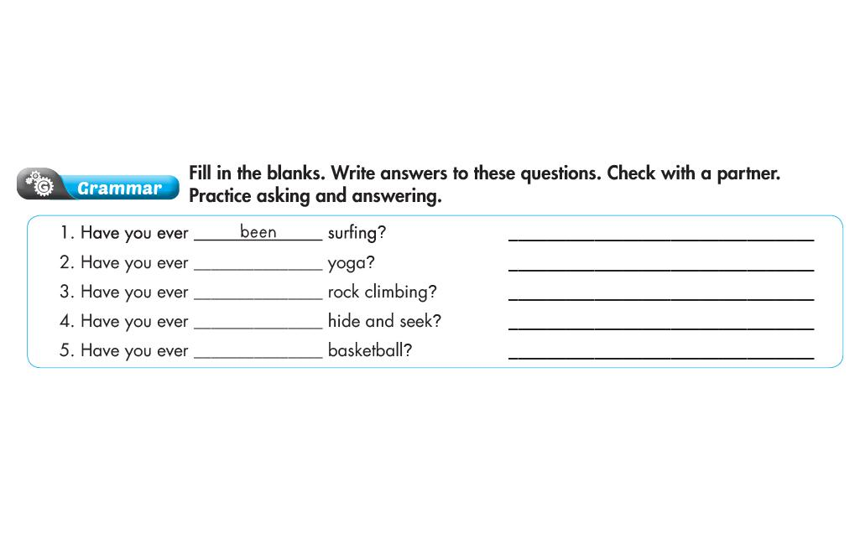
Theme 6 – Lesson 1
?
done
been
?
played
?
played
?
Page 55
Notes:
Review Present Perfect
The difference of “be” and “go” in Present Perfect

Slide 7
Theme 6 – Lesson 1
Page 55
Notes:
Teach students the intonation in Yes / No questions. Compare with WH-questions.
Practice asking and answering questions about sports and games
Make sure students use correct verbs and activities

Slide 8
Theme 6 – Lesson 1
Page 55
Notes:
Review vocabularies students have learnt in the lesson
Review intonation in Yes / No and WH-questions
Students know how to ask and answer questions about sports and games

Slide 9
Theme 6 – Lesson 2
Page 56

Slide 10
Theme 6 – Lesson 2
rarely
?
often
?
sometimes
?
?
usually
?
always
Page 56
Notes:
Introduce adverbs of frequency
Review Present Simple

Slide 11
Theme 6 – Lesson 2
?
always
often
?
usually
?
Page 56
Notes:
Review adverbs of frequency
Review prepositions of time
Remind students of the Present Simple

Slide 12
Theme 6 – Lesson 2
Page 56
Notes:
Practice the ways to ask and answer with “how often”
Note the cases of “never” and “rarely”

Slide 13
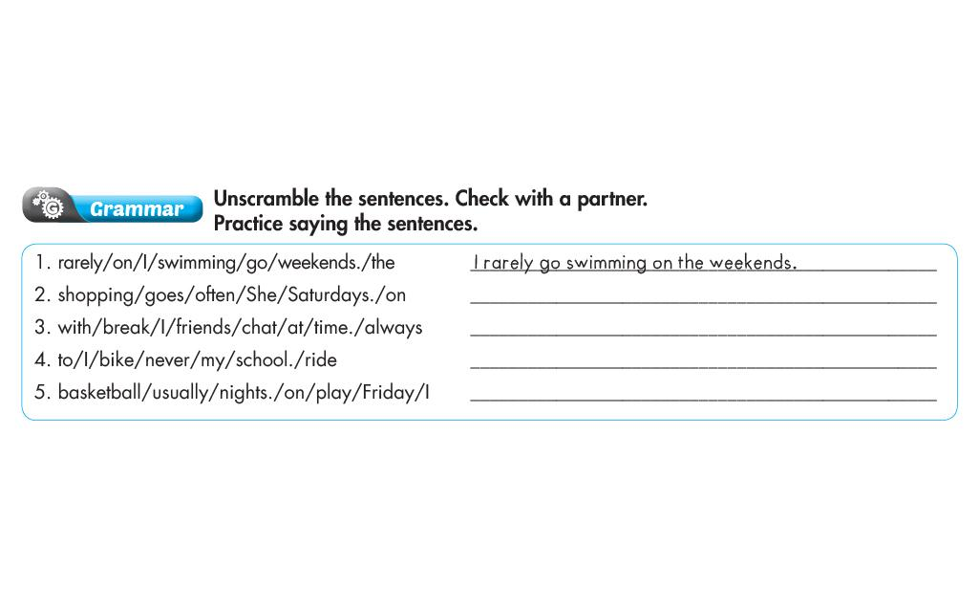
Theme 6 – Lesson 2
She often goes shopping on Saturdays.
?
?
I always chat with friends at break time.
I never ride my bike to school.
?
I usually play basketball on Friday nights.
?
Page 57
Notes:
Review Present Simple
Review adverbs of frequency and prepositions of time

Slide 14
Theme 6 – Lesson 2
Page 57
Notes:
Explain the intonation for statements
Review some vocabularies to talk about activities
Practice asking and answering with “How often” (note the case of “rarely” and “never”)

Slide 15
Theme 6 – Lesson 2
Page 57
Notes:
Review adverbs of frequency
Students should know how to ask and answer with “how often”
Make sure students use correct verbs for each activity
Review the intonation in WH-questions and statements

Slide 16
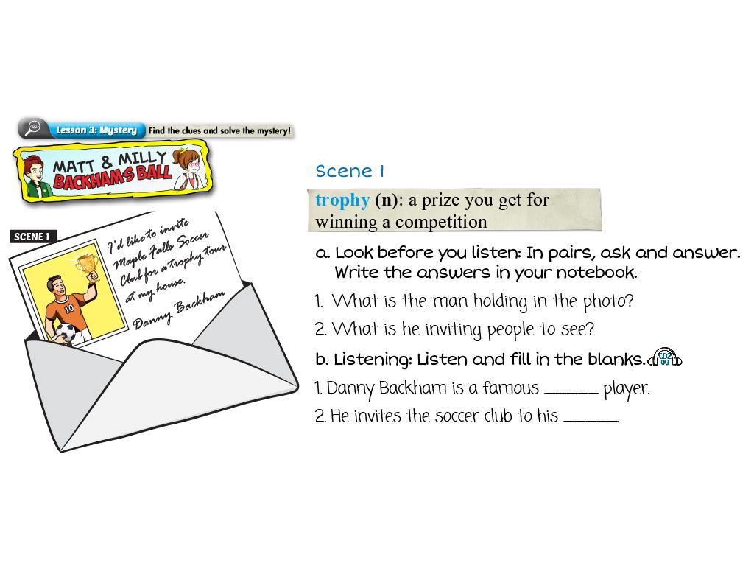
Theme 6 – Lesson 3
?
A trophy
A trophy tour
?
soccer
?
house
?
Page 58
Notes:
Review Present Simple and Present Continuous
Review how to use “would like”

Slide 17
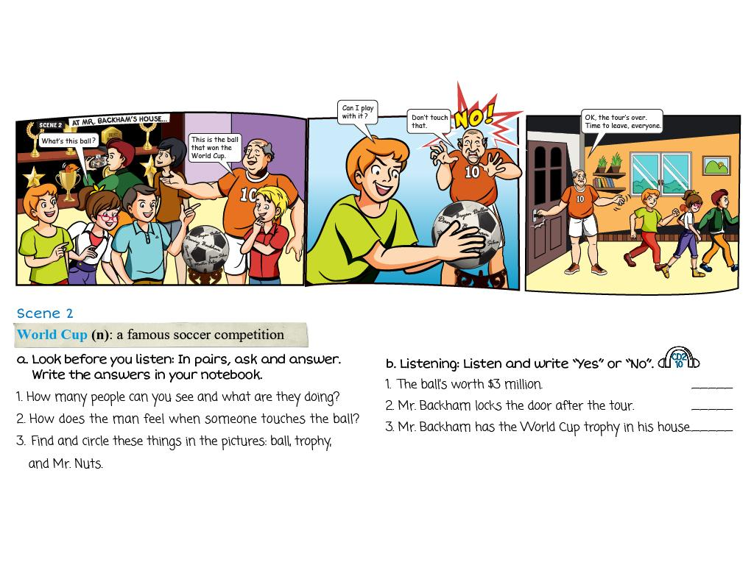
Theme 6 – Lesson 3
No
?
Yes
?
No
?
1. There are 7 people. They are looking around the room
?
2. He’s angry.
?
Page 58
Notes:
Differentiate between “how many” and “how much”
Review Present Simple and Present Continuous
Teach students how to say the price and rules for large number (thousand, million, billion…)

Slide 18
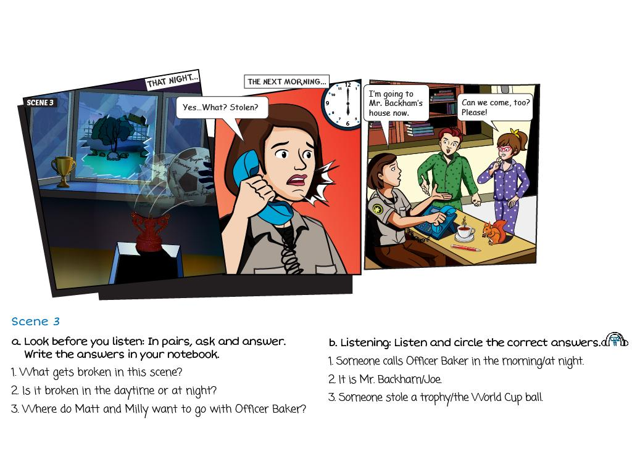
Theme 6 – Lesson 3
The windows
?
At night
?
To Mr.Backham’s house
?
Page 59
Notes:
Review Past Simple
Note the prepositions of time
Explain the indefinite pronouns (someone, somebody…)
Students should use correct intonation for questions

Slide 19
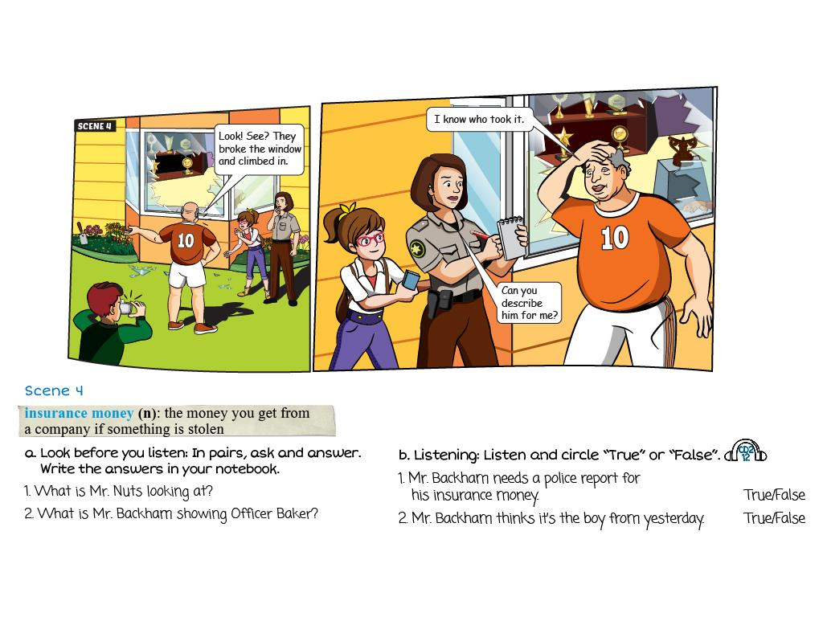
Theme 6 – Lesson 3
?
The glasses
?
The broken windows
Page 59
Notes:
Review Present Continuous and Past Simple

Slide 20
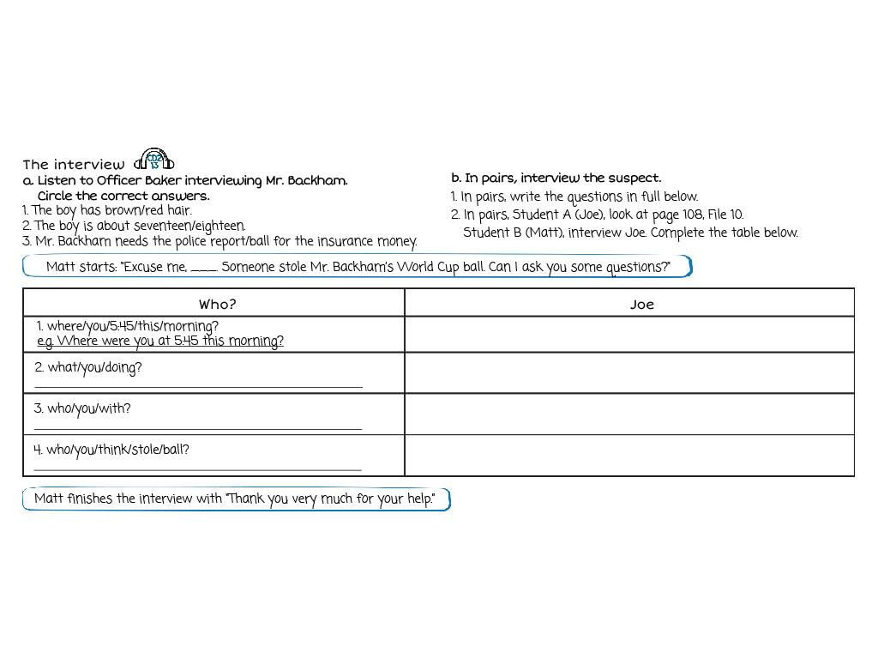
Theme 6 – Lesson 3
?
In the hospital
What were you doing?
visiting my grandfather
?
?
Who were you with?
My parents and the doctor
?
?
Who do you think stole the ball?
I don’t know. I didn’t leave the hospital.
?
?
Page 59
Notes:
Review Present Continuous and Past Simple
Note the use of Present Simple to describe someone
Students should use the intonation for WH-questions and statements

Slide 21
Theme 6 – Lesson 3
Mr. Backham
?
The glass was all outside the window, no inside
?
He wanted the insurance money
?
Page 59
Notes:
Practice how to express agreement and disagreement
Review Present Simple and Past Simple

Slide 22
Theme 6 – Lesson 4
Page 60

Slide 23
Theme 6 – Lesson 4
?
?
3
5
?
?
?
4
6
2
Page 60
Notes:
Explain new words
Review vocabularies to talk about games and sports

Slide 24
Theme 6 – Lesson 4
gymnast
?
sprinter
?
boxer
?
Page 60
Notes:
Review Present Simple and Past Simple
Learn how to say the years in English
Note how to pronounce country’s names (also some countries going with “the”)

Slide 25
Theme 6 – Lesson 4
Page 60
Notes:
Practice asking and answering questions about famous sports stars
Students remember to use intonation

Slide 26
Theme 6 – Lesson 4
He was born in 1970
?
He played for Vietnam’s national team
?
?
He won the Vietnamese Golden Ball prize in 1998 and 2001
Second place
?
Page 61
Notes:
Review Present Simple and Past Simple
Note the use of preposition of time (in)
Students should know how to say the years in English

Slide 27
Theme 6 – Lesson 4
Page 61
Notes:
Review vocabularies students have learnt in this lesson
Practice how to ask and answer questions about famous sports stars
Giving suggestions with “What about”
Students need to use intonation for WH-questions and statements
Make sure students know how to say the dates and years

Slide 28
Theme 6 – Lesson 4
Page 61
Notes:
Review Present Simple and Past Simple
Check vocabularies to talk about sports and famous sports stars
Note the use of superlative

Slide 29
Theme 6 – Lesson 5
Page 62

Slide 30
Theme 6 – Lesson 5
Page 62

Slide 31
Theme 6 – Lesson 5
Page 62
Notes:
Review all vocabularies relating to sports, free time activities
Review the adverbs of frequency
Students should know how to say the years in English

Slide 32
Theme 6 – Lesson 5
Page 62
Notes:
Review Present Perfect, Past Simple and Present Simple
Remind students of the difference between “be” and “go” in Present Perfect
How to use “would like” correctly
Students should remember correct verb for each activity

Slide 33
Theme 6 – Lesson 5
Page 63
Notes:
How to ask and answer with “How often”
Review the adverbs of frequency
Review Present Perfect and “would like”
Check how to ask and answer questions about famous sports stars

Slide 34
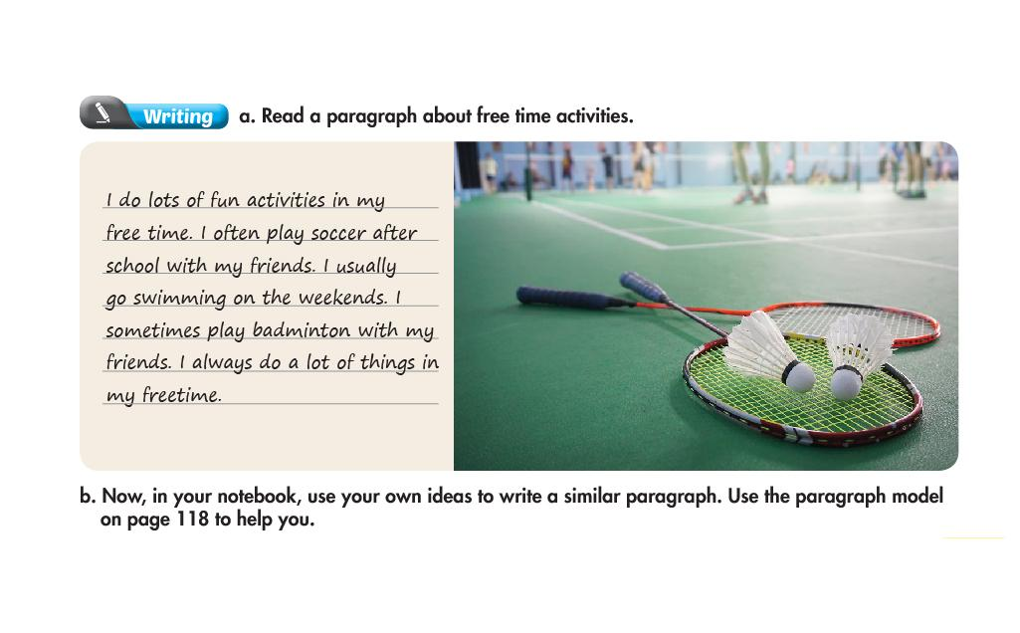
Theme 6 – Lesson 5
Page 63
Notes:
Students should use correct verb for each activity they have learnt
Review adverbs of frequency
Note the indefinite quantifiers (a lot of, lots of…)

Slide 35
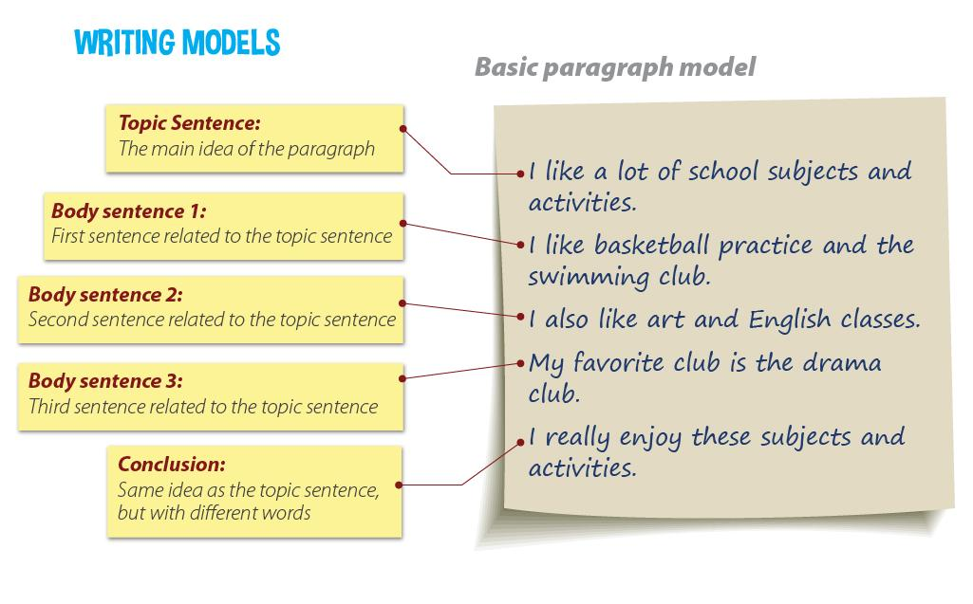
Theme 6 – Lesson 5
Page 118
Notes:
Students should use correct verb for each activity they have learnt
Review adverbs of frequency
Note the indefinite quantifiers (a lot of, lots of…)

Slide 36
Theme 6 – Lesson 3
Page 108
Notes:
Review Present Continuous and Past Simple
Note the use of Present Simple to describe someone
Students should use the intonation for WH-questions and statements

Slide 37
Theme 6 – Lesson 2
Page 110
Notes:
Review adverbs of frequency
Students should know how to ask and answer with “how often”
Make sure students use correct verbs for each activity
Review the intonation in WH-questions and statements

Slide 38
Theme 6 – Lesson 5
Page 113

