Slide 1
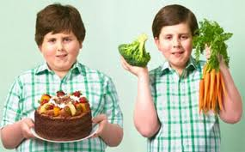
Now you look at two boys. One boy stays fit, but one doesn’t. Today, we will read the text to know the best way to eat food.
(bấn Enter là được)

Slide 2
Unit 12: Let’s eat
B2, 4: OUR FOOD ( page120, 121)
(bấn Enter là được)

Slide 3
B2,4 : OUR FOOD (pages 120, 121)
First, you open the book pages 120 then listen to the audio and read the text just one time.
(Các em hãy mở sách trang 120 nghe và đọc theo bài đọc)
(đi đến slide tiếp theo để nghe nhé,
bấn Enter là được)

Slide 4

B2,4 : OUR FOOD (pages 120, 121)
Listen and read (track 12)
(đi đến slide tiếp theo để nghe nhé,
bấn Enter là được)

Slide 5
Vocabulary
a balanced diet (n): chế độ ăn cân đối

Slide 6
Vocabulary
affect /ə’fekt/(v): ảnh hưởng, tác động

Slide 7
Vocabulary
healthy /’helƟi/ (adj.): khỏe mạnh
health /helƟ/ (n): sức khỏe
unhealthy ≠ healthy

Slide 8
Vocabulary
moderate amount (n) : 1 lượng vừa phải
→ moderation (n) : sự tiết chế, sự điều độ

Slide 9
Vocabulary
energy /’enəʤi/(n) : năng lượng
Notes:
‘

Slide 10
Vocabulary
sensibly /’sensəbli/(adv.) : một cách hợp lý
Notes:
‘

Slide 11
Vocabulary
fatty food (n) : thức ăn nhiều chất béo
Notes:
‘

Slide 12
Vocabulary
body- building food (n) : thực phẩm cấu tạo cơ thể
Notes:
‘

Slide 13
Vocabulary
body- building food (n) : thực phẩm cấu tạo cơ thể
Notes:
‘

Slide 14
Vocabulary
Dairy products (n) : thực phẩm làm từ sữa
We have some dairy products like yogurt, cheese, butter
Notes:
‘

Slide 15
Vocabulary
Dairy products (n) : thực phẩm làm từ sữa
We have some dairy products like yogurt, cheese, butter
Notes:
‘

Slide 16
Vocabulary
Dairy products (n) : thực phẩm làm từ sữa
We have some dairy products like yogurt, cheese, butter
Notes:
‘

Slide 17
Vocabulary
cereals (n) : ngũ cốc
She often eats cereals for her breakfast.
Notes:
‘

Slide 18
Vocabulary
variety /və’raiəti/(n) : sự đa dạng
→ Various /væriəs/ (adj.): đa dạng
Notes:
‘

Slide 19
Vocabulary
guideline /və’raiəti/(n) : sự hướng dẫn
Notes:
‘

Slide 20
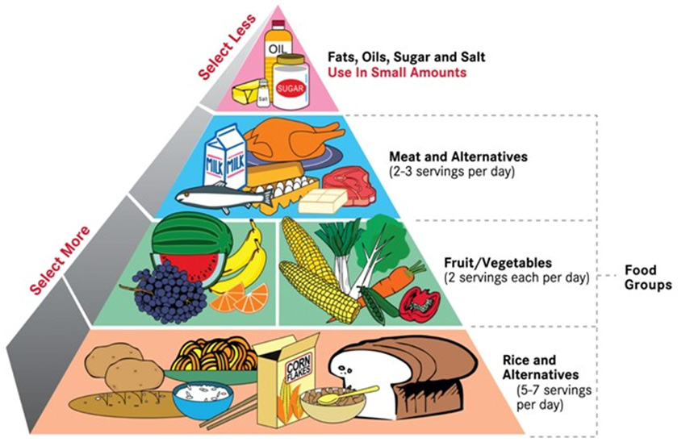
Sugar/cooking oil
Energy-giving
Meat/dairy products
Protective
Fruit/Vegetables
Body-building
Cereals
A balanced diet

Slide 21
II. Read the text again and choose True or False. * True or False ?
Sugar adds taste to food and gives you vitamins.
We should eat a moderate amount of fatty food and sugar.
We should eat a little cereals, fruit and vegetables.
We shouldn’t eat some meat and dairy products.
A balanced diet with regular exercise is the key to a healthy
lifestyle.
Reading text

Slide 22
Now let’s check!
II. Read the text again and choose True or False. * True or False ?
1. Sugar adds taste to food and gives you vitamins.
2. We should eat a moderate amount of fatty food and sugar.
3. We should eat a little cereals, fruit and vegetables.
4. We shouldn’t eat some meat and dairy products.
5. A balanced diet with regular exercise is the key to a healthy
lifestyle.
F
T
plenty of
F
should
F
T

Slide 23
*Revision:
Why?/Why not? → Because….
Example:
1. Why do you think your diet is balanced?
Because I eat the food sensibly.
2. Why don’t we forget about exercise?
Because exercise helps us stay fit and healthy.

Slide 24
*Gap-fill with : energy, moderate, balanced, dairy, Lifestyle, effects
The food we eat (1)----------our whole life. For example, we need sugar
to live. It gives you (2) ---------- and you feel less hungry. But we should
have a (3)------------diet. We should:
eat a (4)------------ ----- amount of fatty food and sugar.
eat some body-building foods, like meat, and (5)------- products.
eat plenty of cereals, fruit and vegetables
Eat the food you enjoy, but don’t have too much. This will help you stay
fit and healthy. Don’t forget about exercise either! that is the key to a healthy (6).---------

Slide 25
Now let’s check

Slide 26
*Gap-fill with : energy, moderate, balanced, dairy, Lifestyle, effects
affects
The food we eat (1)----------our whole life. For example, we need sugar
to live. It gives you (2) ---------- and you feel less hungry. But we should
have a (3)------------diet. We should:
eat a (4)------------ ----- amount of fatty food and sugar.
eat some body-building foods, like meat, and (5)------- products.
eat plenty of cereals, fruit and vegetables
Eat the food you enjoy, but don’t have too much. This will help you stay
fit and healthy. Don’t forget about exercise either! that is the key to a healthy (6).---------
energy
balanced
moderate
dairy
lifestyle.

Slide 27
III. Consolidation
eat a moderate amount of fatty
food and sugar.
a balanced
diet
eat some body-building foods,
like meat, and dairy products.
a healthy
lifestyle
eat plenty of cereals, fruit
and vegetables.
exercise
playing sports
running
jogging

Slide 28
IV.HOMEWORK
bananas
sugar
Protective
food
Energy-giving
food
Body-building
food
chicken

Slide 29
THE END
Thank you for you attending and studying
Goodbye and see you next time!

