Slide 1
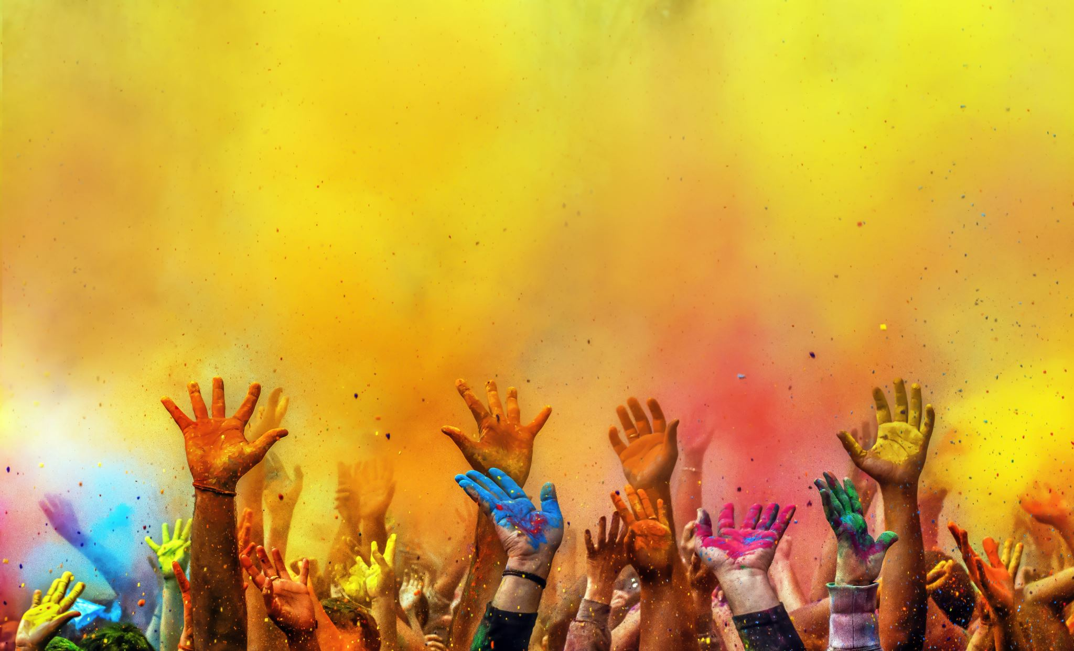
UNIT 4
FESTIVALS AND FREETIME LESSON 2
Giáo viên thực hiện: Lê hiếu thảo& Nguyễn thị ngọc ân

Slide 2



Slide 3
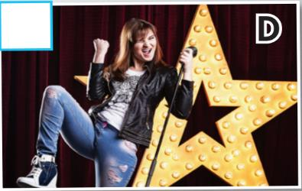
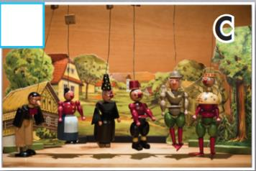
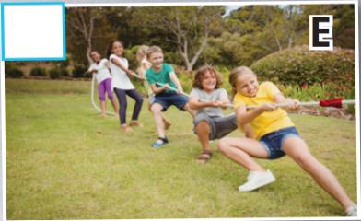
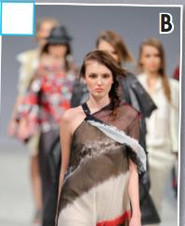
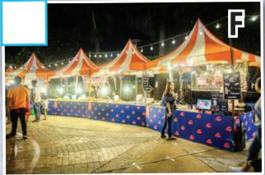
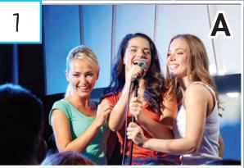
What is it?
music performance /ˈmjuːzɪk/ /pərˈfɔːrməns/ buổi trình diễn âm nhạc
- food stand /fuːd/ /stænd/ quầy bán thức ăn
fashion show /ˈfæʃn/ /ʃoʊ/ buổi trình diễn thời trang
- puppet show / ˈpʌpɪt/ /ʃoʊ/ buổi biểu diễn múa rối
- tug of war /tʌɡ əv ˈwɔːr/ kéo co
- talent show /ˈtælənt/ /ʃoʊ/ chương trình tìm kiếm tài năng

Slide 4
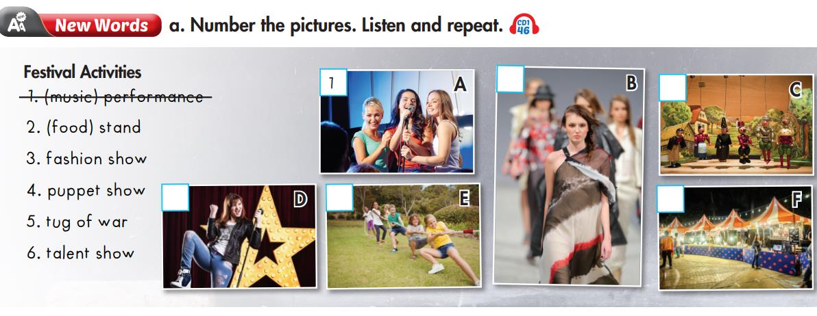
3
4
6
5
2

Slide 5
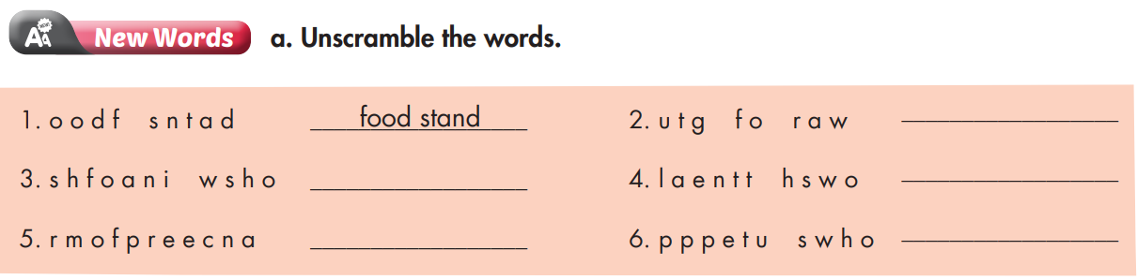
tug of war
fashion show
talent show
performance
puppet show

Slide 6
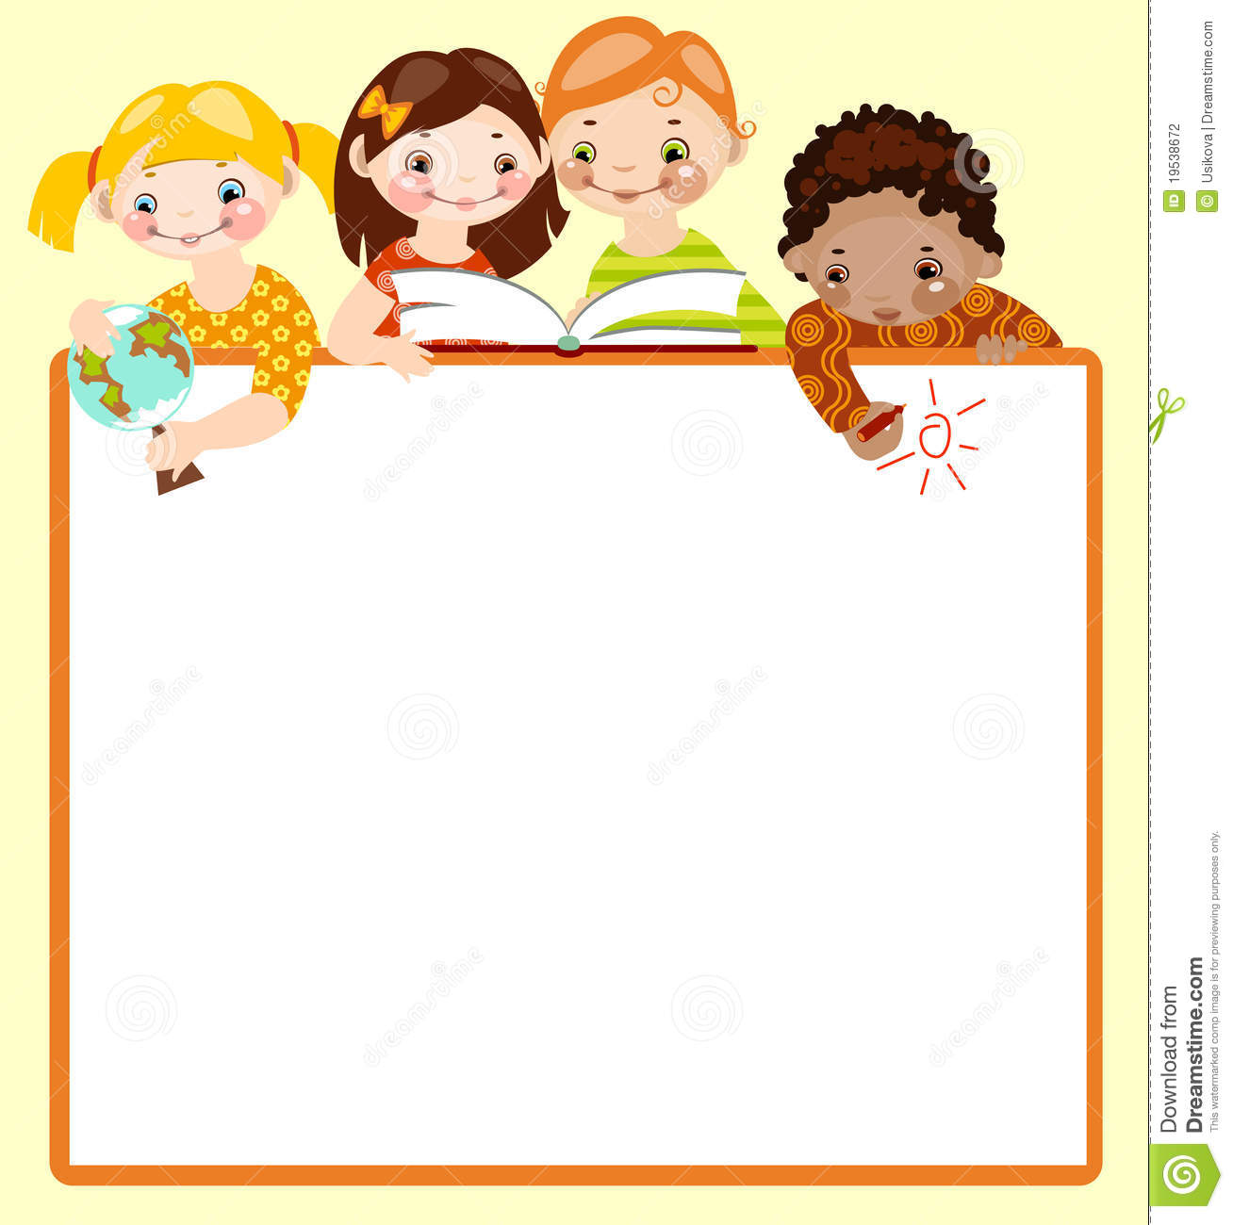
READING

Slide 7
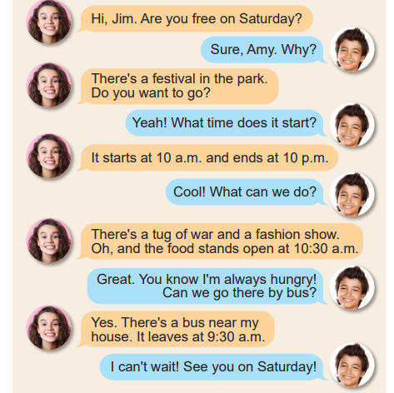

Slide 8
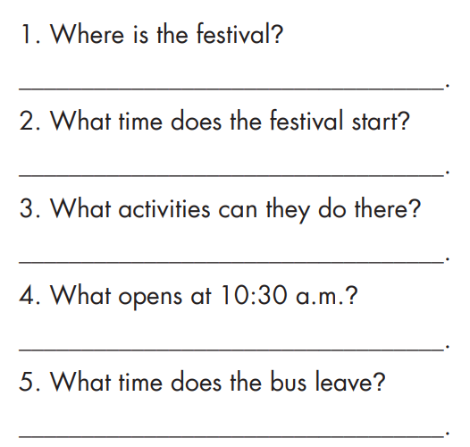

Slide 9
While-Reading
It is in the park.
It starts at 10 a.m
There's a tug of war and a fashion show.
The food stands open at 10:30 a.m.
The bus leaves at 9:30 a.m.

Slide 10


Slide 11

Work in pairs
Talk about an oncoming festival
A: Hi! Are you free this weekend?
B: Sure, why?
A: There’s a festival in the city center. Do you want to go?
B: Sounds interesting! When does it start?
A: It starts at 7p.m on Saturday.
B: Cool! What activities can they do there?
A: There’s a music show, a fashion show and a lot of food stands
B: Great! How can we come to the city center?
A: We can take a taxi
B: ok! I can’t wait. See you on Saturday!

Slide 12
Homework
Learn by hearts vocabularies and make sentences using them.
Do the exercises on page 22 WB
Do the exercises in Tiếng Anh 6 i-Learn Smart World Notebook on page 22
Prepare the next lesson (page 34 SB)

Slide 13


