Slide 1







Unit 12
LET'S EAT
Lesson 3: A3, 4

Slide 2

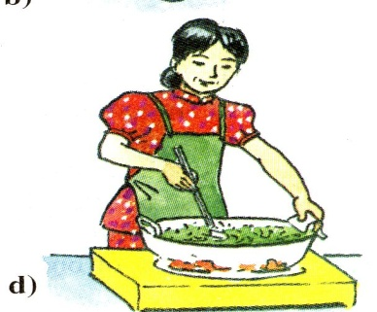
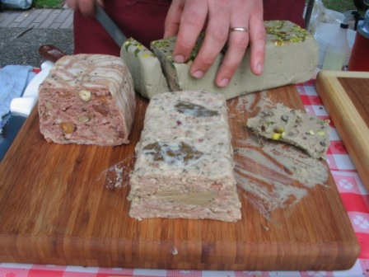


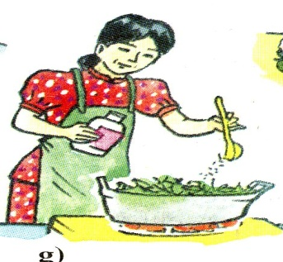
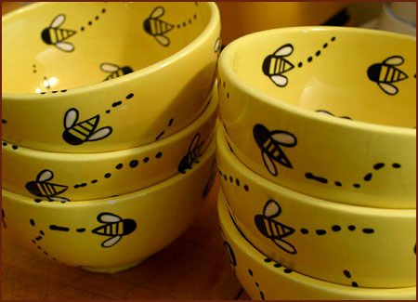
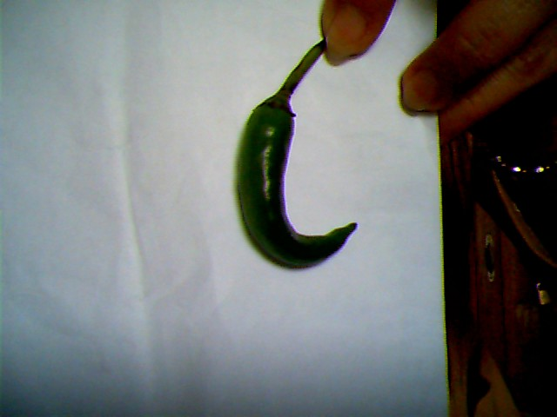
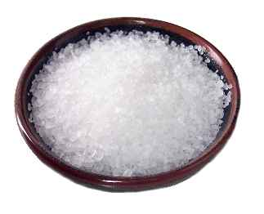

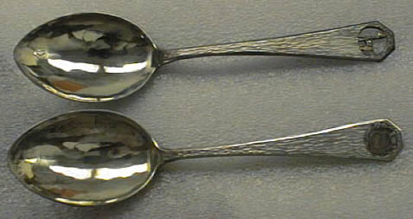
Unit 12: LET’S EAT
Lesson 3: A3,4.
Vocabulary:
(to) slice (v) :
(to) add (v) :
(to) stir-fry (v):
a pepper (n):
soy sauce (n) :
a plate (n):
a bowl (n):
chopsticks (n):
a spoon (n):
salt (n):
thái
thêm vào
xào
quả ớt
xì dầu
cái đĩa
cái bát
đôi đũa
cái thìa
muối

Slide 3
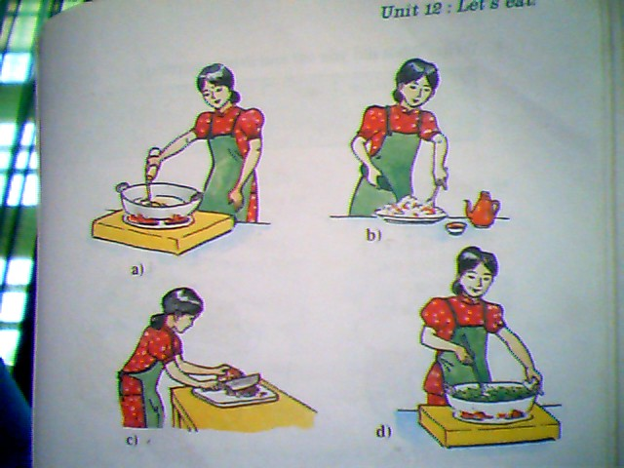
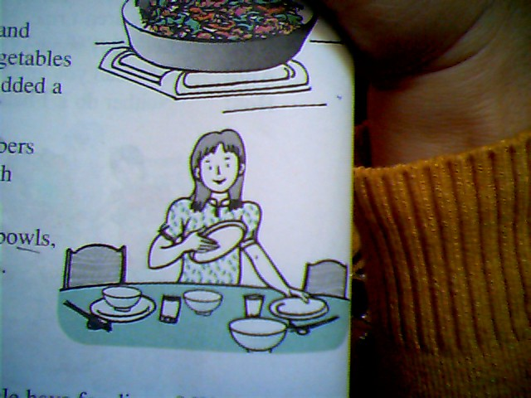
Who are they ?
They are Hoa and her aunt.
Hoa and her aunt prepared for dinner.

Slide 4
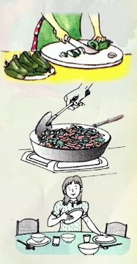
Unit 12: LET’S EAT
Lesson 3: A3,4.
2. Read.:
That evening, Hoa’s aunt cooked dinner. First, she sliced the beef. Next, she sliced some green peppers and onions.
Then, she cooked some rice and boiled some spinach. She added a little salt to the spinach so it tasted good.
After that, she heated a pan and stir-fried the beef and the vegetables in a little vegetable oil. She added a little soy sauce to the dish.
Finally, she sliced the cucumbers and made cucumber salad with some onions.
Hoa set the table with plates, bowls, shopsticks, spoons and glasses. Then they all sat down to eat.

Slide 5
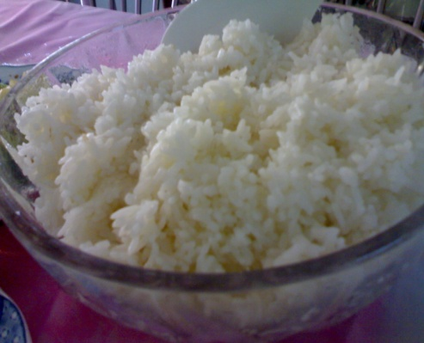
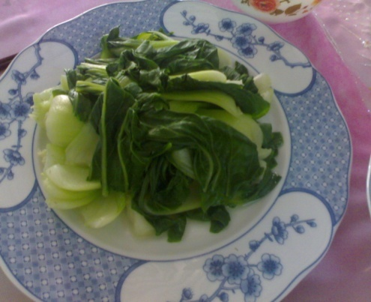
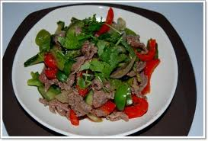

What did Hoa and her aunt have for lunch?
*. Write the menu:
- rice
boiled spinach.
Cucumber salad with onions.
Stir-fried beef with green peppers and onions.

Slide 6

Unit 12: LET’S EAT
Lesson 3: A3,4.
4. Write. What did you eat and drink yesterday?
What did you have for breakfast yesterday?
lunch
dinner
Example: For breakfast, I ate bread and drank milk.
For breakfast, I ate………………....... I drank..............................
For lunch, I ate………………………… I drank………………………
For dinner, I ate………...................... I drank………………….....

Slide 7






Home work
Learn by heart the new words.
Write the menu.
Write a short paragraph to tell what you ate and drink.
Prepare Unit 12- B1

