Slide 1
UNIT 10:HEALTH AND HYGIENE
GRADE 7
A. PERSONAL HYGIENE

Slide 2
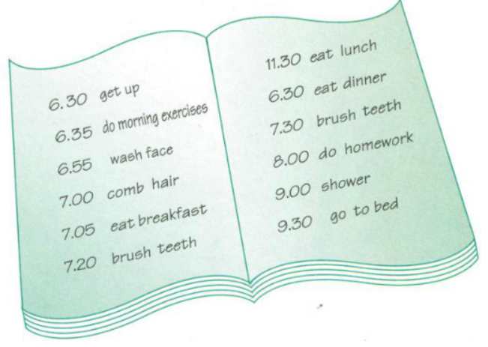
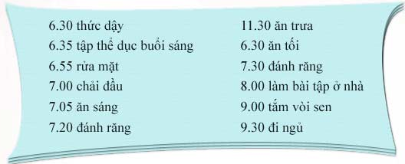
VOCABULARY
Diary (n) nhật kí
Have a nap (v) nghỉ trưa

Slide 3
3. Read Nam’s diary
Write about yourself. Complete a diary entry like Nam's. Then practice with your partner. Ask these questions
1. What do you do every day?
2. What time do you get up/eat breakfast/ do homework/ go to bed?
3. What do you do next?
4. Do you often watch TV?

