Slide 2
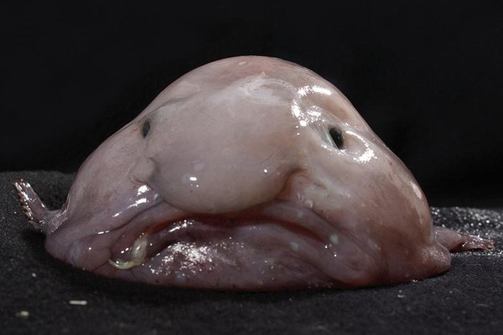
WHICH ANIMAL IS IT?
➔ It is a blobfish.

Slide 3
UNIT 3: wildlife
Lesson : READING - THE UGLIEST ANIMALS? – page 40.

Slide 4
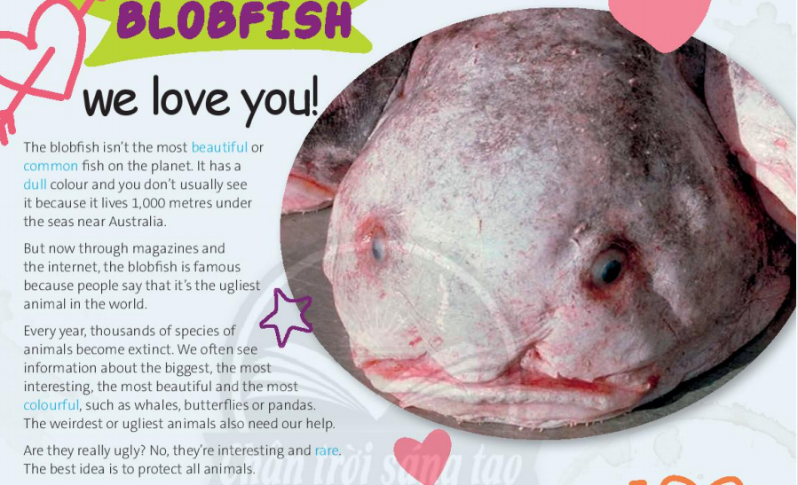

Slide 5
Which sentences does the writer agree with?
1) It’s important to protect all animals because they are all interesting.
2) It’s best to protect the beautiful species, not the ugly ones.
3) A lot of species become extinct every year. Animals in danger need our help.

Slide 6
TRUE – FALSE QUIZ
1) The blobfish is quite rare.
T
2) The blobfish
lives 1,000 metres under the sea.
F
sometimes lives in rivers .
T
3) The blobfish is well-known through magazines and the internet.
F
4) There’s a lot of information about pandas, but not whales.
4) We often see information about pandas, whales,….

Slide 7
ANSWER THE QUESTIONS

Slide 8
Where does the blobfish live?
➔ It lives under the seas near Australia.
2) Why is the blobfish famous?
➔ Because people say it is the ugliest animal in the world.
3) How many species become extinct each year?
➔ Thousands of species become extinct each year.

Slide 9
Homework
Learn new words by heart.
- Do exercises in Workbook – page 28.
- Prepare the next lesson: LANGUAGE FOCUS – page 41.

Slide 11
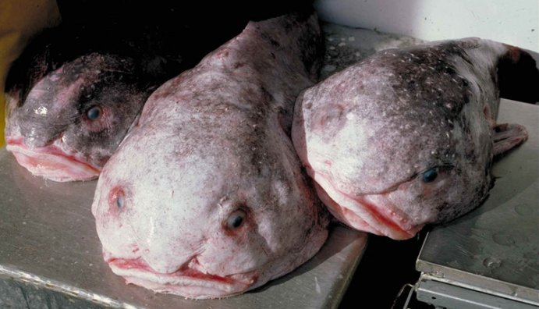
New words:
- blobfish (n)
- species (n)
: a group of animals or plants whose members are similar and can breed together to produce young animals or plants
Ex: There are many species of dogs.
- extinct (adj)
: no longer in existence
Ex: The white rhino is now almost extinct.
- weird (adj)
: very strange and unusual, and difficult to understand or explain.
Ex: She's a really weird girl.

Slide 12
New words:
- rare /reə(r)/(adj)
: not common or frequent; very unusual
Ex: The museum is full of rare and precious treasures.
: the possibility that someone or something
will be harmed , destroyed, or killed
- danger/ˈdeɪndʒə(r)/(n)
Ex: Animals in danger need our help.
: to keep someone or something
safe from harm, damage, or illness.
- to protect /prəˈtekt/(v)
Ex: The best idea is to protect all animals.

Slide 13
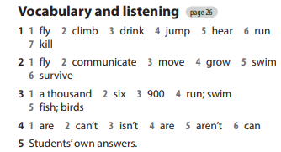
Homework

