Slide 1
ENGLISH 7
UNIT 6
B2,3

Slide 2
UNIT 6: AFTER SCHOOL
Section b: let’s go !
Period 37:( B2,3)

Slide 3
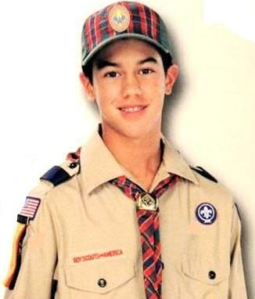
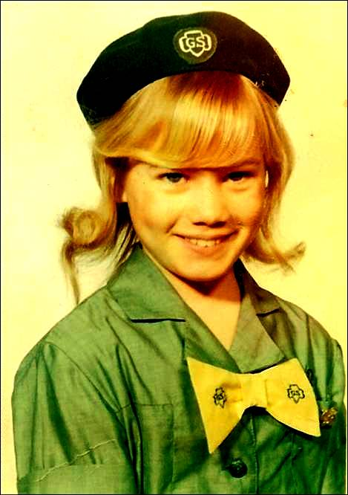
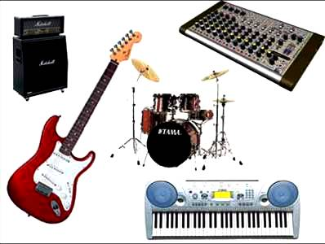
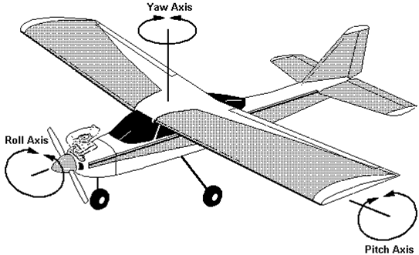
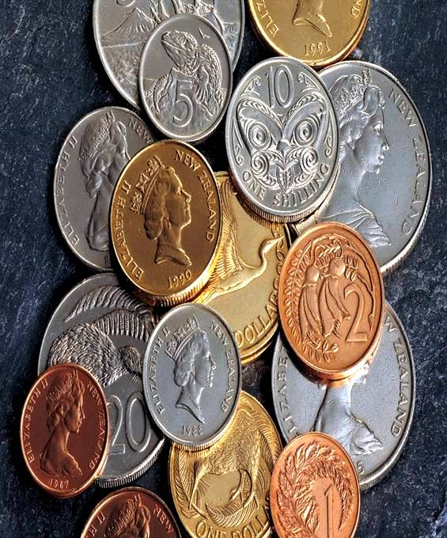
Unit 6 : After School - B2, 3 .Read and discuss
New words
-teenager (n):
thanh thiếu niên
-scout (n):
nam hướng đạo sinh
-guide (n):
nữ hướng đạo sinh
-show (n):
chỉ ra , cho thấy
-musical instrument (n):
dụng cụ âm nhạc
đồng tiền, đồng xu
- coin (n):
- make models of :
làm mô hình
-organization (n):
tổ chức
-attend (v)
tham gia ,có mặt

Slide 4
Matching
teenager
: tham gia
show
: tiền xu
scout
:
: nữ hướng đạo sinh
guide
: nam hướng đạo sinh
attend
: cho thấy , chỉ ra
musical instrument
: nhạc cụ
coin
: thanh thiếu niên
organization
: làm mô hình
make models of
: tổ chức

Slide 5
Guess the ten most popular activities
Amarican teenagers like to do :
1.
2.
3.
4.
5.
6.
7.
8.
9.
10.

Slide 6
Read and discuss.
A magazine survey of 13 years old shows what American teenagers like to do in their free time. Here are the top ten most popular activities.
1. Eat in fast food restaurants.
2. Attend youth organizations such as scouts and guides.
3. Learn to play a musical instrument such as the guitar.
4. Go shopping.
5. Watch television.
6. Go to the movies.
7. Listen to music.
8. Collect things such as stamps or coins.
9. Make model of things such as cars or planes.
10. Help old people with their shopping or cleaning.

Slide 7
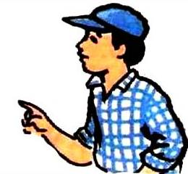
In a group of four, ask your friends what they like doing in their free time. Make a list of your group’s favorite leisure activities
Go shopping
Listen to music
Watch television
Play soccer
Mai
Hoa
Lan
Ba
Ex: What do you do in your free time?
Name | Activities
Mai | Go shopping
Hoa | Listen to music
Lan | Watch television
Ba | Play soccer

Slide 8
Complete what Vietnamese teenagers like to do
American teenagers | Vietnam teenagers
1. Eat in fast food restaurants
2. Attend youth organizations such
as scouts and guides
3. Learn to play a musical
instrument such as the guitar
4. Go shopping
5. Watch television
6. Go to the movies
7. Listen to music
8. Collect things such as stamps or
coins
9. Make model of things such as
cars or planes
10. Help old people with their
shopping or cleaning.
1. Go shopping
2. Listen to music
3. ……
4. …….
5. …….
6. …….
7. …….
8. ……..
9. ……..
10. …….

Slide 9
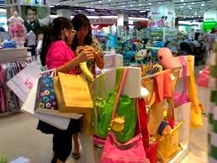
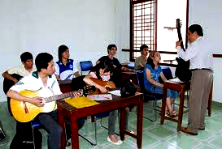
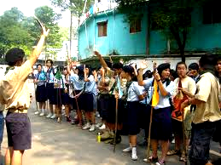
1
3
1-Go shopping
2
2. Attend youth organizations
5
4

Slide 10
8
6
7
9
10

Slide 11
HOMEWORK
- Learn by heart new words.
- Write the top 10 most popular activities in your free time
- Prepare: B3.

Slide 12
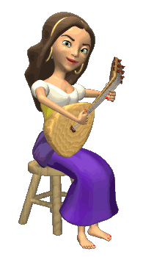
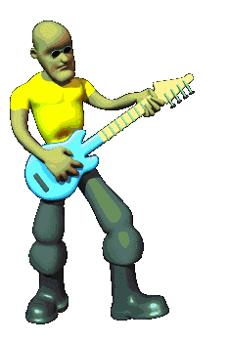
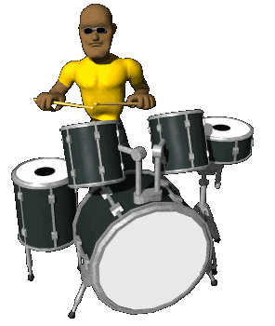
THANK YOU FOR ATTENTION!
GOOD BYE!
the end

Slide 13
American teenagers | Vietnam teenagers
1. Eat in fast food restaurants
2. Attend youth organizations such
as scouts and guides
3. Learn to play a musical
instrument such as the guitar
4. Go shopping
5. Watch television
6. Go to the movies
7. Listen to music
8. Collect things such as stamps or
coins
9. Make model of things such as
cars or planes
10. Help old people with their
shopping or cleaning.
1. Go shopping
2. Attend youth organizations
3. ……
4. …….
5. …….
6. …….
7. …….
8. ……..
9. ……..
10. …….
1
2

Slide 14
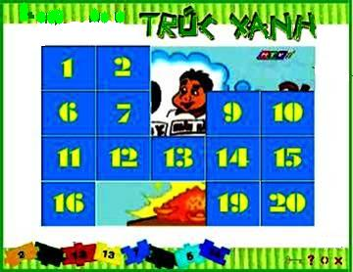
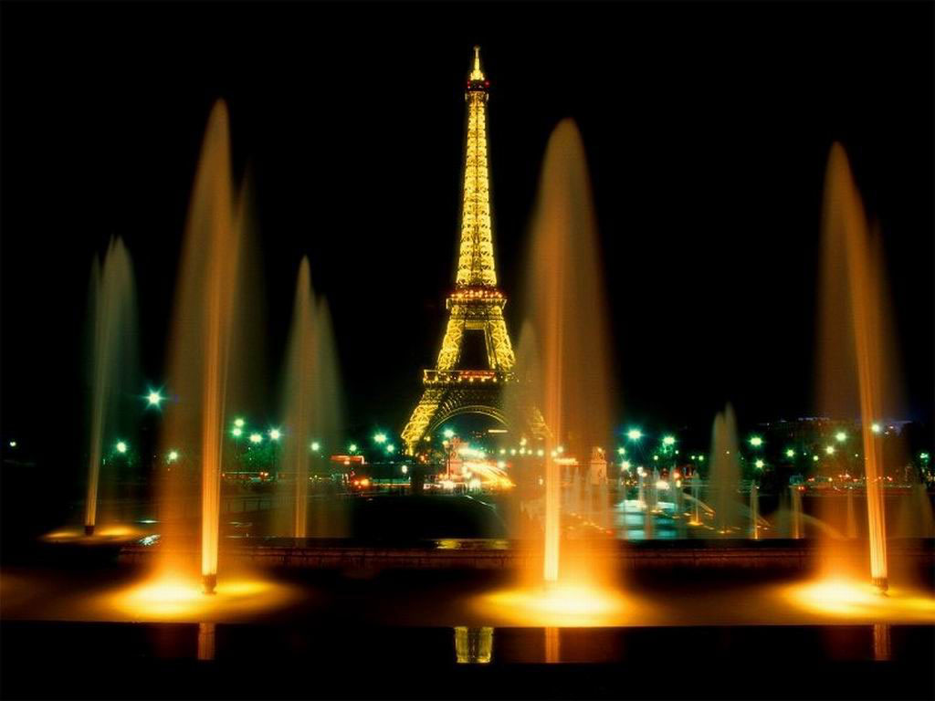
Game:
Game:
A
B
Swimming
1
2
3
WINNER
WINNER
Watching
television
4
5
Playing
games
6
7
play
volleyball
8
9
Playing
soccer
10
11
Reading /
studying
12
KQ
KQ
K
1
2
3
4
5
6
7
8
9
10
11
12

