Slide 1

Unit 3
A trip to the countryside
LESSON : Speak(a)+ Write

Slide 2
c
ANSWER THE QUESTIONS :
1.Where is your home village?
2.How far is it from the city?
3. How can you get there ?
4. How long does it take to get there?
5. What do people do for a living in your village?
6. Does your village have a river?

Slide 3
c
ANSWER THE QUESTIONS :
1. It is to the south of the city.
2. It is 30 kilometers from the city
3. I can get there by bus /car.
4. It takes me about 1 hour.
5. They plant rice and vegetables.
6. Yes, there is a river flowing
across the village.

Slide 4
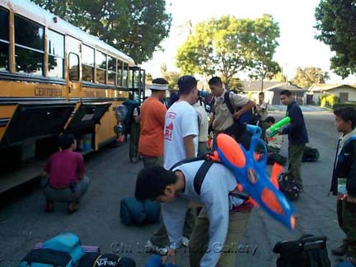
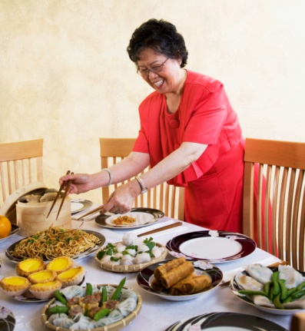
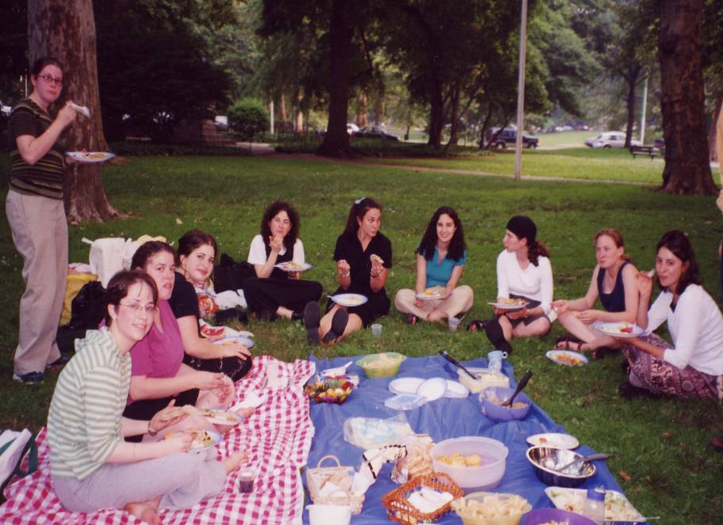
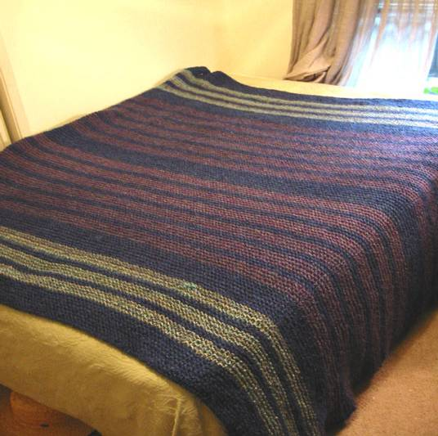
Unit 3 : A TRIP TO THE COUNTRYSIDE
A. Write
I. New words:
- a picnic site :
địa điểm dã ngoại
- A blanket :
chăn, tấm trải
- to lay out – laid – laid:
bày, dọn
- to gather :
tập hợp

Slide 5
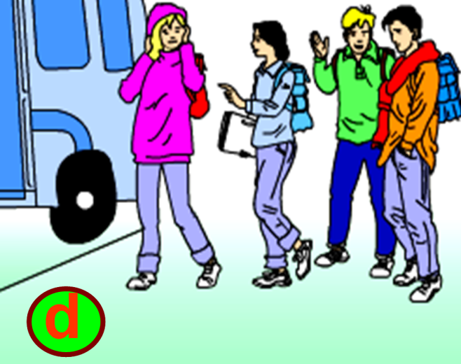
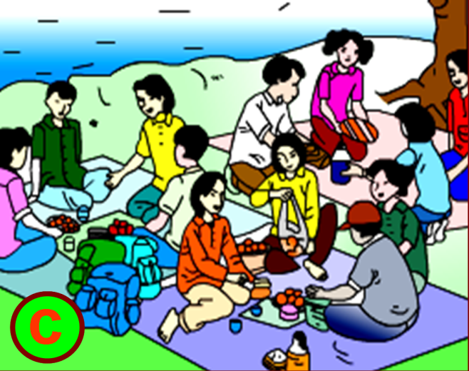
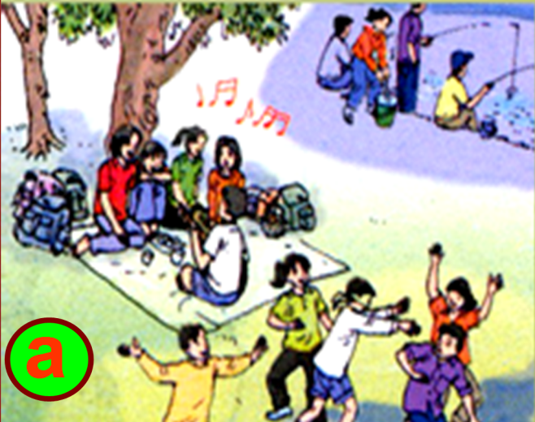
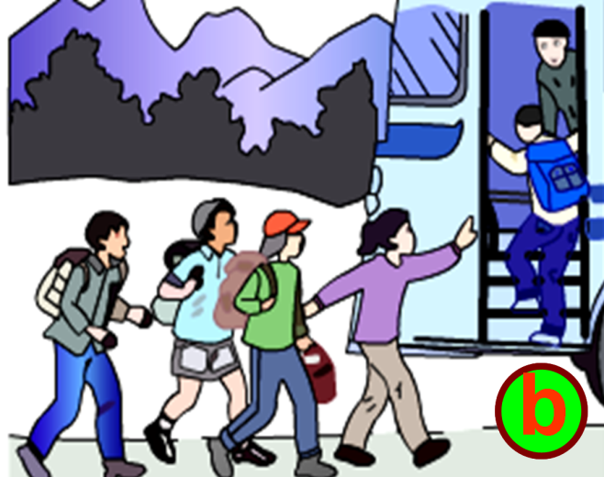
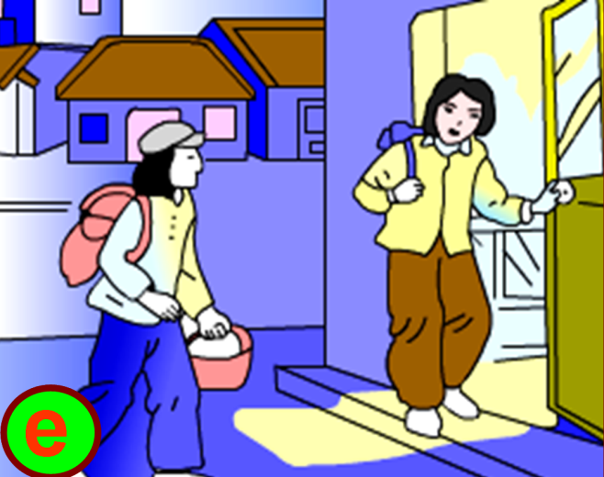
Look at the pictures and the information given. Then write a passage entitled “A Country Picnic”. Start like this: It was a beautiful day …

Slide 6
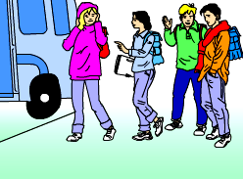
beautiful day / my friends and I / go / picnic.
take / bus / countryside / walk / 20 minutes / picnic site / river.
It was a beautiful day, my friends and I decided to go on a picnic. We took a bus to the countryside and then walked about 20 minutes to the picnic site next to the river.

Slide 7
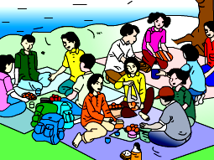
Put down / blankets / lay out / food.
We put down the blankets and laid out the food.

Slide 8
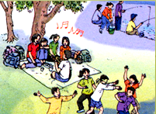
After meal / play / games / “What song is it?” /
blind man’s buff.
Late / afternoon / go fishing. We / enjoy / picnic.
After meal, we played the games “What song is it?” and blind man's buff. Late in the afternoon we went fishing. We enjoyed our picnic.

Slide 9
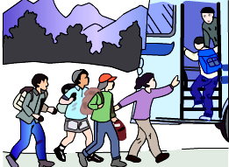
When / look at / time / it / nearly 6.30 pm / hurriedly gather / things / run / bus stop.
When we looked at the time, it was nearly 6.30 pm. We hurriedly gathered our things and ran to the bus stop.

Slide 10
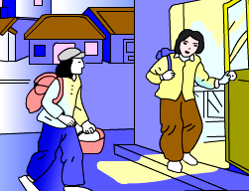
We / lucky / catch / last bus / and / we / arrive / home / very late / evening.
We were lucky to catch the last bus and we arrived home very late in the evening.

Slide 11
It was a beautiful day, my friends and I decided to go on a picnic. We took a bus to the countryside and then walked about 20 minutes to the picnic site next to the river.
We put down the blankets and laid out the food.
After meal, we played the games “What song is it?” and blind man's buff. Late in the afternoon we went fishing. We enjoyed our picnic
When we looked at the time, it was nearly 6.30 pm. We hurried gathered our things and ran to the bus stop
When we looked at the time, it was nearly 6.30 pm. We hurriedly gathered our things and ran to the bus stop.
We were lucky to catch the last bus and we arrived home very late in the evening.

Slide 12
Homework:
review vocab. and grammar of unit 2

