Slide 1


Slide 2





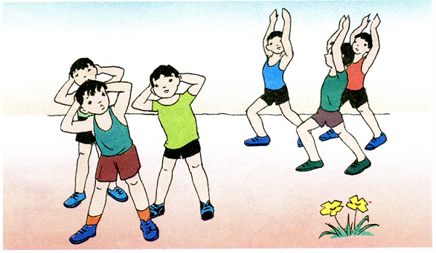
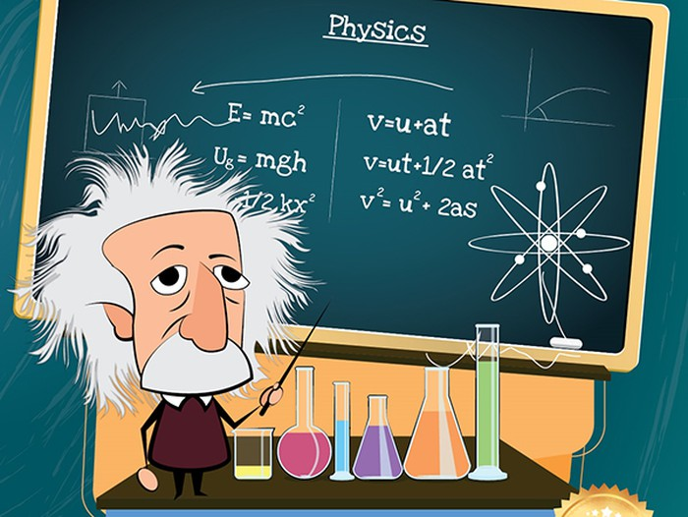


Thursday, September 30th, 2021
UNIT 2: SCHOOL
Lesson 1
I. Vocabulary
1. history (n)
2. P.E (n) = Physical Education
3. IT (n) = Information Technology
4. music (n)
5. geography (n)
6. literature (n)
7. physics (n)
8. biology (n)
9. math (n)

Slide 3
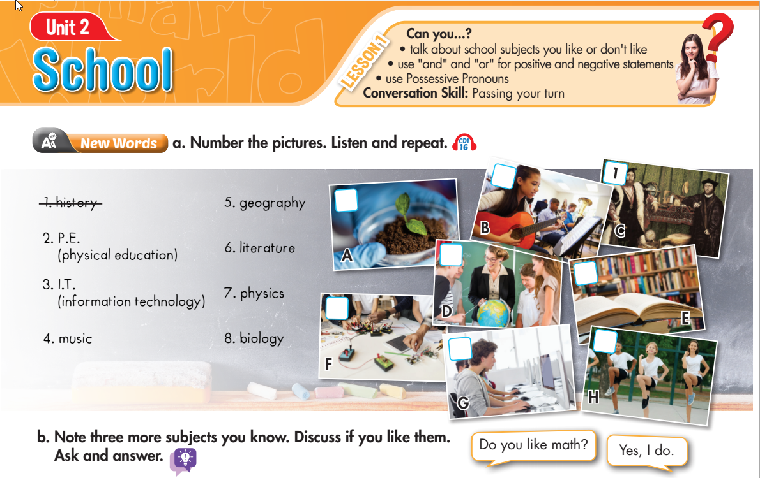

Lesson 1
4
8
5
6
7
3
2
Notes:
Click on the words, they will move and match up with the pictures.

Slide 4
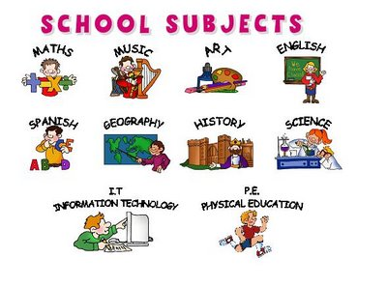
Game : Flip the pictures
1
2
3
4
5
6
7
8
Next

Slide 5

What subject is this ?

Slide 6
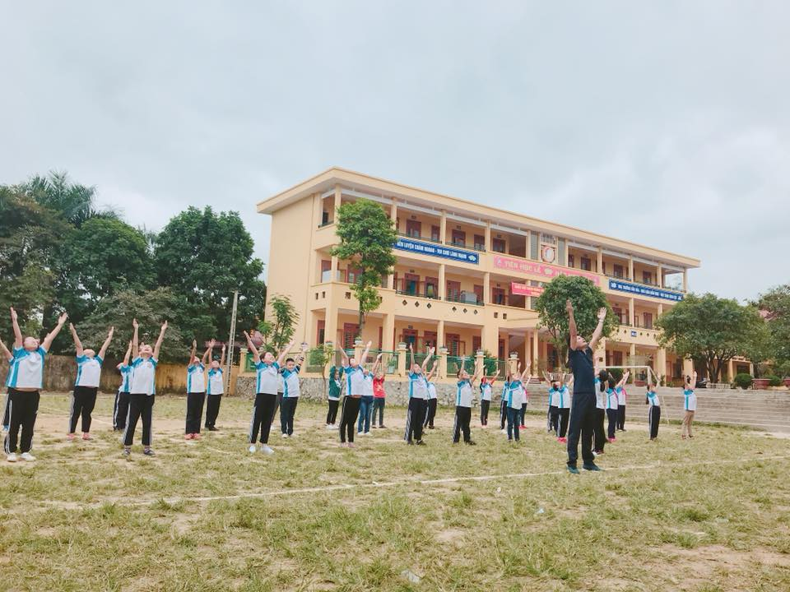
What subject is it ?

Slide 7
What subject is it ?

Slide 8
What subject is it ?

Slide 9
What subject is it ?

Slide 10
What subject is it ?

Slide 11
What subject is it ?

Slide 12
What subject is it ?

Slide 13
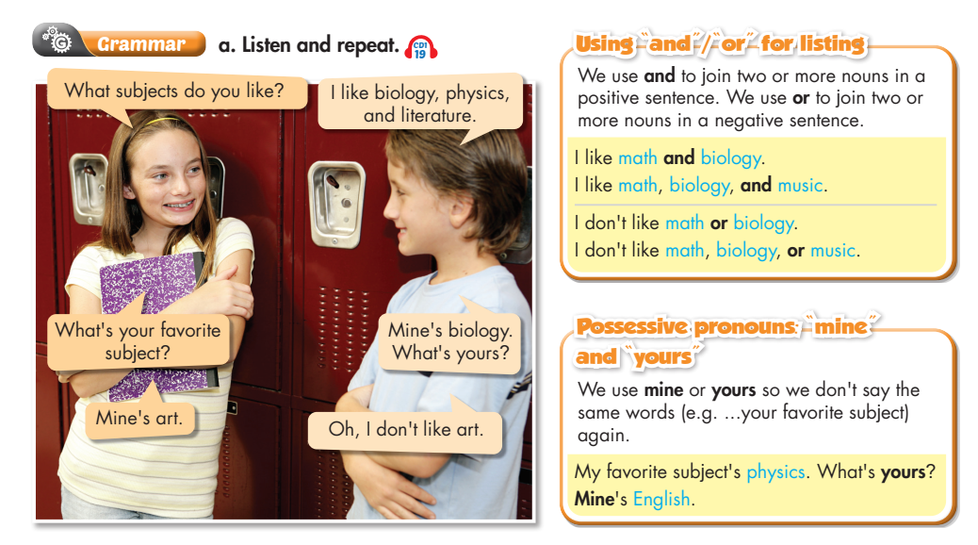
Lesson 1

Slide 14
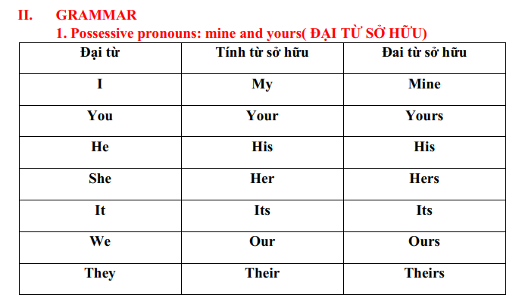
Đại từ
Tính từ sở hữu
Đại từ sở hữu

Slide 15
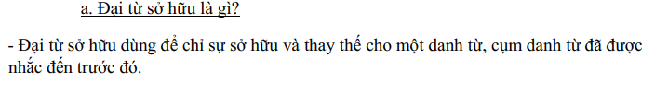
Ex:
A: My favorite subject is Math. What is your favorite subject?
B: My favorite subject is English.
________________
________________
A: My favorite subject is Math. What is yours?
B: Mine is English.

Slide 16
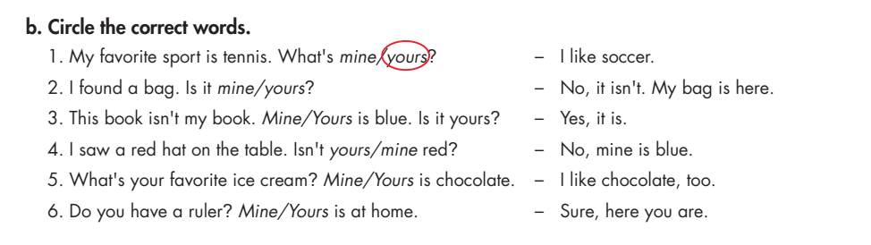
Lesson 1

Slide 17
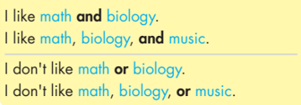
2. Using “and” / “or” for listing
a. and
and
and
b. or
or
or

Slide 18
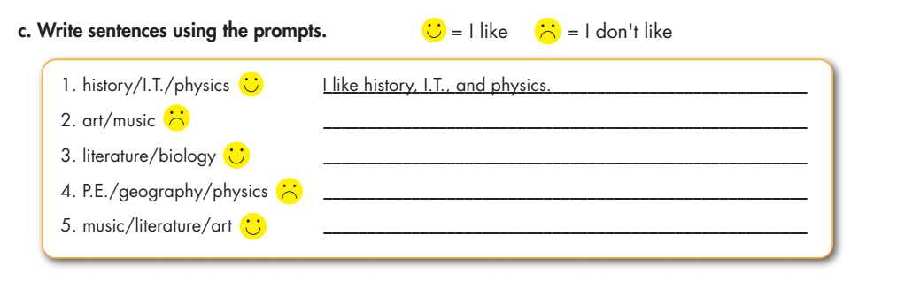
Lesson 1
I don’t like art or music.
I like literature and bilology.
I don’t like P.E., geography or physics.
I like music, literature and art.

Slide 19

HOMEWORK
TUẦN 4
I. Học thuộc Vocabulary và Gammar.
II. Làm bài tập
Trắc nghiệm trên K12 Online
New word (a,b,c) trong sách Workbook trang 8

Slide 20
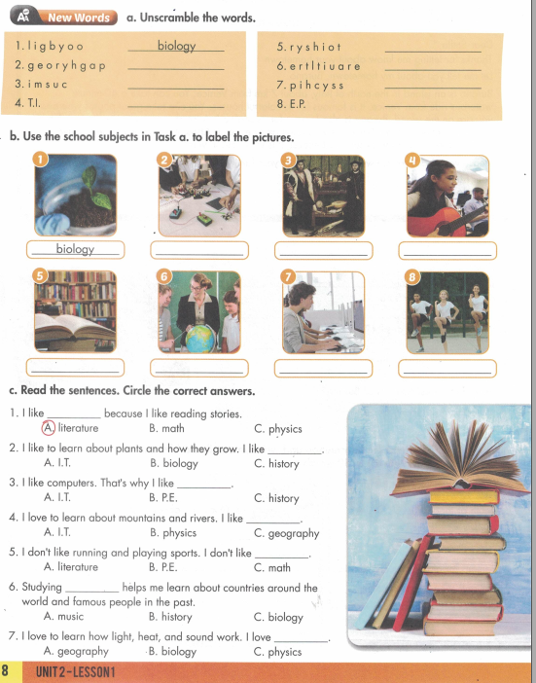
2. New word (a,b,c) trong sách Workbook trang 8

Slide 21
2. New word (a,b,c) trong sách Workbook trang 8

Slide 22
2. New word (a,b,c) trong sách Workbook trang 8

