Slide 1
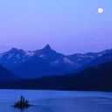
Our school will shine today Our school will shine Our school will shine today All down the line Our school will shine today Our school will shine When the sun goes down When the moon goes up Our school will shine
Good morning Everybody
OUR SCHOOL WILL SHINE
WELCOME TO MY CLASS

Slide 2
Unit 2
PERSONAL INFORMATION
B- My birthday
B1,2,3,4

Slide 3
1. Match cardinal and ordinal numbers (from 1 to 10)
special ordinal
numbers:
Cardinal number | Ordinal number
one two three four five six seven eight nine tenth | first second third fourth fifth sixth seventh eighth ninth tenth
first
second
third
fifth
ninth
twelfth

Slide 4
2. Listen and repeat.

Slide 5
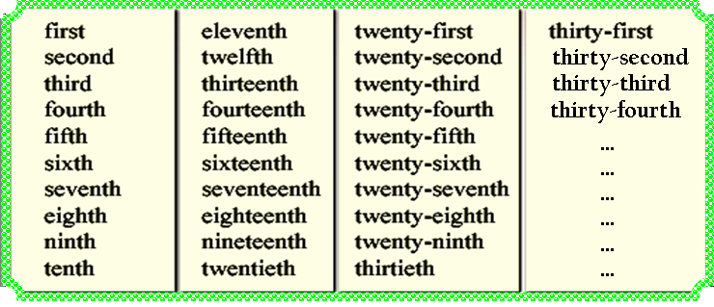
Formation of ordinal numbers.
n^{st}
n^{nd}
n^{rd}
n^{th}

Slide 6
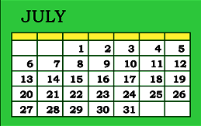
3. Listen and write the dates.
a.
b.
c.
d.
e.
f.
………………..
the first of July
………………..
the nineteenth
………………..
the sixth
………………..
the fourteenth
………………..
the seventeeth
………………..
the thirty-first

Slide 7
4. Write the months in order from first to twelfth.
January
1.
2.
3.
4.
5.
6.
7.
8.
9.
10.
11.
12.
………………
………………
February
March
………………
April
………………
………………
May
June
………………
July
………………
August
………………
September
………………
October
………………
November
………………
December
………………

Slide 8
5. Match the events with the right times
Events | Times
1. Christmas | a. the twentieth of November
2. Teacher’s day | b. The fourteenth of February
3. Women’ day | c. The second of September
4. Valentine | d. The eighth of March
5. Independence day | e. The twenty- fourth of December

Slide 9
Homework
Write a dialog about phoning your friends to see a movie tomorrow evening.
Review ordinal numbers and bring a calendar to class ( 1 calendar/ group)
Prepare Unit 3: A1,2

Slide 10
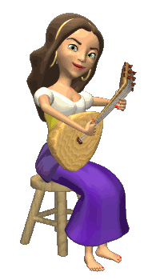
THANK YOU FOR ATTENTION!
GOOD BYE!
the end

