Slide 1
WELCOME TO Arena Of Valor

Slide 2
SIMON SAYS

Slide 3
UNIT 7: GROWING UP VOCABULARY

Slide 4
VOCABULARY

Slide 5
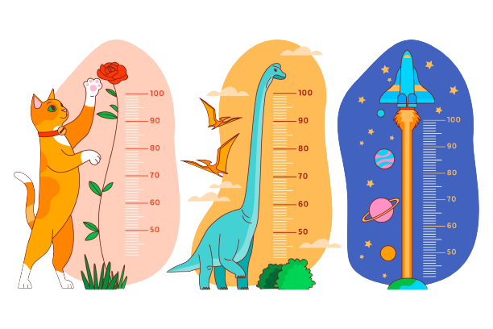
height (n)
/haɪt/
Ex: He was a man of medium height.

Slide 6
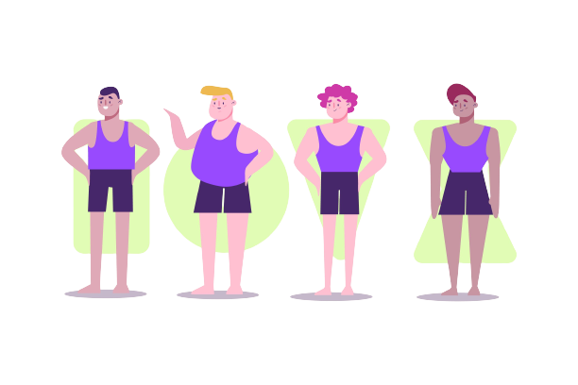
build (n)
/bɪld/
Ex: He has a strong build.
height and weight

Slide 7
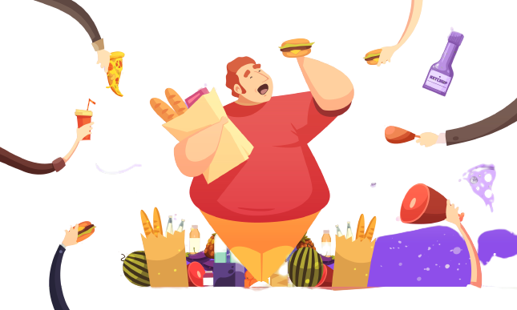
overweight (adj)
/ˌəʊ.vəˈweɪt/
Ex: She doesn’t love him because he is overweight.
eat too much fast food -> fat

Slide 8
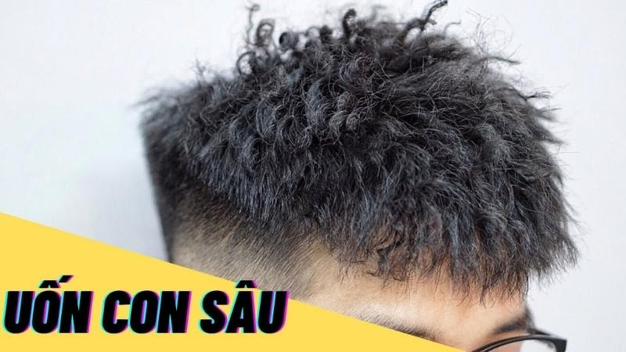
spiky (adj)
/ˈspaɪ.ki/
Ex: She loves boy with spiky hair.
change his appearance -> make a new hair style

Slide 9
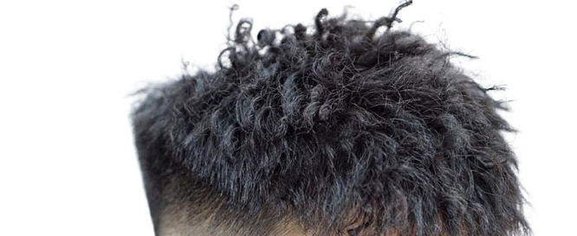
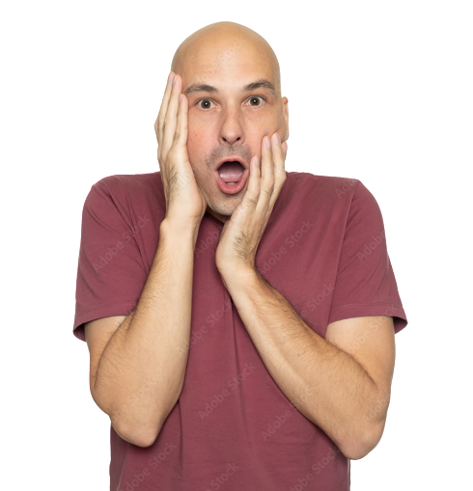
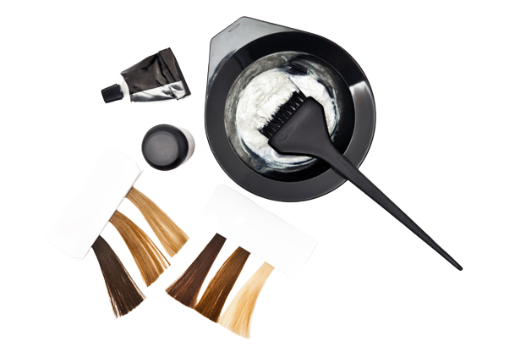
bald (adj)
/bɔːld/
Ex: Going bald is just a fact of life.
LOW QUALITY HAIR - DYE

Slide 10
Hair that men grow above his upper lips
moustache (n)
/məˈstɑːʃ/
Hair that men grow on the lower part of their faces
beard (n)
/bɪəd/
Ex: He shaved off his beard but kept his moustache.

Slide 11
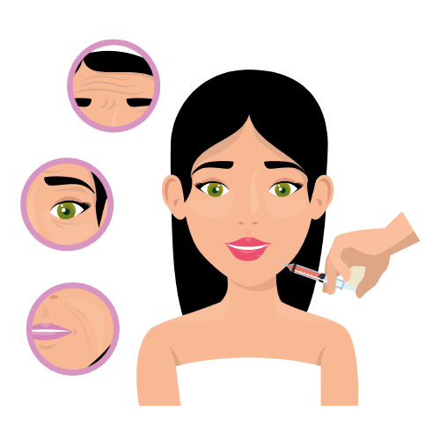
feature (n)
/ˈfiː.tʃər/
Ex: Her eyes are her best feature.
some part of someone's face

Slide 12
NEW WORDS
1. height (n)
5. bald (adj)
2. build (n)
6. moustache (n)
3. overweight (adj)
4. spiky (adj)
7. beard (n)
8. feature (n)

Slide 13
STAND UP SIT DOWN

Slide 14
spiky hair?

Slide 15
overweight?

Slide 16
moustache?

Slide 17
LET’S MEET MY IDOL

Slide 18
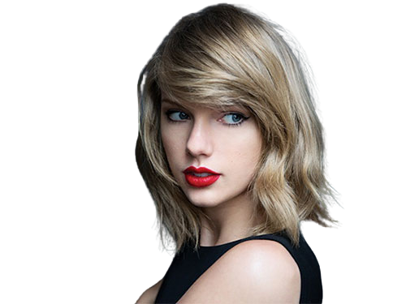
Who are your favourite singers / actors? What does he/she looks like?”
This is my idol.
She has blue eyes and blonde hair.
Taylor Swift

Slide 19
01
Complete 1–6 with the words in the box

Slide 20
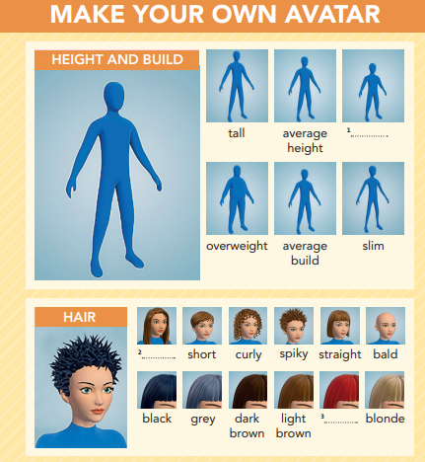
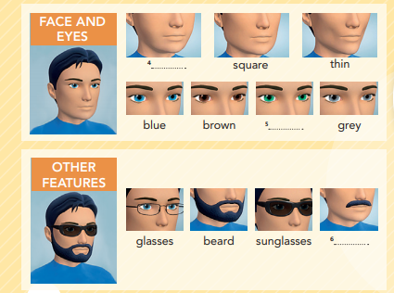
moustache
round
red
long
green
short

Slide 21
02
Listen and repeat the words in EX 1. Which words describe you?

Slide 22
round
short
green
long
moustache
red
-> I am short and slim. My hair is long and brown.
red

Slide 23
03
Pronunciation.Which words is the odd one out?

Slide 24
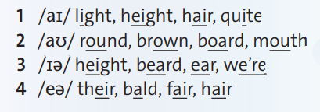
Which words is the odd one out?

Slide 25
04
Watch or listen. Which key phrases does Lewis use?

Slide 26
Which key phrases does Lewis use?
I'm not sure.
I think it's ...

Slide 27
05
Watch or listen again. Look at photos a-g. Which photos are the people talking about?

Slide 28
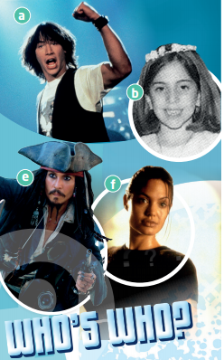
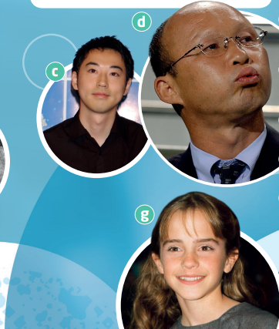

Slide 29
PASS THE BEAR

Slide 30
photo a
photo b
photo c

Slide 31
06
Choose the correct words in descriptions 1-7. Then match the descriptions to photos a-g and name the famous people.

Slide 32
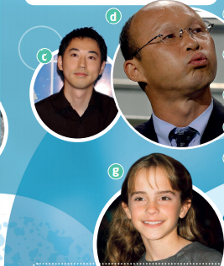
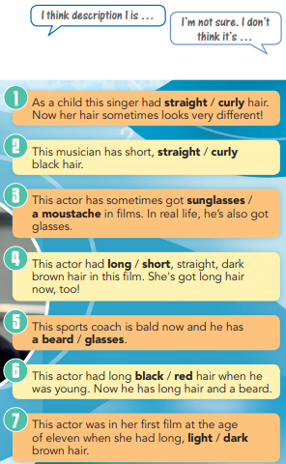

Slide 33
1
4
2
5
7
EXAMPLE
1. Straight - b
6
3

Slide 34
I MADE YOU LOOK

Slide 35
red

Slide 37
- Learn by heart all the new words.
- Workbook: Exercises page 48
- Prepare Lesson 2 – Reading.

Slide 38
THANK YOU!

