Slide 1
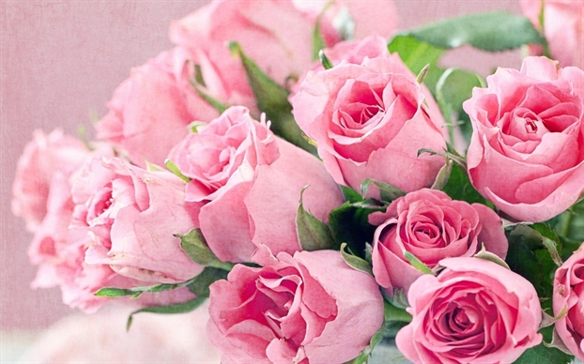
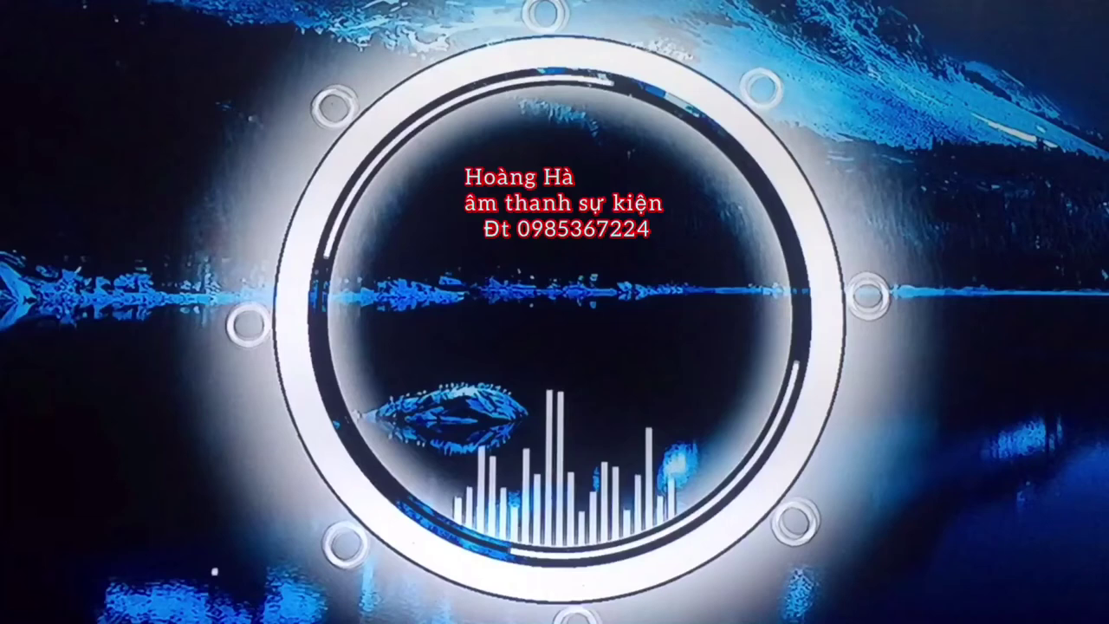
WELCOME OUR TEACHERS
Class: 6A1
Teacher: Phan thị Mộng Linh

Slide 2
Unit 4: Festivals and Free Time
Wednesday, November 9th , 2022
Lesson 1.
2: Grammar

Slide 3
Unit 4: Festivals and Free Time
Lesson 1.2: Grammar

Slide 4
1. Adverbs of frequency in the song:
always
sometimes
usually
never
normally
often
rarely
Adverbs of frequency are used to:
do things
things happen
Talk about: How often we ....................or how often ...................
Ex: I usually go swimming on Sunday.
Ex: It is often hot in the summer.

Slide 5
2. Main verbs in the song:
Unit 4: Festivals and Free Time
Lesson 1.2: Grammar
Sing
Dance

Slide 6
Unit 4: Festivals and Free Time
Lesson 1.2: Grammar
3. Question word to ask for adverbs of frequency in the song:

Slide 7
Adverbs of frequency
How often + do/ does + Subject + Verb + Phrase/ Noun?
Ex: How often do you play soccer?
Subject
Verb
Noun
Subject + Adv of Frequency + Verb + ...
Ex: I usually play soccer on the weekends.
Adverb of Frequency
Verb

Slide 8
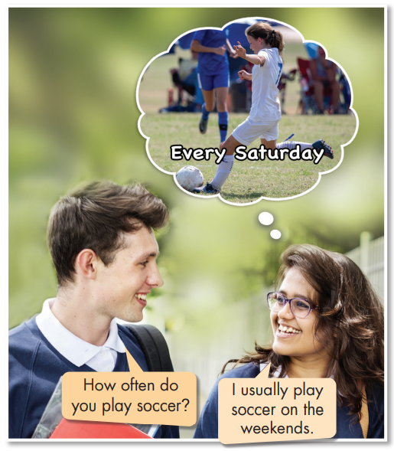
Unit 4: Festivals and Free Time
Lesson 1.2: Grammar
A: How often do you play soccer?
B: I usually play soccer on the weekends.

Slide 9
Adverbs of frequency
Note:
Always, usually
☹ I always play soccer.
☺
I always play soccer
on Saturdays
time phrase

Slide 10
Grammar
Adverbs of frequency
I usually sing.
Before the main verb.
You are always happy.
After the verb “To Be”.

Slide 11
Grammar:
Put adverbs of frequency in the correct place
always
rarely
often
usually
sometimes
never

Slide 12
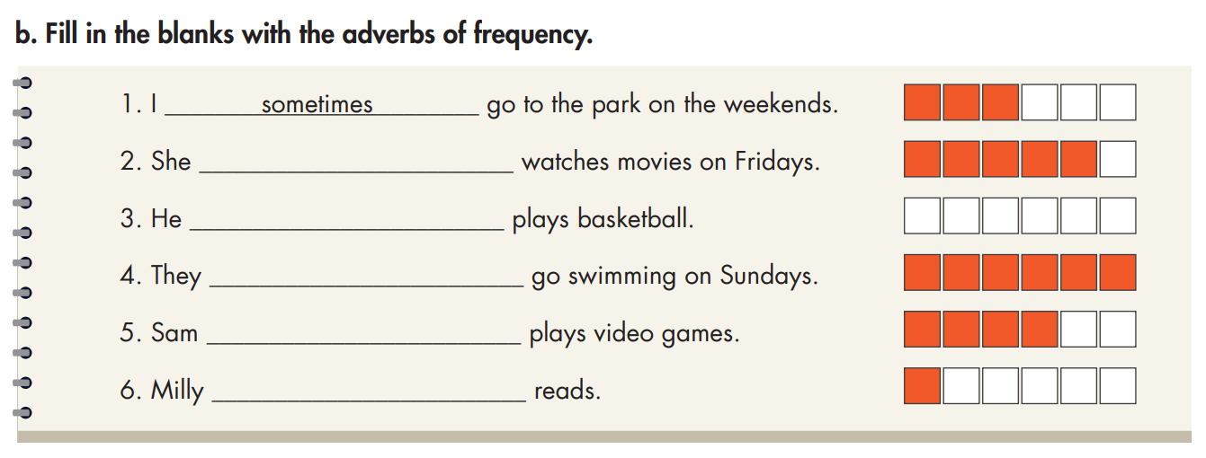
Unit 4: Festivals and Free Time
Lesson 1.2: Grammar
Practice
usually
never
always
often
rarely

Slide 13
Pair work
How often + do/ does + Subject + Verb ......?
-> Subject + Adverb of frequency + Verb......
Ex:How often do you go to the park?
-> I sometimes go to the park on the weekends.

Slide 14
Unit 4: Festivals and Free Time
Lesson 1.2: Grammar
Write
He rarely goes shopping.
He always does homework.
She sometimes plays soccer.
She often has barbecues.

Slide 15
Unit 4: Festivals and Free Time
Lesson 1.2: Grammar
Pair work
A
E
B
D

Slide 16
Rearrange these phrases to make meaningful sentences
Practice
1. often / and makes / laugh a lot. / My teacher / our class / tells the jokes /
2. after eating / Lan and / often do / dinner. / her sister / the dishes
3. is / when his / problems with / Nam / always helpful / friends have / their homework. /
4. usually / a walk / My grandmother / early to / around the park. / gets up / go for/
My teacher often tell the jokes and make our class laugh a lot.
Lan and her sister often do the dishes after eating dinner.
Nam is always helpful when his friends have problems with their homework.
My grandmother usually gets up early to go for a walk around the park.

Slide 17
Unit 4: Festivals and Free Time
Lesson 1.2: Grammar

Slide 18
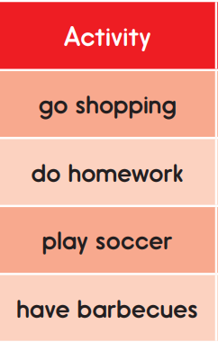
Unit 4: Festivals and Free Time
Lesson 1.2: Grammar
A: How often do you .............?
B: I usually/ sometimes/ always/ often/ never/ rarely .............

Slide 19
Extra Practice
WB page 20
soccer
Practice
rarely
soccer
usually
sometimes
always
usually

Slide 20
Group work
Quizz: Complete the sentences
1. I am always on time. I .....................late.
B. usually C. always
A. never
A. never
2. Emily lives next door, so I ...................see her.
A. never B. often C. rarely
B. often
3. Which sentence is correct?
A. He often doesn’t wear jeans.
B. He doesn’t often wear jeans.
C. He doesn’t wear jeans often.
B. She doesn’t often wear jeans.

Slide 21
Group work
Quizz: Complete the sentences
4. Which sentence is correct?
A. Are you sometimes tired at work?
B. Are you tired sometimes at work?
C. You are sometimes tired at work?
A. Are you sometimes tired at work?
5. Which sentence is correct?
A. My brother watches rarely TV.
B. My brother rarely watches TV.
C. My brother watches TV rarely.
B. My brother rarelywatches TV.

Slide 22
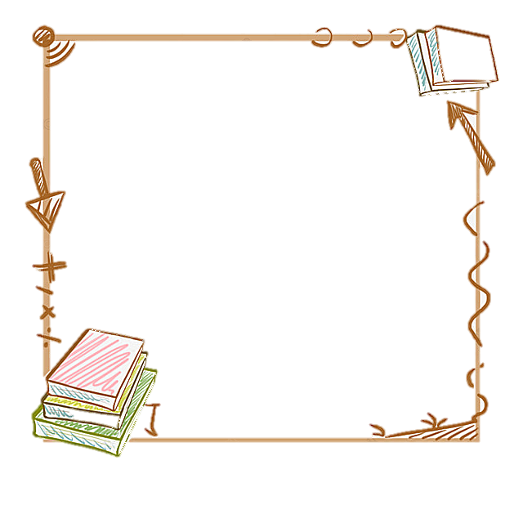
Unit 4: Festivals and Free Time
Wednesday, November 9th , 2022
Lesson 1.2: Grammar
Grammar
Adverbs of frequency
Before the main verb.
I usually sing.
After the verb “To Be”.
You are always happy.

Slide 23
Unit 4: Festivals and Free Time
Wednesday, November 9th , 2022
Lesson 1.2: Grammar
Grammar
Adverbs of frequency
How often + do/ does + Subject + Verb ......?
-> Subject + Adverb of frequency + Verb......
Ex:How often do you go to the park?
-> I sometimes go to the park on the weekends.

Slide 24
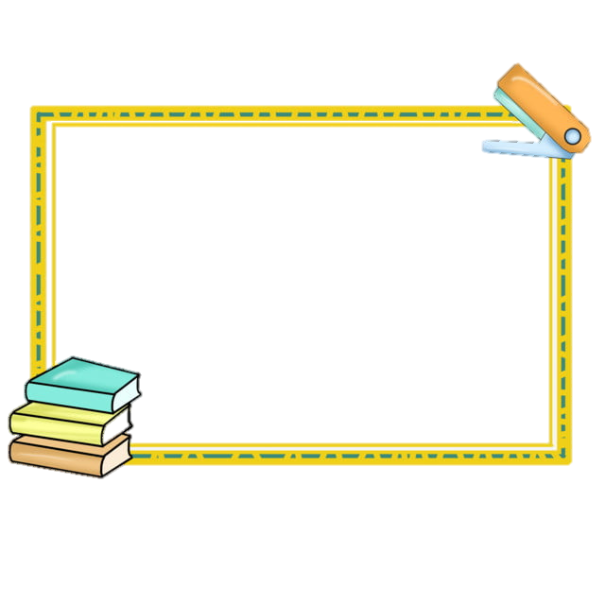
Homewwork:
- Write 3 sentences
Do exercises on page 23 ( workbook)
Prepare the next lesson on page 32 (students book)

