Slide 1
UNIT 9
A FIRST-AID COURSE
Getting Started -
Listen and read (page 80, 81)

Slide 2
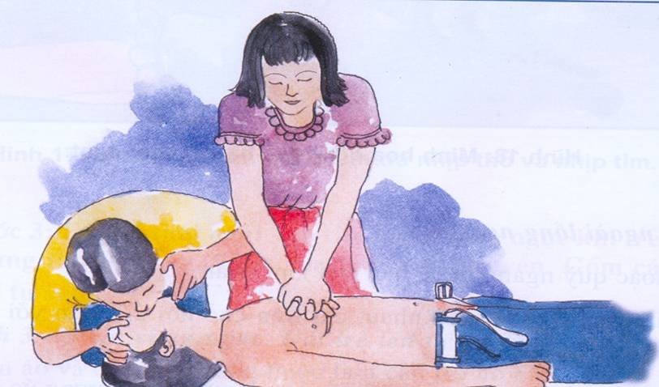

Slide 3
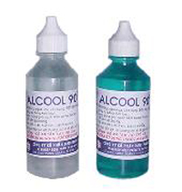
alcohol

Slide 4
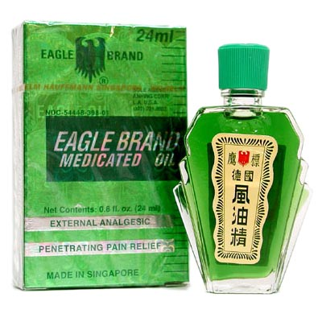
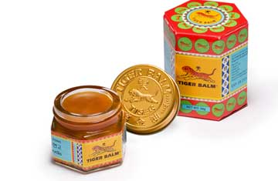
balm(n): dầu nóng

Slide 5
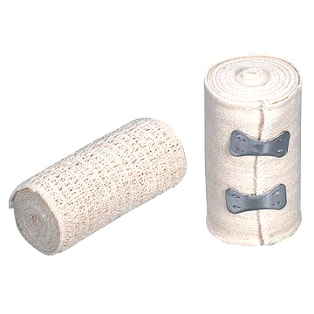
bandage(n): băng
(v): băng bó

Slide 6
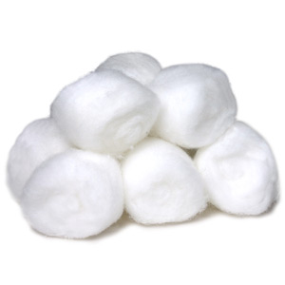
cotton wool: bông gòn

Slide 7
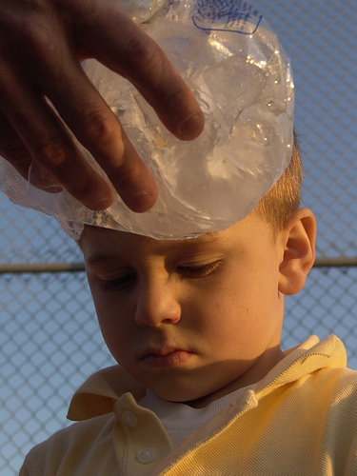
ice bag: túi đá

Slide 8
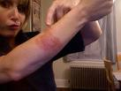
burn(n): vết bỏng

Slide 9
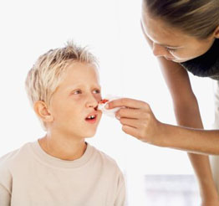
nose bleed: chảy máu mũi
bleed - bled - bled: chảy máu
bleeding (n): sự chảy máu

Slide 10
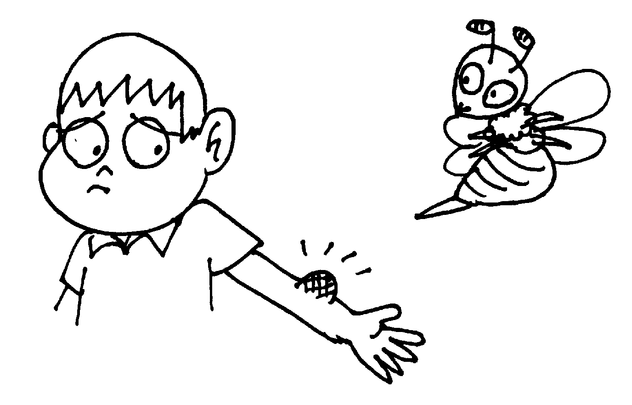
bee sting: ong đốt

Slide 11
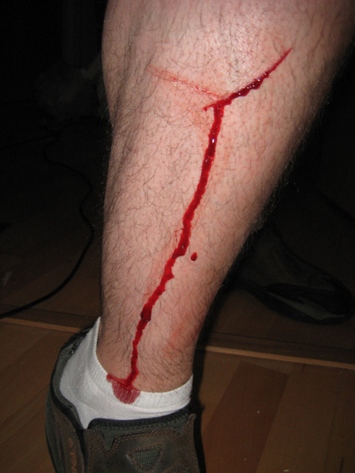

Slide 12
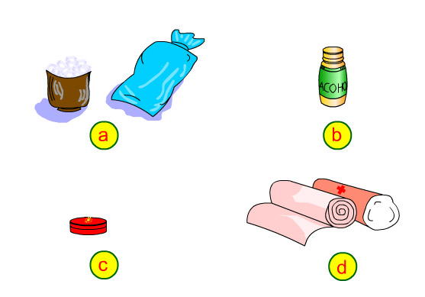
Matching Game
b
1- a boy has a bad cut on his leg.
2- a girl has a nose bleed
3-a girl has a burn on her arm.
4- a boy has a bee sting.
d
a
c

Slide 13
LISTEN/ page 80

Slide 14
Listen and read:
1- What happened at Quang Trung school?
A girl student fell off her bike and hit her head on the road.
2- What did the nurse talk with Lan in the conversation?
She gave Lan first-aid instructions.

Slide 15
New words:
- emergency (n): tình trạng khẩn cấp
- ambulance (n) : xe cứu thương
wound (v) = injure: làm bị thương
(n) = injury: chỗ bị thương
- unconscious (adj.): bất tỉnh
≠ conscious (adj.) : tỉnh táo
- to bleed (v): chảy máu
- the bleeding (n): sự chảy máu
to fall off (v): té xuống
keep s.o awake (exp.): giữ ai đó tỉnh táo
handkerchief (n): khăn tay

Slide 16
Remember
The Future Simple tense:
The ambulance will be there in about 10 minutes.
(+) S + will + V_ inf …
(-) S + will + not +V_ inf ...
(?) Will + S + V_ inf ..?

Slide 17
ANSWER THE QUESTIONS

Slide 18
Who are talking in the
conversation?

Slide 19
Who are talking in the
conversation?
→ Lan and a nurse are talking on the phone.

Slide 20
What’s the name of the hospital?
→ It is Bach Mai hospital.

Slide 21
What happened with the girl?
→ She fell off her bike and hit her head on the road.

Slide 22
What did the nurse ask Lan to do?
→ She asked Lan to try to stop the bleeding and keep the student awake.

Slide 23
True or False ?
1- There is an emergency at Quang Trung school.
2- A student fell off her bike and she has a wound on her leg.
3- The nurse gives Lan first-aid instruction.
4- The ambulance will be there in about 15 minutes.
5- Lan must keep the student awake.

Slide 24
True or False ?
1- There is an emergency at Quang Trung school.
2- A student fell off her bike and she has a wound on her leg.
3- The nurse gives Lan first-aid instruction.
4- The ambulance will be there in about 15 minutes.
5- Lan must keep the student awake.
T
____
F
head
T
10
___
F
T

Slide 25
Select The topics covered In the dialogue
a- describing the condition of the injured person
b-asking for the address
c-asking about the condition of the injured person
d-asking for advice
e-giving first-aid instruction
f-arranging for an ambulance
g- saying the injured person’s name

Slide 26
GAP-FILLING:
There was an emergency at Lan’s school. A student…….... off her bike and her head hit on the road. She was ……………. .but she had a bad cut on her head and the …… was ………….. badly. Lan telephoned Bach Mai hospital and asked the nurse to send an….................. to Quang Trung school. The nurse asked Lan to use a towel or a handkerchief to cover the ….………, to put pressure on it and to ……..… it tight to stop the bleeding. Lan must keep the student …….….. while waiting for the ambulance.

Slide 27
GAP-FILLING:
There was an emergency at Lan’s school. A student…….... off her bike and her head hit on the road. She was ……………. .but she had a bad cut on her head and the …… was ………….. badly. Lan telephoned Bach Mai hospital and asked the nurse to send an….................. to Quang Trung school. The nurse asked Lan to use a towel or a handkerchief to cover the ….………, to put pressure on it and to ……..… it tight to stop the bleeding. Lan must keep the student …….….. while waiting for the ambulance.
fell
conscious
cut
bleeding
ambulance
wound
hold
awake

Slide 28
Homework
Learn new words and structure by heart
Write 5 sentences using WILL
Prepare unit 9- SPEAK

Slide 29
Good bye !

