Slide 2

UNIT 8: PUZZLES AND GAMES

Slide 3


Slide 4


Slide 5
1/ These things help you to move around from one place to another place, such as a car, a bus, or a truck ... There are eight letters.
___________ | ___________ | ___________ | ___________ | ___________ | ___________ | ___________ | ___________
V
E
H
I
C
L
E
S

Slide 6
2/ This word means changing from one place to another. There are four letters.
_________________ | _________________ | _________________ | _________________
M
O
V
E

Slide 7
3/ This word means sitting on an animal, especially a horse, and make it move along. There are four letters.
_________________ | _________________ | _________________ | _________________
R
I
D
E

Slide 8
4/ These things are round and they are under the buses, cars, bicycles, ... There are six letters.
____________ | ____________ | ____________ | ____________ | ____________ | ____________
W
H
E
E
L
S

Slide 9
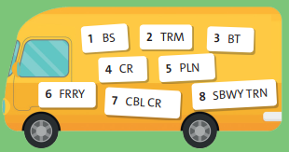
1/ How do you travel on your holiday? Add vowel(s) (A, E, I, O or U) to the words in the bus. Then write the words.
1/ BUS
2/ TRAM
3/ BOAT
4/ CAR
5/ PLANE
6/ FERRY
7/ CABLE CAR
8/ SUBWAY TRAIN

Slide 10
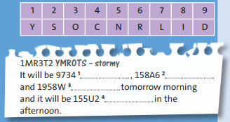
2/ Work in pairs. Use the code to complete the weather forecast. Then use the code to write a weather forecast for your partner:
cold
rainy
windy
sunny

Slide 11

Now, write a weather forecast for your partner by using the code:

Slide 12
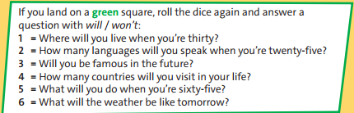
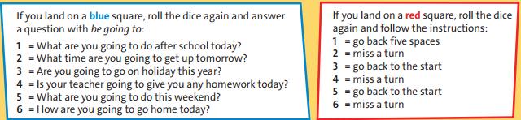
3/ A BOARD GAME. Work in pairs. You need a dice. Take turns rolling the dice and moving from START to FINISH. If you land on a blue, red or green square, follow the instructions in the coloured box

Slide 13
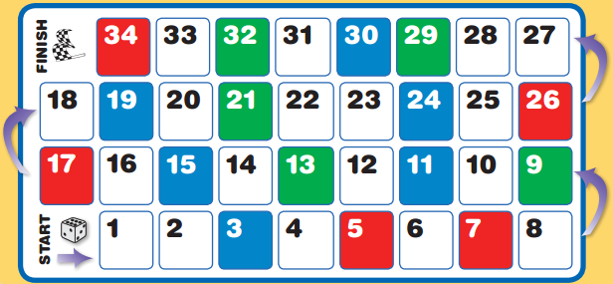
3/ A BOARD GAME. Work in pairs. You need a dice. Take turns rolling the dice and moving from START to FINISH. If you land on a blue, red or green square, follow the instructions in the coloured box

Slide 14

DISCUSSION TIME!
=>What have we learnt in Unit 8?

Slide 15

* Homework: - Learn by heart all structures and vocabulary. - Complete the “Progress Review 4”.

Slide 16



www.phuongnam.edu.vn

Slide 17



Thank you!
CTCP ĐẦU TƯ VÀ PHÁT TRIỂN GIÁO DỤC PHƯƠNG NAM

