Slide 2

UNIT 7: PUZZLES AND GAMES

Slide 3


Slide 4
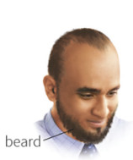

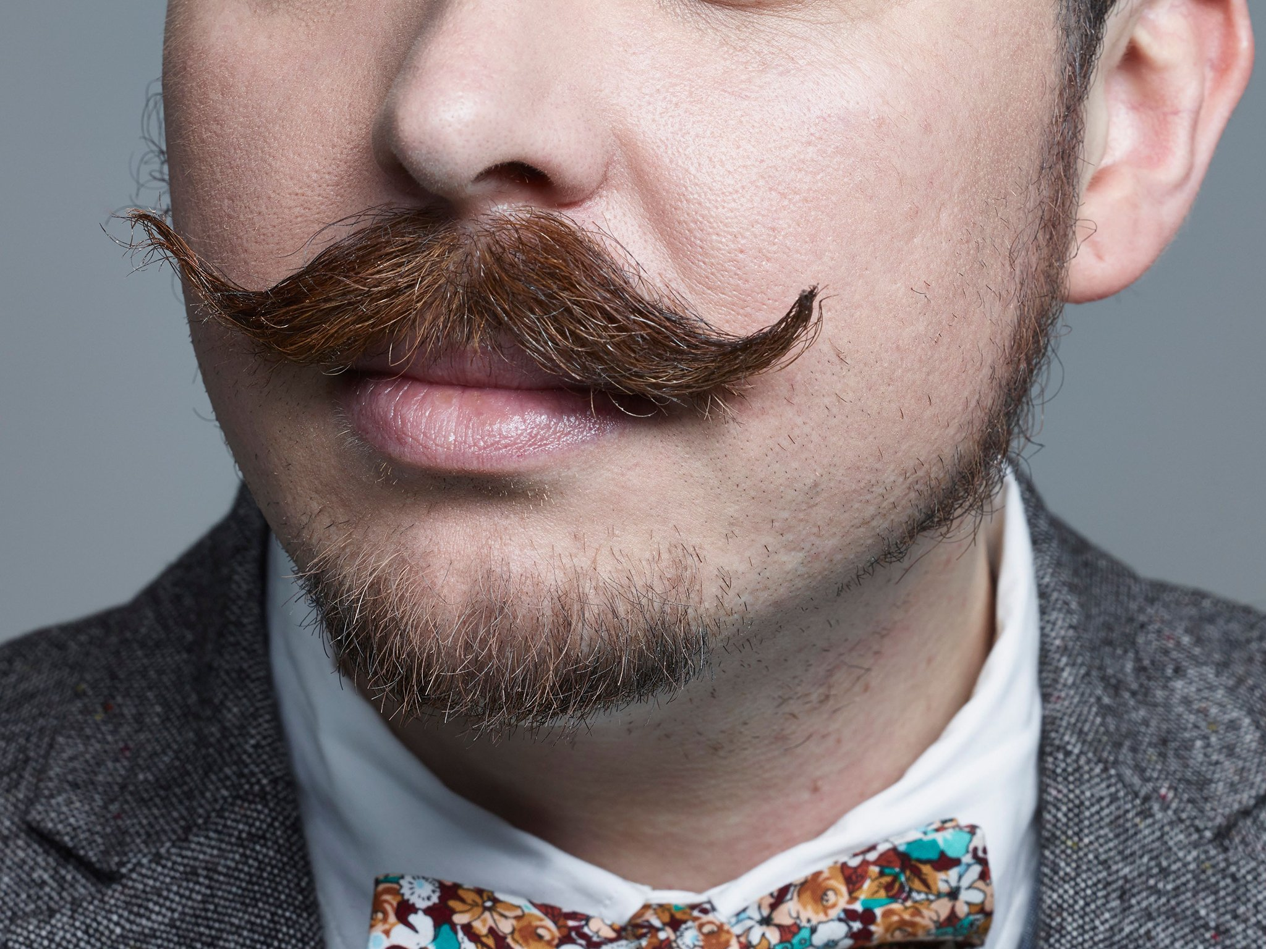
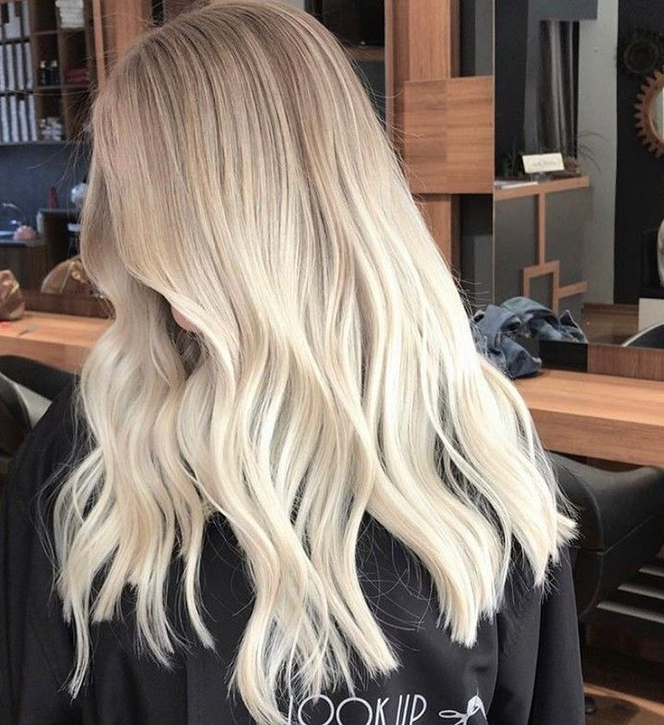


* MATCHING:
 | spiky hair
 | beard
 | moustache
 | glasses
 | curly hair
 | blonde hair

Slide 5
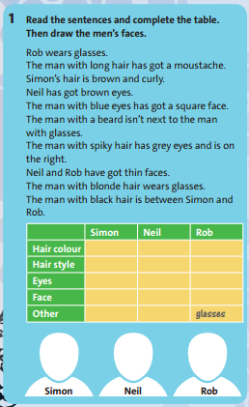
1/ Read the sentences and complete the table. Then draw the men’s faces:
 | Simon | Neil | Rob
Hair colour
Hair style
Eyes
Face
Other |  |  | glasses
brown
black
blonde
curly
long
spiky
blue
brown
grey
square
thin
thin
beard
moustache

Slide 6
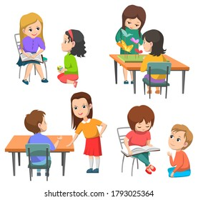
2/ PAST SIMPLE TENNIS. Play in pairs. Follow the instructions:
Student A: Say a verb to Student B.
eat
Student B: Say the past simple form of the verb. Then say a different verb to Student A.
ate

Slide 7

3/ WORDSNAKE. Find seven object pronouns:

Slide 8
4/ Unscramble the words to find five life events:
egt drmiera get married
1/ egt a ojb -> ___________________
2/ rwgo pu -> ___________________
3/ eevla loshoc -> ________________
4/ og ot syniurvtei -> ______________
5/ avhe dilercnh -> ________________
get a job
grow up
leave school
go to university
have children

Slide 9
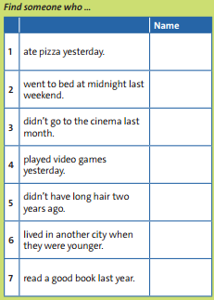

5/ FIND SOMEONE WHO... . Walk around the class and ask questions. Write a differen name for each question:
Did you eat pizza yesterday?
Yes, I did.

Slide 10
DISCUSSION TIME!
=>What have we learnt in Unit 7?

Slide 11

* Homework: - Learn by heart all structures and vocabulary. - Prepare LESSON 8 “GOING AWAY” - VOCABULARY: MEANS OF TRANSPORT.

Slide 12



www.phuongnam.edu.vn

Slide 13



Thank you!
CTCP ĐẦU TƯ VÀ PHÁT TRIỂN GIÁO DỤC PHƯƠNG NAM

