Slide 1

UNIT 1: PUZZLES AND GAMES

Slide 2

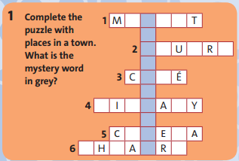
A
R
K
E
E
S
Q
A
E
T
A
F
U
L
B
R
R
A
I
N
M
T
E
T
E

Slide 3
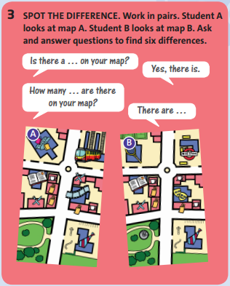
SPOT THE DIFFERENCE. Work in pairs. Student A looks at map A. Student B looks at map B. Ask and answer questions to find six differences.
For example:
1.Is there a …on your map?
Yes, there is.
2.How many … are there on your map?
There are …

Slide 4
1/ There’s a cinema on map A, but a theatre on map B.
2/ There’s a train station on map A, but a bus stop on map B.
3/ There’s a shopping center on map A, but a sports center on map B.

Slide 5
4/ There are two restaurants on map A, but only one on map B.
5/ There are two cafés on map A, but three on map B.
6/ There isn’t a monument in the park on map A, but there is on map B.

Slide 6
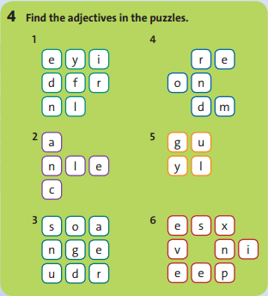
1/ friendly
2/ clean
3/ dangerous
4/ modern
5/ ugly
6/ expensive

Slide 7
*COMPARATIVE BINGO:
friendly, quiet, clean, pretty, old, dangerous, dirty, ugly, small, big, bad, exciting
clean
exciting
small
exciting
pretty
dangerous

Slide 8

* Homework: - Review the grammar structures and new words of unit 2. - Prepare for next lesson – Language focus: comparative adjectives

