Slide 1


UNIT 8
THE WORLD AROUND US

Slide 2



LESSON 9
REVIEW

Slide 3
WARM-UP

Slide 4

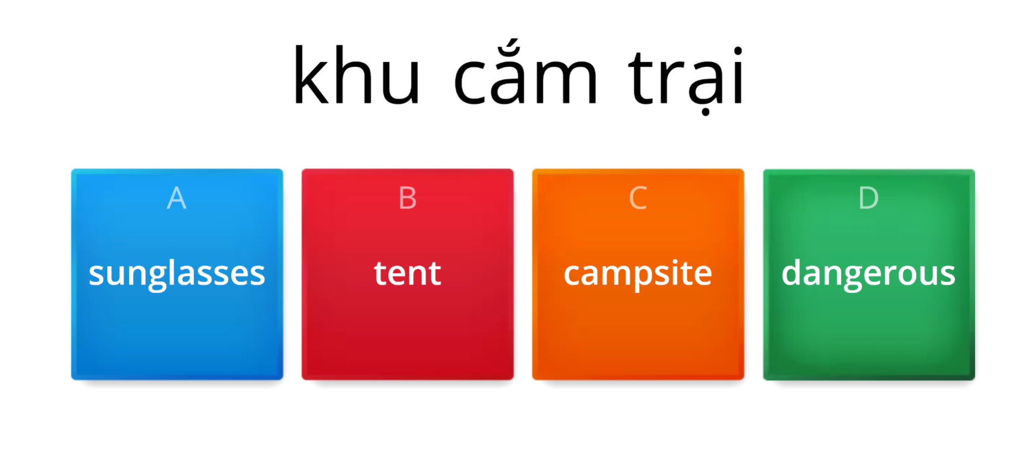
PRACTICE ONLINE VOCABULARY
https://wordwall.net/resource/25444024

Slide 5
VOCABULARY REVIEW
n
chèo thuyền vượt thác
1. rafting
n
hẻm núi
2.canyon
n
hang động
3. cave
n
4. hiking
leo núi
5. campsite
n
khu cắm trạia
6.kayaking
n
bơi thuyền
7. battery
n
pin
8.flashlight
n
đèn pin
9. tent
n
cái lều

Slide 6
n
nước đóng chai
10. bottled water
n
túi ngủ
11. sleeping bag
n
khăn tắm
12.towel
n
cao nguyên
13. highland
n
bãi biển
14.beach
15. mountain
n
núi
n
thác nước
16. waterfall
n
vịnh
17. bay
n
rừng
18.forest
n
đảo
19.island

Slide 7
GRAMMAR REVIEW
1. MODALS (SHOULD/SHOULDN’T, CAN/CAN’T)( Động từ khuyết thiếu)
Usage: Động từ khuyết thiếu đứng trước động từ chính nhằm bổ nghĩa cho động từ chính.
Form : Modals + V(inf)
should/shouldn’t
can/can
+ V(inf)

Slide 8
2. Conjunctions : Liên từ/từ nối
Từ nối trong tiếng Anh (còn gọi là linking words hay conjunctions), được dùng để liên kết giữa các câu, giúp cả đoạn văn chặt chẽ hơn, mạch lạc hơn.
Common conjunctions : (Những từ nối thường gặp)
So: Vì vậy
- Others : and : và, but: nhưng , or : hoặc là , because : bởi vì.

Slide 9

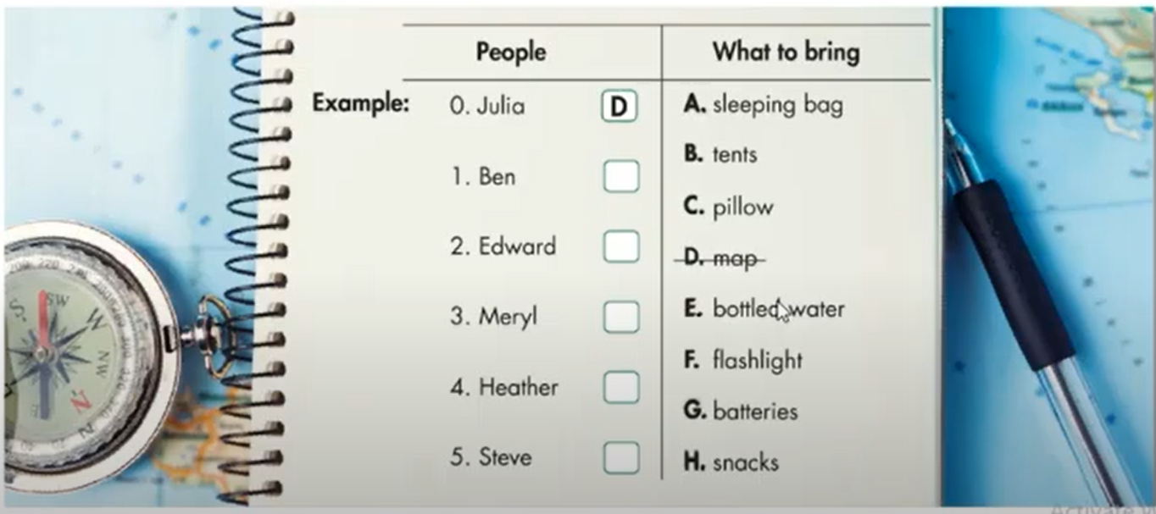
Listening
You will hear some information about a camping trip. What will each person bring? For each question, write a letter ( A-H) next to each person. You will hear the conversation twice.
People
What to bring
Example:
0. Julia
D
A. sleeping bag
1. Ben
E
B. tents
C. pillow
2. Edward
F
D. map
3. Meryl
B
E. bottled water
G
4. Heather
F. flashlight
H
G. batteries
5. Steve
H. snacks

Slide 10
Reading
Look and read. Choose the correct answer. ( A,B, or C)
Example:
0. Go the Adventure Forest if you want to...
go somewhere close to town.
sleep comfortably.
play indoor games.
Adventure Forest
Outdoor activities!
Stay our campsite!
Only thirty minutes away from Green town!
1.
Campers have to bring batteries.
Campers can buy flashlights there.
Campers need flashlights to see at night.
Campsite Notice
Campers, please remember to bring flashlights so you can see after dark. You can buy batteries at the store.
2.
Anyone can do the activities.
Children under ten years old can’t go kayaking
River rafting is for adults only
Kayaking in the bay – Ages 10+
River Rafting – 4 people max. At lease one adult.
3.
The weather is verry nice in the winter.
There isn’t much to do
Joe thinks April should go to Adventure Forest
Hey, April,
Adventure Forest is great. There are so many fun activities! But you shouldn’t go in the winter because of the bad weather. Have a great time! Joe.

Slide 11
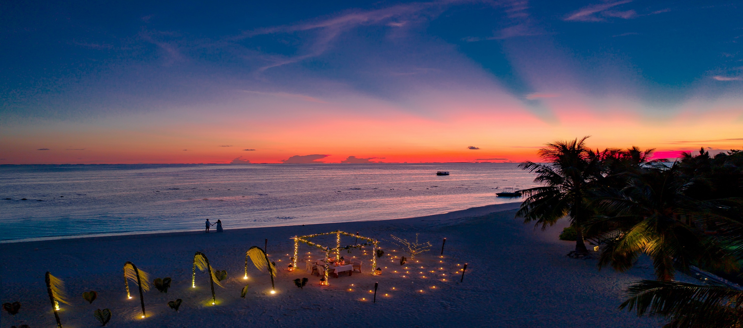
Vocabulary
These mountains are very beautiful . That’s why many people like ______here.
We don’t need to take b___________w_________because there is tap water at the campsite.
Phú Quốc is a very beautiful i_________________ in Vietnam.
Rafting and k____________________ are both great fun, but rafts have more people in the boat.
Oh no! the flashlight isn’t working and I don’t have any b__________________.
I like walking in the f______________________ because I can see many birds in the trees.
My s_______b________is very warm. That’s why I like slepping in my tent.
hiking
otted
ater
sland
ayaking
atteries
orest
leeping
ag

Slide 12
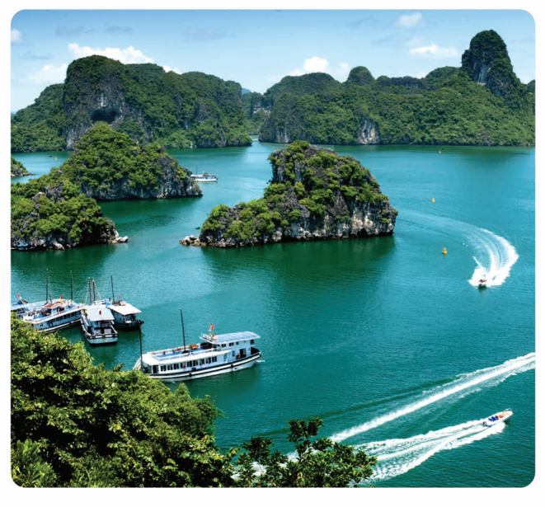
Grammar
Circle the correct words.
You should/shouldn’t go to the beach. It really is very beautiful.
What can/need we do in Đà Nẵng?
We need/should to bring a pillow because the campsite doesn’t have any.
It’s very cold at night so/don’t bring a jactket.
You should/can’t swim in that water. It’s very dangerous.
The campsite has food so/should we don’t need to bring any.
Should/Need I go in October?

Slide 13
PRONUNCIATION
Circle the word that has the underlined part pronounced differently from others.
1. A. fishing B. highland C. swimming D. kicking
2. A. bay B. vacation C. jacket D. place
3. A. phone B. cold C. postcard D. forest
4. A. hotel B. hour C. house D. hiking
5. A. garden B. car C. far D. bay
6. A. island B. scuba C. thirsty D. forest

Slide 14
WARP-UP

Slide 15

HOMEWORK
Assign Ss to do exercises in workbook after class
Ask them to get ready for the next lesson –
Unit 9: Houses in the future.

