Slide 1
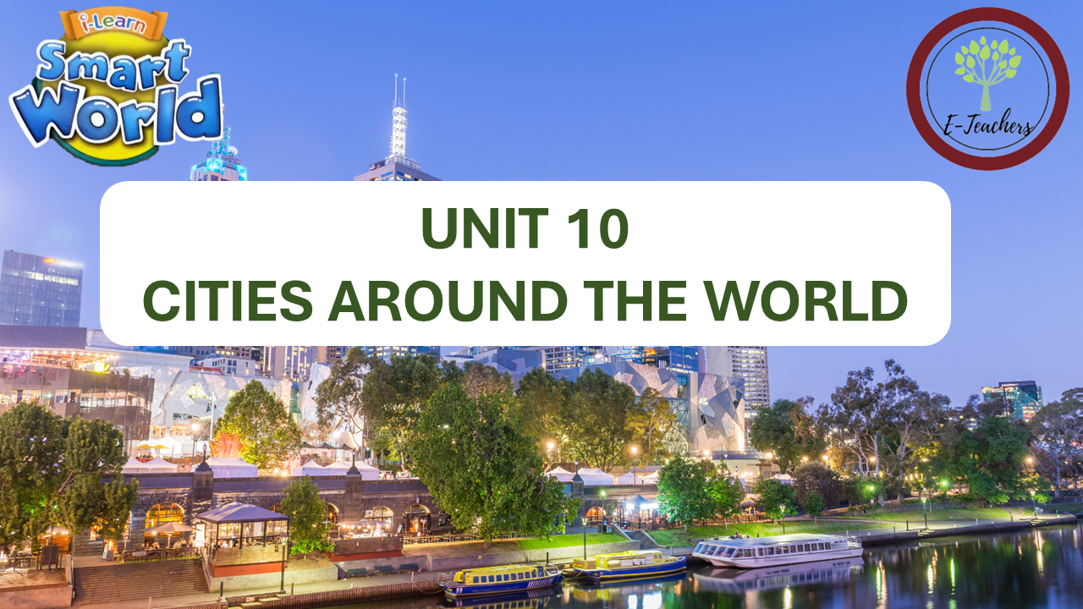

Slide 2

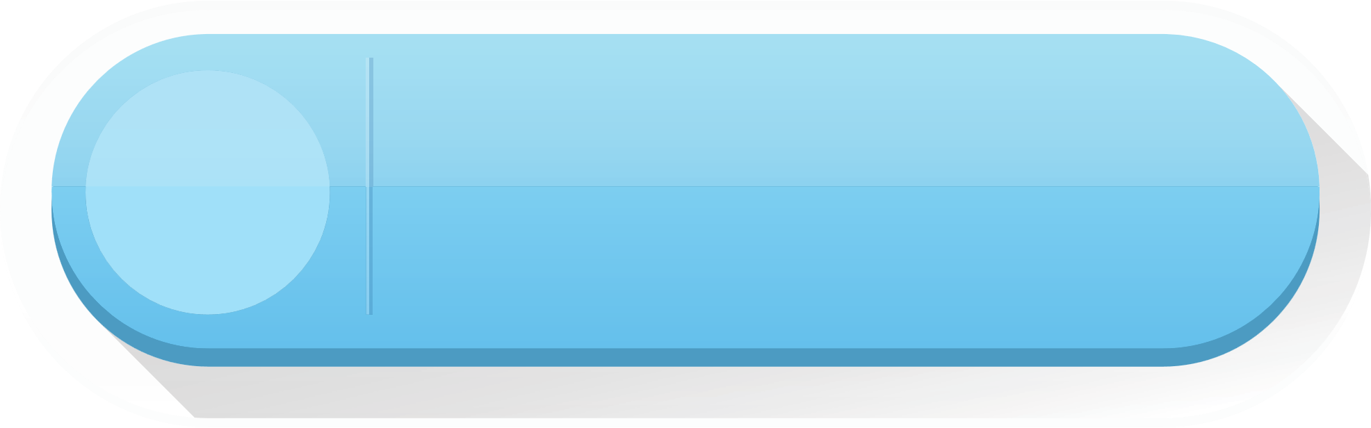

LESSON 9
REVIEW

Slide 3
WARM UP

Slide 4

VOCABULARY REVIEW
n
trung tâm thương mại
1. shopping mall
n
công viên giải trí
2. amusement park
n
3. building
tòa nhà
adj
4. crowded
đông đúc
adj
ồn ào
5. noisy
adj
hiện đại
6.modern
adj
yên bình
7. peaceful
n
8.opinion
ý kiến, quan điểm
n
phương tiện giao thông công cộng
9. public transport
n
10. cheap
adj
rẻ
11. expensive
adj
đắt

Slide 5
adj
sạch
12.clean
adj
bẩn
13. dirty
adj
ô nhiễm
14.polluted
Ms Phương
Zalo: 0966765064
adj
đông đúc, ồn ào
15. populated
n
nhiệt đọt
16. temprature
n
thủ đô
17. capital
n
18.million
triệu
n
19.price
giá
n
20.university
trường đại học
n
21.restaurant
nhà hàng

Slide 6

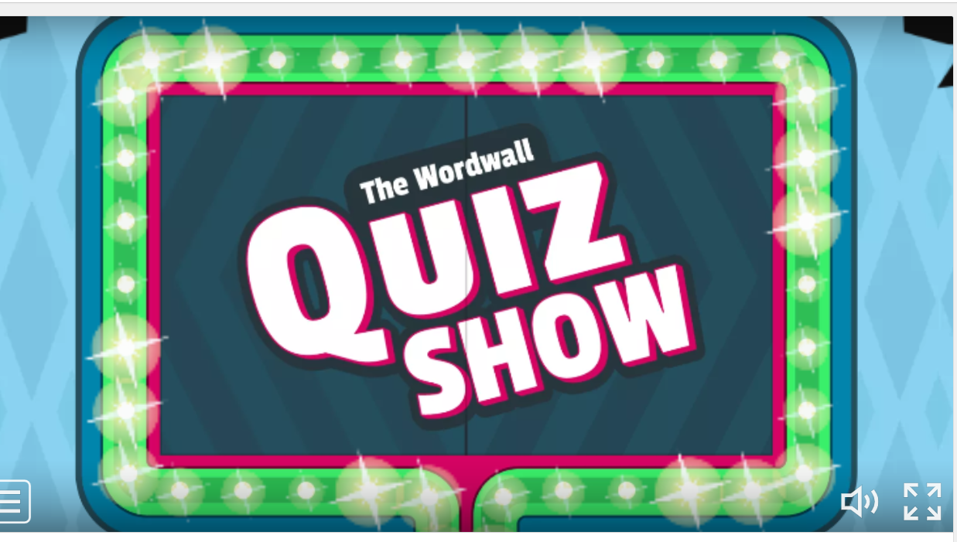
ONLINE GAME : CLICK HERE

Slide 7
GRAMMAR REVIEW
1. THE FIRST CONDITION ( Câu điều kiện loại 1)
Usage (cách sử dụng): Câu điều kiện loại 1 là câu điều kiện diễn tả những điều có thật, có thể xảy ra ở hiện tại và tương lai.
Form ( cấu trúc)
( Mệnh đề chính) ( Mệnh đề “ If”)
Hiện tại đơn Tương lai đơn
( S+ V(e,es) S + will + V(o)
Example ( Ví dụ)
If it rains, Mary will go to the supermarket.

Slide 8
2. Comparative and Superlative (Câu so sánh hơn và câu so sánh nhất)
Ms Phương
Zalo: 0966765064
Tính từ
So sánh hơn
So sánh nhất
1 âm tiết hoặc 2 âm tiết kết thúc bằng et, er, ow,y
S1+ tobe ( am/is/are) + Tính từ+er+ than + S2
S+ tobe ( am/is/are) + the tính từ+est....
Có 2 âm tiết trở lên ( tính từ dài)
S1+ tobe ( am/is/are) + more + tính từ + than + S2
S+ tobe ( am/is/are) + the most + tính từ
good – better – the best little – less – the least
bad – worse – the worst
many/much – more – the most
Tính từ đặc biệt.
far – farther/further – the farthest/the furthest

Slide 9

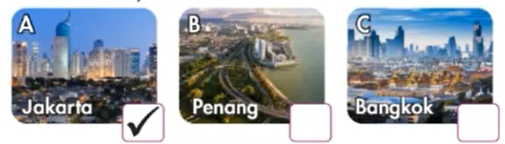
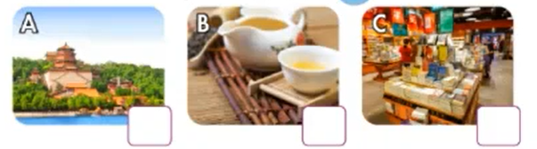

Listening
You will hear five short conversations. You will hear each conversation twice. There is one question for each conversation. For each question, choose the correct answer ( A,B, or C)
0. Which city is more crowded?
1. What will Suzy do if it rains?

Slide 10
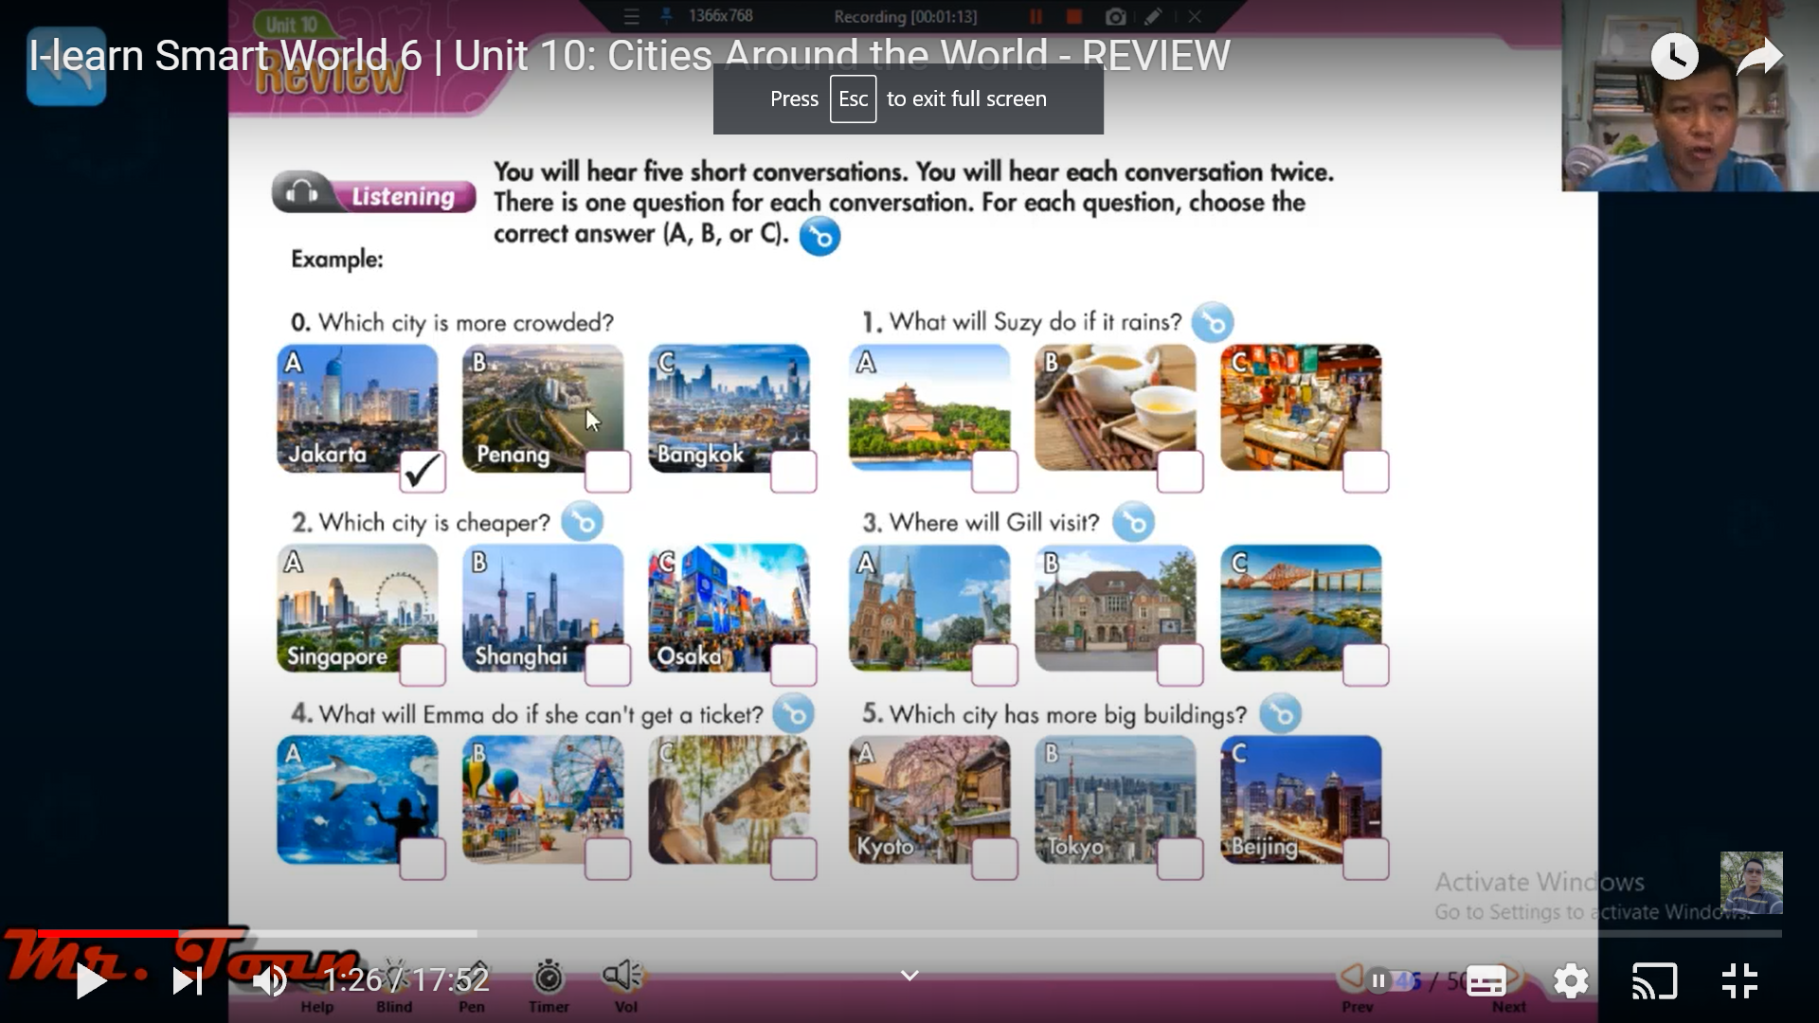
2. Which city is cheaper?
3. Where will Frill visit?

Slide 11
4. What will Emma do if she can’t get a ticket?
5. Which city has more big buildings?

Slide 12
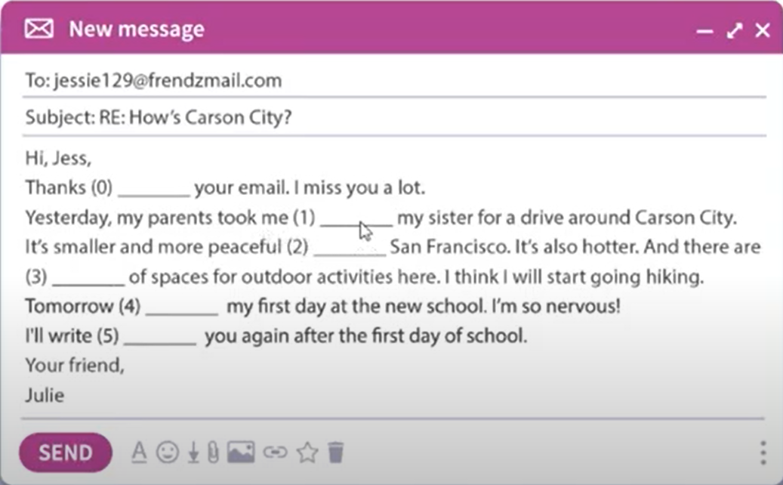
Reading
Read the email.Write one word for each blank.
Example:
To: juessie 129@frendzmail.com
0 | for
Subject: RE: How’s Carson City?
Hi, Jess,
Thanks(0)_____your email. I miss you a lot.
Yesterday, my parents took me(1) ____________my sister for a drive around Carson City. It’s smaller and more peaceful (2) _________San Fancisco. It’s also hotter. And there are (3) _________of spaces for outdoor activities here. I think I will start going hiking. Tomorrow(4) __________my first day at the new school. I’m so nervous!
I’ll write (5) __________you again after the first day of school.
Your friend,
Julie
and
1
than
2
lots
3
is
4
to
5

Slide 13
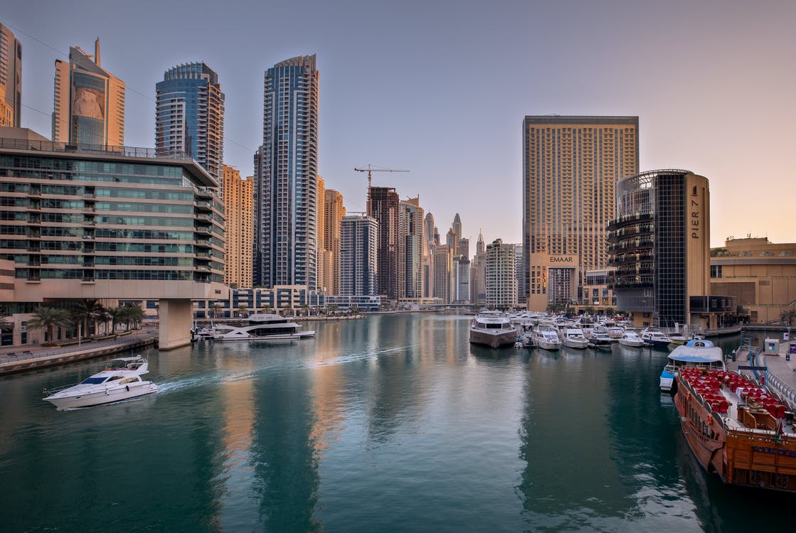
Vocabulary
Fill in the blanks with words from the unit. The first letter is already there.
An ______________ is a place to watch musical performances. The one in Sydney is very famous.
Kings and queens often live in a p_____________. Versailes in France has a very famous one.
A b______________helps people travel over rivers.
I don’t like going on the train 7: a.m. There are too many people and it’s very c_______________.
The park in my town is very p___________. There are only a few people and it’s very ____________.
The average t_____________in Kuala Lumpur in October is 27.5 oC
There’s no trash on the streets in Singapore. It’s famous for being c__________________.
opera house
alace
ridge
rowded
eaceful
emprature
lean

Slide 14
Vocabulary
Unscramble the sentences.
1. Moscow/is/than/polluted/London./more/think/I
I think Moscow is more pullulated than London.
_______________________________________________________________________________
2. This/most/is/expensive/article/Singapore/the/city/says/in/the/world.
This article says Singapore is the most expensive city in the world.
_______________________________________________________________________________
3.New York/than/has/more/museums/Mexico City.
New York has more museums than Mexico city.
_______________________________________________________________________________
4. January in/than/Đà Nẵng/hotter/is/in Paris.
January in Đà Nẵng is hotter than in Paris.
_______________________________________________________________________________
5. cleanest/USA./the/is/city/in/the/Honolulu.
Honolulu is the cleanest city in the USA
_______________________________________________________________________________
6. than/Hanoi/think/I/crowded/is/more/Phú Quốc.
I think Hanoi is more crowded than Phú Quốc.
_______________________________________________________________________________
7.modern/think/Los Angeles/is/more/I/than/Berlin
I think Los Angeles is more modern than Berlin
_______________________________________________________________________________

Slide 15
PRONUNCIATION
Circle the word that has the underlined part pronounced differently from others.
A. thing B. this C. thank D. think
A. although B. there C. tooth D. weather
A. theater B. third C. month D. then
A. those B. three C. fifth D. birthday
A. brother B. clothes C. both D. than
A. bath B. breath C. teeth D. breather

Slide 16
WARP UP

Slide 17
HOMEWORK
Learn new words and practice with the learnt language of Unit 10.
01
- Do the exercises on page 71 (WB).
02
- Prepare for the End of term test
03

