Slide 1
to class

Slide 2
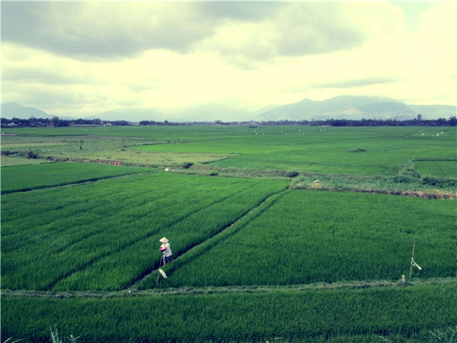
Let’s play guessing game
Which place am I talking about ?
On the way to the place, tourists have a chance to travel between the green paddy fields

Slide 3
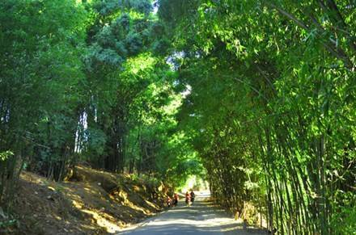
Which place am I talking about ?
or cross the small bamboo forest

Slide 4
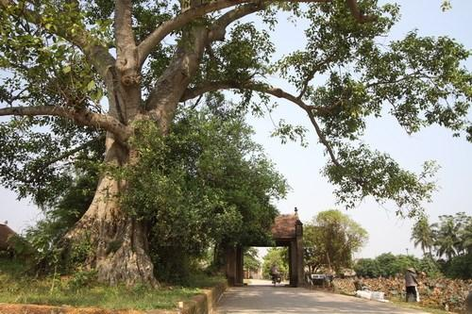
Which place am I talking about ?
They can see a big banyan tree at the entrance

Slide 5
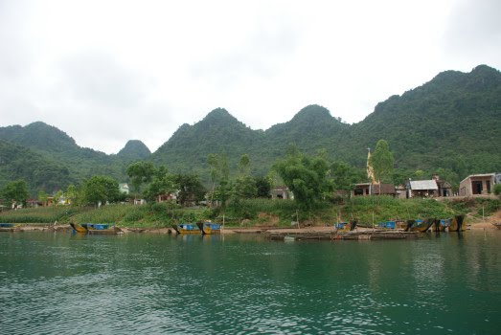
Which place am I talking about ?
It is near a river and a mountain
It is Ba’s village

Slide 6
Does your village have a banyan tree?
I wish my village had a banyan tree.
Does your village have a river?

Slide 7
If you wish to have a river in your village, what will you say ?

Slide 8
Unit 3: cont
Lesson 4: Language focus
1. Model could with wish
2. The past simple with wish
3. Preposition of time
2. Adverb clause of result

Slide 9
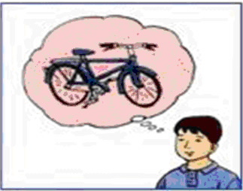
unit 3: cont
Lesson 4: Language focus
Ba / have / new bicycle
Ba wishes he had a new bicycle.
For unreal wishes at present
S1 + wish (es) + S2 + V(simple past) be → were

Slide 10
unit 3: cont
Lesson 4: Language focus
Ba / can have / a new bicycle.
Ba wishes he could have a new bicycle.
For unreal abilities at present
S1 + wish (es) + S2 + could + V

Slide 11
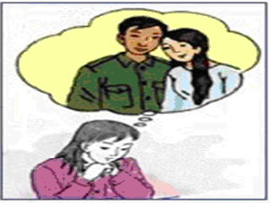
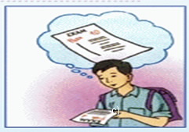
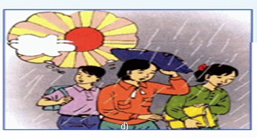
unit 3: cont
Lesson 4: Language focus
1. Model could with wish
1. Sentence patterns
S1 + wish (es) + S2 + V(simple past) be → were
- For unreal wishes at present :
- For unreal ability at present :
S1 + wish (es) + S2 + could + V
2. Write to complete these sentences using pictures and words given
b.
c.
Hoa / can visit / parents
I / can pass / exam
d.
e.
We / it / not rain
They / stay / Hue

Slide 12
unit 3: cont
Lesson 4: Language focus
1. Model could with wish
1. Sentence patterns
S1 + wish (es) + S2 + V(simple past) be → were
- For unreal wishes at present
- For unreal ability at present
S1 + wish (es) + S2 + could + V
2. Write to complete these sentences using pictures and words given
b. Hoa / can visit / parents
Hoa wishes she could visit her parents.

Slide 13
unit 3: cont
Lesson 4: Language focus
1. Model could with wish
1. Sentence patterns
S1 + wish (es) + S2 + V(simple past) be → were
- For unreal wishes at present
- For unreal ability at present
S1 + wish (es) + S2 + could + V
2. Write to complete these sentences using pictures and words given
b.Hoa wishes she could visit her parents
c.
I / can pass / exam
I wish I could pass the exam

Slide 14
unit 3: cont
Lesson 4: Language focus
2. Write to complete these sentences using pictures and words given
b. Hoa wishes she could visit her parents
c. I wish I could pass the exam
d.
We / it / not rain
We wish it did not rain

Slide 15
unit 3: cont
Lesson 4: Language focus
2. Write to complete these sentences using pictures and words given
b.Hoa wishes she could visit her parents.
c. I wish I could pass the exam.
d. We wish it did not rain.
e.
They / stay / Hue
They wish they stayed in Hue.

Slide 16
unit 3: cont
Lesson 4: Language focus
2. Writing to complete these sentences using pictures and words given
b. Hoa wishes she could visit her parents.
c. I wish I could pass the exam.
d. We wish it did not rain.
d. They wish they stayed in Hue.
3. Preposition of time
on, in, at, till/ until, from…(up)to, between…and, before, after, since, for
* Van will live with the Parkers on the farm __ the beginning of October.
till
preposion of time

Slide 17
unit 3: cont
Lesson 4: Language focus
* IN + Month: in đứng trước ngày, tháng, năm, buổi trong ngày.
* on + day of week: trước thứ trong tuần và ngày
* at + time, part of a day… : trước giờ, phần của ngày at noon, at night….
* Between …..and: khoản tời gian
* Till ….. To: cho đến….
* for: khoản thời

Slide 18
unit 3: cont
Lesson 4: Language focus
3. Preposition of time
1. on, in, at, till/ until, from…(up)to, between…and, before, after, since, for
on
* Fill in the blanks.
1. __
__ Sunday
__ May 23rd
__ New Year’s Eve
2. __
__ 1998
__ Summer
__ the morning/afternoon
in
at
3. __
__ 6 o’clock
__ Christmas
__ noon/ night/ midday
on
in
at
on
in
at
on
in
at

Slide 19
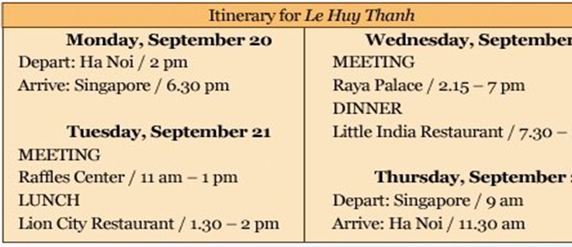
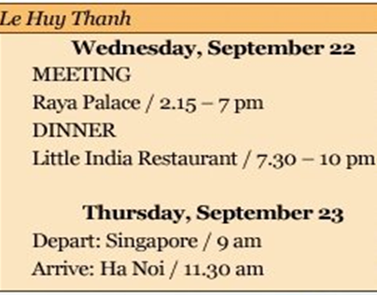
itinerary (n)
/ iˈtinərəri /

Slide 20
* Complete the sentences with :
on, at, till/ until, up to, between, after
at
a. Mr Thanh leaves Ha Noi __ 2 pm.
on
b. He arrives in Singapore __ Monday evening.
c. On Tuesday morning, there is a meeting _______ 11 am and 1 pm.
between
d. On Wednesday, Mr Thanh has appointments ___10 pm.
till
after
e. He returned to the hotel ____ 10 pm.
up to
f. He will be in Singapore from Monday _____Thursday.

Slide 21
unit 3: cont
Lesson 4: Language focus
3. Preposition of time
on, in, at, till/ until, from…(up)to, between…and, before, after, since, for
1. Completing the sentences
a. at
b. on
c. between
d. till
e. after
f. up to
2. Complete the sentences with : on, at, in, for
on
a. Goodbye! See you __ Monday.
at
in
b. The bus collected us __ 5 o’clock early __the morning.
in
c. We usually go to our home village at least once __ the summer.
for
d. We walked __ half an hour to reach the waterfall.
in
e. They planned to have the trip __ June.
at
f. She loves to watch the stars __ night.

Slide 22
unit 3: cont
Lesson 4: Language focus
4. Adverb clause of result:
* USE: ADVERB CLAUSES OF RESULT / CONSEQUENCE (Mệnh đề trạng từ chỉ hậu quả) : SO / THEREFORE + clause.
EXAMPLE:
1. The Parkers are nice, so Van feels like a member of their family.
2. It’s a very fine day; therefore, we decide to go for a picnic.
so
Everyone was tired, __ they sat down under the tree and had snack.
clause of result

Slide 23
* Match the half- sentences:
1. Hoa worked hard, ..
a. so I turned on the air conditioner.
b. so she didn’t have time for breakfast.
2. It was hot, ..
3. Nga is sick today, ..
c. so Mrs. Robinson took it back to the shop.
4. Na woke up late, ..
d. so she won’t go to school.
5.The new camera
didn’t work, ..
e. so she passed her exam.
Example:
1-e) Hoa worked hard, so she passed her exam.

Slide 24
* Complete these sentences
1. It’s a pity I can’t tell you how to use this iphone.
I could tell you how to use this iphone.
I wish ______________________________
before
2. I’m at work till 11:00, so don’t phone me _____ 11:00.
3. Nam failed the exam because he played video game too much.
Nam played video game too much
he failed the exam.
__________________________ , so ______________

Slide 25
Homework
_ Complete all exercises.
_ Write 5 wish sentences.
_ Review how to use prepositions of time.
_ Write 3 sentences, containing adverb clauses of result.
+

Slide 26
Thanks for your attention !
Goodbye

