Slide 1
UNIT 1 A VISIT FROM A PENPAL
GETTING STARTED – LISTEN & READ

Slide 2
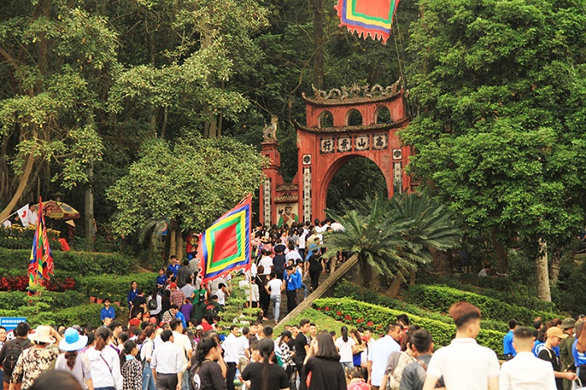
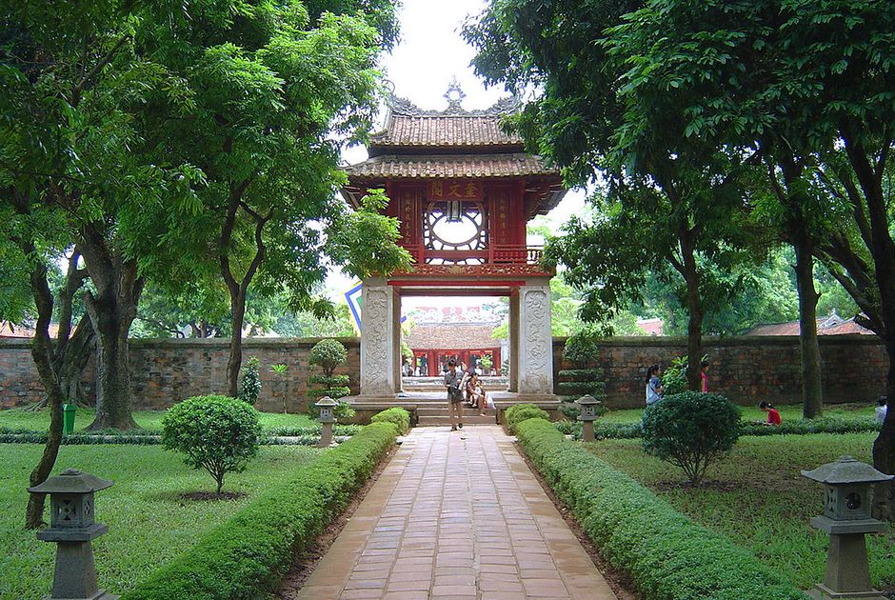
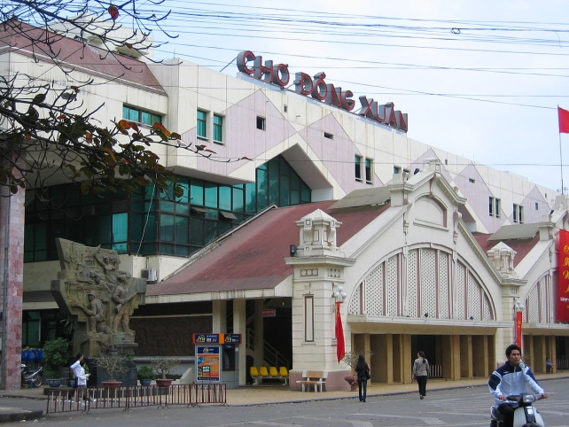
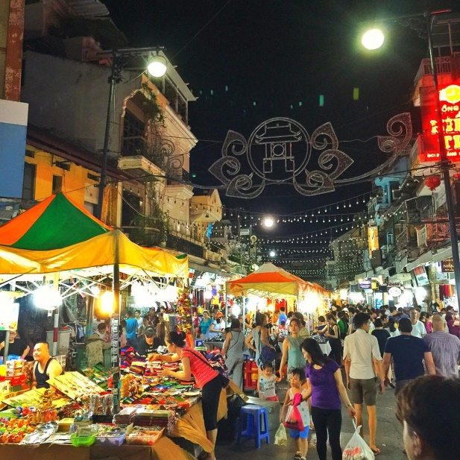
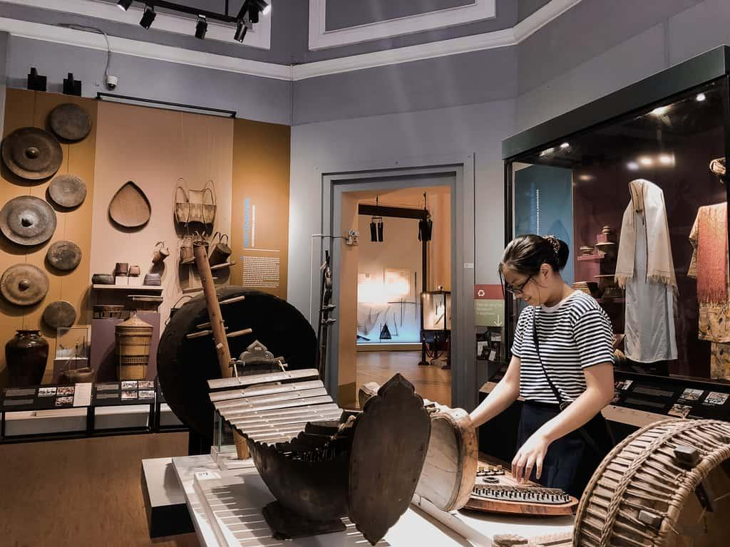
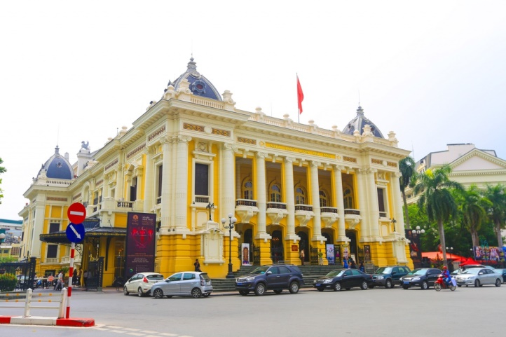
I/ GETTING STARTED
1/ Which place is it?
Hung Kings’ Temple
The Temple of Literature
Dong Xuan Market
History Museum
Night market
Hanoi Opera House

Slide 3
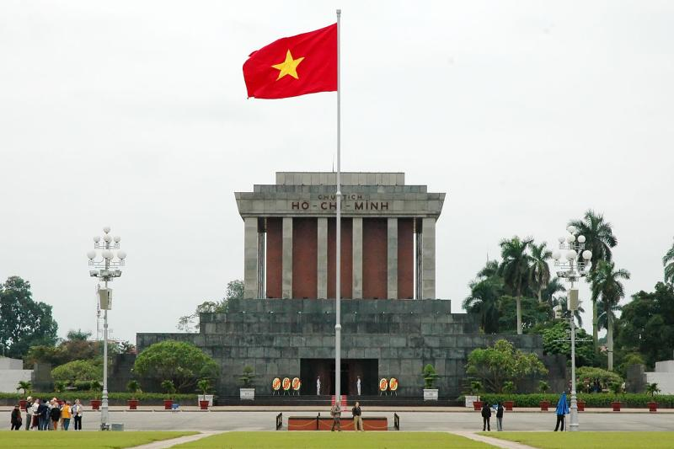
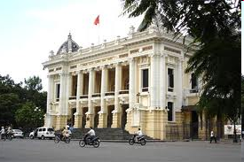
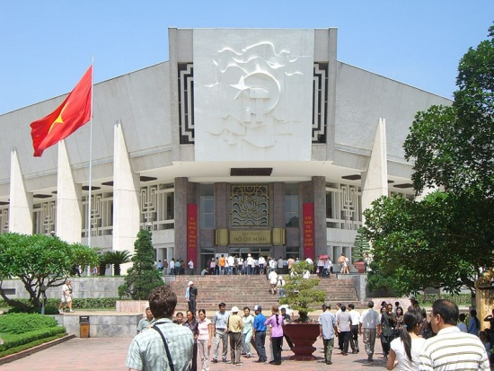
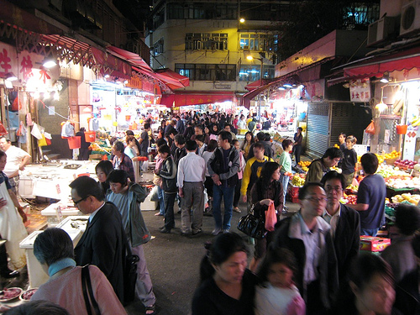
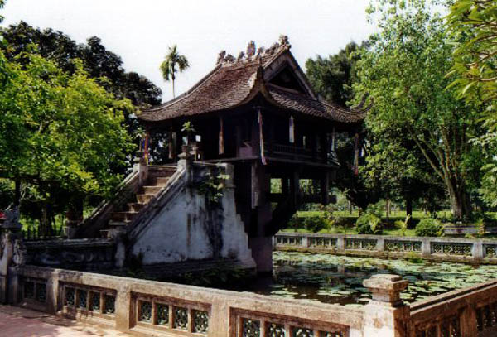
2/ You have a foreign pen pal. He (She) is coming to stay with you for a week. What activities would you do during the visit?
I think I would ..................

Slide 4
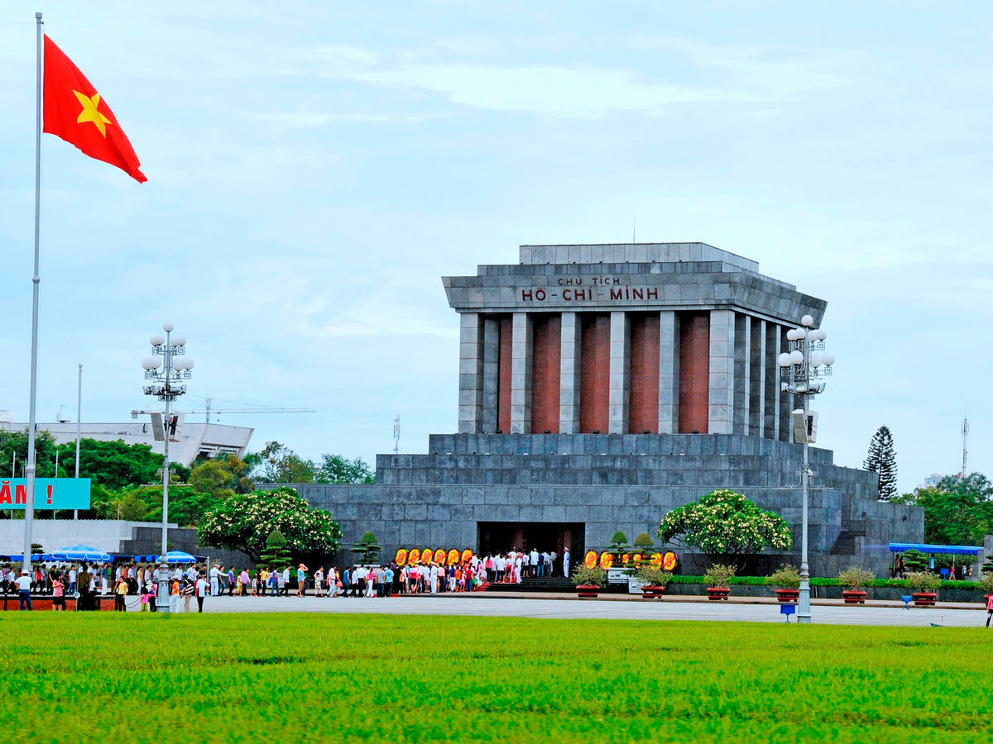
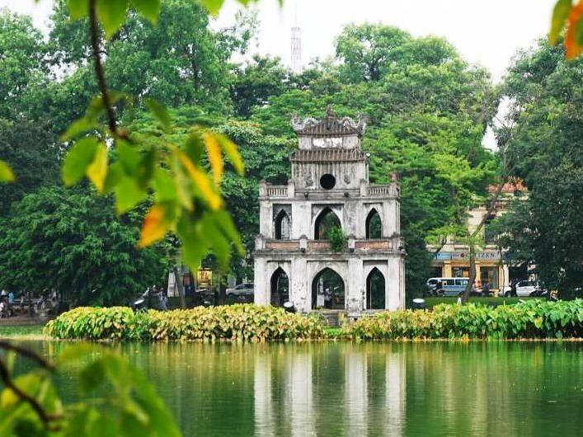
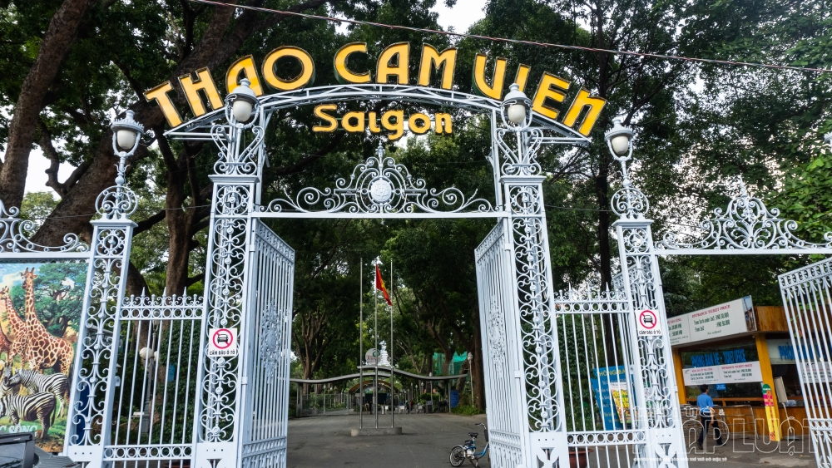
Ho Chi Minh Mausoleum
Dam Sen Water Park
Saigon Zoo
Hoan Kiem Lake

Slide 5
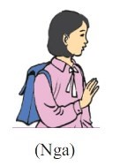
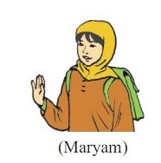
II/ LISTEN AND READ:

Slide 6
Lan’s Malaysian pen pal, Razali Maryam, was staying with Lan last week. Maryam is from Kuala Lumpur. Maryam and Lan have been pen pals for over two years and they correspond at least once every two weeks, but this was their first meeting.
On Maryam's first day in Ha Noi, Lan took her to Hoan Kiem Lake. Like Kuala Lumpur, Ha Noi is a busy modern city. Maryam was really impressed by the beauty of the city and by the friendliness of its people.
Over the next few days, the girls visited Ho Chi Minh's Mausoleum, the History Museum and the Temple of Literature, as well as many beautiful parks and lakes in Ha Noi. On Friday, Maryam wanted to visit the mosque on Hang Luoc Street. Lan used to walk past the mosque on her way to primary school. However, this was Lan’s first visit. She enjoyed the peaceful atmosphere while Maryam was praying.
“I wish you had a longer vacation,” Lan said to Maryam at the end of the week.
“Yes, I wish I had more time to get to know your beautiful country better. Lan, would you like to come and visit me next summer?” Maryam asked.
“That would be great! However, it seems very difficult for me to have a trip abroad. It all depends on my parents. Anyway, we’ll keep in touch.”

Slide 7
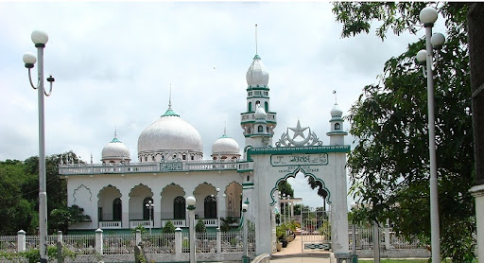
1. Vocabulary:
trao đổi thư
ấn tượng bởi
nhà thờ Hồi giáo
cầu nguyện
mong ước
sự thân thiện
tùy thuộc vào
không khí yên tĩnh
giữ liên lạc
- correspond (v):
- be impressed by:
- a mosque (n):
- pray (v):
- wish (v):
- friendliness (n):
- depend on (v)
- peaceful atmosphere:
- keep in touch:

Slide 8
2/ Grammar:
Example:
* The Wish sentence
1/ Lan is not here now.
Form:
→ Lan wishes she were here now.
S + wish(es) + S + V2/ed
2/ I don’t have a new laptop.
Note:
Be → Were
→ I wish I had a new laptop.
I/ You/ We/ They…+ wish
He/ She/ It… + wishes

Slide 9
T
Lan’s pen pal comes from Malaysia.
Kuala Lumpur is an old city.
The girls visited Hang Luoc Street on Monday.
They will write letter to each other again.
True or False?
F
F
T

Slide 10
Question: Where did Lan take Maryam to?
* Lan took Maryam to:
Hoan Kiem Lake;
Ho Chi Minh’s Mausoleum;
the History Museum;
the Temple of Literature;
many beautiful lakes and parks in Ha Noi;
the mosque on Hang Luoc Street.

Slide 11
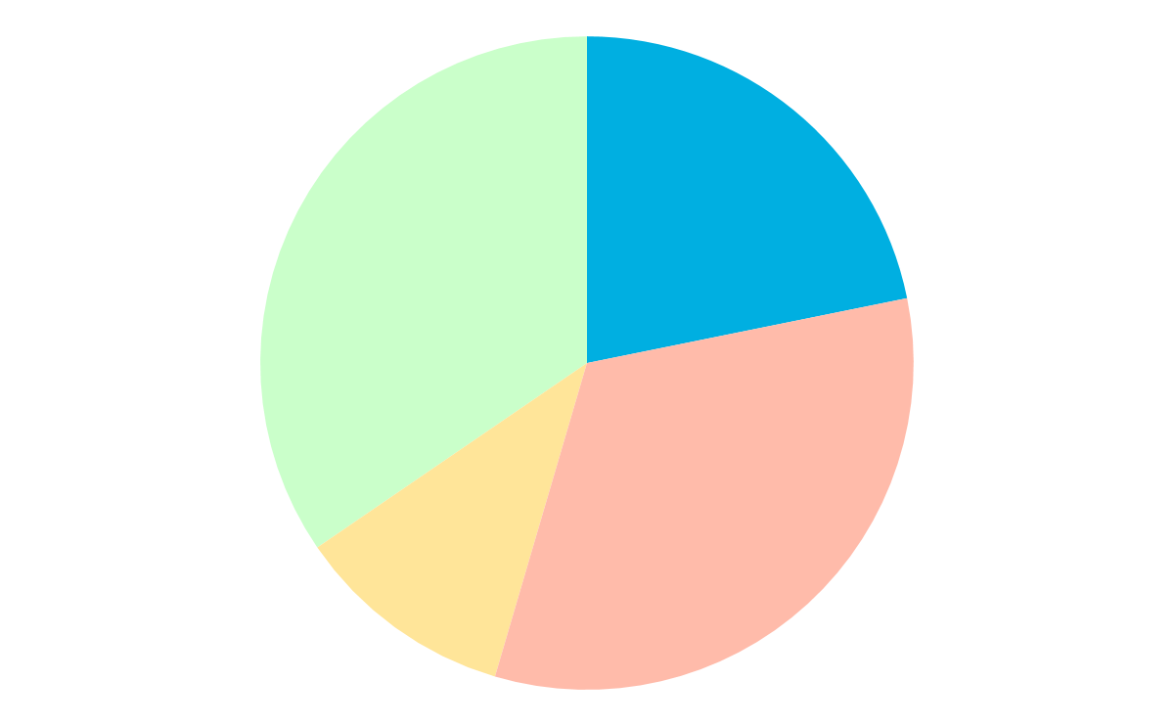
1. Lan and Maryam usually write to one another every…
Choose the correct option/ 7:
Two years
month
B
A
C
D
day
Two weeks

Slide 12
2. Maryam was impressed because…
C
A
Hanoi was different from Kuala Lumpur.
Hanoi was big and modern.
B
D
Hanoi people were friendly.
Hanoi and Kuala Lumpur were the same.

Slide 13
3. The girls went to see…
A
B
famous places in Hanoi.
areas for recreation
D
C
all the above.
a place of worship.

Slide 14
4. Maryam wanted to…
A
C
visit Hanoi the next summer.
stay in Hanoi.
B
D
invite Lan to Kuala Lumpur.
Visit Ho Chi Minh city.

Slide 15
* QUESTIONS:
Where is Maryam from?
2. How long have they been pen pals?
3. Were Hanoi and Kuala Lumpur different?
4. Did Maryam enjoy Hanoi? Why?
5. What did Lan say to Maryam at the end of the week?
→ Kuala Lumpur, Malaysia
→ For over 2 years.
→ No, they weren’t. They were the same.
→ Yes, she did. Because of people’s friendliness and beautiful places.
→ Lan said : “I wish you had a longer vacation”.

Slide 16
HOMEWORK
Learn the vocabulary and the wish sentences by heart.
Read the text again and answer the questions at home.
Prepare Speak & Listen (page 8).

