Slide 1


Welcome
All the teachers visiting
our class!

Slide 2

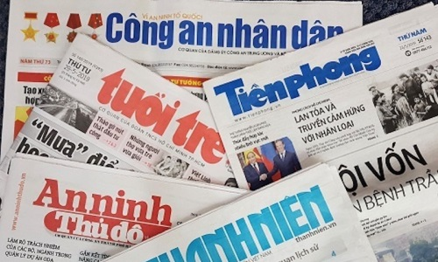
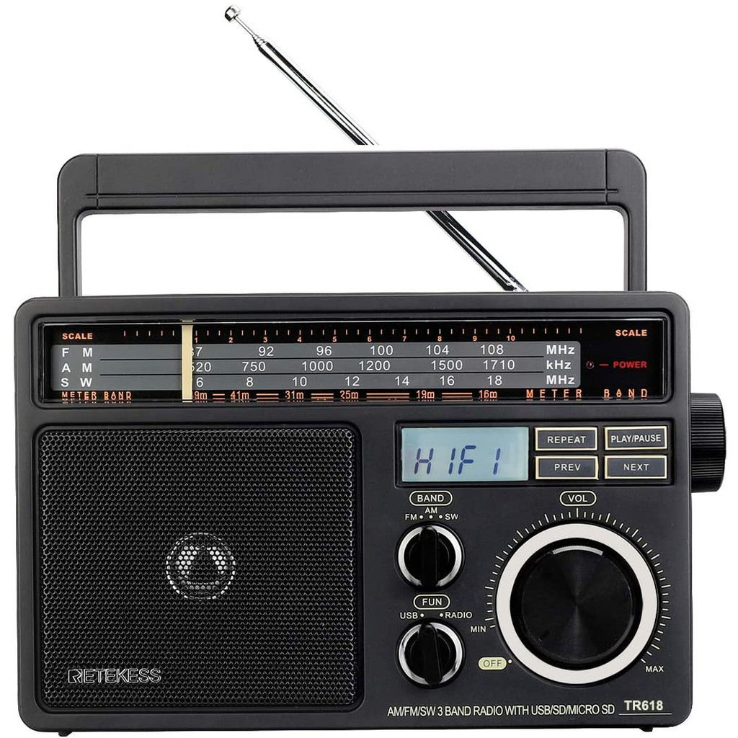


The
Media

Slide 3

UNIT 5: THE MEDIA
Listen and Read

Slide 4
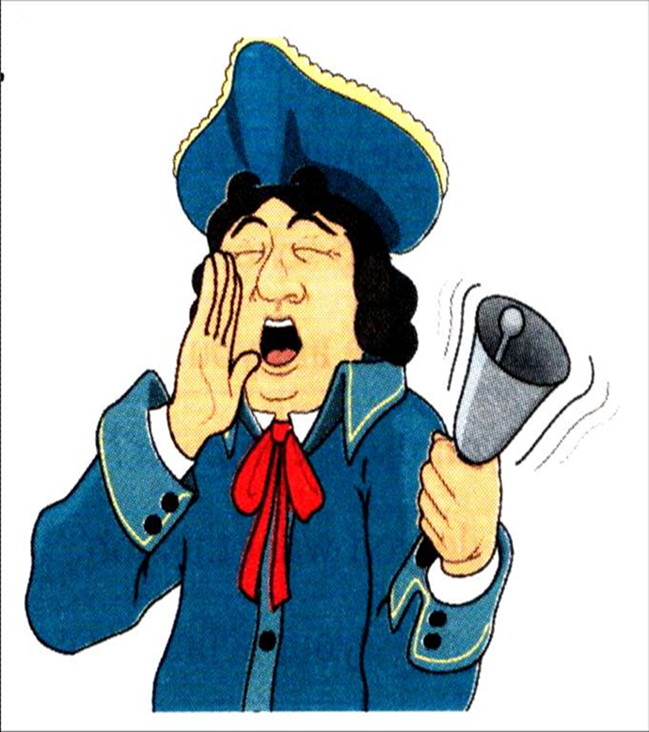
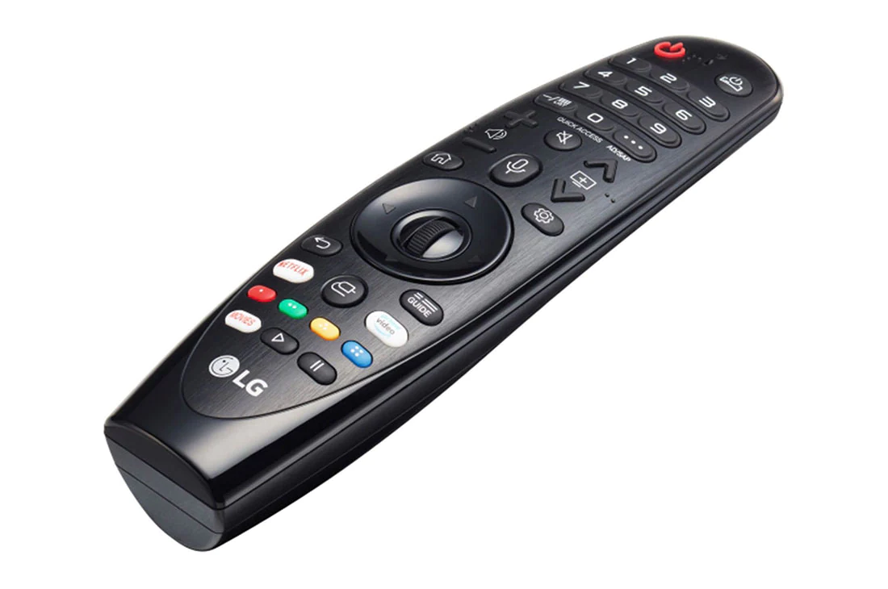
2. Listen and read
*Vocabulary:
crier (n) người rao tin tức
shout (v) kêu to, hét lên
variety (n) sự đa dạng
remote control (n) điều khiển từ xa
benefit (n) lợi ích
interactive (a) tương tác

Slide 5
MATCHING
1. crier
2. shout
3. variety
4. remote control
5. benefit
6. interactive
a. điều khiển từ xa
b. sự đa dạng
c. kêu to, hét lên
d. lợi ích, phúc lợi
e. tương tác
f. người rao tin tức

Slide 6
*Grammar: Gerund (V_ing)
Ex : People love reading newspapers and magazines.
love
enjoy
like
S +
+ V-ing
dislike
hate
- She / like / walk / to school.
She likes walking to school.
- We / enjoy / learn / English.
We enjoy learning English.

Slide 7


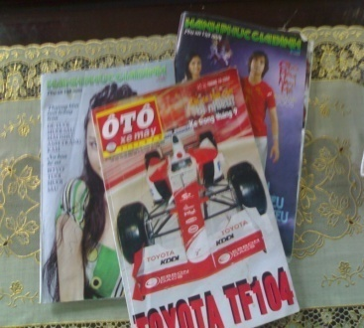
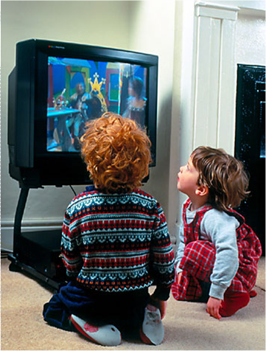
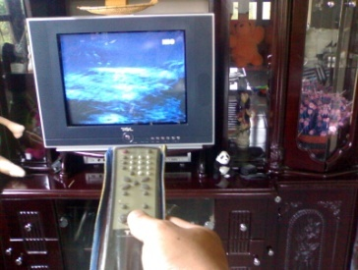
2. Listen and read.
A. Before newspapers were invented, town criers would go through city streets ringing a bell. They shouted the latest news as they were walking.
B. In Viet Nam people love reading newspapers and magazines. The Kien Thuc Ngay Nay is one of the most popular magazines and is widely read by both teenagers and adults.
C. Thanks to television people can get the latest information and enjoy interesting programs in an inexpensive and convenient way. Nowadays, viewers can watch a variety of local and international programs on different channels.
D. The next stage in the development of television is interactive TV. Viewers are able to ask questions about the show by using their remote controls.

Slide 8
a. Complete the table
FACTS & EVENTS | PASSAGE LETTER
1. Remote controls are used to interact with TV.
2. One of the most popular magazines.
3. People of different ages like this magazine.
4. Benefits of TV.
5. People got the news from town criers.
6. Interactive TV is available now.
D
B
B
C
A
D

Slide 9

1. What was a town crier?
A town crier was a person whose job was to go through city streets ringing a bell to shout the latest news as he was walking.
A town criers would go through city streets ringing a bell.
A town criers was a person who shouted the latest news as he was walking.
A

Slide 10

2. How popular is the Kien Thuc Ngay Nay?
A. The Kien Thuc Ngay Nay is the most popular magazines in Viet Nam.
B. The Kien Thuc Ngay Nay is one of the most popular magazines and is widely read by both teenagers and adults.
C. The Kien Thuc Ngay Nay is widely read in Viet Nam.
B

Slide 11
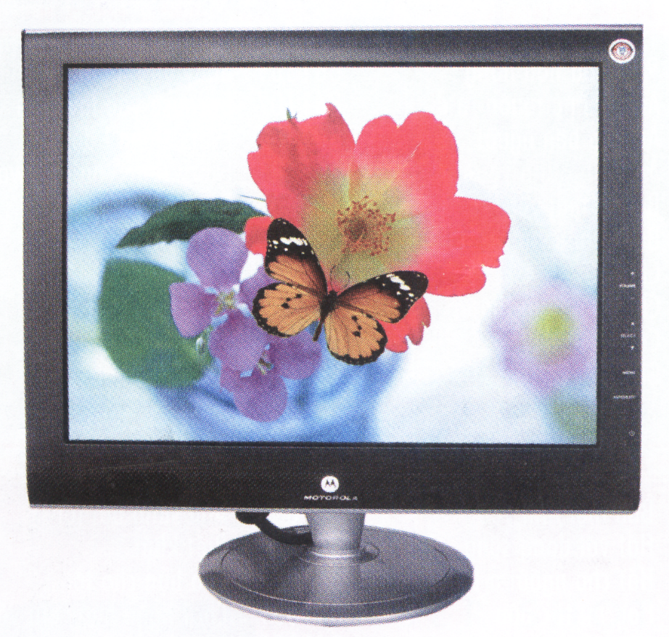
3. What benefits does TV bring about to people’s life?
A. People can get information and enjoy programs on TV.
B. People can enjoy interesting programs in an inexpensive and convenient way.
C. People can get the latest information and enjoy interesting and inexpensive local and international programs in a convenient way.
C

Slide 12

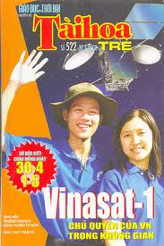


4. What kinds of magazines and newspapers do you read?
I often read ……

Slide 13
5. What is your favorite type of media? Why?
Ex: I like TV because it is inexpensive and convenient.
inexpensive
convenient
fast
provide more information.
news update

Slide 14
Fill in each blank with a suitable word from the box.
read
read
news
news
criers
criers
interactive
interactive
inexpensive
teenagers
about
inexpensive
teenagers
about
media
media
The newspapers , magazines , television , radios and internet are the .........(1)..... . Before the invention of newspapers, people got the news by listening to the town ........(2)... . They shouted the latest ...(3)…. while they were walking on the city streets. Television is an.. …...(4)...... ………and convenient way to get the latest information . With ........(5)...........TV , viewers are able to ask questions ...(6)......... the show using their remote controls . In Vietnam the kien Thuc Ngay Nay is widely .......(7)... .by both …....(8)... ….. and adults .

Slide 15

Homework
- Learn by heart new words.
Rewrite the answers of task b on notebook.
- Prepare: Listen on page 43.

