Slide 1



Slide 2



LESSON 2
GRAMMAR

Slide 3
WARM-UP
Work in pair. brain storm some types of film you remember in the previous lesson.
KINDS OF FILM

Slide 4
GRAMMAR
PREPOSITIONS OF TIME
Giới từ chỉ thời gian

Slide 5



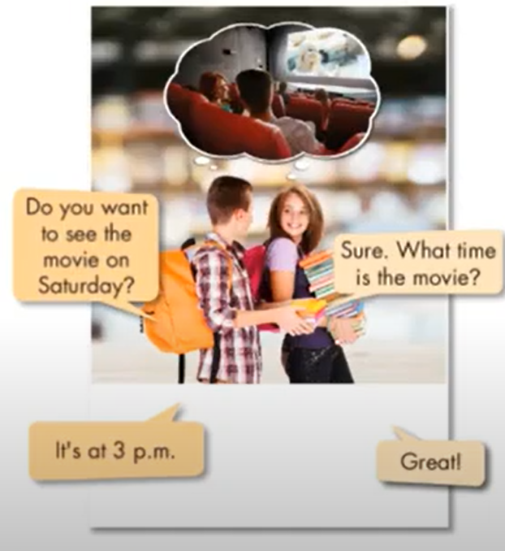
a. Listen and repeat.
We use prepostions of time to say when things happen.
Use on with days, dates
Use at with specific times
Use in with periods of time
Do you want to see the movie on Saturday?
The movie is on Saturday.
Do you want to see a movie on March 6?
What time is the movie?
The movie is at 3:p.m
I watch a lot of movies in the winter.
Sure. What time is the movie?
It’s at 3 p.m
Great

Slide 6
IN
ON
at
Part of the day ( buổi)
Days ( thứ)
Time ( giờ)
In the morning , in the afternoon, in the evening
At 6 o’clock , at 10:30 p.m
Months ( tháng)
On Monday , on Sundays
In January , in May , in December…..
Date ( ngày)
Meals ( bữa ăn)
Seasons ( mùa)
at breakfast , at lunch , at dinner
On 15th Monday , on Tuesday 2nd
In summer, in spring, in winter, in autumn /fall.
Holidays ( kỳ nghỉ)
Parts of special day
Year ( năm)
at Christmas , at Easter , ….
In 2021 , in 2000
on Monday morning, on Tuesday afternoon.
Phrases ( cụm từ)
Decade, century( thế kỷ, thập kỷ)
At night , at midnight , at the moment, at the weekend, at the same time, at present…
In the 80s, in the 20 century.

Slide 7
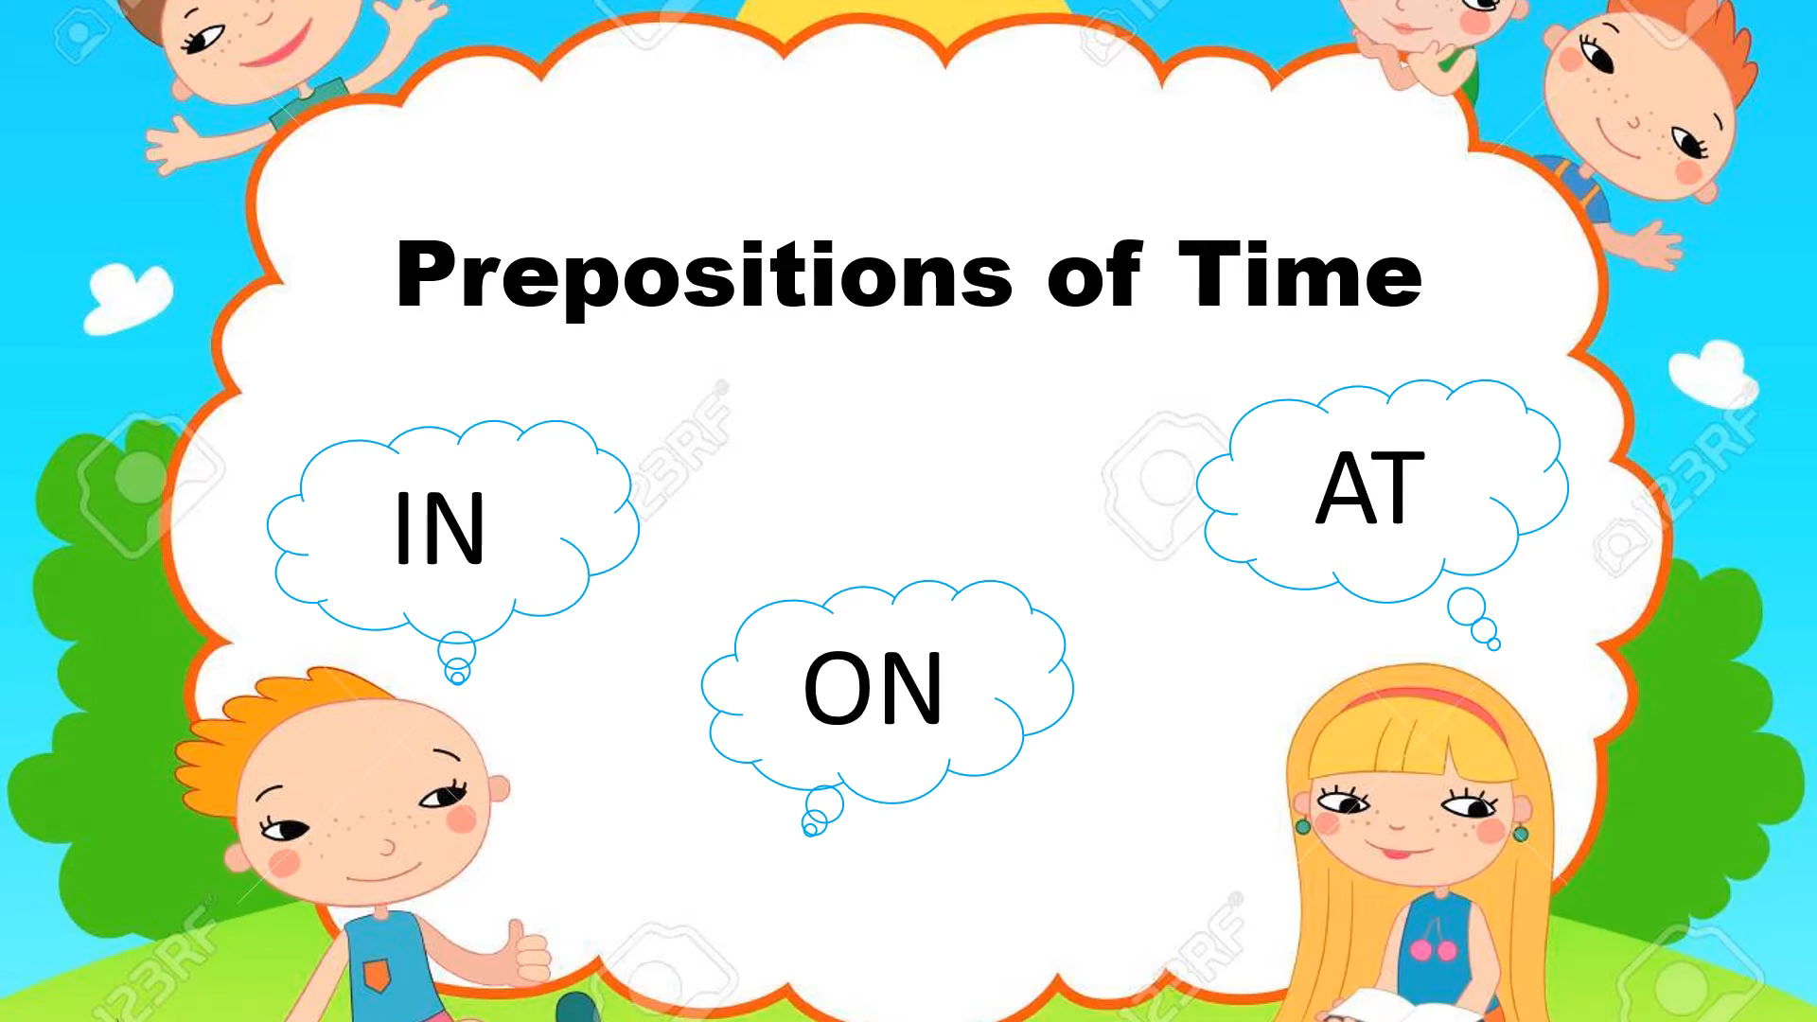
Watch the video and see some examples of prepositions of time.

Slide 8
b. Write the time words in the correct box.
  Saturday 6: 30 the summer Christmas Day
  Tuesday night bedtime the evening July 27th
  my birthday the morning three o’clock May
on | at | in
Saturday
three o’clock
the morning
my birthday
6:30
the evening
Christmas Day
the summer
bedtime
Tuesday night
May
July 27th

Slide 9
c. Fill in the blanks.
I am going to see a movie _______________________(Saturday/4 p.m)
I like to watch TV and play games ______________________( evening)
I am playing soccer ______________( 2 p.m)
What are you doing _________________________( Sunday/10 a.m)
What do you like to do______________________( summer)?
My English lesson is ____________________________( 10:30/morning).
at 4 p.m on Saturday
in the evening
at 2 p.m
at 10 a.m on Sunday
in the summer
at 10:30 in the morning

Slide 10
d. Now, with your partner, ask and answer about what you are doing at different times.
  I am doing homework in the morning. I am watching a movie at 4 p.m
What are you doing on Saturday?
tonight
at the weekend
What are you doing.....?
on next Monday

Slide 11
WRAP-UP

Slide 12
Unit 7
MOVIE
Lesson 2: Grammar
Prepositions of time : giới từ chỉ thời gian
In + buổi trong ngày/tháng/năm/thế kỷ/thập kỷ
  On + ngày
  At + giờ cụ thể
  At + cụm từ ( at the moment, at present, at the same time, at lunch, at noon, at midnight, at night, at the weekend)

Slide 13
GAME
Divide the class into two teams to turn the words and say prepositions of time goes before the words. If anyone gives the correct answer , the team will get the point behind the words.

Slide 14





January
b
c
d
e
a
Monday
7 o’clock
summer
night
f
g
h
i
k
the afternoon
lunch
September
the moment
Sunday morning
Ms Phương
Zalo: 0966765064
l
m
n
o
p
the morning
2021
Christmas
my birthday
9:10 a.m
q
r
s
t
u
winter
Sundays
the evening
2nd November
the weekend

Slide 15
HOMEWORK
- Learn the usages of: on/ in/ at.
- Do exercises on page 39 in the workbook.
+ Fill in the blanks with the correct prepositions.
+ Writing. Answer the questions using your ideas or the given information.
- New lesson: Pronunciation/ Practice/ Speaking on page 56.

