Slide 2
LESSON 5
GRAMMAR

Slide 3
WARM- UP

Slide 4
Ask student to make a sentence with an adjective. For example :
“I think horror is terrible”.

Slide 5
GRAMMAR
Ms Phương
Zalo: 0966765064
Past simple “ tobe”

Slide 6
Today
Yesterday
I am at home today.
I was at home yesterday.
Tom is at school today.
Tom was at school yesterday.
We are on the beach to day
We were on the beach to day
Present “ tobe” : am,is,are
Past simple “ tobe” : was,were

Slide 7
STRUCTURE
 | Positive(+) | Negative (-) | ..............
I
He
was
wasn’t
She
It
We
You
were
weren’t
They
Question(?) : ( WH) + Was / Were + S + ………?

Slide 8
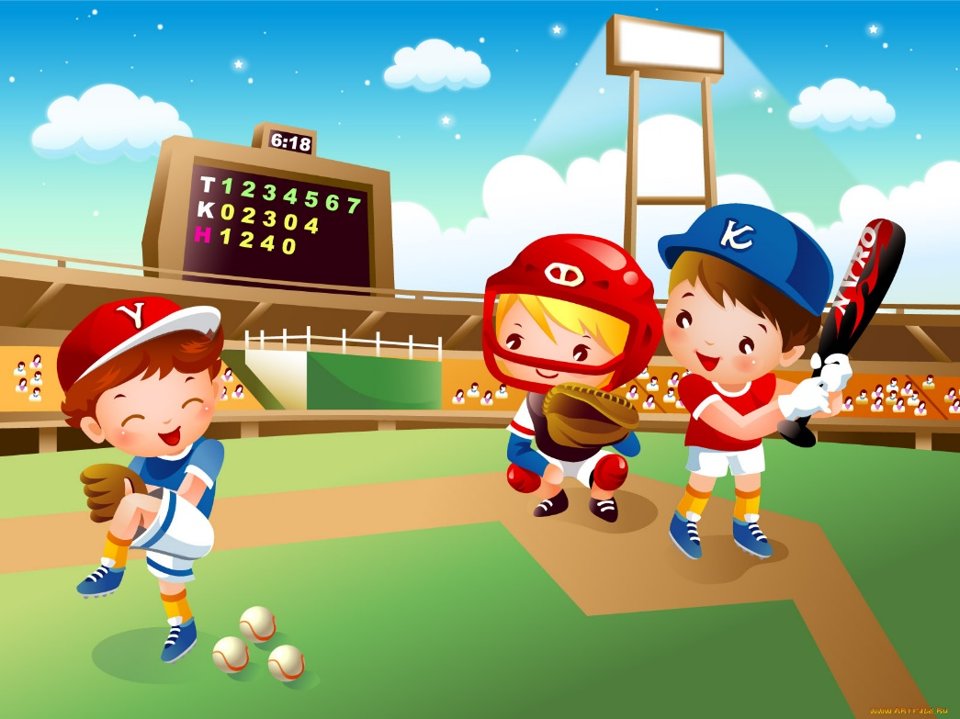
WAS/WERE
Look at the picture and say true sentences.
Example:
Where was Tim yesterday?
Ms Phương
Zalo: 0966765064
Tim
He wasn’t at the library.
He was at the stadium.
Tim was at the library.

Slide 9
Look at the picture and say true sentences.
Where was Mark yesterday?
Mark
He wasn’t at the cinema.
Ms Phương
Zalo: 0966765064
He was at school.
check
Mark was at the cinema.

Slide 10
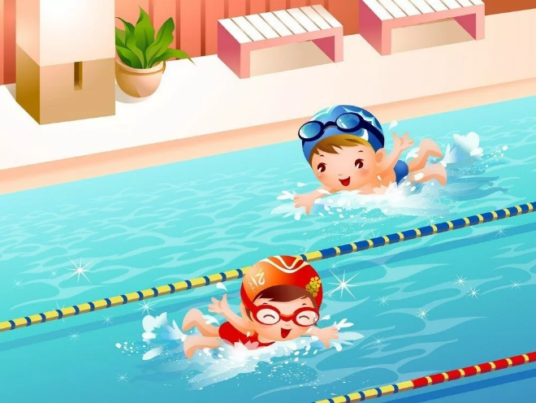
Look at the picture and say true sentences.
Where was Jane yesterday?
She wasn’t at home.
Ms Phương
Zalo: 0966765064
She was at the swimming pool.
Jane
check
Jane was at home.

Slide 11
Look at the picture and say true sentences.
Where were the children yesterday?
They were at the library.
Ms Phương
Zalo: 0966765064
They weren’t at the museum.
The children were at the museum.
check

Slide 12
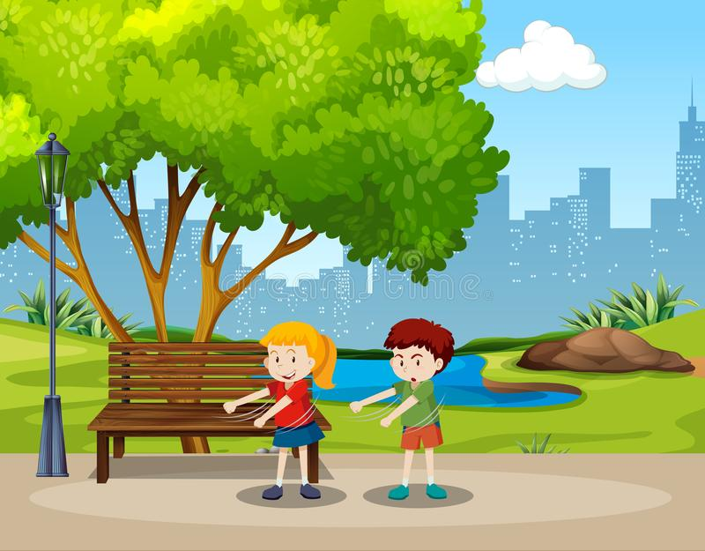
Look at the picture and say true sentences.
Where were Kate and Tom yesterday?
They were in the park.
Ms Phương
Zalo: 0966765064
Kate Tom
They weren’t at the library.
Kate and Tom were at the library.
check

Slide 13
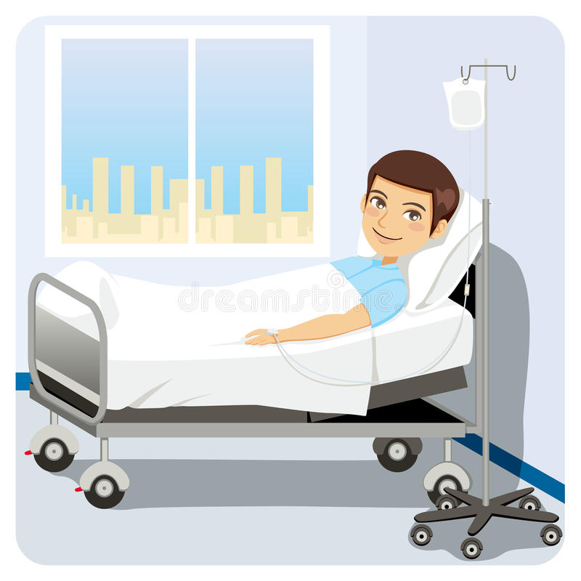
Look at the picture and say true sentences.
Where was Mike yesterday?
He was in hospital.
Mike
Ms Phương
Zalo: 0966765064
He wasn’t at the cafe.
Mike was at the cafe.
check

Slide 14
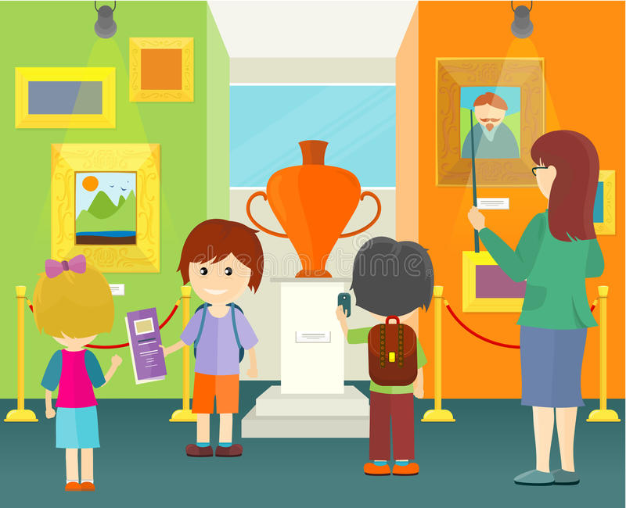
Look at the picture and say true sentences.
Where was Ann yesterday?
She was at the museum.
Ms Phương
Zalo: 0966765064
Ann
She wasn’t at school.
Ann was at school.
check

Slide 15
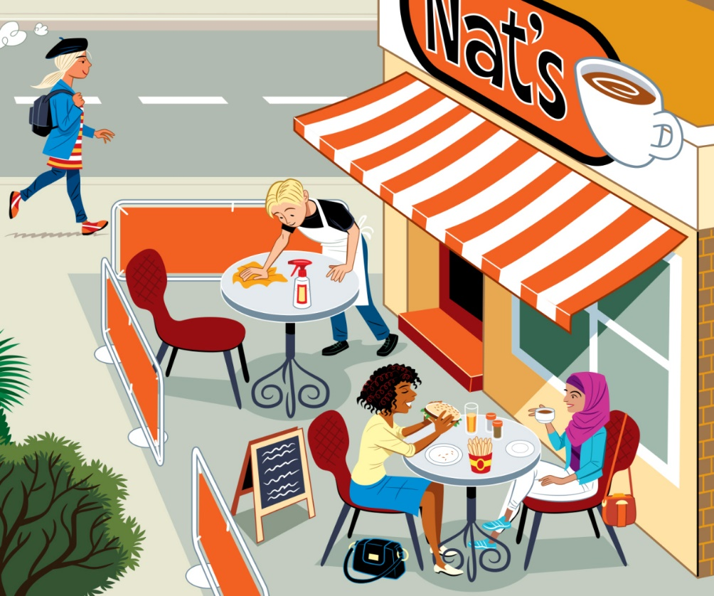
Look at the picture and say true sentences.
Where was Lucas yesterday?
1. He was at the cafe.
Ms Phương
Zalo: 0966765064
Lucas
2. He wasn’t in hospital.
Lucas was in hospital.
check

Slide 16
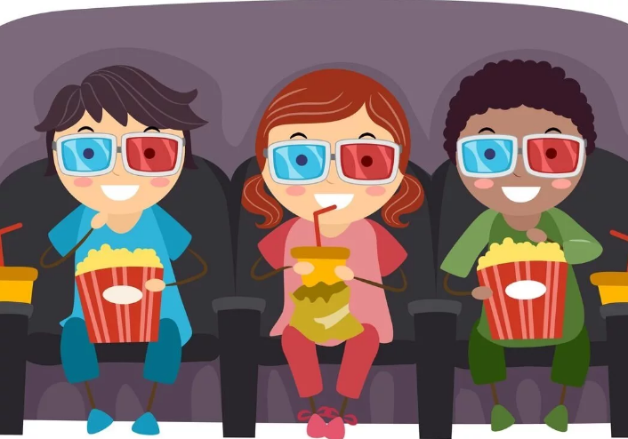
Look at the picture and say true sentences.
Where were Lucy and John yesterday?
Lucy John
1. They were at the cinema.
Ms Phương
Zalo: 0966765064
2. They weren’t at the restaurant.
Lucy and John were at the restaurant.
check

Slide 17
a. Listen and repeat.
We use the Past Simple to talk about completed events, states, or actions.
I watched a horror movie last night.
I
was
He/She/ It
wasn’t ( was not)
Ms Phương
Zalo: 0966765064
You
were
What was it?
We
weren’t ( were not)
They
What was the movie? It was Great Day
Was it good? Yes, it was / No, it wasn’t
How was the movie? It was terrible.
Where were they?They were in the movie theater
Were they happy? Yes, they were/ No, they weren’t
What time were the movies on? They were on at 6 p.m and 10 p.m
The Long Night
Was it good?
Yes, it was fantastic

Slide 18
b. Circle the correct verbs.
I love the movie. It was/wasn’t fantastic.
What was/were it?
The movie was/wasn’t really exciting. you should go and see it.
Where was/were you yesterday?
Was/Were they at the movie theater?
What time was/were it on?
Ms Phương
Zalo: 0966765064

Slide 19
c. Look at the table and complete the dialogue.
Sid: What was the the movie you saw?
Ann: It was The Great Bananas
Sid: Was it good?
Ann: 2. __________________________________
Sid: What time was it on?
Ann: 3.____________________________________
Sid: What was the movie you saw last week?
Ann: 4______________________________________
Sid: How were they?
Ann: 5________________________________
Sid: What time were they on?
Ann: 6_____________________________________
The Great Bananas
Ms Phương
Zalo: 0966765064
very funny
Yes, it was very funny.
4:45
It was on at 4:45
Time 7 and Earthlife
They were Time 7 and Earthlife
exciting
They were exciting.
7:30 and 9 p.m
They were on at 7:30 and 9 p.m

Slide 20
Last night, Greg, Anna and Emma(1) _____at the cinema with Anna’s dad. - After the film at Anna’s house. - Hello! (2)_____you at the shopping center? - No, we (3)______. - We were at the cinema. - Was the film (4) _________? - Yes, it was really (5)___________. - It’s was (6)_____________. - No, it wasn’t. It was scary. - Uhm, That was delicious. - Anna, the film (7)______ delicious. - Umm, No, the popcorn was. - Anna was (8) ______________
Listen and fill in the blanks.
was
Were
weren’t
good
funny
boring
was
hungry

Slide 21
Ms Phương
Zalo: 0966765064

Slide 22
Ms Phương
Zalo: 0966765064
WARP-UP

Slide 23
Unit 7
MOVIE
Lesson 5: GRAMMAR
Thì quá khứ với động từ tobe “ was, were”
Ms Phương
Zalo: 0966765064
Loại câu | Câu khẳng định (+) | Câu phủ định (-) | Câu nghi vấn (?)
Cấu trúc | S + was / were + N/adj | S + was / were + not + N/adj | (Wh) was / were + S + N/adj?
Ví dụ | It was rainy yesterday. | It was not rainy yesterday. | Was it rainy yesterday?
Dấu hiệu nhận biết
Thì quá khứ đơn có những dấu hiệu nhận biết thông qua cáctrạng từ chỉ thời gian như: yesterday, last year/ month/ week … , ago, in + mốc thời gian trong quá khứ …

Slide 24
Extra practice: Choose “ was or were.

Slide 25
HOMEWORK
- Prepare for the new lesson on page 59
- Do the Listening and Grammar exercises on page 41 in the workbook

