Slide 1



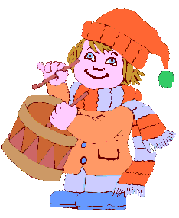


Welcome to
our class

Slide 2

Kim’s game

Slide 3
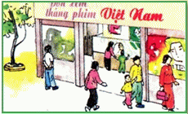
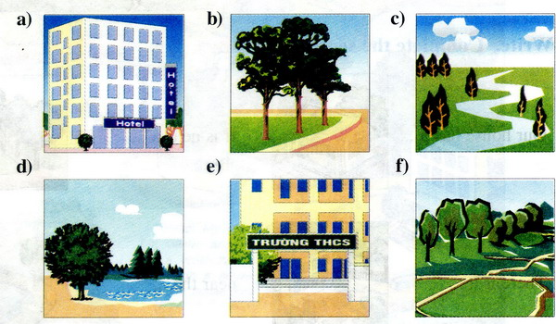
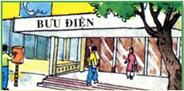
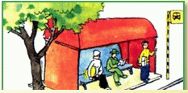
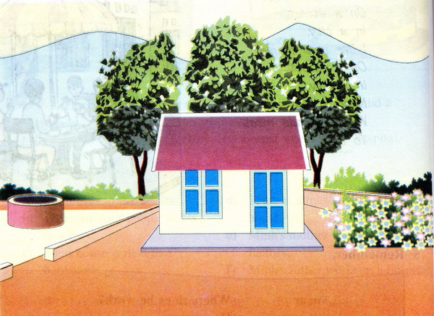
Kim’s game
6
11
3
14
12
Start
15
13
8
10
7
2
5
4
9
1

Slide 4
Time up !
Kim’s game
1
4
8
0
2
9
7
6
3
5
10

Slide 5
Kim’s game

Slide 6
Friday, October 26th, 2012
Unit 1: BACK TO SCHOOL
B. Names and addresses(4,5)
B4. Listen. Then practice with a partner.

Slide 7

B4. Listen. Then practice with a partner.
Nam: Where do you live?
Hoa: I live at 12 Tran Hung Dao Street.
Nam: How far is it from your house to school?
Hoa: It’s not far- about one kilometer.
Nam: How do you go to school?
Hoa: I go to school by bike.

Slide 8
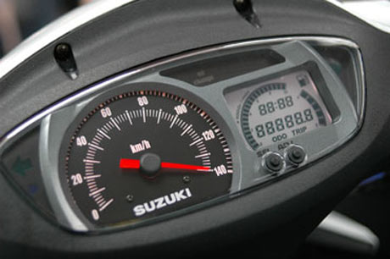
Friday, October 26th, 2012
Unit 1: BACK TO SCHOOL
B. Names and addresses(4,5)
B4. Listen. Then practice with a partner.
Vocabulary
How far:
meter:
kilometer:
* How far?

Slide 9

How far?
?
2 kilometers = meters
3.5 kilometers = meters
1500 meters = kilometers
3000 meters = kilometers
2000
?
3500
?
1.5
?
3

Slide 10

Practice
the dialogue

Slide 11
Friday, October 26th, 2012
Unit 1: BACK TO SCHOOL
B. Names and addresses(4,5)
B4. Listen. Then practice with a partner.
Vocabulary
How far:
meter:
kilometer:
* Practice with a partner
B5. Ask and answer with a partner.
Structure:
How far is it from your house to school?
It’s about 1 kilometer.

Slide 12

Chain game
How far is it from your house to school?
It’s about 1 kilometer.
500 meters.
100 meters.

Slide 13
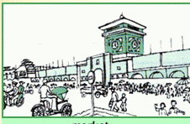
Ask and answer

Slide 14
Survey:
… from your house to ...
Name | How far | How
Nam
2 kilometers
by bike

Slide 15

Make a dialogue

Slide 16
Nam: Where do you live?
Hoa: I live at 12 Tran Hung Dao Street.
Nam: How far is it from your house to school?
Hoa: It’s not far- about one kilometer.
Nam: How do you go to school?
Hoa: I go to school by bike.

Slide 17

Good bye!
Thank you

