Slide 1
WELCOME
UNIT 1: BACK TO SCHOOL
A. Friends

Slide 2
A1. Listen and practice with partners:
Ba : Hello, Nga.
Nga : Hi,Ba. Nice to meet you again.
Ba : Nice to see you,too.
Nga : This is our new classmate. Her’s name Hoa.
Ba : Nice to meet you, Hoa.
Hoa : Nice to meet you, too.

Slide 3
Now answer :
A, What is the new girl’s name?
→ Her’s name is Hoa.
B, What class is she in?
→ She’s in class 7A.
C, Who is also in class 7A?
→ Nam is also in class 7A.

Slide 4
 Structure:
Nice to meet you.
Nice to see you.
Nice to meet you, too.
Nice to see you, too.

Slide 5
Example:
1, Long likes apples.
So do I.
2, I’m study in class 7A1. ( Lan )
So is Lan.
3, Upin likes listen to hip-hop music. ( Ipin)
So does Upin.

Slide 6
So am I = Me, too
So + be / trợ ĐT + S
Dùng để diễn tả câu nói mang nghĩa “ ai đó cũng vậy”. Tránh nhắc lại câu nói vừa nói của người đang đối thoại.

Slide 7
A2. Read:
 Answer the questions:
A, Where is Hoa from?
B,Who is she staying with?
C,Does Hoa have a lot of friends in Ha Noi?
D,How is her new school different from her old school?
E,Why is Hoa unhappy?

Slide 8
A, Hoa is from Hue.
B, She is staying with her uncle and aunt in Ha Noi.
C, No, she doesn’t.
D, Her new school is bigger than her old school.
E, Because she misses her parents and her friends.

Slide 9
A3. Listen and practice with a partner.
A4.Listen. Complete these dialogues:
How are you today?
How are you?
How is everything?
How about you?
So am I.
Me, too.
Just fine. (Cũng ổn )
Not bad. (Không tệ lắm)
Pretty good. ( Cũng tốt lắm)
OK. ( Ổn mà)

Slide 10
A,
How are you
Mr.Tan : Hello, Lien. …………...................?
Miss Lien: ………………..,thank you.
........................….., Tan?
Mr.Tan : ……………….., but I’m very busy.
Miss Lien: ….......... …………
Pretty good
How about you
Not bad
Me, too

Slide 11
B,
Nam : Good afternoon, Nga.
………………………………..?
Nga : ………., thanks. ……………………………, Nam?
Nam : ………………………, thanks.
Nga : I’m going to the lunch room.
Nam : Yes. …………….
How is everything?
Ok
How are you today
Just fine
So am I

Slide 12
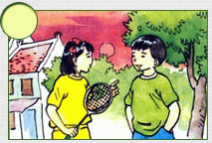
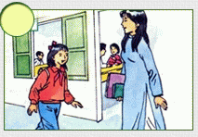
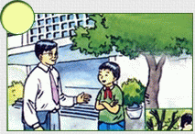
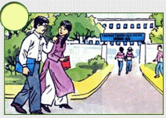
A5, Listen:
4
2
1
3

Slide 13
 Remember:
I’m in class 7A.
So am I.
A lot of
Lots of
Many
(n) Đếm được số nhiều
She has a lot of friends.

