Slide 1

WELCOME ALL PARENTS AND STUDENTS

Slide 2


INTRODUCE CHU VAN AN
SECONDARY SCHOOL

Slide 3


CHU VAN AN
CHU VAN AN
SECONDARY SCSHOOL
2019-2020
Welcome to our home
It is not a normal school which is our home
SECONDARY SCHOOL
CHU VAN AN

Slide 4
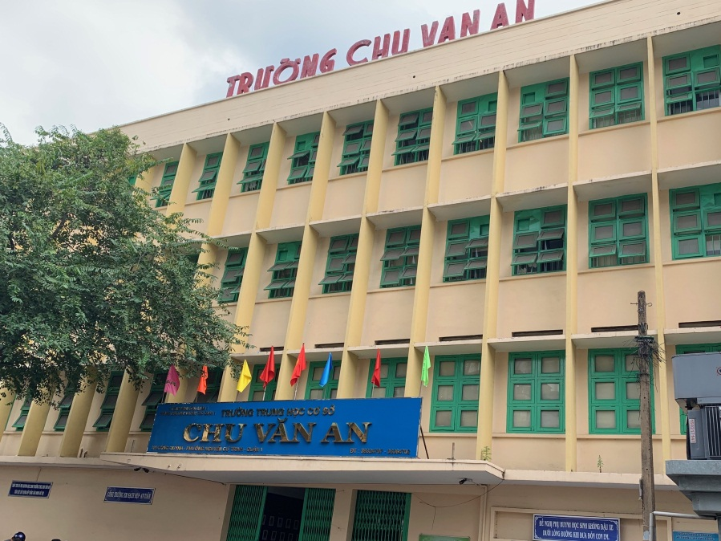

CHU VAN AN

Slide 5
CHU VAN AN
CHU VAN AN
About our school
SECONDARY SCSHOOL
CHU VAN AN
SECONDARY SCHOOL

Slide 6
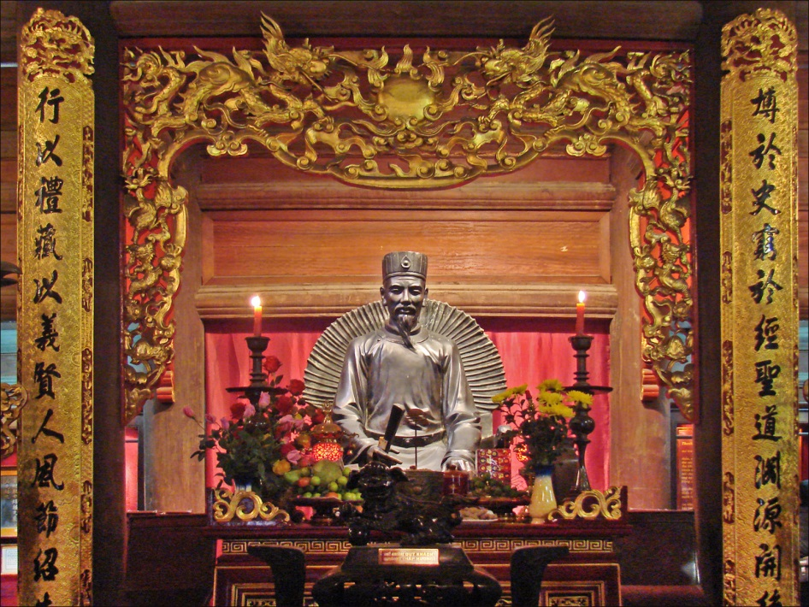

Founded in 1959 by
a national hero Hung Dao
After 1978 till now it has been changed name by a teacher Chu Van An
Chu Van An secondary school is located at
115 Cong Quynh Street, Nguyen Cu Trinh ward, Dist. 1-Ho Chi Minh city
60 years of development
Managed by the head of district 1 committee

Slide 7

WHO IS CHU VAN AN?
Chu Van An was born in 1292 and died in 1370.
He became a mandarin of the Tran Dynasty. He was very famous from an early age as an upright person, fixed himself cleanly, kept secret, did not seek fame and fortune. He stayed at home and taught himself by reading books and opened school in his village.
King Tran Minh Tong invited him to teach the prince. Chu Van An bravely offered "Seven dead whites" to slay the seven flattering men, all of whom were loved by the king. But the king did not listen. He returned the coat, from the mandarin to his hometown and died at home. Until now, there are many historic monuments in the country honoring him. It can be affirmed that Chu Van An has passed the threshold of being a good teach of one generation to become the teacher of all generations.
Nowadays, many schools was named after Chu Văn An in our country. We are proud of being students in Chu Van An secondary school.

Slide 8
CHU VAN AN
CHU VAN AN
Organization of the school
SECONDARY SCSHOOL
CHU VAN AN
SECONDARY SCHOOL

Slide 9
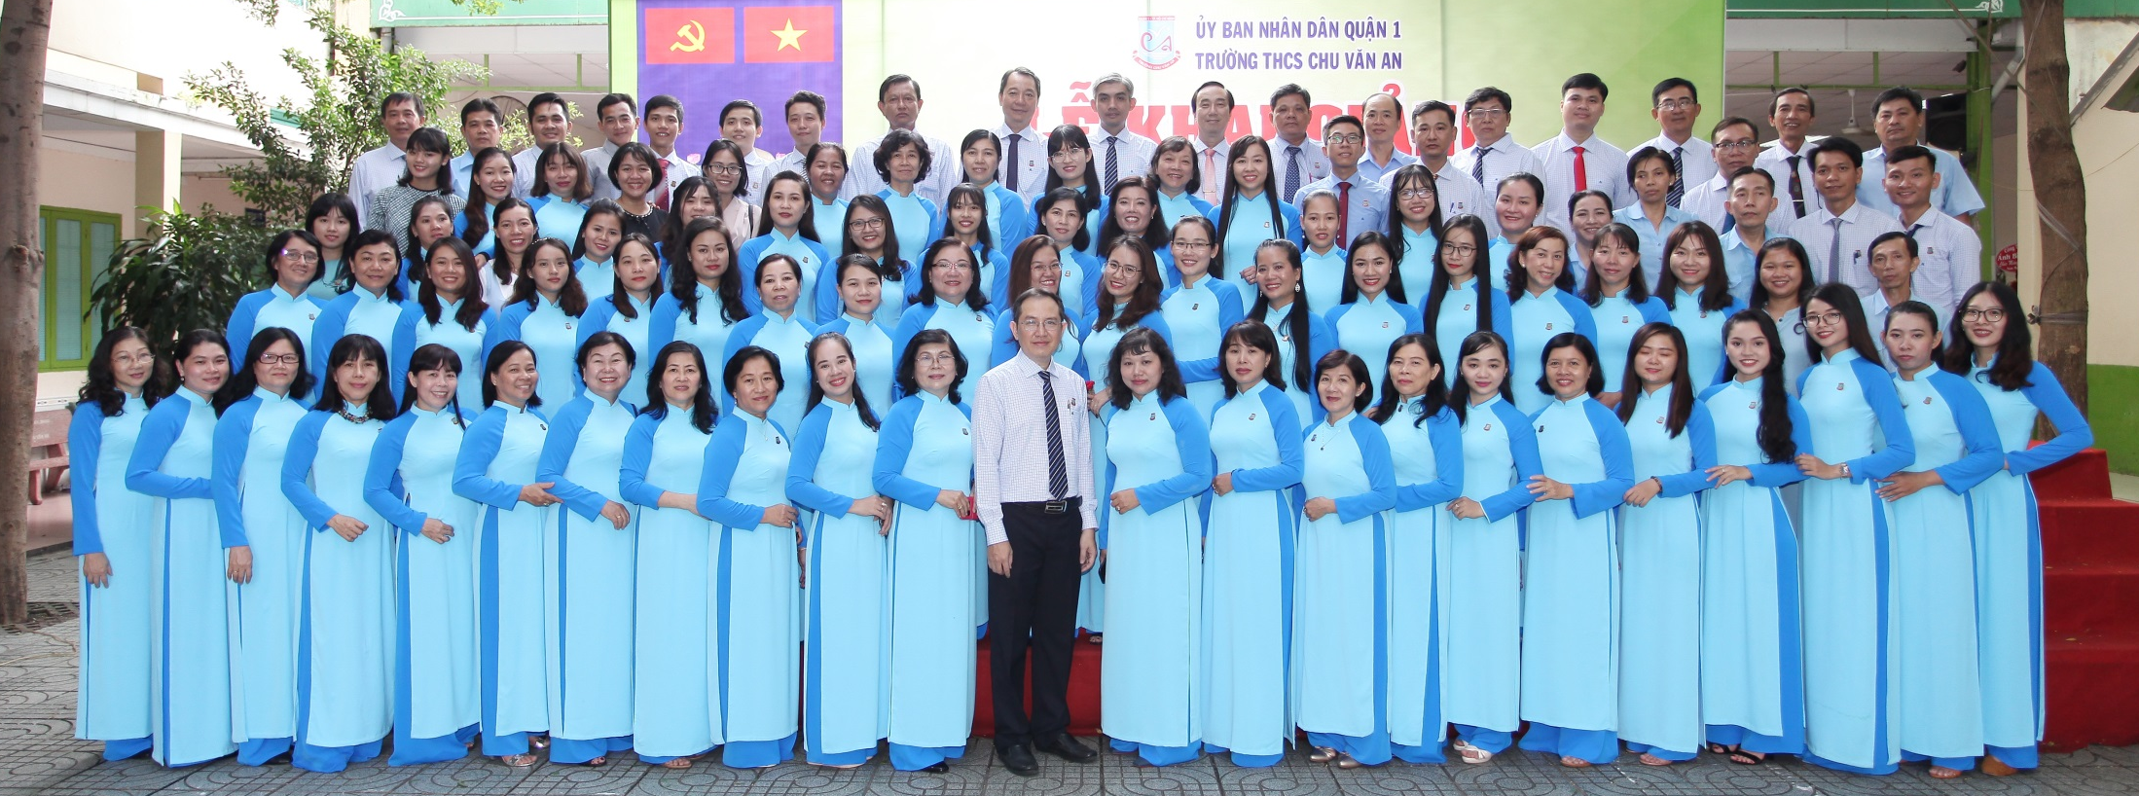
Including 3 managers: a principal, 2 vice principals,
52 teachers and 12 employees
All teachers are well – qualified

Slide 10
CHU VAN AN
CHU VAN AN
School facilities
SECONDARY SCSHOOL
CHU VAN AN
SECONDARY SCHOOL

Slide 11
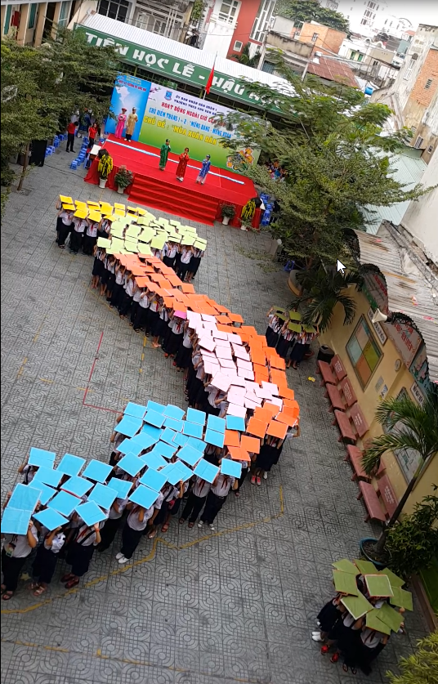
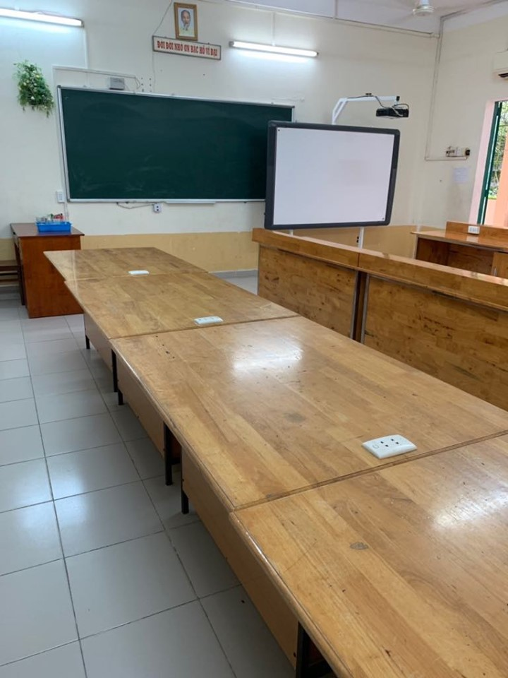
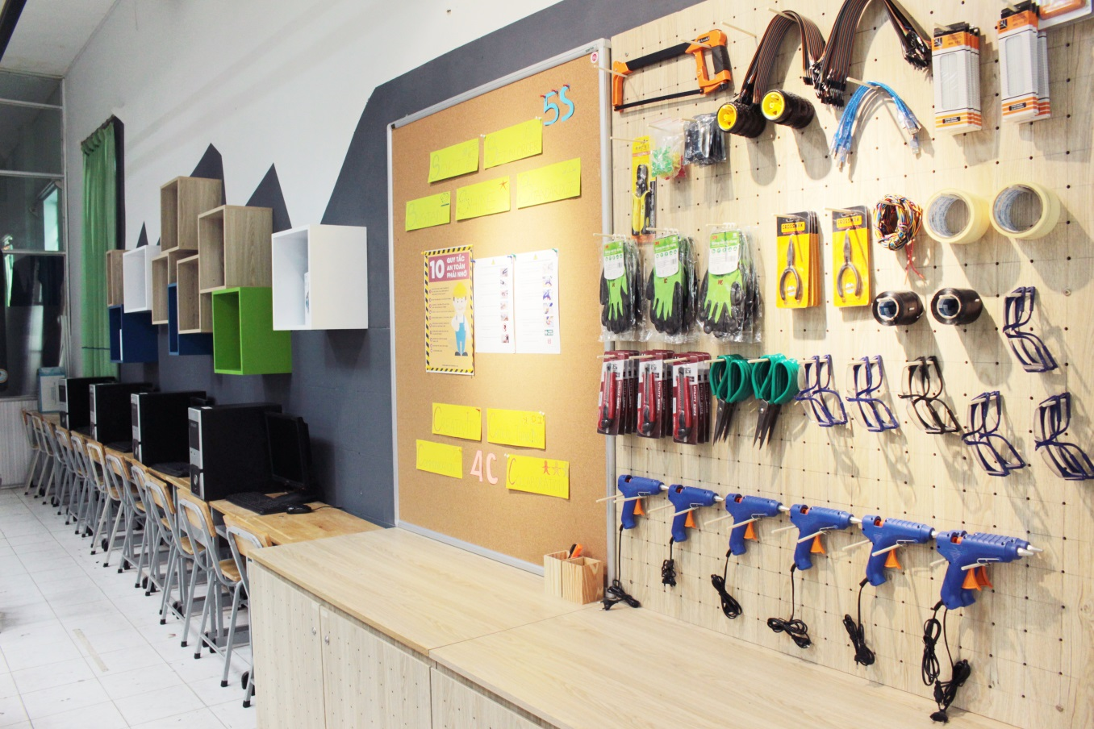
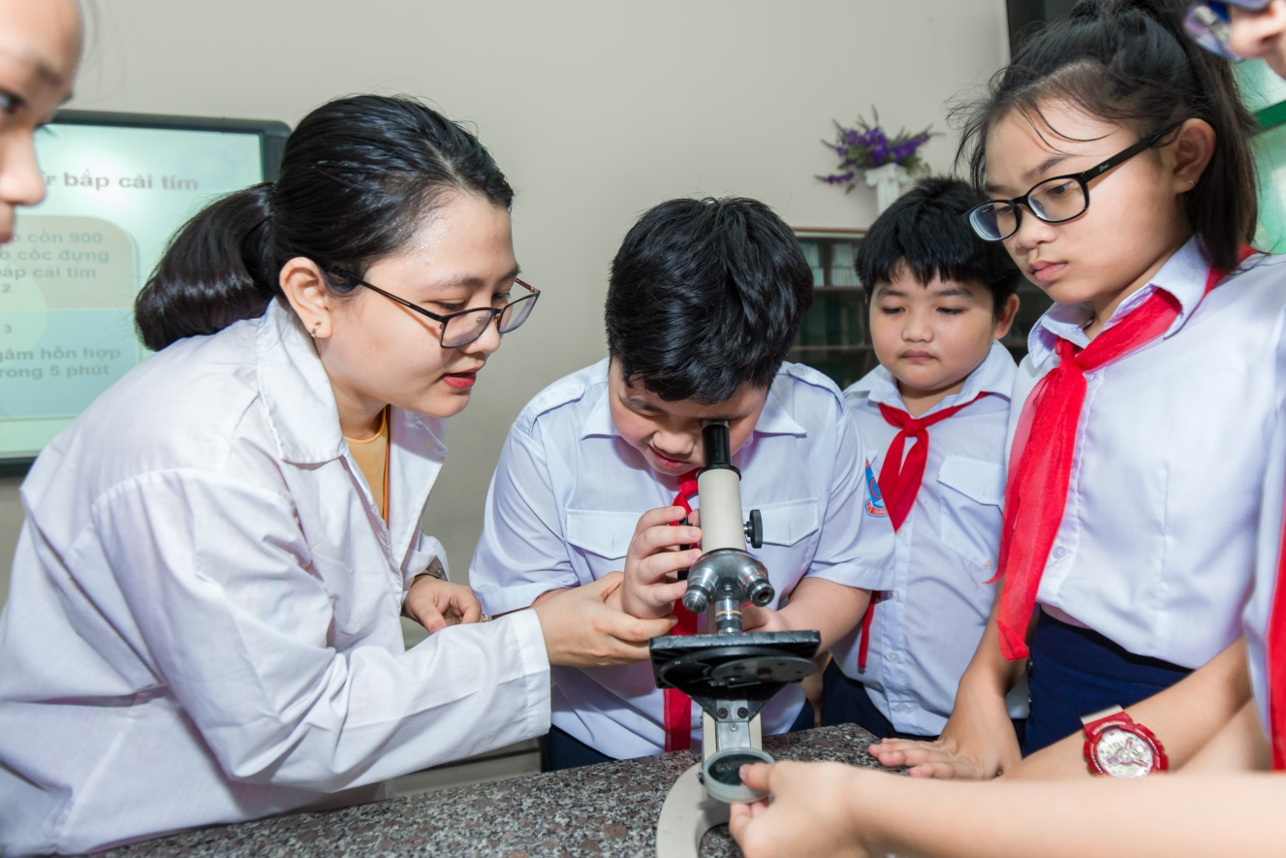
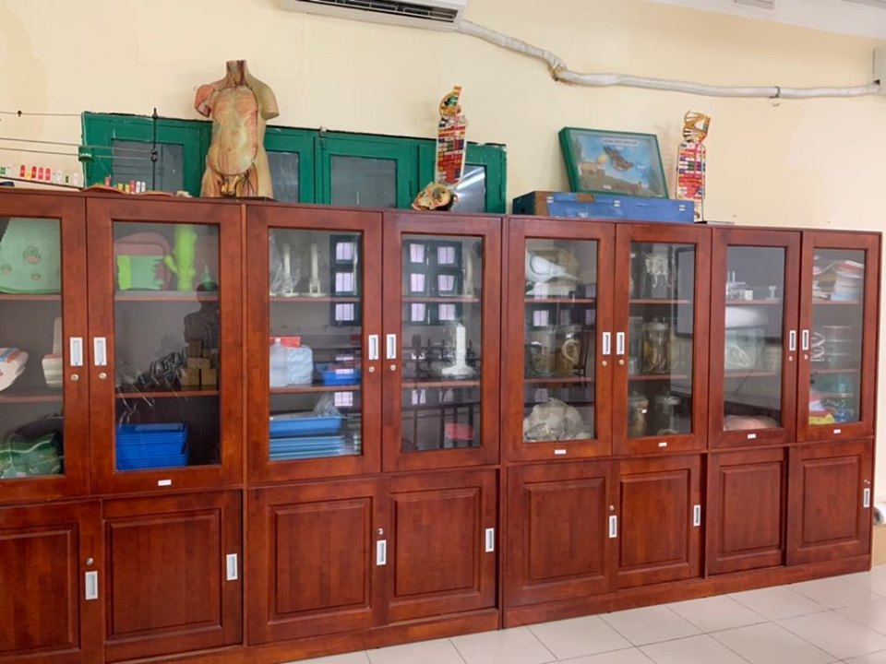
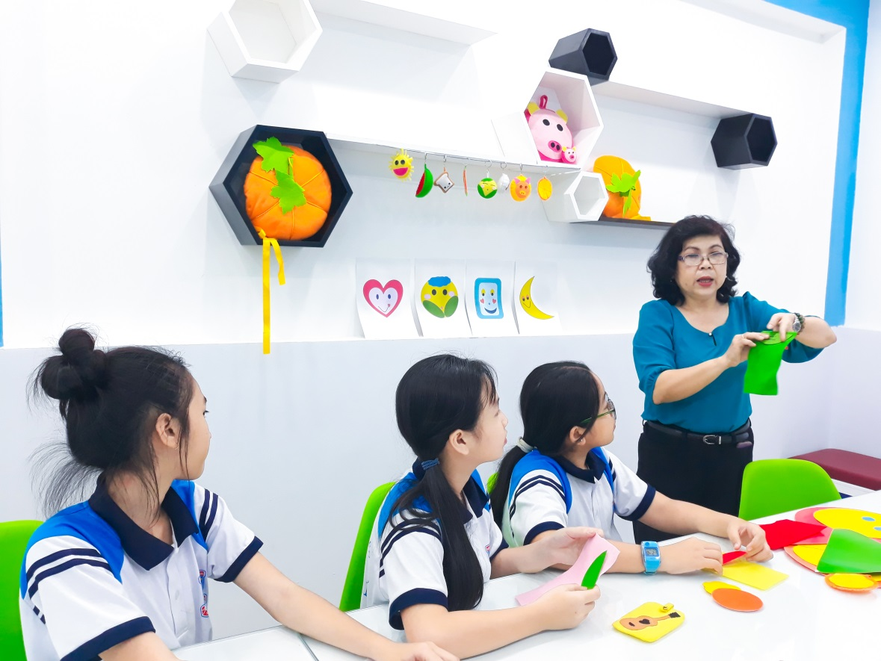
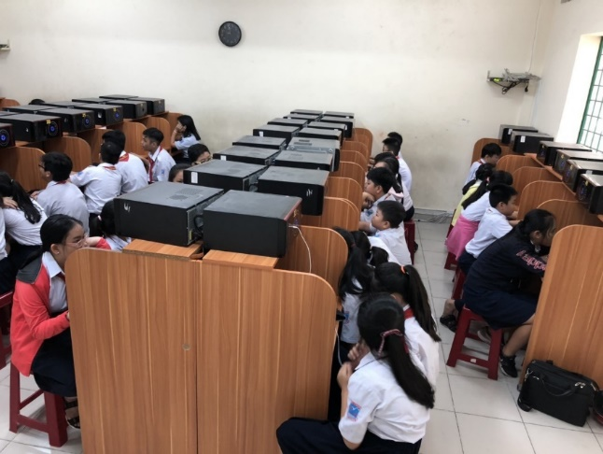
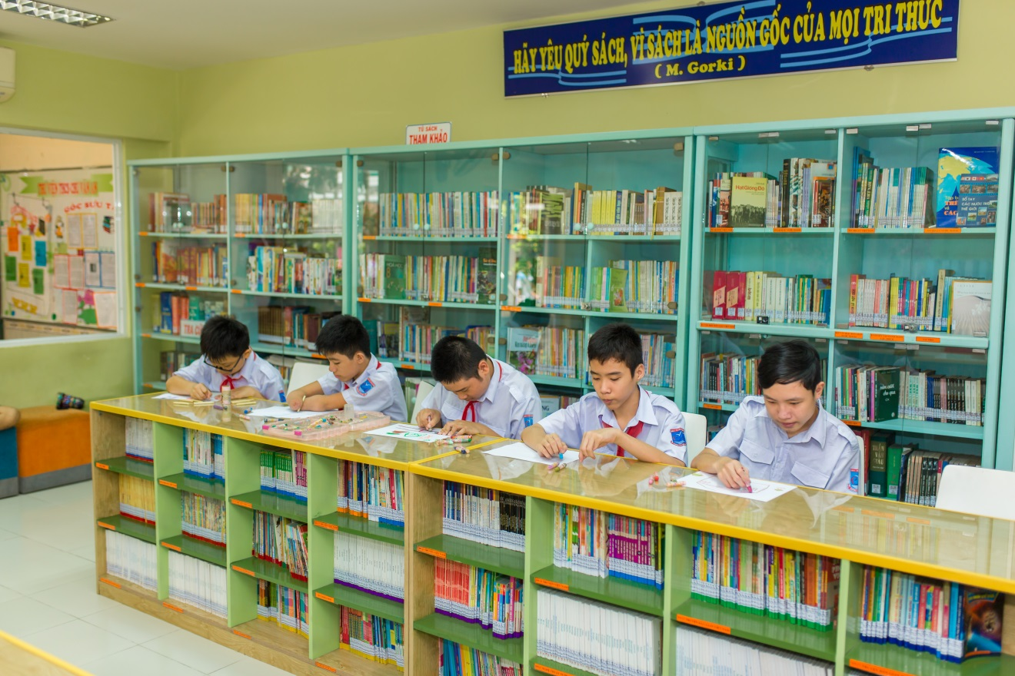
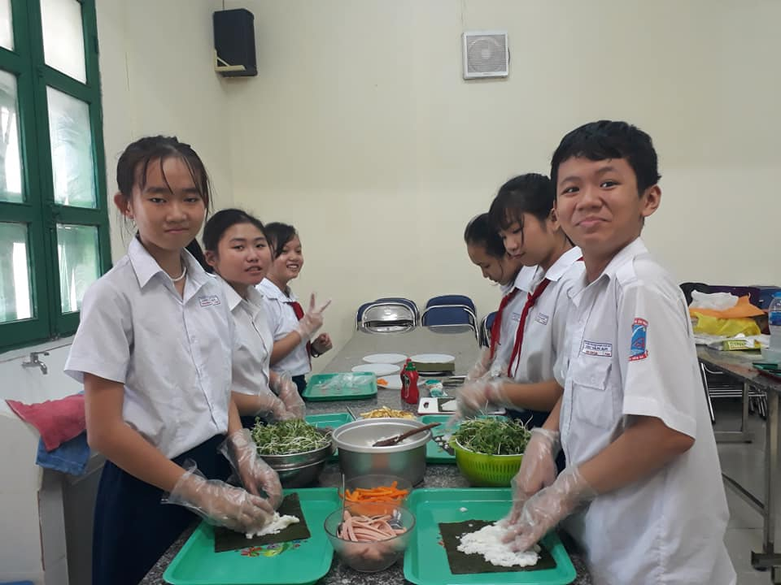
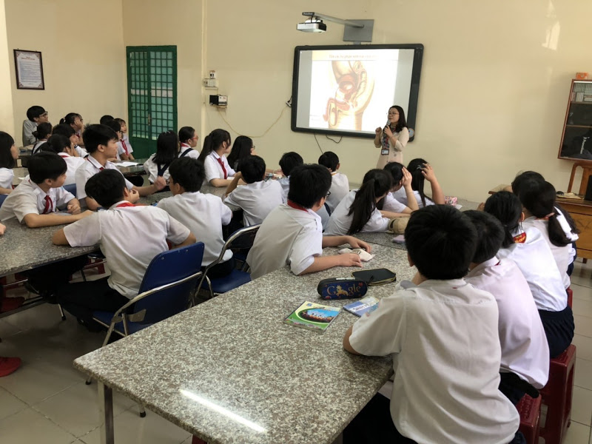
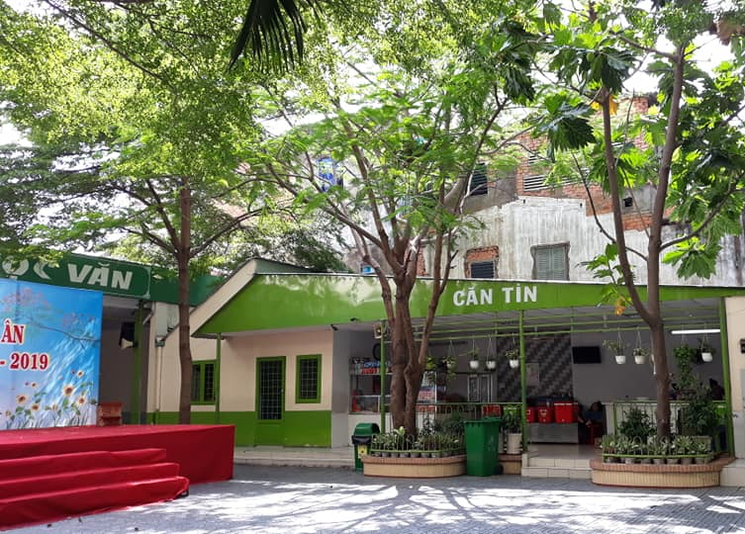
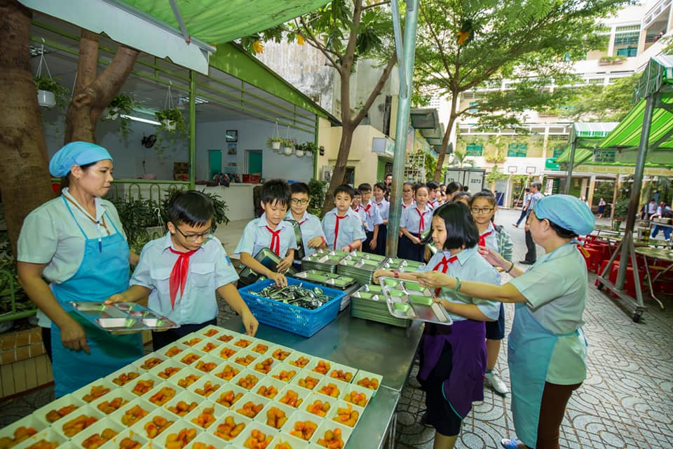
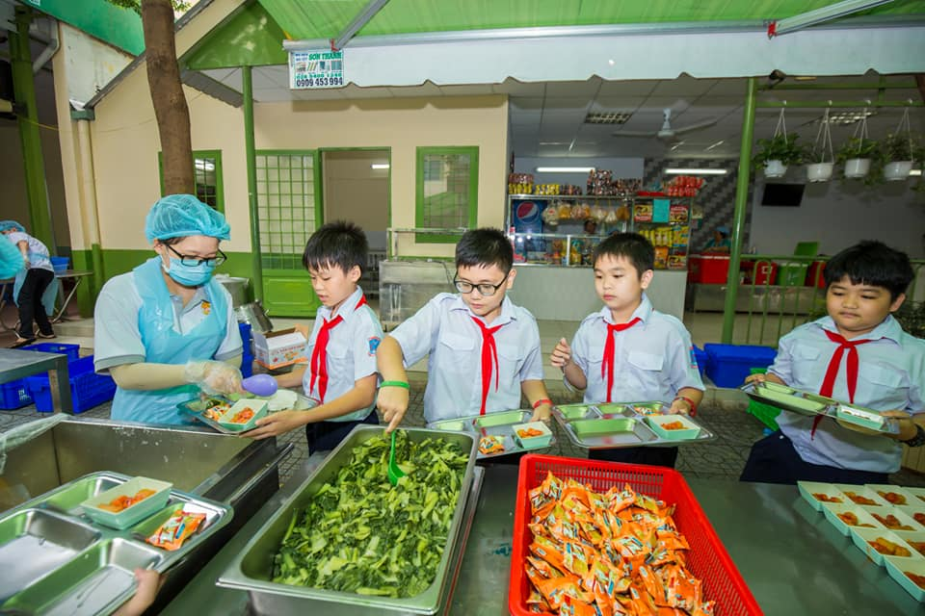
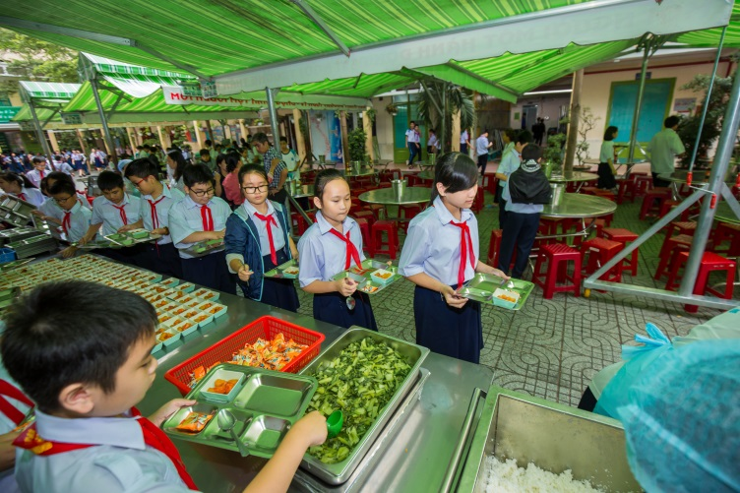
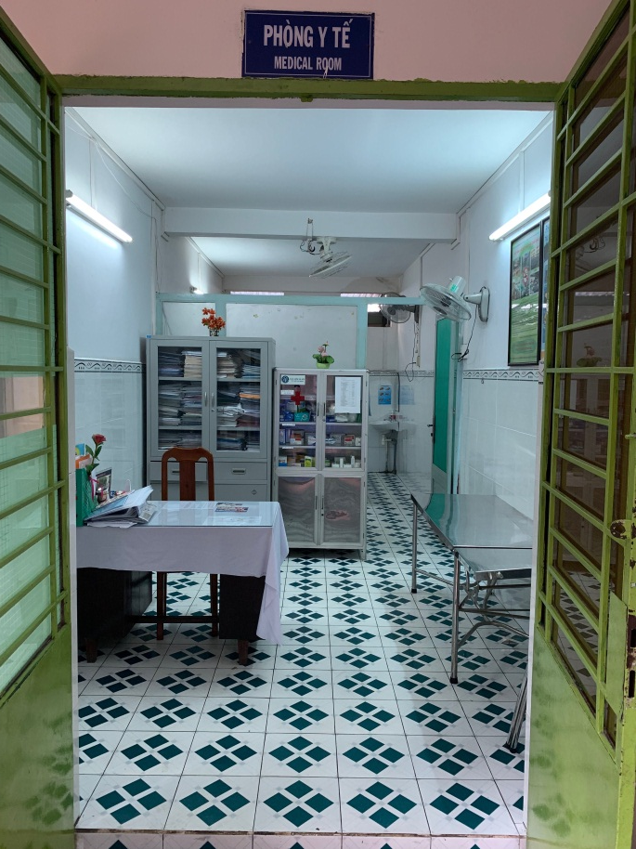
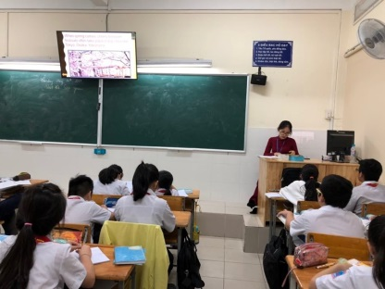
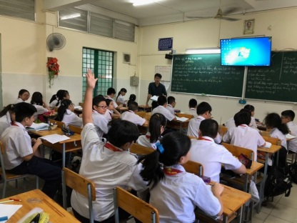
Campus consists of 1.799 Spm2
2 STEM rooms
A canteen
A library
A cooking room
An eating area
A multimedia room
An infiramry
A physics laboratory
A biology laboratory
A chemistry laboratory
A psychological – inclusive education support room
School’s facilities support for teaching well – equipped and modern facilities
Students have lunch and relax at school
All air- conditioned classrooms
2 ICT rooms

Slide 12
CHU VAN AN
CHU VAN AN
Subjects
SECONDARY SCSHOOL
CHU VAN AN
SECONDARY SCHOOL

Slide 13
6
Math
Physics
Chemistry
7
Liturature
Biology
History
8
English
Home Economic
Geography
9
ICT
Civic education
Physical education
Music
Art
There are 4 grades from grade 6 to grade 9,
children are 11 years old to 14 years old

Slide 14
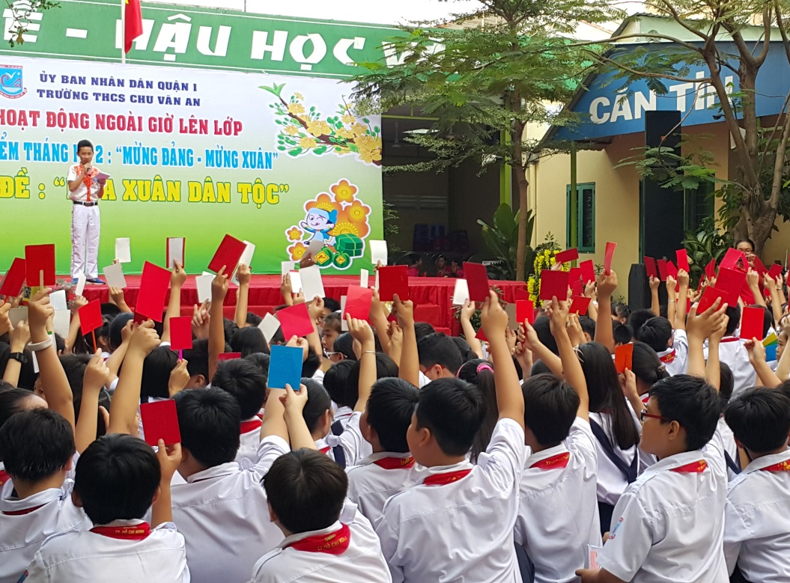
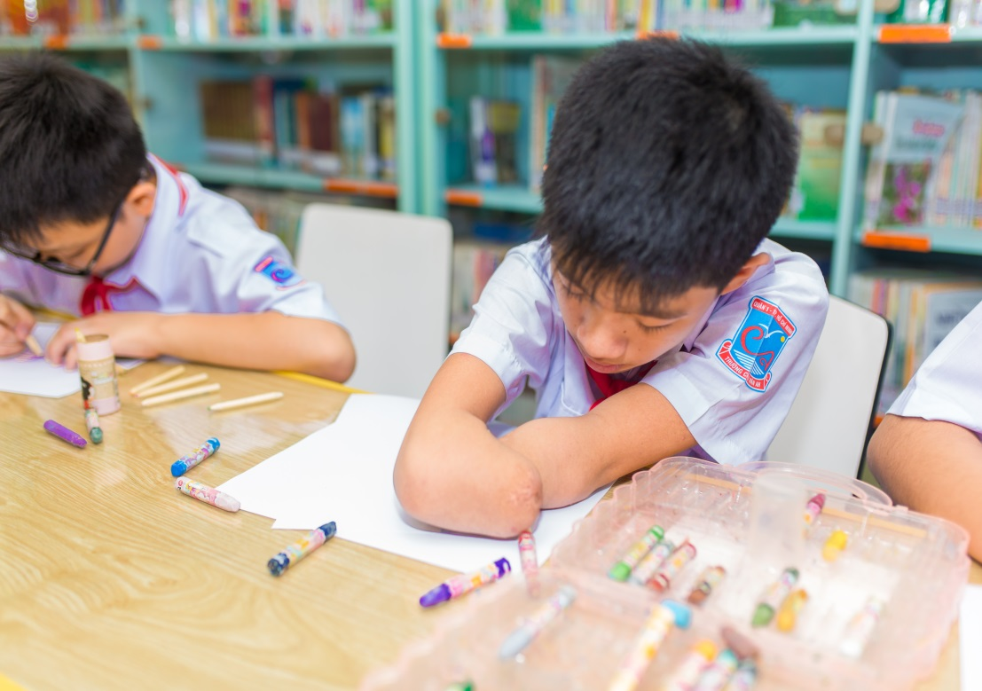
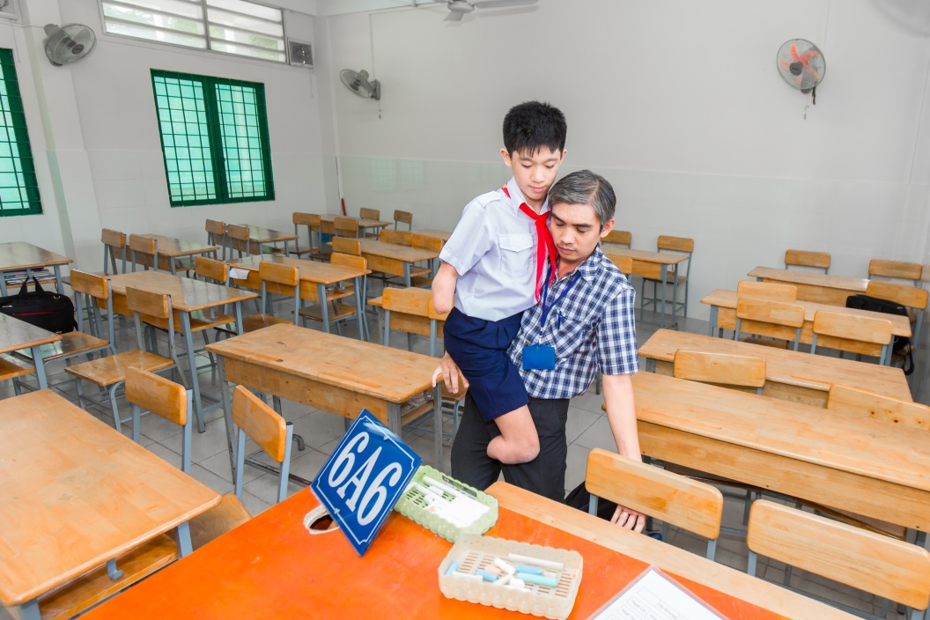
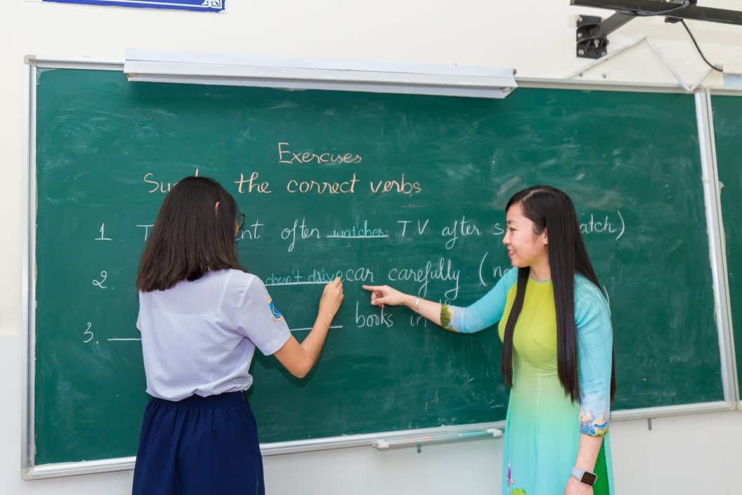
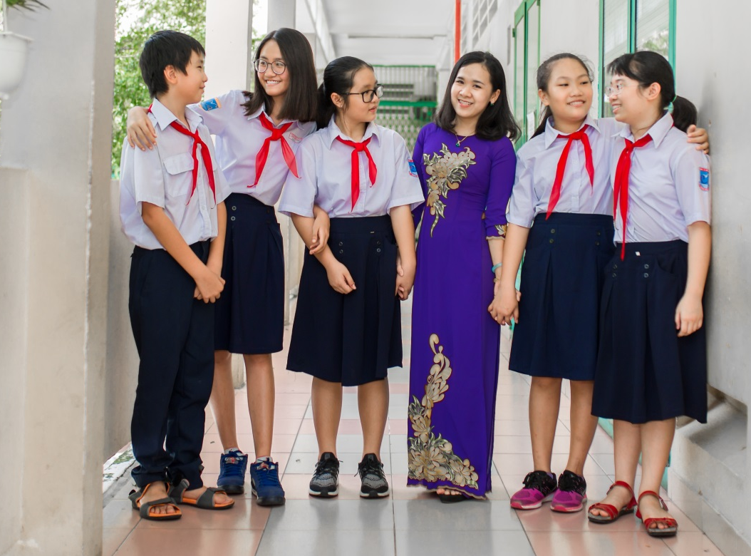
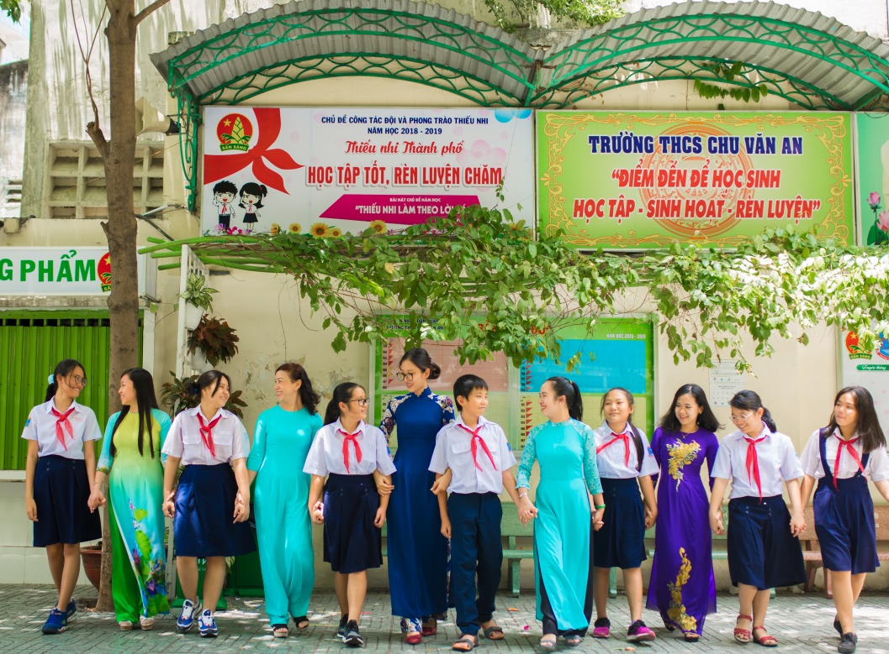
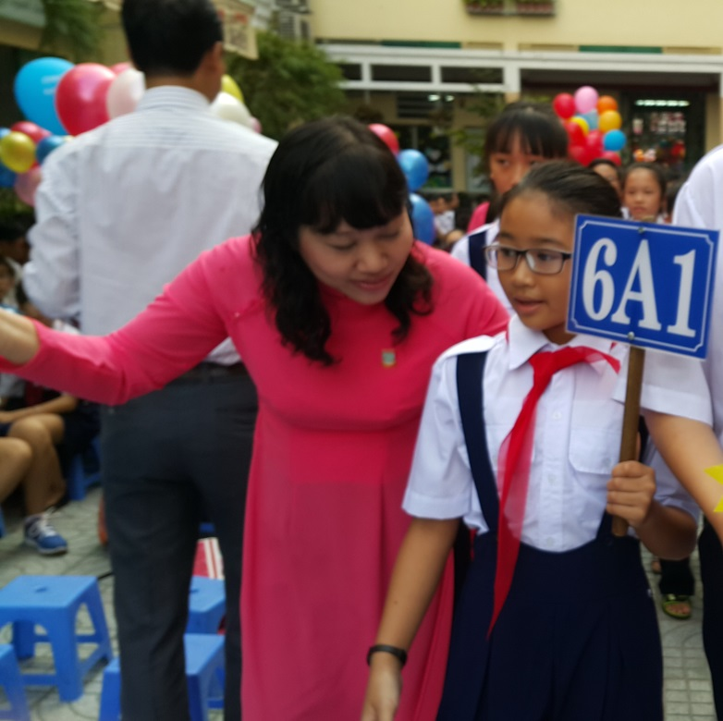
Providing positive and friendly educational environment

Slide 15
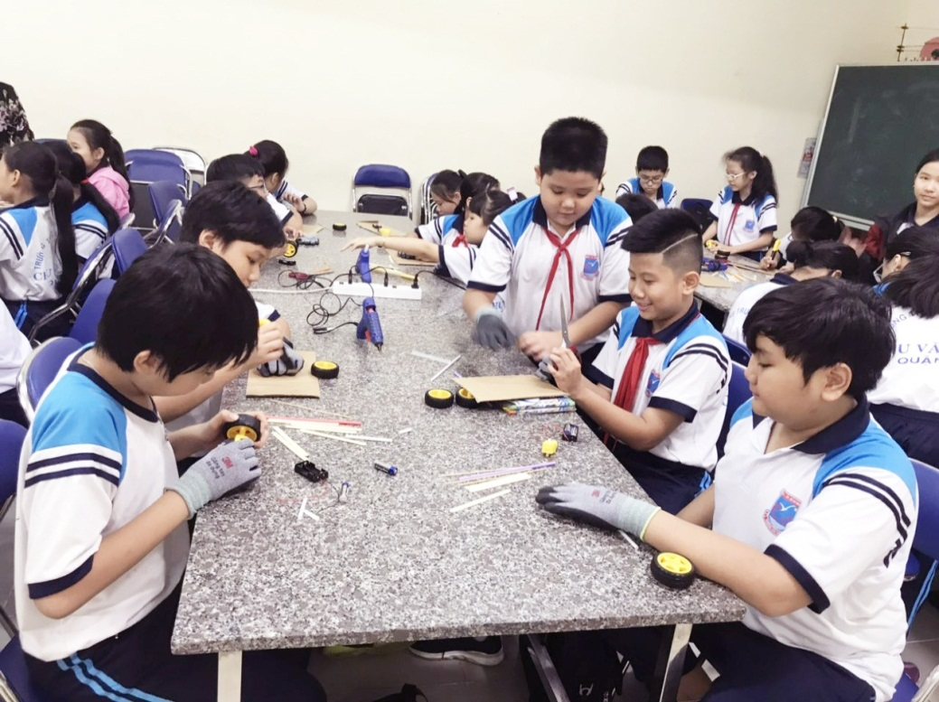
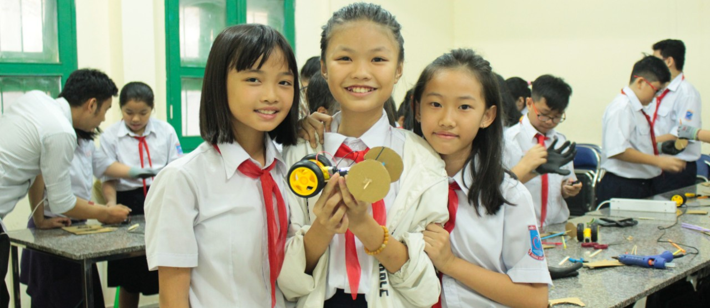
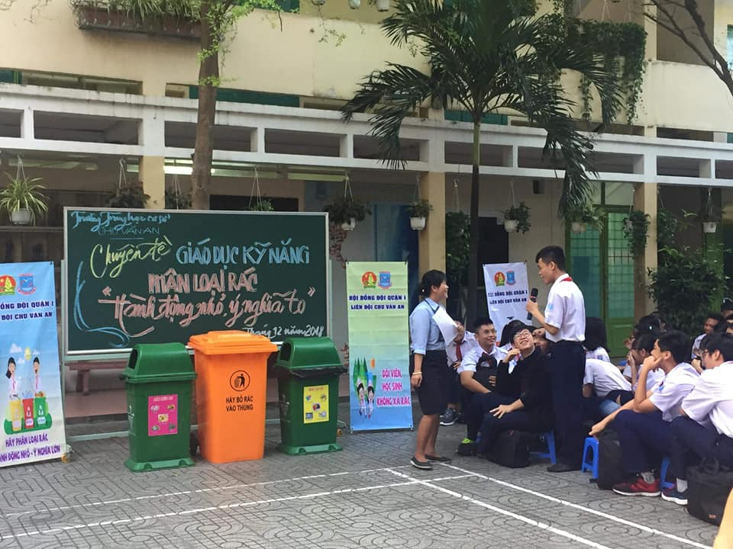
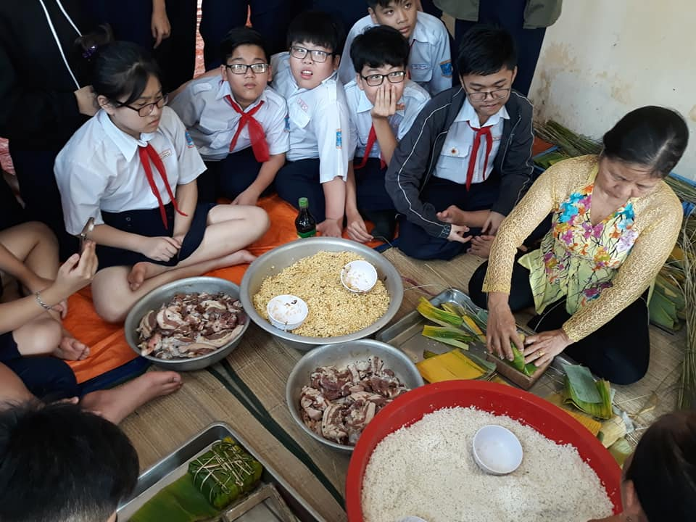
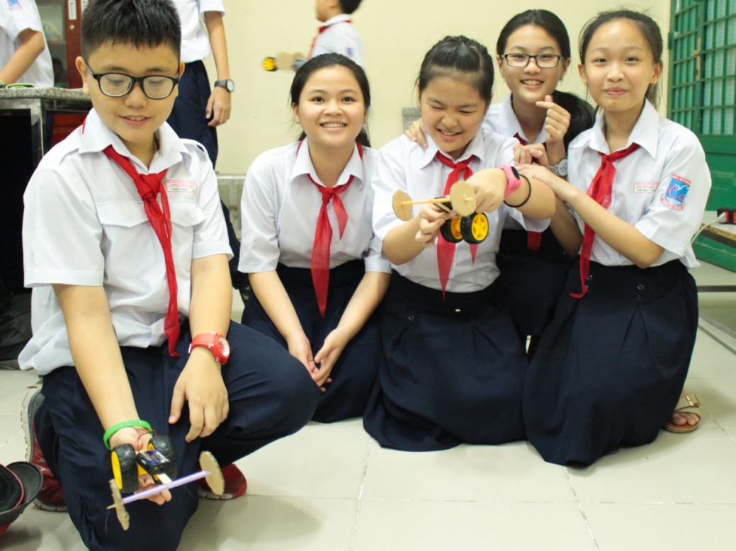
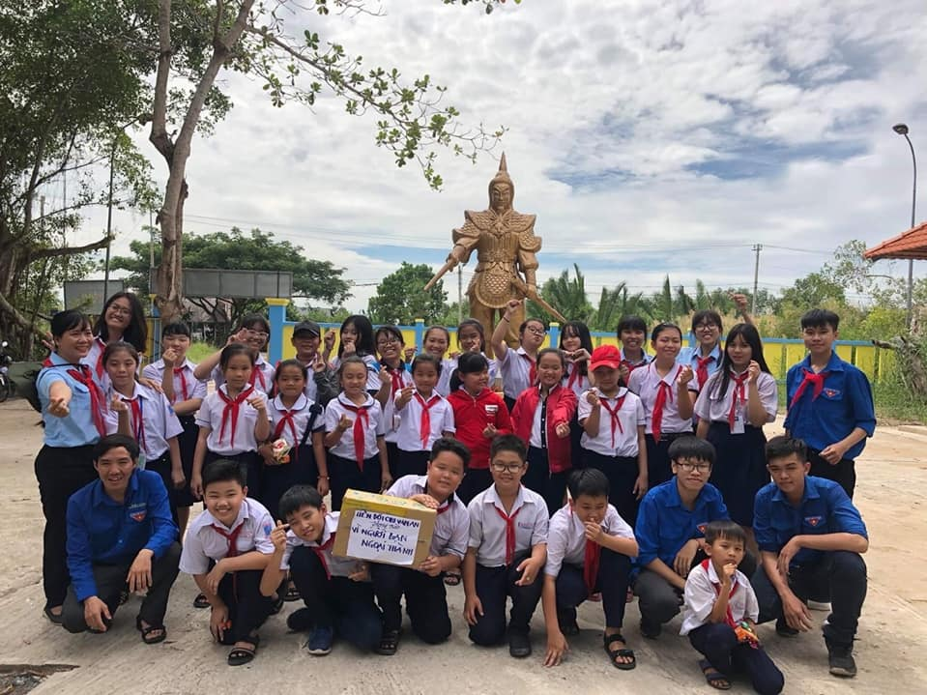
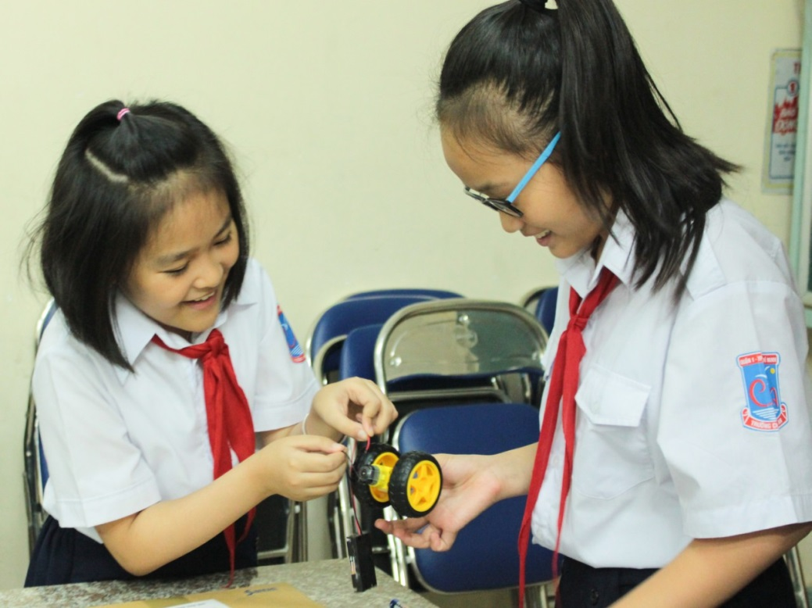
Learning through experimental activities

Slide 16
CHU VAN AN
CHU VAN AN
Achievements
SECONDARY SCSHOOL
CHU VAN AN
SECONDARY SCHOOL

Slide 17
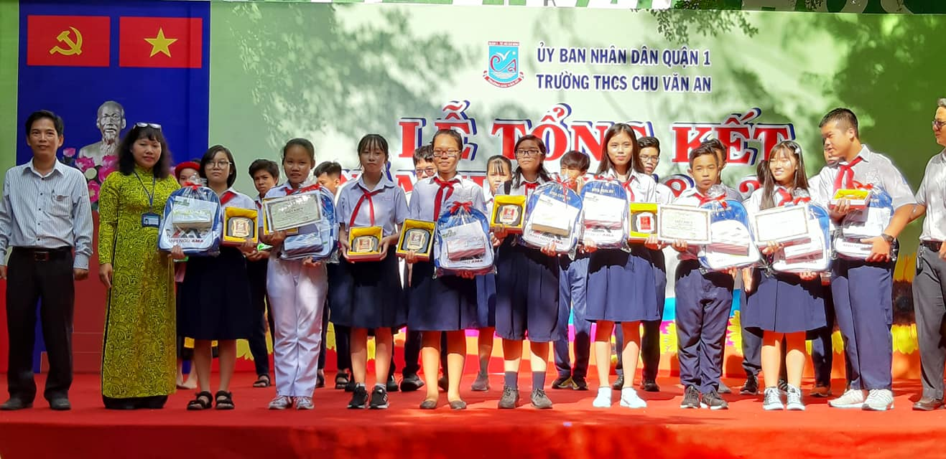
The closing ceremony
Reward teachers and students for achievements

Slide 18
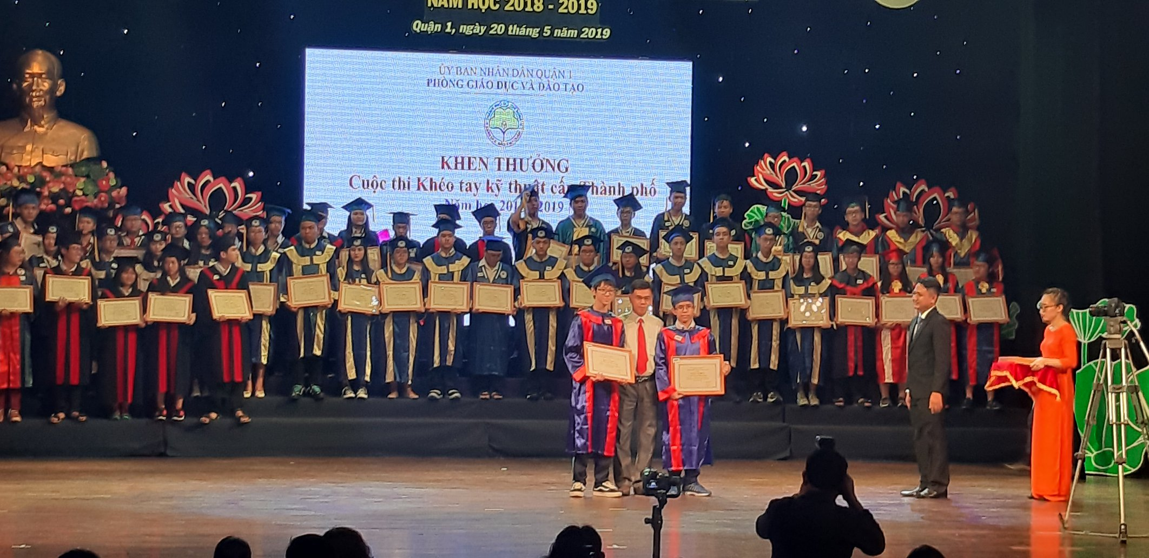
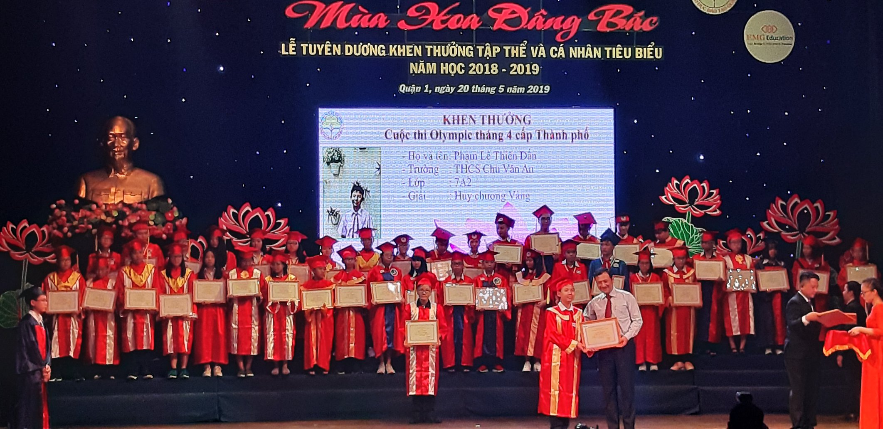
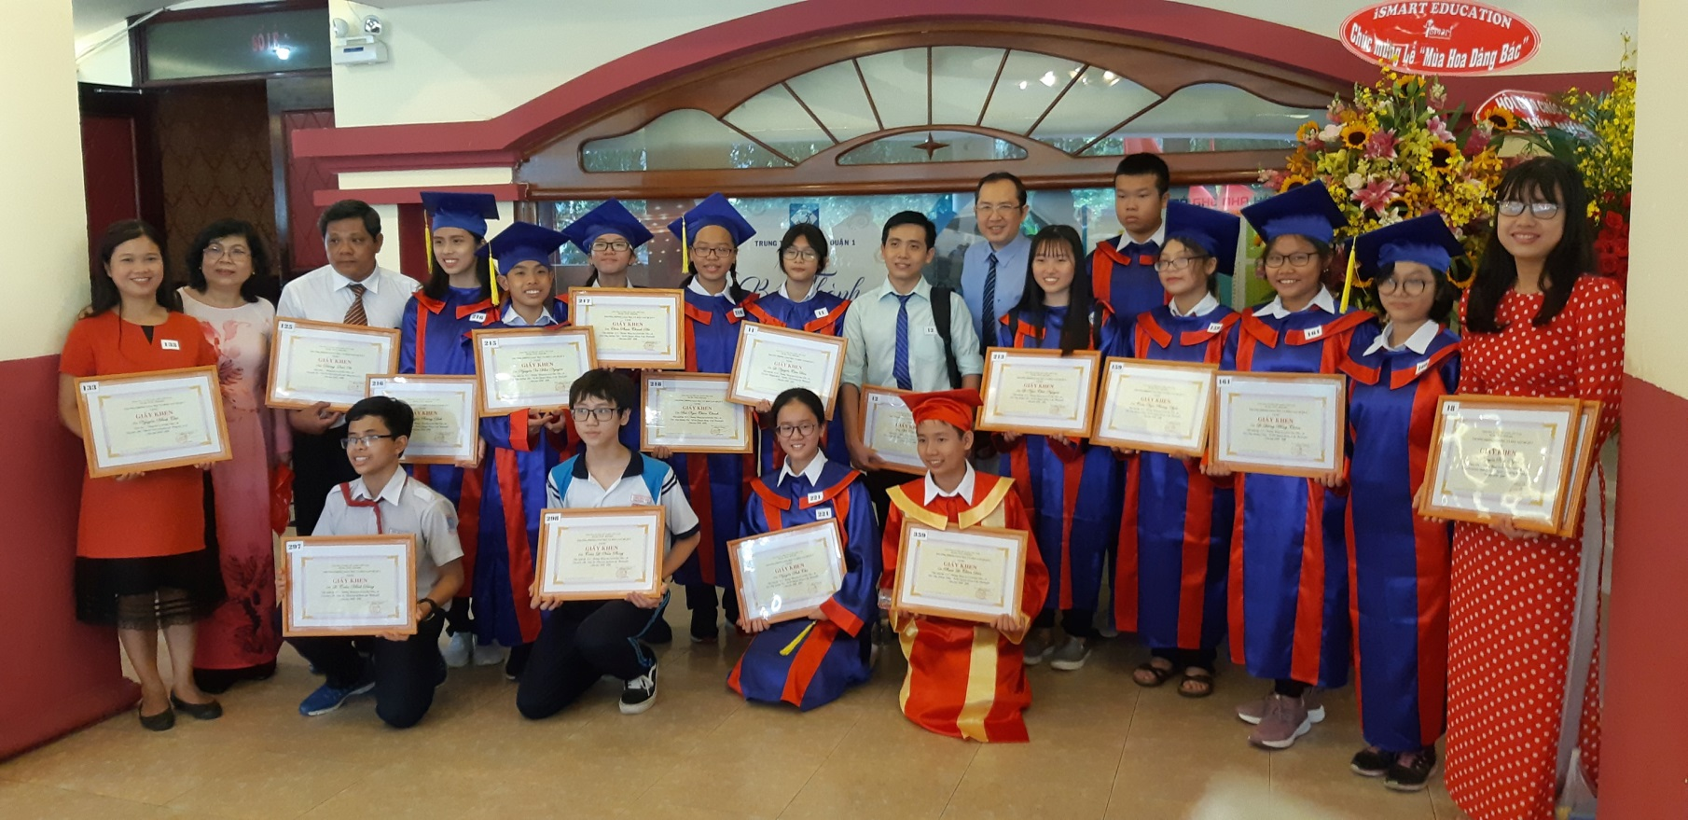
Commendation Ceremony for teachers and students in the school year
2018-2019 of District 1 Education and Training Department

Slide 19
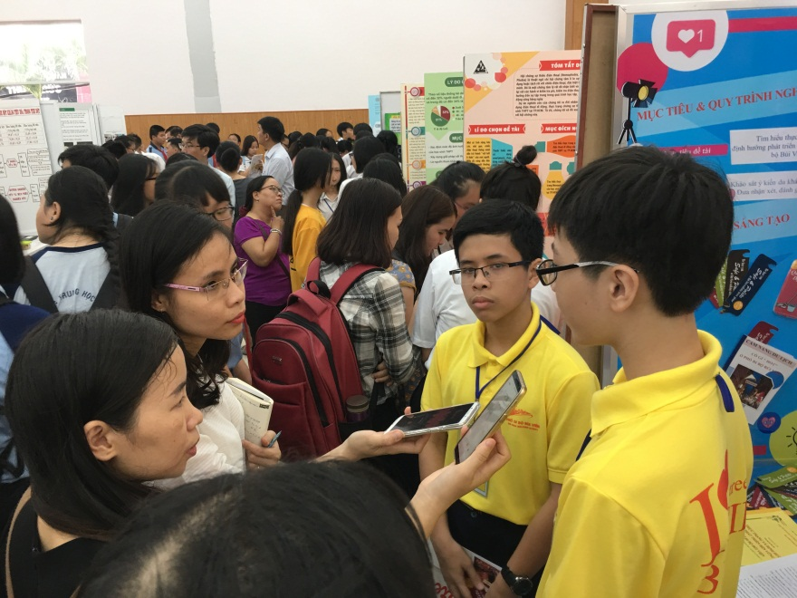
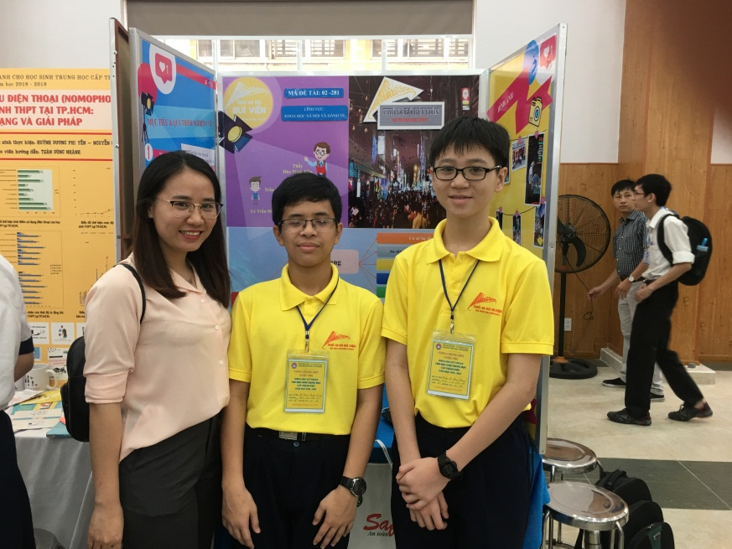
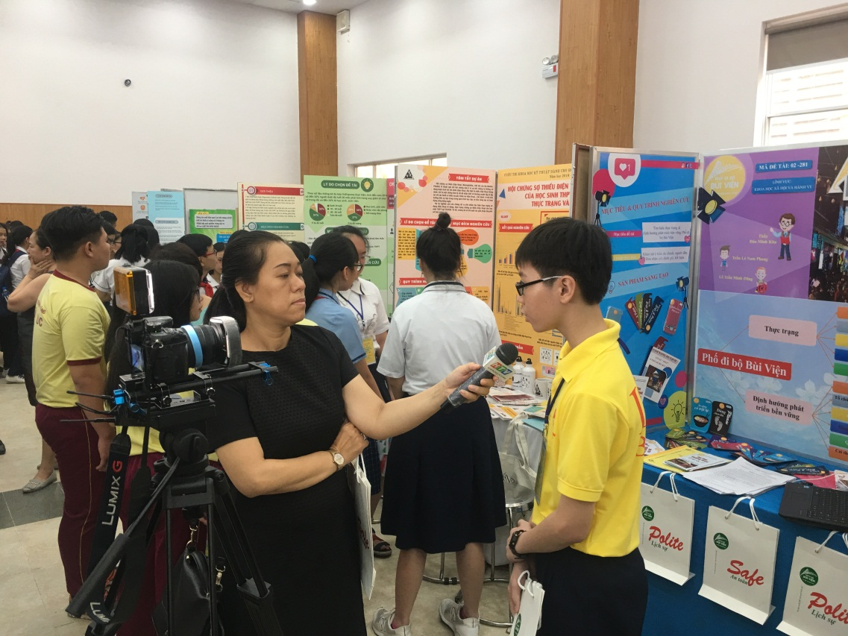
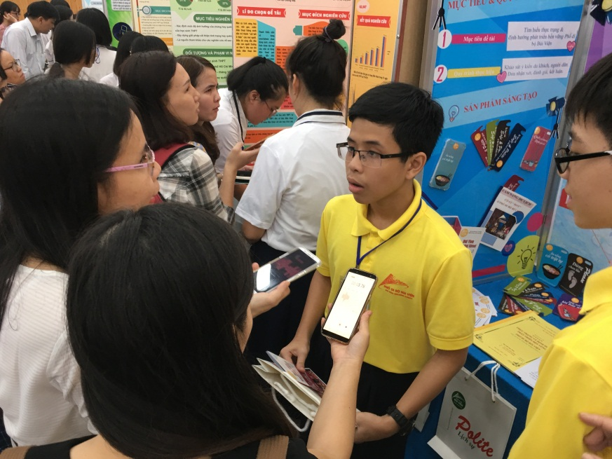
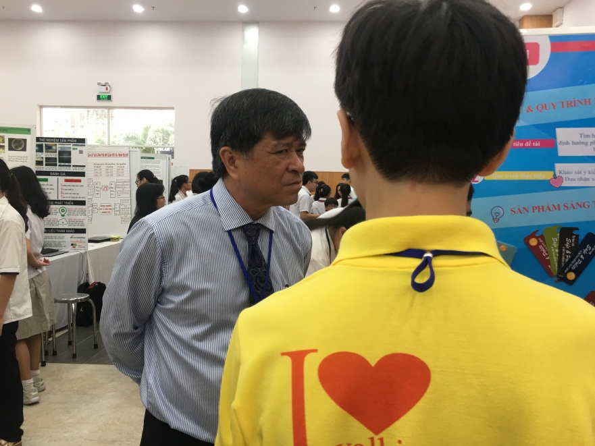
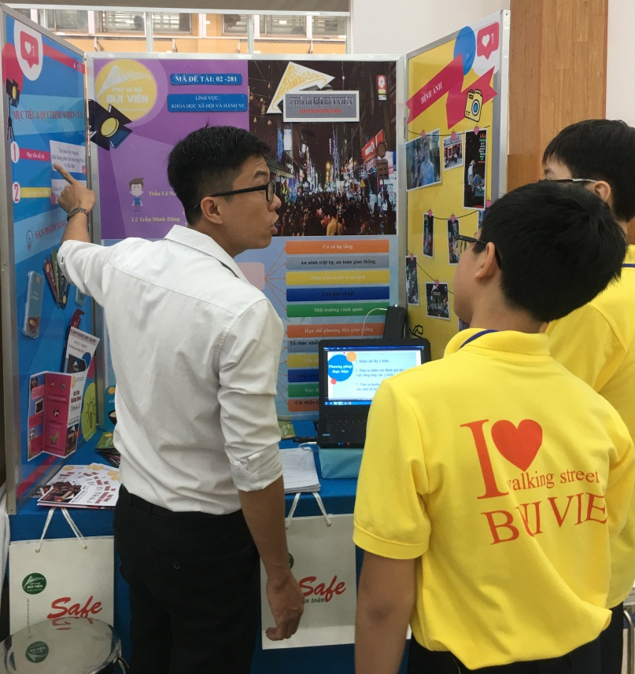
Students won the second prize in the scientific research competition of the city

Slide 20
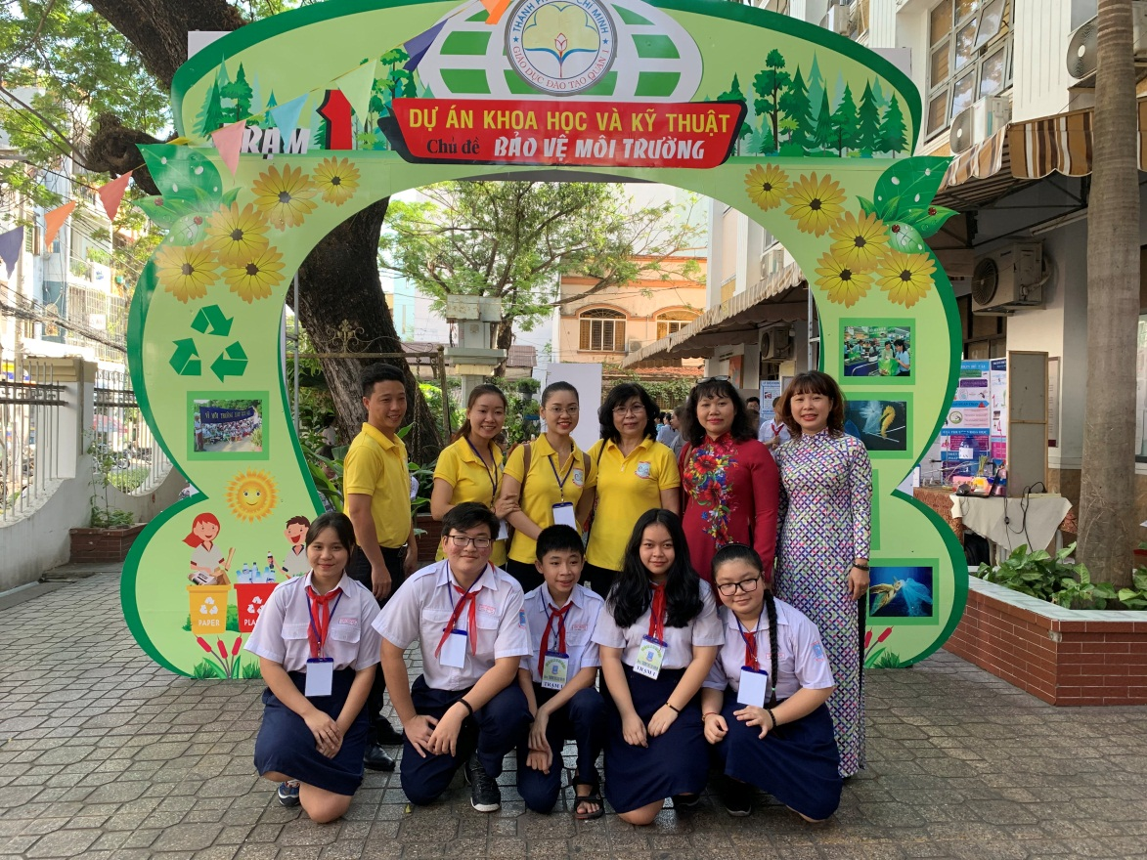
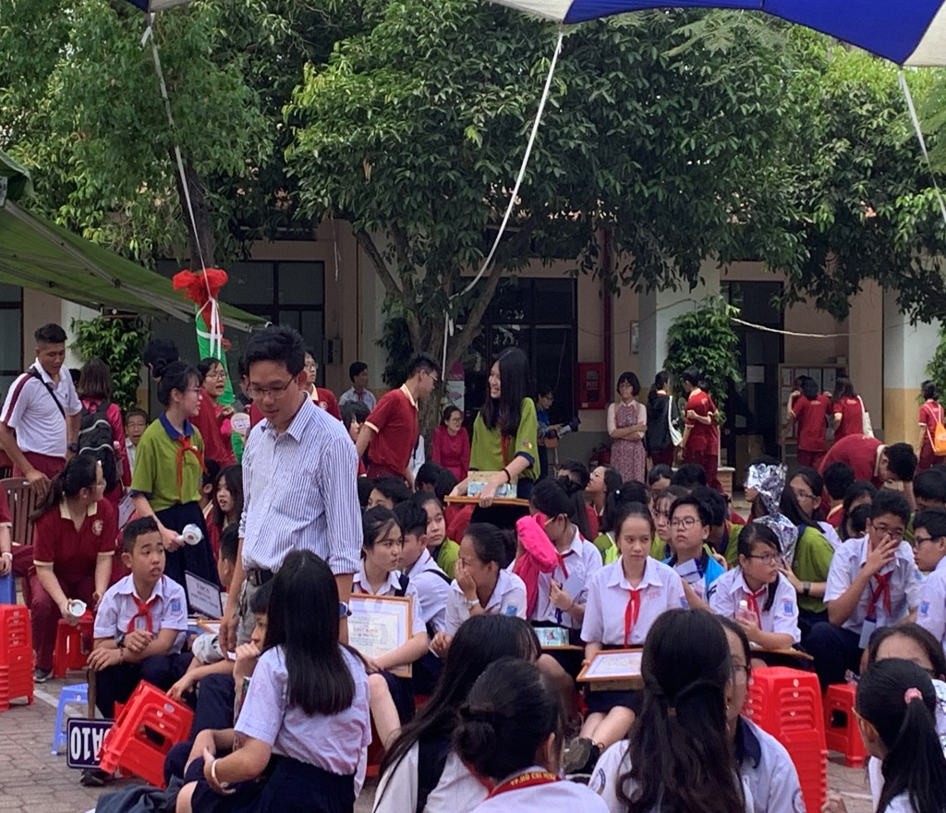
Students take part in the festival of secondary schools together.

Slide 21
CHU VAN AN
CHU VAN AN
Variety of extracurricular activities
SECONDARY SCSHOOL
CHU VAN AN
SECONDARY SCHOOL

Slide 22
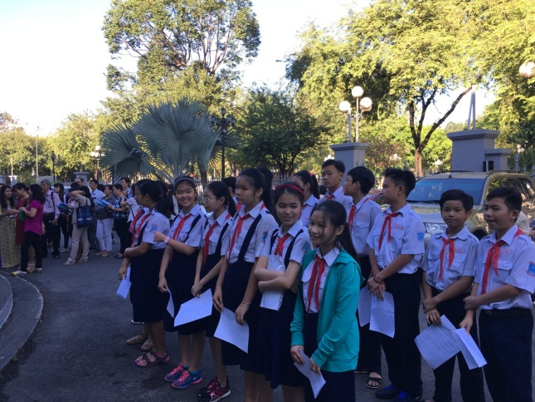
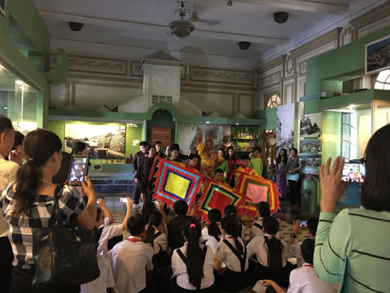
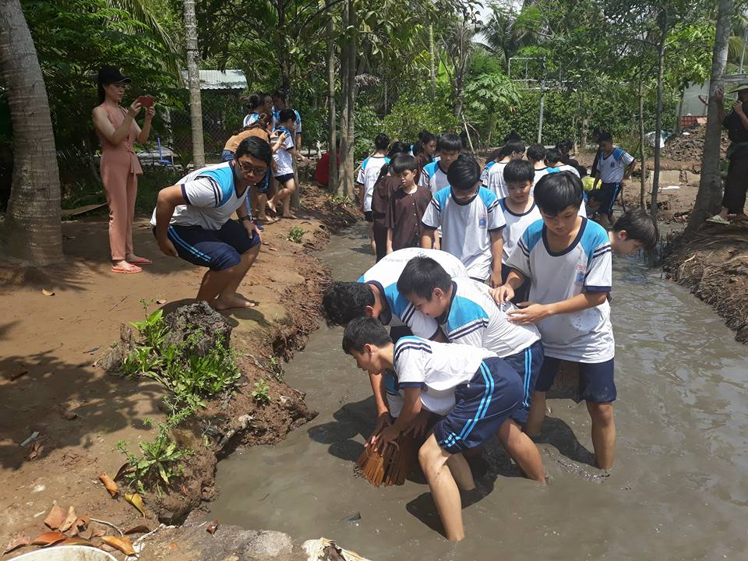
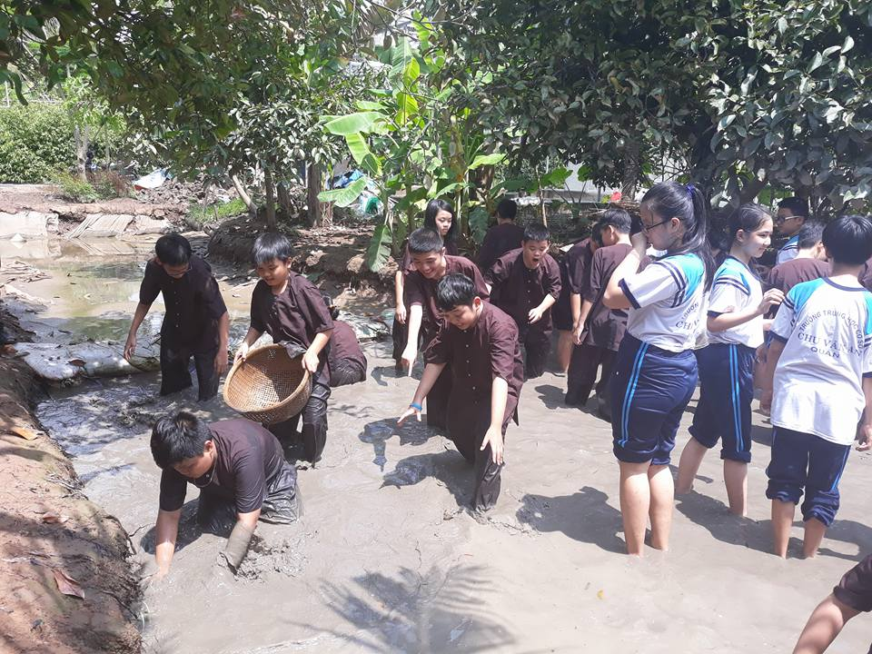















Indoor classes and outdoor classes

Slide 23





Taking part in clubs at school

Slide 24



Participating in Charity works

Slide 25




Participating in traditional activities

Slide 26


Participating in flash mode competitions and parades

Slide 27
nd
CHU VAN AN
CHU VAN AN
And so more activities…
SECONDARY SCSHOOL
CHU VAN AN
SECONDARY SCHOOL

Slide 28












participating in many contests such as painting, flower- arranging, singing, ...

Slide 29
OUR OUTSTANDING ACHIEVEMENTS
Certificate of Merit from the City People's Committee.
Certificate of Merit from the Ministry of Education and Training.
Prime Minister's Commendation.
Labor Medal 3rd Class.
In 2020, receiving the 2nd Certificate of Educational Quality Accreditation.

Slide 30


Chu Van An Secondary School
Destination for students
Study
Join
Practise
KNOWLEDGE EXCHANGE
TEACHING SKILLS
INCREASING TRAINING
DREAM COME TRUE
LEARN TO BE HUMAN - LEARN TO IMPROVE YOURSELF

Slide 31
CHU VAN AN
CHU VAN AN
THANKS FOR WATCHING
SECONDARY SCSHOOL
CHU VAN AN
SECONDARY SCHOOL

