Slide 1
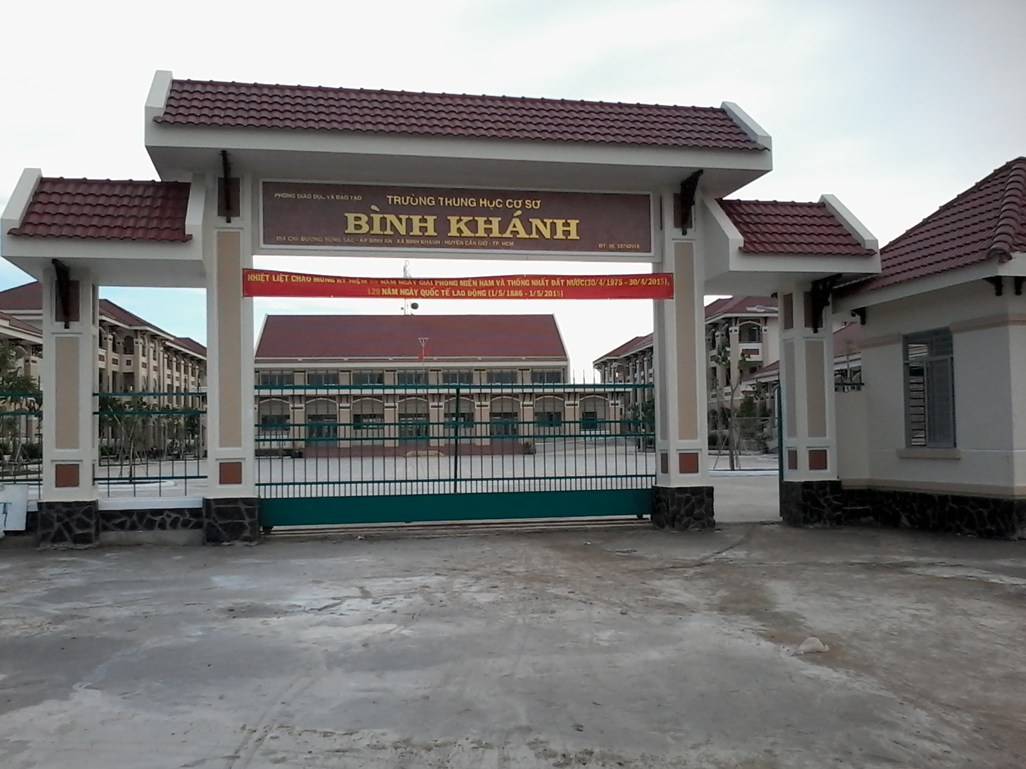
BINH KHANH SECONDARY SCHOOL
ENGLISH 8

Slide 2
Warm-up: MATCHING
A 1. Opening 2. Date 3. Closing 4. Heading 5. Writer’s address 6. Body of letter | B a. Ngày tháng b. Thân bài của lá thư c. Tiêu đề d. Địa chỉ của tác giả e. Phần kết f. Phần mở đầu

Slide 3
Unit 8: Country life and city life
Period 48: Write

Slide 4
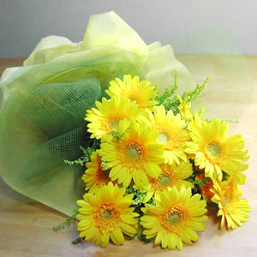
Put the outline for an informal letter in the correct order.
1, Opening
2, Date
3, Closing
4, Heading
5, Writer’s name
6, Body of the letter
4, Heading
5, Writer’s name
2, Date
Dear,…..
1, Opening
6, Body of the letter
3, Closing

Slide 5
Answer the questions
1, Where do you live?
-> I live in a small town/ a big city/ a small village.
2, What does your house look like?
-> My house looks very like/ small with 4/5 rooms and a nice/small garden.
3, What can you see from your bedroom window?
-> From my window, I can see a small garden with many
green trees and colorful flowers
4, How far is it from your house to school?
-> My house is near school so I can walk./ My house is far
from school so I have to ride my bike to it.
5, What kind of facilities are there in your neighborhood?
-> There is a stadium/ a movie theater/ some restaurants/
a post office/ a library…
6, What things in your neighborhood do you like best? Why?
-> I like… best because it’s….

Slide 6
Can Gio district 13th December 2021
Dear, Mary
I live in a…, a small village. My family has a large house with four rooms and a small garden. I like my house and my bedroom, too. From my bedroom window I can see a big field with green trees, a lot of beautiful flowers. I don’t live far from my school so I can walk to it with my friends. In my neighborhood, there is a big pond a sea. In the afternoon, my friends and I often go swimming there. We usually take buffalos and cow wander along it. But the things we like best is to play some games such as: blind man bluff, catch, marbles….with the children in the village. Is there any interesting thing in the place where you live? Write to me. I like to say goodbye now. I’m looking forward to hearing from you soon. Love. Rose

Slide 7
Homework:
Do exercise 6 in workbook
Rewrite a letter to your friends.
Prepare Unit 8: Lesson 5: Language focus

Slide 8
Thank you for your attendance
Best wishes for you

