Slide 1
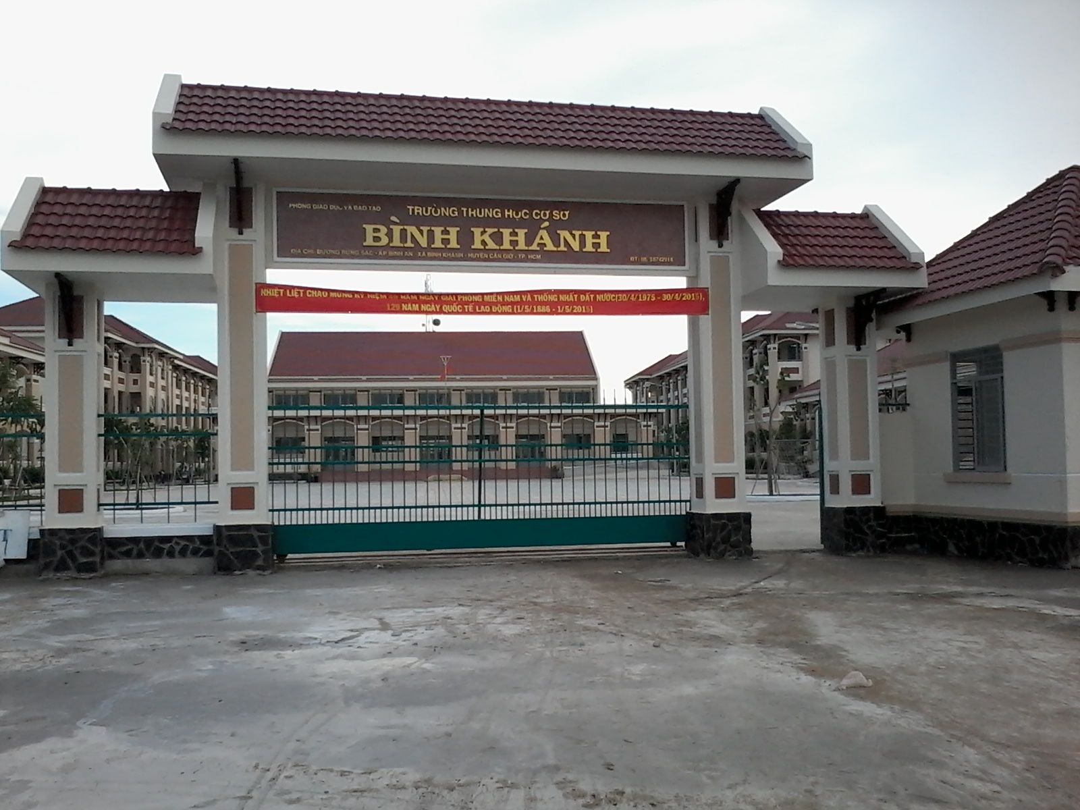



BINH KHANH SECONDARY SCHOOL
ENGLISH 8

Slide 2
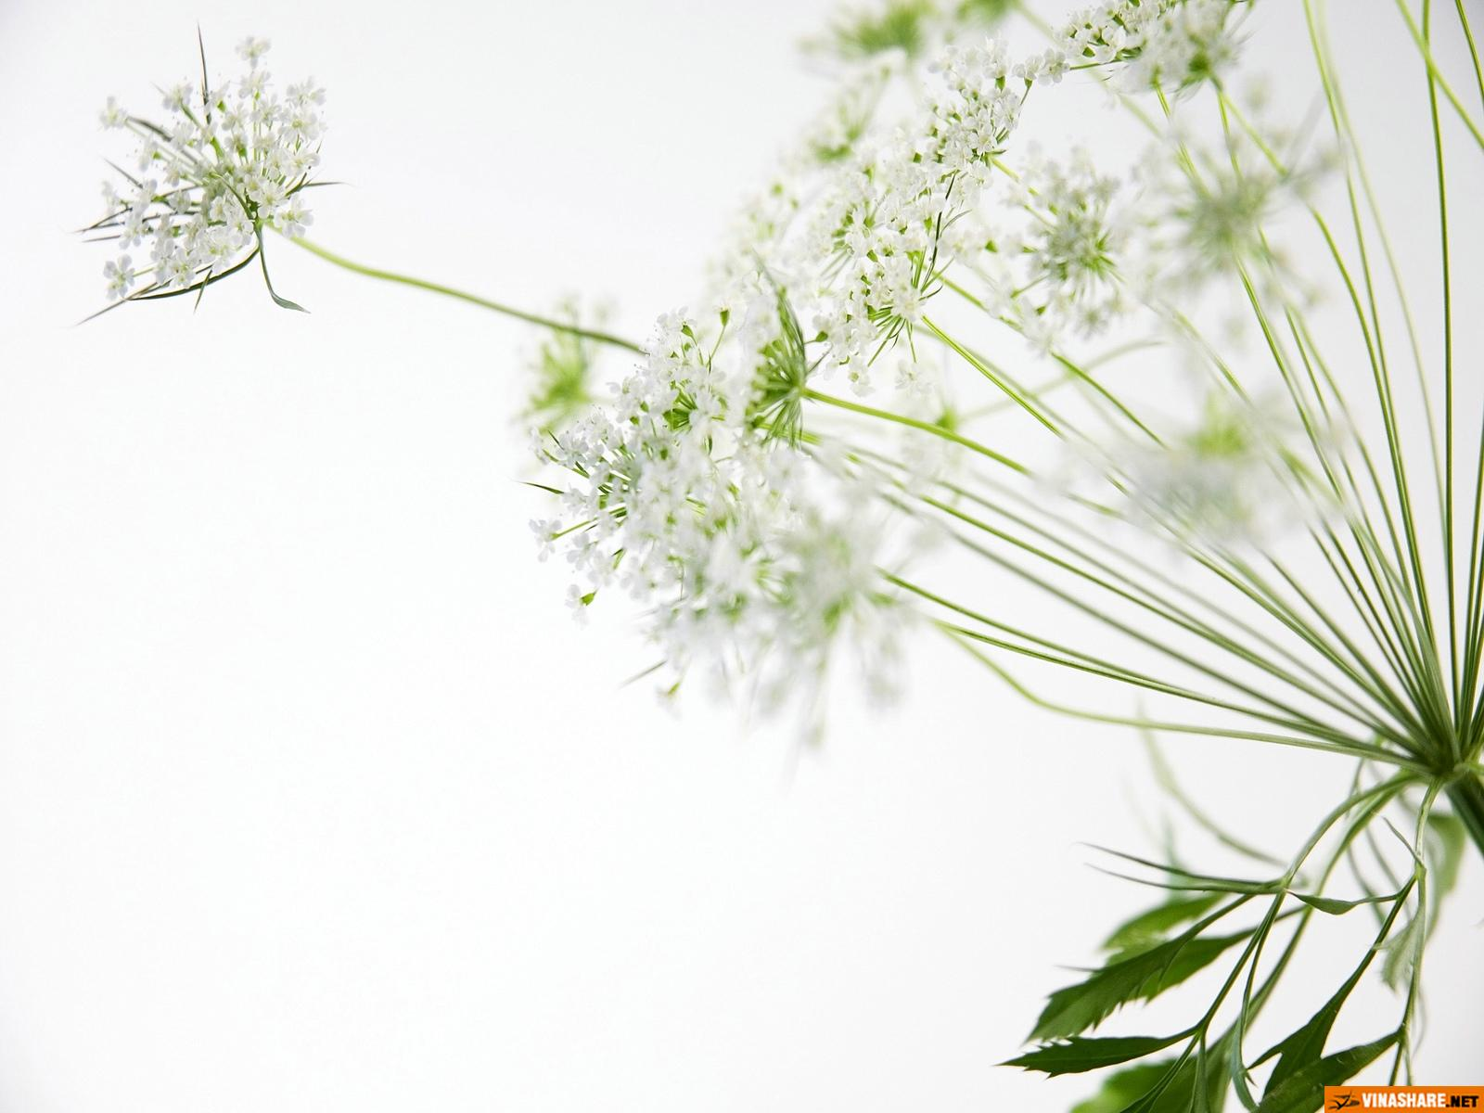


Welcome All Students

Slide 3
Game: Pelmalism
1
2
3
see
5
be
eat
live
4
do
6
7
10
done
been
8
9
eaten
seen
lived

Slide 4

Unit 7. MY NEIGHBORHOOD
Lesson 5: Language focus
I. Present perfect tense: Thì hiện tại hoàn thành
1. dấu hiệu:
since
+ mốc thời gian; for+ khoảng thời gian
already đã xong, just vừa mới, ever đã từng, never chưa bao giờ…
2. Cấu trúc:
(+) S + have/ has + V3/Ved + O
(-) S + have/ has + not + V3/Ved + O
(?) Have/ Has + S + V3/Ved+ O ?
Lưu ý: khi chủ từ là I/You/ We /They/ số nhiều ta dùng: have
Khi chủ từ là She/ he /it / số ít ta dùng: has
3: cách dùng
Diễn tả sự việc xảy ra trong quá khứ kéo dài đến hiện tại hoặc có thể xảy ra trong tương lai.
-diễn tả 1 sự việc đã xảy ra mà mình không nhớ rõ thời gian, hoặc 1 việc vừa mới xảy ra
- diễn tả sự trải nghiệm về 1 điều gì đó, 1 việc gì đó

Slide 5
Ex1. Match
be gone
go lived
eat attended
live been
attend eaten
see collected
do seen
write done
work written
collect worked

Slide 6
Ex2. Use for or since
1. _________ five minutes
2. _________ January
3. _________ 1990
4. _________ 10 weeks
5. _________ Friday

Slide 7
Ex3. Give the correct form of the verbs in the brackets
have lived
(live)
(not eat)
(not see)
(attend)
(just work)
(collect)
a. I ……………... here since last week
b. We ………. . .. in that restaurant for two years
c. I ……………… her since yesterday
d. They ……………….. Quang Trung School since last year.
e. My dad ………………….. for this company .
f. …….. Ba ………. … stamps since 1995 ?
haven’t eaten
haven’t seen
have attended
has just worked
Has
collected
be
see
eat
live
do
attend
collect
eaten
been
attended
done
seen
lived
collected

Slide 8
4/Complete the conversation. Use the correct form of the verbs in box:
hope | be (3) | live | see | look | want
Ba : Hi. My name’s Ba
Tom : Nice to meet you, Ba. I’m Tom.
Ba : Are you a newcomer here?
Tom : Yes. I (1) _____________here since last week.
Ba : I’m sure you’ll love this place.
Tom : I (2) ________so. How long _______ you (3) _____ here?
Ba : For 15 years.
Tom : So you must know the area very well. (4) ____ there a post office near here?
have been
hope
have
lived
Is
Ba : Yes. There’s one next to my house. Why ?
Tom : Ah! I (5)__________ to send this postcard to my parents.
Ba : Let me have a look. Oh! It (6)________ very beautiful. Where’s your house ?
Tom : In London. ________ you ever (7) ________there ?
Ba : Not yet. But I (8) ____________ it through films and magazines.I’m going there with my father next summer.
Tom : That’s great. I hope to see again over there.
want
looks
Have
been
have seen

Slide 9
II. Comparison
Bao is like An.
Bao is the same as An.
Bao is different from Hau.
Bao is as tall as Hau.
like: giống như
(not) the same as: (không) giống như
So sánh về sự giống hoặc khác nhau
(not) different from: (không) khác
(not) as + adj + as: ...... như

Slide 10
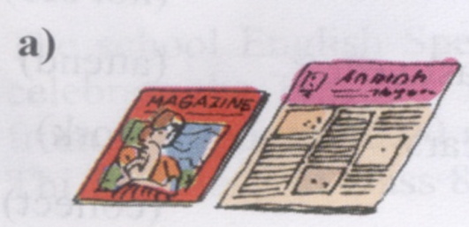
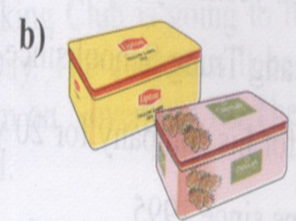
Ex5. Look at the pictures and complete the sentences
different expensive cheap modern long same large
not as large as
a. The magazine is ………….. ……. the newspaper.
different from
b. Lipton tea is ………………… Dilmah tea.

Slide 11
LUCKY NUMBERS
1
2
3
4
5
6
7
8

Slide 12
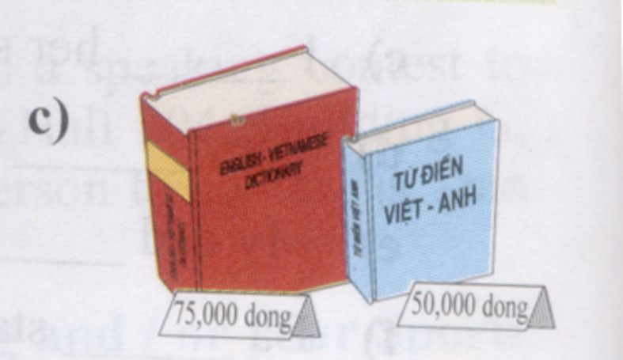
Ex5. Look at the pictures and complete the sentences
different expensive cheap modern long same large
not as cheap as
c. the red dictionary is ……………………the blue dictionary.

Slide 13
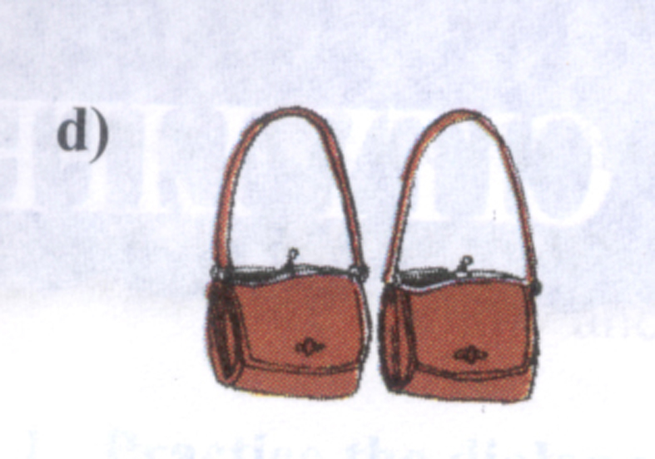
Ex5. Look at the pictures and complete the sentences
different expensive cheap modern long same large
d/ The bag on the left is …………………the bag on the right.
the same as

Slide 14

LUCKY NUMBER !

Slide 15
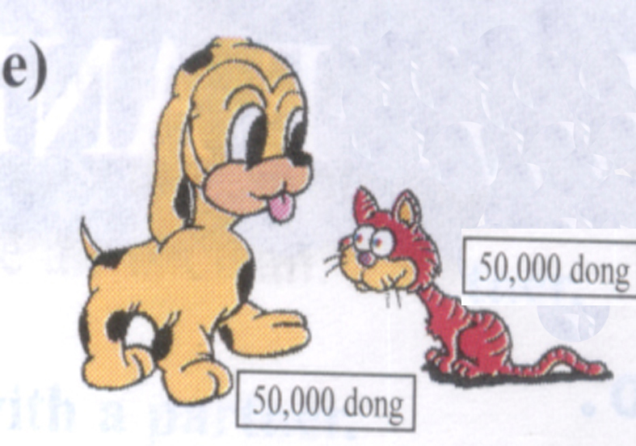
Ex5. Look at the pictures and complete the sentences
different expensive cheap modern long same large
as expensive as
e. The toy cat is ………………………. the toy dog.

Slide 16
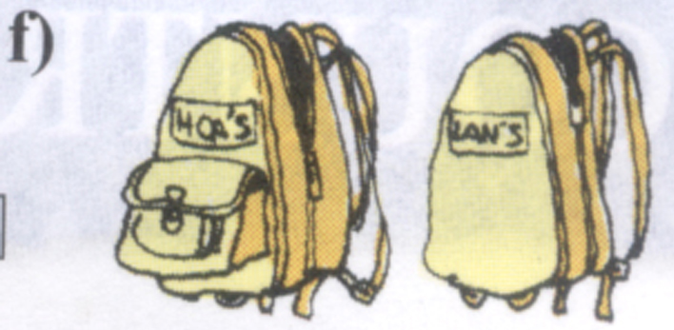
Ex5. Look at the pictures and complete the sentences
different expensive cheap modern long same large
different from
f. Hoa’s backpack is …………………… Lan’s backpack.

Slide 17
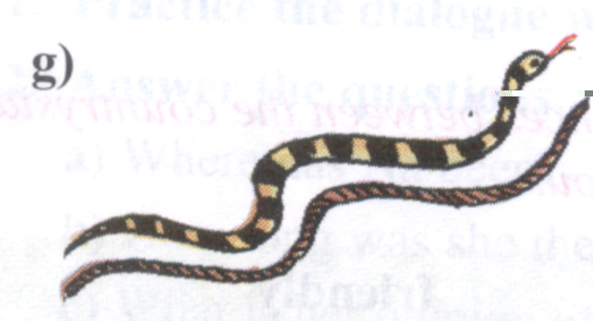
Ex5. Look at the pictures and complete the sentences
different expensive cheap modern long same large
as long as
g. The snake is ………………… the rope.

Slide 18
LUCKY NUMBER !

Slide 19
LUCKY NUMBER !

Slide 20
Unit 7. My neighborhood
Period 43: Language focus
I. Present perfect tense
1. Signs:
since
+ mốc thời gian
for
+ khoảng thời gian
2. Form:
(+) S + have/ has + P_{II} + ……
(-) S + have/ has + not + P_{II} + ……
(?) Have/ Has + S + P_{II} + ……?
3. Usage:
Diễn tả sự việc xảy ra trong quá khứ kéo dài đến hiện tại hoặc có thể xảy ra trong tương lai.
II. Comparison
like: giống như
(not) the same as: (không) giống như
So sánh về sự giống hoặc khác nhau
(not) different from: (không) khác
(not) as + adj + as: ...... như

Slide 21
Further Practice
Choose the best answer to complete the sentences:
1. I have lived here ……2005.
a. since b. for c. in d. at
2. Nam’s mother…… worked in that hospital since last year.
a. are b. is c. have d. has
3. They have …… for a bus since 6.00 am.
a. wait b. waited c. waiting d. to wait
4. My ruler is …… as your ruler.
a. the same b. same c. different d. like
5. A book is different …… a notebook.
a. with b. in c. to d. from
6. England is not as …… as Vietnam.
a. hot b. hotter c. cold d. colder
a
d
b
a
d
a

