Slide 1
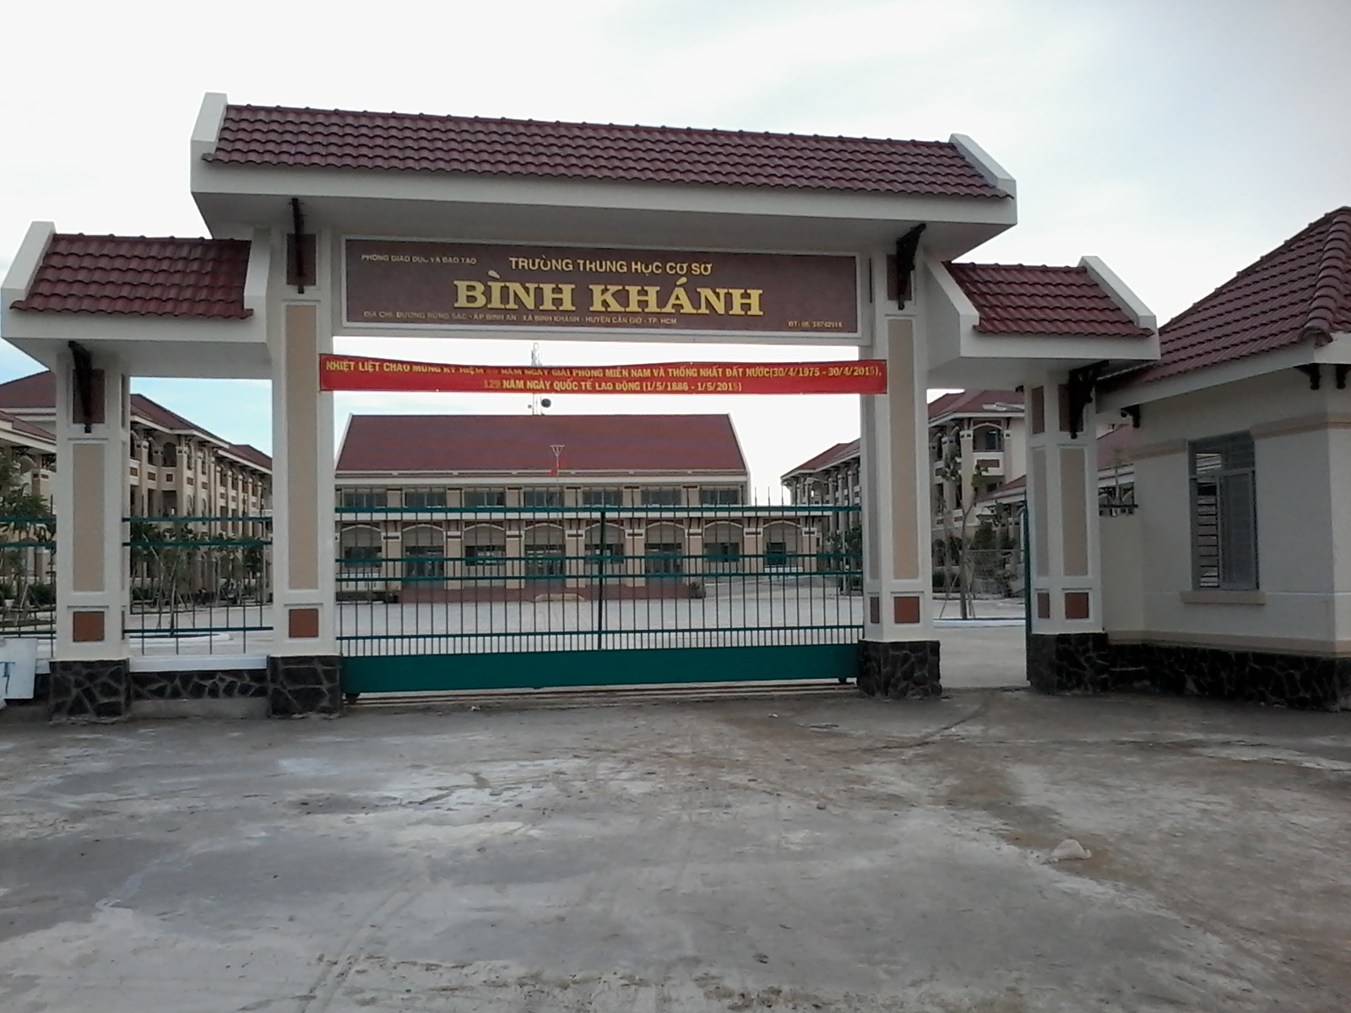
BINH KHANH SECONDARY SCHOOL
ENGLISH 8

Slide 2
UNIT 7: MY NEIGHBORHOOD
Period 40: Listen

Slide 3
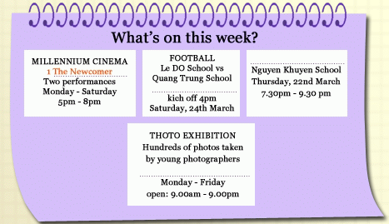
Do you remember Na?
Na is new to the neighborhood. She’s talking with Nam about .
Look at the advertisement of “ What’s on this weekend?”
What she’s going to do on the weekend?
3
2
4

Slide 4
Vocabulary
Town Ground
Sân vận động thành phố
Cultural House
Nhà văn hóa
English speaking contest
Cuộc thi nói tiếng Anh
Vs= versus
Le Do school vs Quang Trung school
The Newcomer
Người mới đến
By three thirty
Trước 3 giờ 30

Slide 5
Present perfect
1. with Before
Na says: “I have seen this film before.
I saw it on Star movies”
S + have / has + V3/ Ved + before.
Người này đã từng làm việc này trước đây.
2. with Never
Na says: “I have never been to soccer match before.”
S + have / has +never+ V3/ Ved + before.
Người này chưa bao giờ làm việc này trước đây.

Slide 6
4. Listen Then fill the blank in each of the advertisement with one phrase from the box
Town Ground- The Newcomer- English speaking Club-Culture House
3
2
4

Slide 7
Check the answers
Town Ground- The Newcomer- English speaking Club-Culture House
3
English Speaking Contest
2
Town Ground
4
Culture House

Slide 8
IV/ Listen and check (٧) the correct box.
True False No
information
Na does not know the neighborhood very well.
Na doesn’t like movies.
Na will go to the photo exhibition this weekend.
Na won’t go to the English speaking contest.
Na will go to the soccer match with Nam.
Nam is a soccer fan.

Slide 9
IV/ Listen and check (٧) the correct box.
True False No
information
Na does not know the neighborhood very well.
Na doesn’t like movies.
Na will go to the photo exhibition this weekend.
Na won’t go to the English speaking contest.
Na will go to the soccer match with Nam.
Nam is a soccer fan.
٧
٧
٧
٧
٧
٧

Slide 10
Fill in the missing information
1. Na has been here ……………………………………
a. since last week b. for 1 year
2. She has seen the Newcomer film ………….
a. Before b. never
3. Na has …………….. been to a soccer match before
a. Before b. never

Slide 11
Homework
HOMEWORK
- Write 2 sentences talking about things that you have done for your parents
Practice speaking more at home
Prepare Unit 7: Read

Slide 12
GOODBYE

