Slide 1
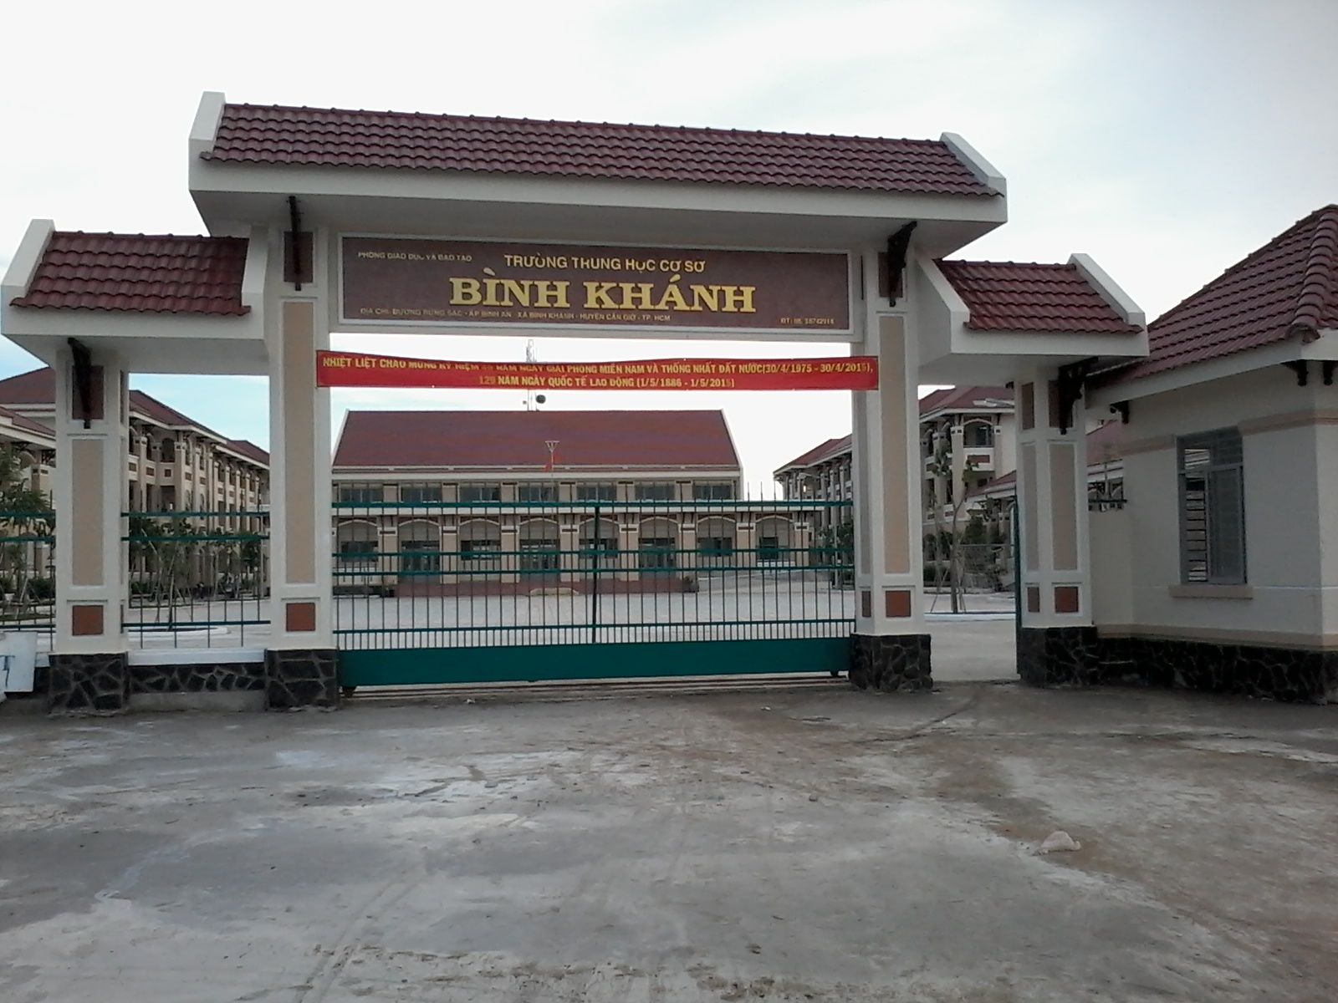



BINH KHANH SECONDARY SCHOOL

Slide 2

Unit 6- The young Pioneers Club
Lesson 3: Listen

Slide 3




free time activities
Listen to music
Play games
Watch TV

Slide 4

Unit 6: The young pioneers club
Lesson 3: Listen

Slide 5
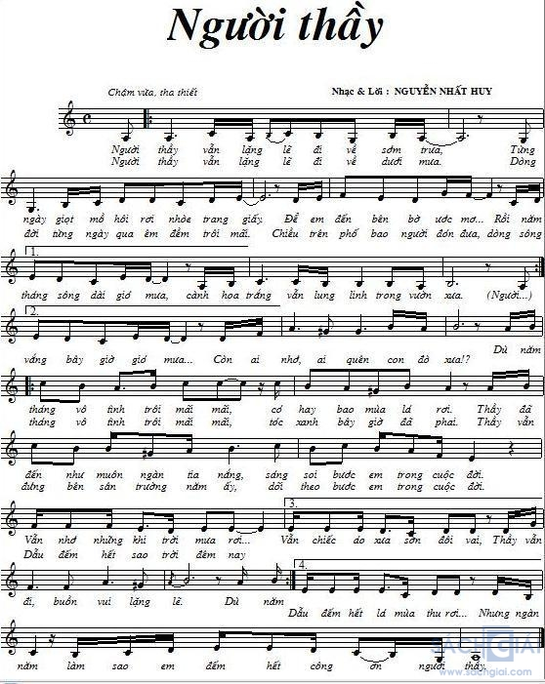

Slide 6
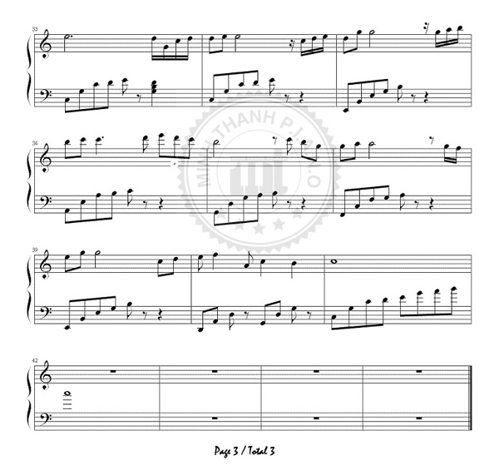
CHILDREN OF THE WORLD UNITE
Children of our land (1)______. Let’s sing for (2) ______Let’s sing for (3) ______.
.
.
Let’s sing for the (4)____ between (5)_____ and (6)_______,
Oh, children (7) ______our land, unite,
Children of the (8) ______hold hands. Let’s (9) ______our love
from(10)_________to place Let’s shout (11) ______ loud,
Let’s make a (12) ______ , Oh, children of the (13)_______ hold hands

Slide 7

peace (n):
hòa bình
unite (v) :
đoàn kết
right (n):
quyền bình đẳng

Slide 8
* Listen . Filling in the missing words.
Children of our land
(1)__________.
Let’s sing for (2) ______.
Let’s sing for (3) ______.
Let’s sing for the (4)____
between (5)_____
and (6)_______,
Oh, children (7) ______
our land, unite,
Children of the (8) ______
hold hands.
Let’s (9) ______our love
from(10)_________to place
Let’s shout (11) ______ loud,
Let’s make a (12) ______ ,
Oh, children of the (13)
_______ hold hands.

Slide 9
* Filling in the missing words.
Children of our land
(1)__________.
Let’s sing for (2) ______.
Let’s sing for (3) ______.
Let’s sing for the (4)____
between (5)_____
and (6)_______,
Oh, children (7) ______
our land, unite,
Children of the (8) ______
hold hands.
Let’s (9) ______our love
from(10)_________to place
Let’s shout (11) ______ loud,
Let’s make a (12) ______ ,
Oh, children of the (13)
_______ hold hands.
world
unite
peace
show
right
place
love
out
north
south
stand
of
world

Slide 10


CHILDREN OF THE WORLD UNITE
Children of our land unite.
Let’s sing for peace,
Let’s sing for right.
Let’s sing for the love between north and south,
Oh, children of our land, unite.
Children of the world hold hands.
Let’s show our love from place to place.
Let’s shout out loud,
Let’s make a stand,
Oh, children of the world, hold hands.
Apdapted from a song by Margarette Thornas-Cochran

Slide 11
HOMEWORK
Copy the song into notebooks.
Practice singing if you can.
Prepare lesson – Read –page 57.

