Slide 1
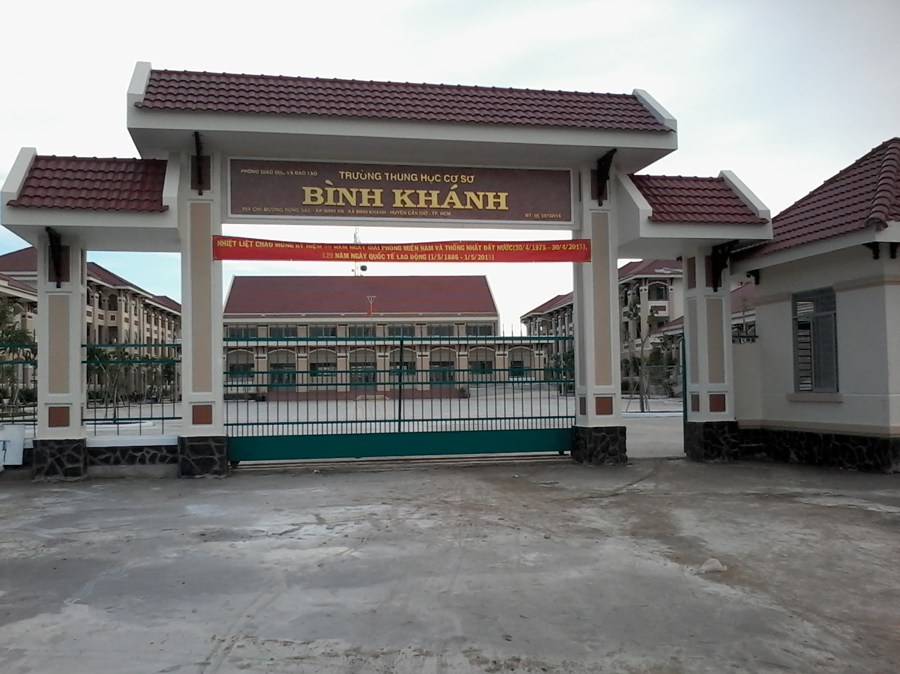
BINH KHANH SECONDARY SCHOOL
ENGLISH 8

Slide 2
t
0
WELLCOME TO OUR
CLASS !

Slide 3
Unit 4 : LEARNING A FOREIGN LANGUAGE lesson 2 : Speak
I.VOCABULARY

Slide 4
Unit 4 : LEARNING A FOREIGN LANGUAGE lesson 2 : Speak
I.VOCABULARY
1.Scholarship (n) :
Học bổng

Slide 5
Unit 4 : LEARNING A FOREIGN LANGUAGE lesson 2 : Speak
I.VOCABULARY

Slide 6
Unit 4 : LEARNING A FOREIGN LANGUAGE lesson 2 : Speak
I.VOCABULARY
1.Scholarship ( n ) :
Học bổng
2.Award ( v ) :
Thưởng , tặng

Slide 7
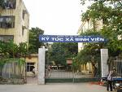
Unit 4 : LEARNING A FOREIGN LANGUAGE lesson 2 : Speak
I.VOCABULARY

Slide 8
Unit 4 : LEARNING A FOREIGN LANGUAGE lesson 2 : Speak
I.VOCABULARY
1.Scholarship (n) :
Học bổng
2.Award ( v ) :
Thưởng, tặng
3.Dormitory ( n ) :
Ký túc xá

Slide 9
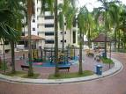
Unit 4 : LEARNING A FOREIGN LANGUAGE lesson 2 : Speak
I.VOCABULARY

Slide 10
Unit 4 : LEARNING A FOREIGN LANGUAGE lesson 2 : Speak
I.VOCABULARY
1.Scholarship (n) :
Học bổng
2.Award ( v ) :
Thưởng, tặng
3.Dormitory ( n ) :
Ký túc xá
4.Campus ( n ) :
Khuôn viên

Slide 11
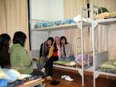
Unit 4 : LEARNING A FOREIGN LANGUAGE lesson 2 : Speak
I.VOCABULARY

Slide 12
Unit 4 : LEARNING A FOREIGN LANGUAGE lesson 2 : Speak
I.VOCABULARY
1.Scholarship (n) :
Học bổng
2.Award ( v ) :
Thưởng , tặng
3.Dormitory ( n ) :
Ký túc xá
4.Campus ( n ) :
Khuôn viên
Gần gũi
5. Quite close :

Slide 13
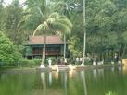
Unit 4 : LEARNING A FOREIGN LANGUAGE lesson 2 : Speak
I.VOCABULARY

Slide 14
Unit 4 : LEARNING A FOREIGN LANGUAGE lesson 2 : Speak
I.VOCABULARY
1.Scholarship (n) :
Học bổng
2.Award ( v ) :
Thưởng , tặng
3.Dormitory ( n ) :
Ký túc xá
4.Campus ( n ) :
Khuôn viên
Gần gũi
5. Quite close :
6. Scenery ( n ) :
Phong cảnh

Slide 15
Unit 4 : LEARNING A FOREIGN LANGUAGE lesson 2 : Speak
I.VOCABULARY
1.Scholarship (n) :
Học bổng
2.Award ( v) :
Thưởng , tặng
3.Dormitory ( n ) :
Ký túc xá
4.Campus ( n ) :
Khuôn viên
Gần gũi
5. Quite close :
6. Scenery ( n ) :
Phong cảnh
7.Western culture(n) :
Văn hóa phương tây

Slide 16
Unit 4 : LEARNING A FOREIGN LANGUAGE lesson 2 : Speak
I.VOCABULARY
1.Scholarship (n) :
Học bổng
2.Awarded ( v ) :
Cấp phát
3.Dormitory ( n ) :
Ký túc xá
4.Campus ( n ) :
Khuôn viên
Gần gũi
5. Quite close :
6. Scenery ( n ) :
Phong cảnh
7.Western culture(n) :
Văn hóa phương tây
8.Reputation (n) :
Danh tiếng

Slide 17
Unit 4 : LEARNING A FOREIGN LANGUAGE lesson 2 : Speak
I.VOCABULARY
1.Scholarship (n) :
Học bổng
2.Award ( v) :
Thưởng , tặng
3.Dormitory ( n ) :
Ký túc xá
4.Campus ( n ) :
Khuôn viên
Gần gũi
5. Quite cloce :
6. Scenery ( n ) :
Phong cảnh
7.Western culture(n) :
Văn hóa phương tây
8.Reputation (n) :
Danh tiếng

Slide 18
Unit 4 : LEARNING A FOREIGN LANGUAGE lesson 2 : speak & listen
I.VOCABULARY
1.Scholarship (n) :
Học bổng
2.Award ( v) :
Thưởng, tặng
3.Dormitory ( n ) :
Ký túc xá
4.Campus ( n ) :
Khuôn viên
Gần gũi
5. Quite close :
6. Scenery ( n ) :
Phong cảnh
7.Western culture(n) :
Văn hóa phương tây
8.Reputation (n) :
Danh tiếng

Slide 19
Unit 9 : LEARNING A FOREIGN LANGUAGE lesson 2 : Speak
II.SPEAKING
THU
TÂM
Seattle school of English - USA
KIM
The Brighton Language center - UK
Brisbane Institute of E - Australia

Slide 20
Unit 9 : LEARNING A FOREIGN LANGUAGE lesson 2 : Speak
II.SPEAKING
Thu
* live in a dormitory on campus
*school has exellent reputation
*six weeks
Apporximately US$ 2,000
The Brighton Language Center - UK

Slide 21
Unit 9 : LEARNING A FOREIGN LANGUAGE lesson 2 : Speak
II.SPEAKING
*stay with Vietnamese friends
* experience Western culture
*seven weeks
Apporximately
US$ 1,700
Tâm
Seattle School of English- USA

Slide 22
Unit 9 : LEARNING A FOREIGN LANGUAGE lesson 2 : Speak
II.SPEAKING
* stay with an Australian family
*quite close to Viet Nam
*beautiful scenery
*seven weeks
Apporximately
US$ 1,200
KIM
Brisbane Institute of E - Astralia

Slide 23
Unit 9 : LEARNING A FOREIGN LANGUAGE lesson 2 : Speak
II.SPEAKING
* The expression :
I think ……..
What do you think ………………?
I agree / disagree because ……….
I don’t understand ……………
Why don’t we ………….
If we go to ………, we can ……….
We should ……………
Let’s ……………………………..

Slide 24
Unit 9 : LEARNING A FOREIGN LANGUAGE lesson 2 : Speak
II.SPEAKING
Tâm : I think we should go to the Seattle School of English in the USA .We can stay with Vietnamese friends .
Kim : I disagree because we can’t practice speaking English with native speakers .
Thu : why don’t we go to the Brighton Language Center in the United Kingdom ? If we go there , we can live in a dormitory on campus .
Tâm : But the course is too expensive . It costs US$ 2,000 .
Kim : What do you think about the Brisbane Institute of English in Australia ?
Thu : I think it’s not comfortable to live with foreigners .

Slide 25
Unit 9 : LEARNING A FOREIGN LANGUAGE lesson 2 : Speak
II.SPEAKING
Dialogue 1:
to the Brisbane Institute of English in Autralia because it has beautiful sceneries and it’s the cheapest
A: I think we should go……………………………………………………………………
……………………………………………………………………………………………………………………..
…………………………………………………………………………………………………………………………………..
B:What do you think about ………………………………………………….
C : why don’t we go …………………………………………………………………
B: I disagree because ……………………………………………………………
Dialogue 2
A: Let’s …………………………………………………………………………………….
B: Why don’t we go …………………………………………………………………...........
C; What do you think about ………………………………………………….............
A: I think we should …………………………………………………………………………..

Slide 26
Unit 9 : LEARNING A FOREIGN LANGUAGE lesson 2 : Speak
Game : Find someone who ……………….
(How to learn English)
Do you ……………………………… ? Yes , I do / No , I don’t .
Find someone who …….. | Name
1- Reads English comics
2- Does the homework
3- Learns by heart all the new words
4- Uses dictionary for reading
5- Learns to sing English songs
Duyen

Slide 27
t
0
Thank you for your attendance and goodbye!

