Slide 1
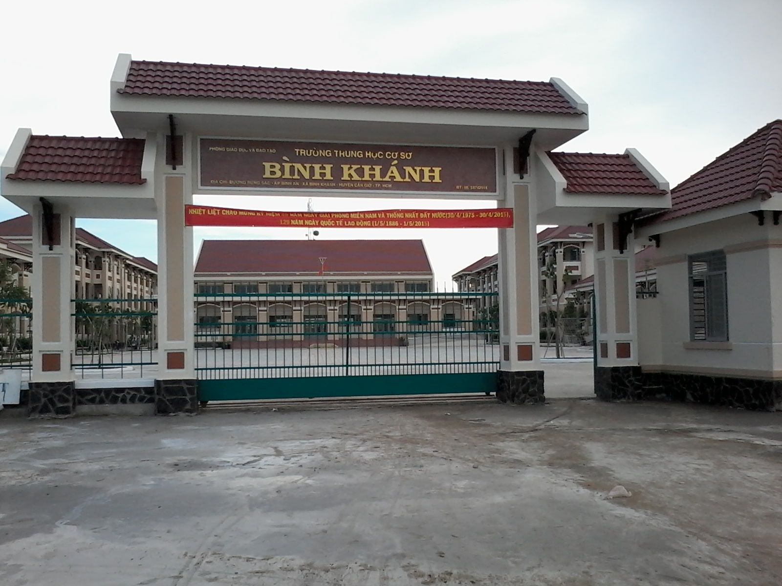



BINH KHANH SECONDARY SCHOOL
ENGLISH 8

Slide 2


WELCOME TO
OUR CLASS

Slide 3


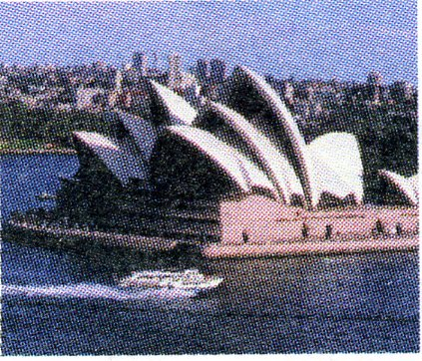
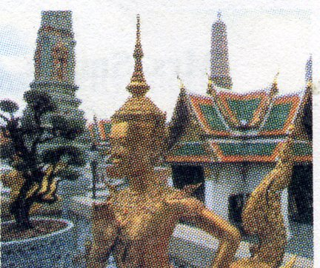



I. GETTING STARTED
1. Match the names of the countries in the box with appropriate pictures / flags.
Canada
Britain
Thailand
Australia
Japan
The United States of America
a)
b)
c)
d)
e)
f)

Slide 4
I. GETTING STARTED
2.Tell your partner which country you would like to visit and why?
A: Which country do you want to visit?
B: I’d like to visit __________.
A: Why ?
B: Because _________ people are friendly.
Australia
Australian
* the sights / beautiful
* want / improve / English
…

Slide 5

Unit 12: A vacation abroad
Getting Started
- Listen and Read

Slide 6

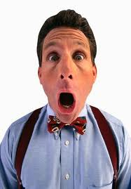

New words :
+ surprise (n)
sự ngạc nhiên, điều bất ngờ
+ include (v)
bao gồm, gồm có, kể cả
+ come over (v)
đến, ghé thăm
Exp: come to Sb’s house to visit for a short time
+ pick sb up (v)
rước, đón (ai)
Exp: come and get Sb in your car to drive him/her to a place.
+ abroad (adv)
ở nước ngoài
= in a foreign country

Slide 7
Matching
1. (to) include | a. sang, ghé thăm
2. (to) pick sb up | b. bao gồm
3. (to) come over | c. sự ngạc nhiên
4. surprise | d. đón ai
5. abroad | e. đi nước ngoài

Slide 8

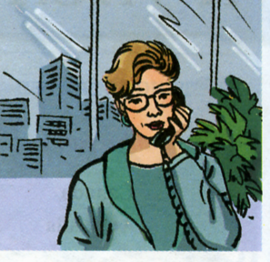
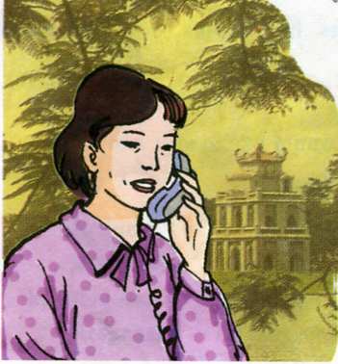


Introduce the Dialogue
Mrs. Smith
Mrs. Quyen

Slide 9


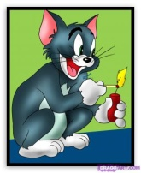
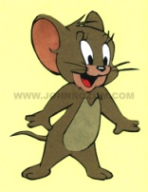
PREDICTION
 | SAY IF THESE SENTENCES ARE TRUE OR FALSE
1 | Mrs. Quyen will come to San Francisco alone. | T F | T F
2 | She will have dinner with Mrs.Smith on the 27th. | T F | T F
3 | On Thursday 28, Mrs.Quyen will leave San Francisco. | T F | T F
KEY

Slide 10

UNIT 12: A VACATION ABROAD– Period 76 – Getting started + Listen and read
II. LISTEN AND READ
Mrs. Smith: Hello.
Mrs. Quyen: Sandra, It’s Quyen. I’m calling from Ha Noi.
Mrs. Smith: Hello, Quyen. This is a nice surprise!
Mrs. Quyen: Thanh and I are coming to San Francisco on Monday.
Mrs. Smith: That’s wonderful! Would you like to come and stay with
us while you’re in town.
Mrs. Quyen: That’s very kind of you, but we’re coming on a tour. Our accommodation
is included in the ticket price.
Mrs. Smith: Then you must come over for dinner one night.
Mrs. Quyen: Yes, we’d love to but we’ll only be in town for three nights. We leave on the 28th.
Mrs. Smith: Are you free on Tuesday evening?
Mrs. Quyen: No, I’m going out that night, but I’m not busy the following evening.
Mrs. Smith: What about Thanh? Will he come with you?
Mrs. Quyen: No. Unfortunately, he has a business meeting in the
evening.
Mrs. Smith: Oh dear. He’s always working. Well, I’ll pick you up at
your hotel. Shall we say seven o’clock?
Mrs. Quyen: That sounds fine. Thanks, Sandra. See you then.
Mrs. Smith: Bye.

Slide 11
CHECKING PREDICTION
 | SAY IF THESE SENTENCES ARE TRUE OR FALSE
1 | Mrs.Quyen will come to San Francisco alone. | T F | T F
2 | She will have dinner with Mrs.Smith on the 27th. | T F | T F
3 | On Thursday 28, Mrs.Quyen will leave San Francisco. | T F | T F
KEY
F
T
T

Slide 12
Getting started + Listen and read
1. Complete Mrs. Quyen's schedule .
DATE | Monday 25 | Tuesday 26 | Wednesday 27 | Thursday 28
SCHEDULE | Coming to San Francisco
Going out
Having dinner with the Smiths
Leaving San Francisco

Slide 13
UNIT 12: A VACATION ABROAD– Period 76 – Getting started + Listen and read
LUCKY STARS
Answer the questions:

Slide 14









Lucky Stars

Slide 15
1
a. Will Mrs. Quyen and her husband stay at Mrs. Smith’s house? Why? Why not?
No, they won’t. Because they are coming on a tour and their accommodation is included in the ticket price, so they will stay at the hotel.
6

Slide 16

2
Lucky Stars
6

Slide 17
3
b. Will Mrs. Quyen’s husband have dinner with the Smiths? Why(not)?
No, he won’t. Because he will have a business meeting in the evening that day.
4

Slide 18
4
c. How will Mrs. Quyen go to Mrs. Smith’s house?
Mrs. Smith will pick her up at her hotel.
3

Slide 19
5
Lucky Stars
5

Slide 20
6
How long will Mrs. Quyen be in San Francisco?
For three nights.
1

Slide 21
7
Where is Mrs. Quyen calling from ?
She is calling from Ha Noi.
4

Slide 22
8
When is Mrs. Quyen going
out?
On Tuesday evening.
2

Slide 23


Congratulations

Slide 24
UNIT 12: A VACATION ABROAD– Period 76 – Getting started + Listen and read
III. Grammar notes:
1. Making an invitation.
Would you like to come and stay with us… ?
+ Yes, I’d love to.
- That’s very kind of you, but…

Slide 25



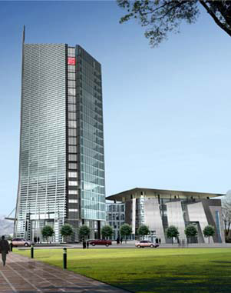
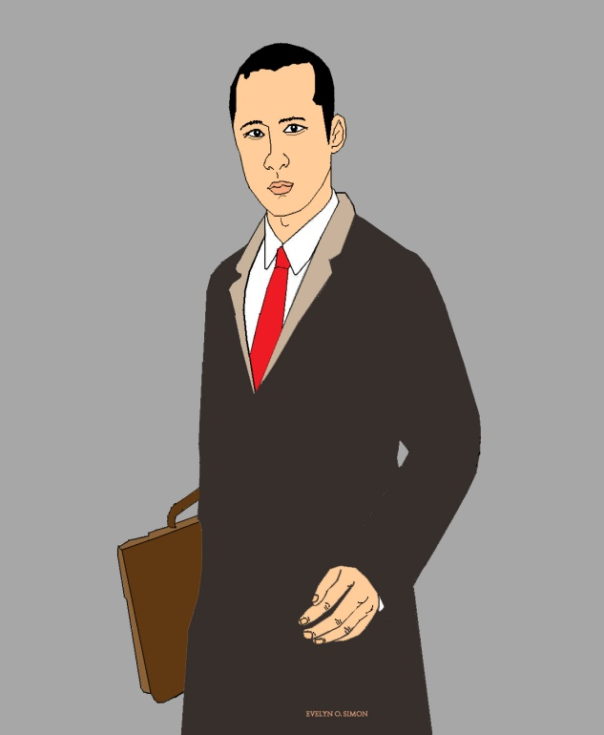
Friday
Thursday
Saturday
Wednesday
Sunday
Tuesday
COMPANY
Monday
He’s always working.

Slide 26
UNIT 12: A VACATION ABROAD– Period 76 – Getting started + Listen and read
III. Grammar notes:
1. Making an invitation.
Would you like to come and stay with us… ?
+ Yes, I’d love to.
- That’s very kind of you, but…
2. Making a complaint.
Oh dear. He’s always working.

Slide 27


Learn new words by heart.
Read the dialogue fluently.
Do exercise 1,2/p113 in the workbook.
Prepare next period:
Unit 12. (cont)
Period 77. Speak and Listen.

Slide 28

Thanks for your attention
GOODBYE
And
SEE YOU AGAIN

