Slide 1
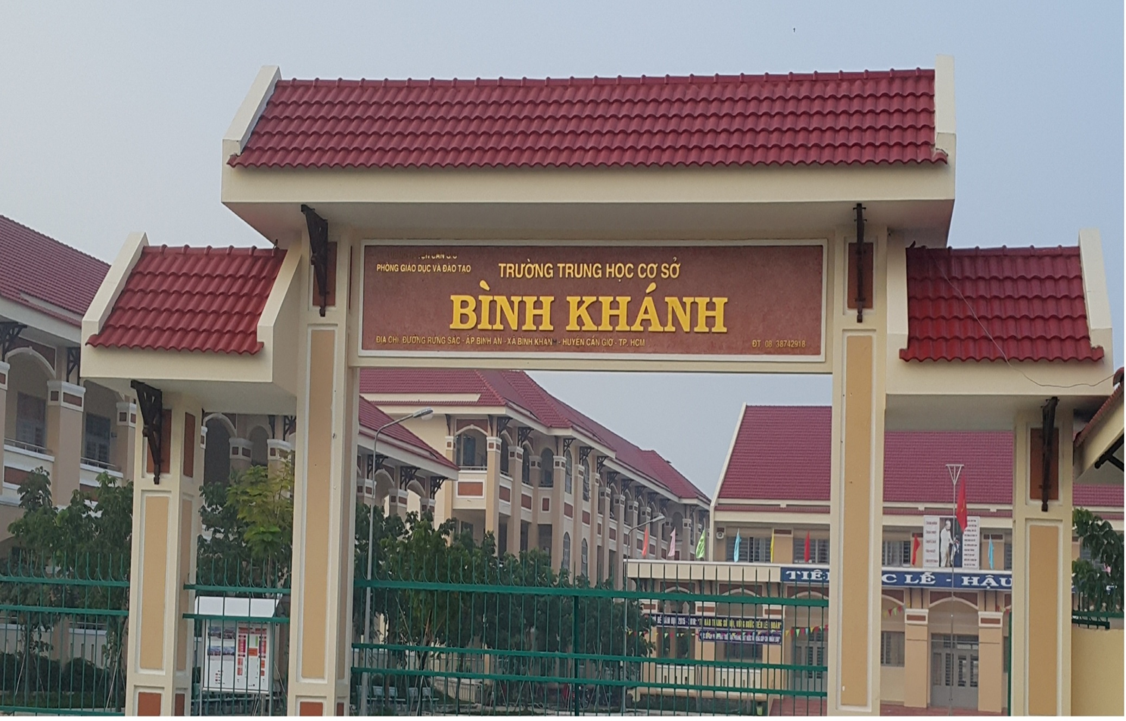
BINH KHANH SECONDARY SCHOOL
ENGLISH 9

Slide 2





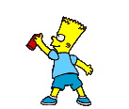
Welcome all the teachers

Slide 3



Unit 10
Life on other planets
Period 2 :
Listen and Speak
Welcome to our class

Slide 4
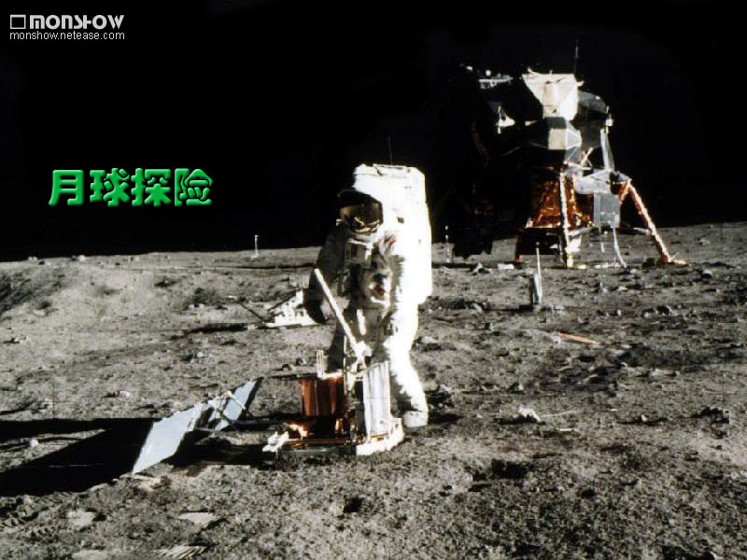

Slide 5
Unit 10: Life on other planets
Period 2: Listen and Speak
I. Listen:
Guessing: On the moon may have ...
air
sounds
lakes
longer days
water
rivers
plants
mountains
great round holes
animals

Slide 6
Unit 10: Life on other planets
Period 2: Listen and Speak
I. Listen:
Listen to the description of the moon. Then choose the words you hear.
sounds
sounds
air
sounds
lakes





longer days

water

rivers
plants

mountains

great round holes
animals


Slide 7
Unit 10: Life on other planets
Period 2: Listen and Speak
I. Listen:
Listen to the description of the moon. Then check the correct statement about the moon.
a, There is no air on the moon.
b, There are rivers and lakes on the moon.
c, There are no sounds on there moon.
d, It is very cold at night on the moon.
e, During the day the temperature is even lower.
f, There are great round holes on the moon.
g, There are no mountains on the moon.
h, You will weigh 8 kilos heavier on the moon.
i, You will be able to jump very high on the moon.
j, One day on the moon lasts for two weeks.
Listen to the description of the moon. Then check the correct statement about the moon.
a, There is no air on the moon.
b, There are rivers and lakes on the moon.
c, There are no sounds on there moon.
d, It is very cold at night on the moon.
e, During the day the temperature is even lower.
f, There are great round holes on the moon.
g, There are no mountains on the moon.
h, You will weigh 8 kilos heavier on the moon.
i, You will be able to jump very high on the moon.
j, One day on the moon lasts for two weeks.







Slide 8
Unit 10: Life on other planets
Period 2: Listen and Speak
II. Speak:

Slide 9
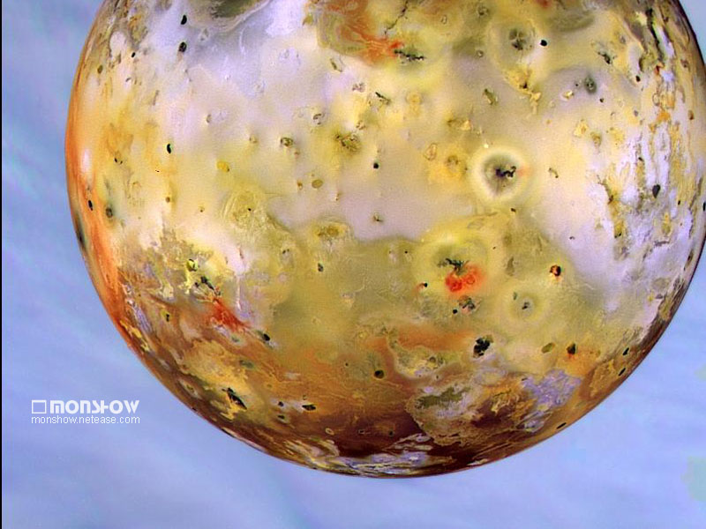
Mars

Slide 10
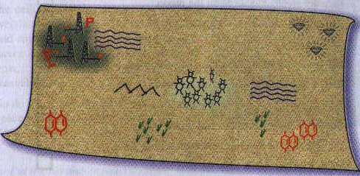
Unit 10: Life on other planets
Period 2: Listen and Speak
Match the correct words with the suitable drawings
minerals
plants
little creature
mountains
gemstones
water
gas
microorganism

Slide 11
Unit 10: Life on other planets
Period 2: Listen and Speak
Practice the dialogue with a partner.
Nam: What do these drawings say, Hung?
Hung: There might be water in Mars.
Nam: And what about those black sparkling spots on the right corner?
Hung: Well, they might be traces of gemstones. There may be a lot of precious stones on Mars.

Slide 12
Unit 10: Life on other planets
Period 2: Listen and Speak
Make up similar dialogues about the drawing, using the cues in section a,
What does the
S1: ……………….... red shapes……?
S2: ………………..
minerals…………
S1: ……………...those signs on the left corner?
S2: ……………...........
…gas.
say
There might be
in Mars
What about
There may be a lot
of

Slide 13
Homework
Prepare Read.

