Slide 1
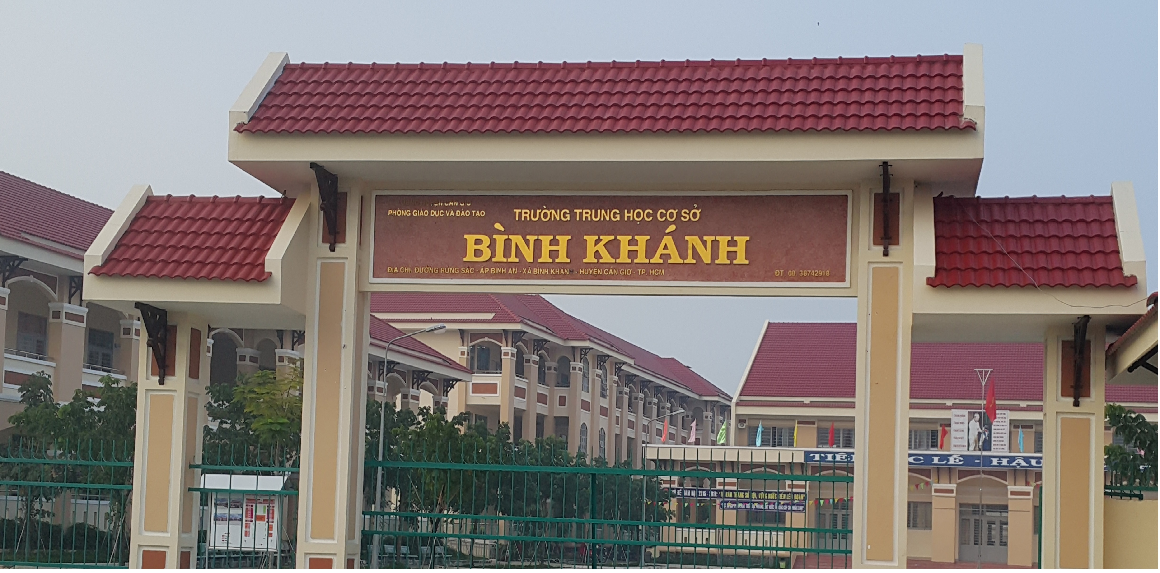
ENGLISH 9
BINH KHANH SECONDARY SCHOOL

Slide 2
WELCOME TO MY CLASS
Good morning Everybody

Slide 3
Unit 1
A VISIT FROM A PEN PAL
Write

Slide 4
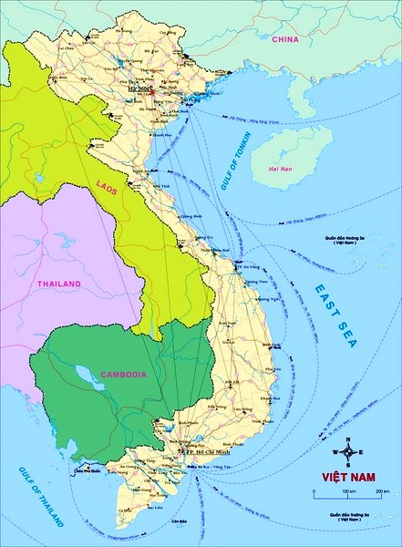
Vietnam:
- Area:
330.991 sq km
- Population:
80 million
- Capital city:
Hanoi
- Unit of currency:
dong
- National language:
Vietnamese

Slide 5
warm-up
Have you ever written a letter?
Who do you write to?
What do you write about?

Slide 6
WRITE:
Imagine you are visiting your relatives or friends in another part of Viet Nam or a different country. Write a letter to your family. Follow the outline.

Slide 7
Pre-writing
Dear Mum,
I arrived in Hue yesterday morning. Uncle Tam met me at the train station and took me home by motorbike.
Hue is rather hot this season. Cousin Chi and I have taken a boat trip along the Huong River, and we have visited Thien Mu Pagoda. Then we have enjoyed Hue’s pan cakes at Thuong Tu. I have bought some jelly-like candy (“me xung” as people here call it). We’ll go to Lang Co tomorrow to have a swim.
opening
introduction
Main parts ( what she did / visited / ate / bought)

Slide 8
I feel quite comfortable here, although I miss you and Dad very much. The people are very hospitable, and the food is delicious – I like all kinds of food here. I’ll come back home next Sunday. Please pick me up at the train station at around 2 p.m.
With love
Nga
Concluding comment (impressions, likes, when to come back home)
Ending + signature

Slide 9
- Who did you visit?
I visited . . . . . .
- Where does she/he live?
She/He lived . . . . . .
- How did you go there?
First paragraph:
I went there . . . . . .
- When did you arrive?
I arrived . . . . . .
- Who met you at the bus/ train station/ airport?
. . . . . .met me at the bus/ train station/ airport.

Slide 10
- What places have you visited?
I have visited . . . . . . . .
- What food have you tried?
I have tried . . . (pancake, stuffed pancake. . .)
Second paragraph
- Who did you meet?
I met . . . . . . .
- What things have you bought?
I have bought . . . . . . . .

Slide 11
- How do you feel?
I feel. . . . .
(happy, disappointed)
- What do you enjoy most?
Third paragraph
I enjoy . . . .
(people, places, activities)
- When will you leave there/ return home?
I will leave there/ return home . . . . .

Slide 12
WRITE:
a. Very happy / get / your mail.
I’m very happy to get your mail.
b. I / back / from / holiday / countryside.
I have been back from a holiday to the countryside.
c. It / one / most / interesting / trip / have.
It was one of the most interesting trip I have ever had.
d. I / play / lots / traditional games / eat / fresh fruit.
I played lots of traditional games and ate lots of fresh fruit.
e. What / you? / nice / weekend?.
What about you? Did you have a nice weekend?
f. Please / write back / me /soon / possible.
Please write back to me as soon as possible.

Slide 13
VI. Homework:
Rewrite your letter at home.
Prepare : language focus

Slide 14
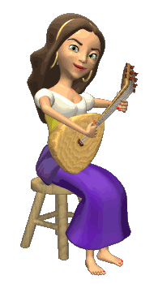
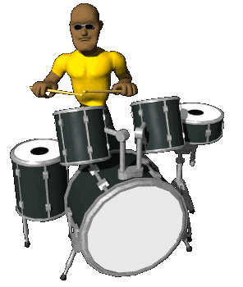
THANK YOU
FOR YOUR ATTENTION !
Goodbye !
Celinne Dion – And so this is Xmax

