Slide 1
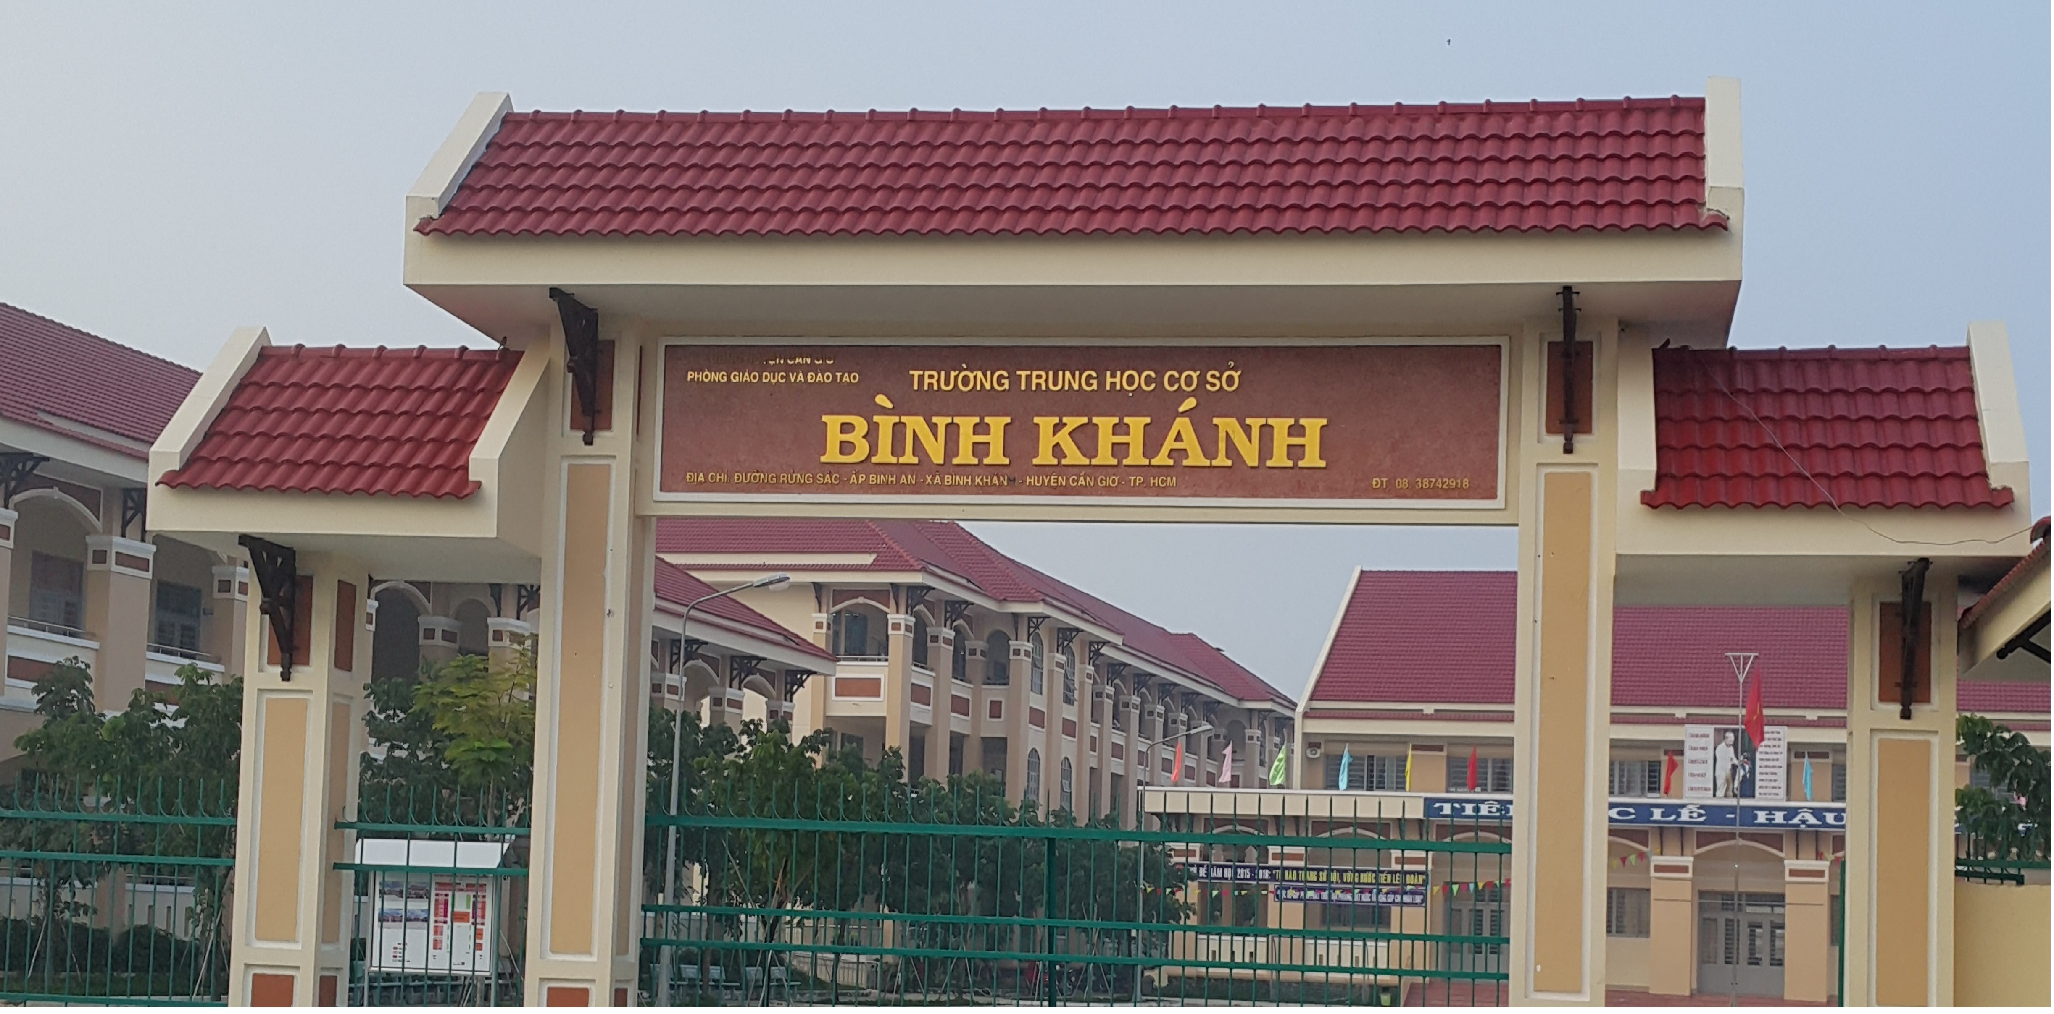
ENGLISH 9
BINH KHANH SECONDARY SCHOOL

Slide 2
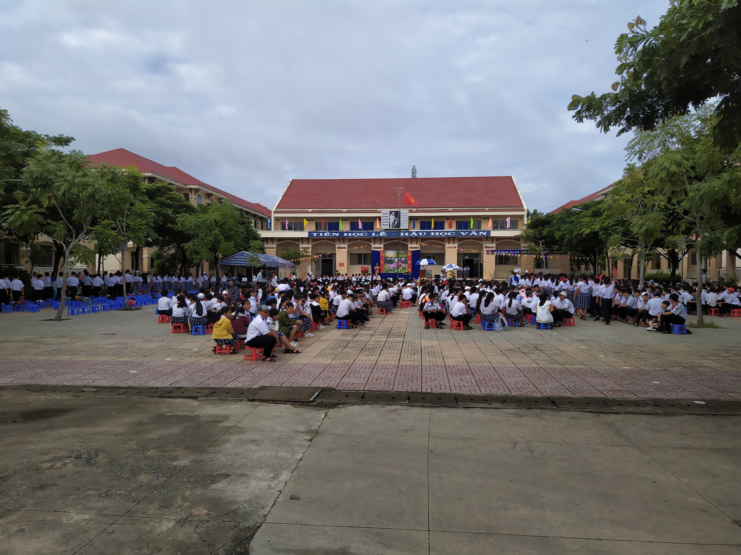
BINH KHANH SECONDARY SCHOOL
WARMLY WELCOME BACK TO
ALL STUDENTS!

Slide 3


Unit 1
A visit from a pen pal
Lesson 2
Speak & Listen

Slide 4
A.Speaking

Slide 5


a. Nga is talking to Maryam. They are waiting for Lan outside her school.
That’s right, I am
Hello. You must be Maryam.
Nga
Maryam

Slide 6
*Answer keys
1c – 5b – 4d – 2e – 3a – 6
+Nga: Hello. You must be Maryam
+Maryam: That’s right, I am.
+Nga: Nice to meet you. Let me introduce myself. I’m Nga.
+Maryam: Nice to meet you, Nga. Are you one of Lan’s classmates?
+Nga: Yes, I am. Are you enjoying staying in Viet Nam ?
+Maryam: Oh yes, very much. Vietnamese people are very friendly and Ha Noi is a very interesting city.
+Nga: Do you live in a city, too ?
+Maryam: Yes. I live in Kuala Lumpur. Have you been there?
+Nga: No. Is it different from Ha Noi ?
+Maryam: The two cities are the same in some ways.
+Nga: I know. Oh! Here’s Lan. Let’s go.

Slide 7
Yoko | Paul | Jane
Yoko from Tokyo, Japan (a busy big capital city) Like Vietnamese people Love old cities in Viet Nam | Paul from Liverpool, England (an industrial city, north of England) Love the people, the food, and the beaches in Viet Nam | Jane from a small town in Perth, Australia (a quiet small town) Love the temples and churches in Viet Nam Love ao dai, Vietnamese food. especially nem

Slide 8
b. Now make similar dialogues. Take turn to be one of Maryam’s friends
Example Exchange:
you
Paul
Hello. You must be Paul
Nice to meet you. I am …
Yes, I am. Are you enjoying staying in Viet Nam ?
Do you live in a city, too ?
No. Is it different from Ha Noi?
I know. Oh! Here’s Maryam. Let’s go.
That’s right, I am.
Nice to meet you, …. Are you one of Maryam’s classmates
Oh yes, very much. I love the people, the food and the beaches in Viet Nam
Yes. I live in Liverpool in England. Have you been there ?
It’s an industrial city , in the North of England.

Slide 9
B.Listening

Slide 10
* Vocabulary:
catch (v):
park (v-n):
pond (n):
Grass (n):
Hamburger (n):

Slide 11
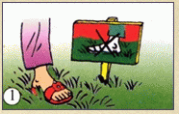
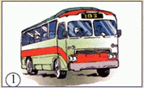
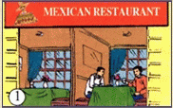
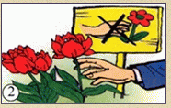
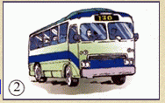
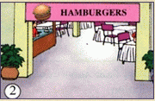
Tim Jones’s Mexican pen pal, Carlo, is visiting the USA. Listen to their conversation and check (√) the numbers of the correct pictures.

Slide 12
Tim Jones’s Mexican pen pal, Carlo, is visiting the USA. Listen to their conversation and check (√) the numbers of the correct pictures.
-Don’t walk on the grass.
-Don’t cut the flowers.

Slide 13

Tim Jones’s Mexican pen pal, Carlo, is visiting the USA. Listen to their conversation and check (√) the numbers of the correct pictures.
The bus 103
The bus 130

Slide 14
Tim Jones’s Mexican pen pal, Carlo, is visiting the USA. Listen to their conversation and check (√) the numbers of the correct pictures.
Mexican restaurant
American restaurant

Slide 15
Tim Jones’s Mexican pen pal, Carlo, is visiting the USA. Listen to their conversation and check (√) the numbers of the correct pictures.



√

Slide 16
Homework
Practice speaking the dialogue at home
Prepare : Unit 1 - Read

Slide 17


Thanks for joining my lesson

Slide 18
* Answer the questions
- Where are Tim and Carlo going to go ?
- Are they going to take a bus?
- Are they going to eat Mexican food?

Slide 19
THE END

