Slide 1
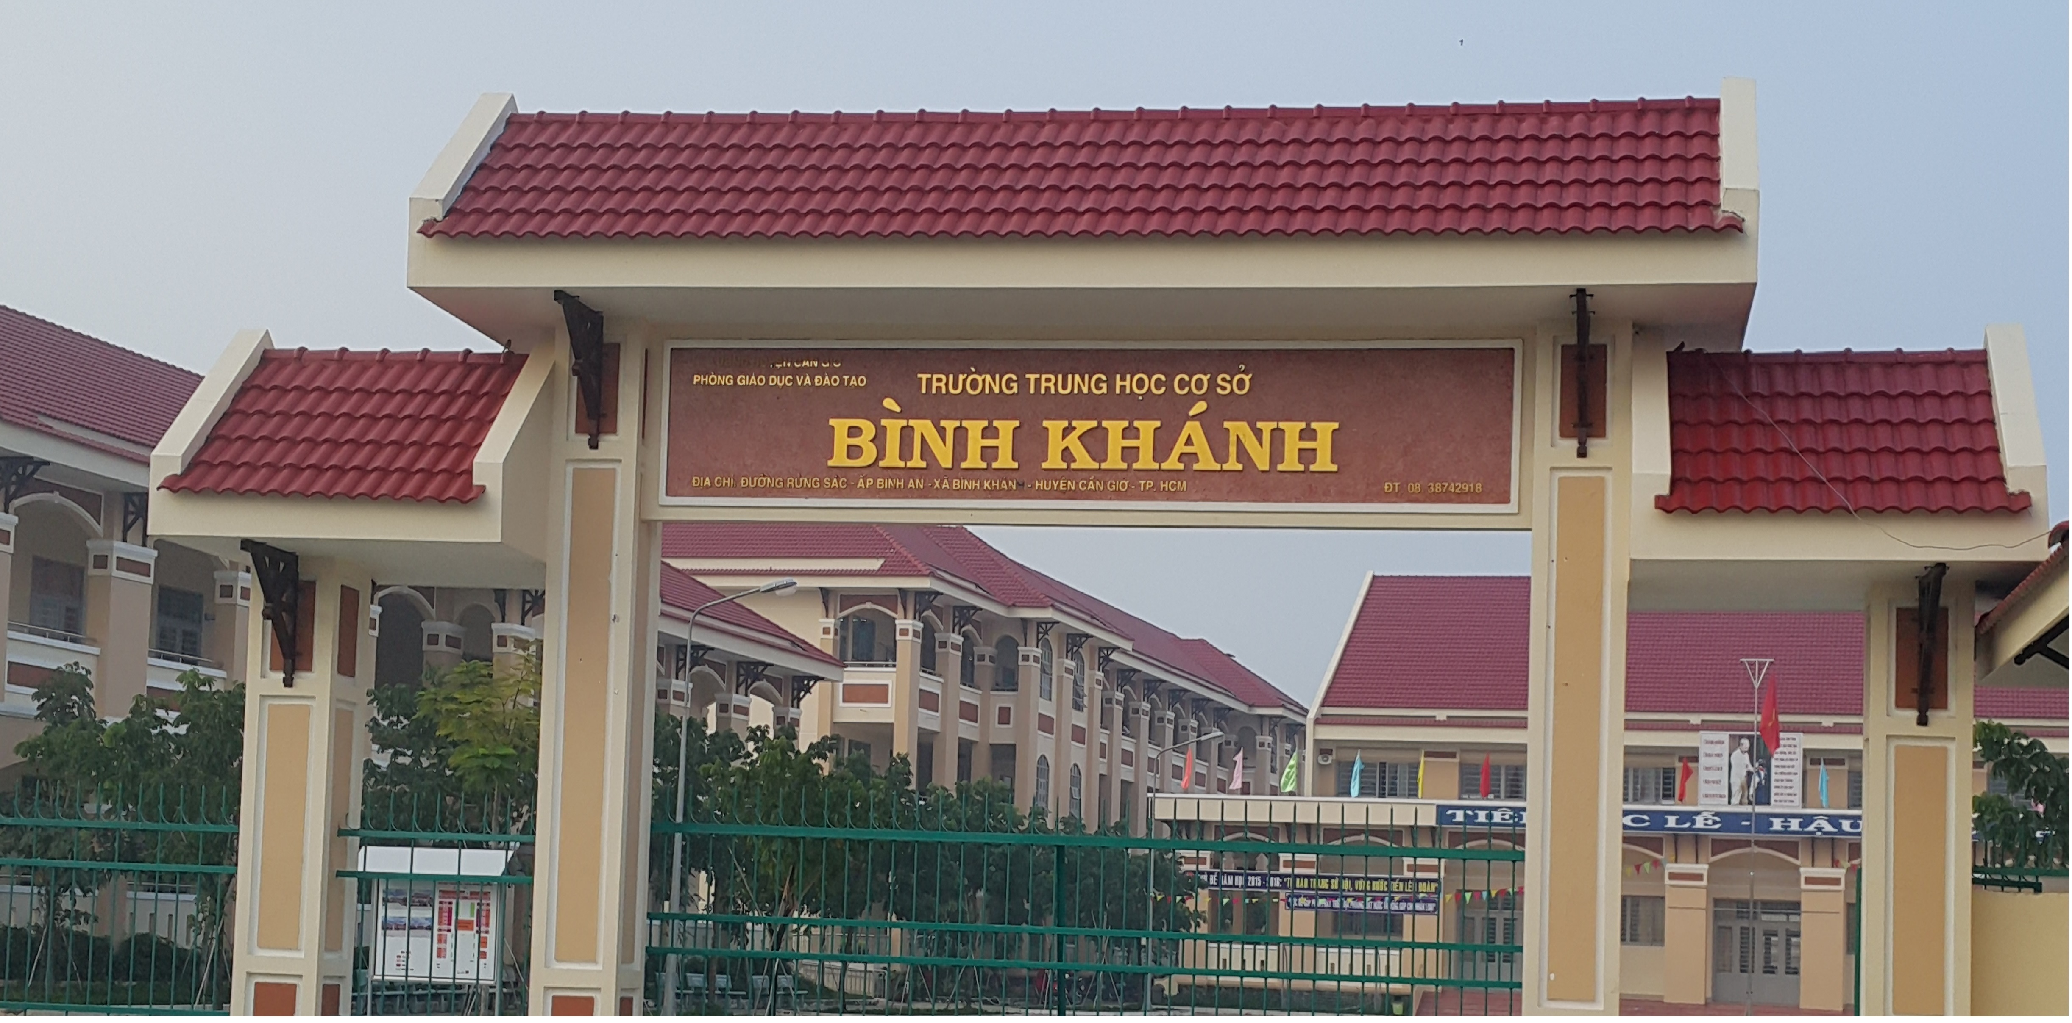
ENGLISH 9
BINH KHANH SECONDARY SCHOOL

Slide 2
LISTEN AND READ

Slide 3
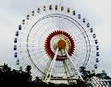
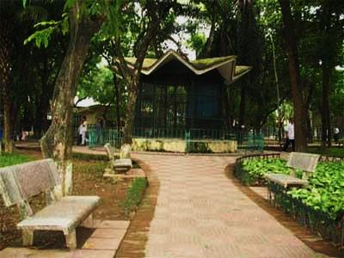
HCM Mausoleum
Water Park
Thu Le Zoo
Hoan kiem Lake

Slide 4
Lan
Maryam

Slide 5
I. Vocabulary
- correspond (v) : trao đổi thư
- be impressed by: ấn tượng bởi
- a mosque (n) : nhà thờ hồi giáo
- pray (v): cầu nguyện
- wish (v): mong ước
- seem (v): có vẻ
- depend on : tùy thuộc vào
- peaceful atmosphere : không khí yên tĩnh
- keep in touch : giữ liên lạc

Slide 6
Grammar: The Wish sentences
Form: S1+ Wish(es) + S2 + V2/ed …..
Be → Were / Ordinary verbs → Simple past
Ex: I wish Lan were here now.
Minh wishes he worked for Ha Noi newspaper now.

Slide 7
II. Listen and read
Lan’s Malaysian pen pal, Razali Maryam, was staying with Lan last week. Maryam is from Kuala Lumpur. Maryam and Lan have been pen pals for over two years and they correspond at least once every two weeks, but this was their first meeting.
On Maryam's first day in Ha Noi, Lan took her to Hoan Kiem Lake. Like Kuala Lumpur, Ha Noi is a busy modern city. Maryam was really impressed by the beauty of the city and by the friendliness of its people.
Over the next few days, the girls visited Ho Chi Minh's Mausoleum, the History Museum and the Temple of Literature, as well as many beautiful parks and lakes in Ha Noi. On Friday, Maryam wanted to visit the mosque on Hang Luoc Street. Lan used to walk past the mosque on her way to primary school. However, this was Lan’s first visit. She enjoyed the peaceful atmosphere while Maryam was praying.
“I wish you had a longer vacation,” Lan said to Maryam at the end of the week.
“Yes, I wish I had more time to get to know your beautiful country better. Lan, would you like to come and visit me next summer?” Maryam asked.
“That would be great! However, it seems very difficult for me to have a trip abroad. It all depends on my parents. Anyway, we’ll keep in touch.”

Slide 8
Guiding questions
1. Where did Lan take Maryam to?
Lan took Maryam to:
Hoan Kiem Lake
Ho Chi Minh’s Mausoleum
the History Museum
the Temple of Literature
many beautiful lakes and parks in Ha Noi.
the mosque on Hang Luoc Street

Slide 9
10
9
8
7
6
5
4
3
2
1
0
CHOOSE THE BEST ANSWER
1.Lan and Maryam usually write to
one another every ………..
⬧
A
two years
B
month
two weeks
C
two weeks
D
day

Slide 10
10
9
8
7
6
5
4
3
2
1
0
CHOOSE THE BEST ANSWER
2. Maryam was impressed
because ………
⬧
A
Ha Noi was big and modern
B
Ha Noi people were friendly
Ha Noi people were friendly
C
Ha Noi was different from Kuala Lumpur
D
Ha Noi and Kuala Lumpur were the same

Slide 11
10
9
8
7
6
5
4
3
2
1
0
CHOOSE THE BEST ANSWER
3. The girls went to see ……………
⬧
A
famous places in Ha Noi
B
areas for recreation.
C
a place of worship.
all the above
D
all the above

Slide 12
10
9
8
7
6
5
4
3
2
1
0
CHOOSE THE BEST ANSWER
4. Maryam wanted to ……………
⬧
A
visit Ha Noi the next summer
invite Lan to Kuala Lumpur.
B
invite Lan to Kuala Lumpur.
C
stay in Ha Noi
D
visit Ho Chi Minh City.

Slide 13
Comprehension questions
1. Where is Maryam from?
2.How long have they been pen pals?
3.Were Hanoi and Kuala Lumpur different?
Kuala Lumpur - Malaysia
For over 2 years
No, they weren’t. they were the same.
4. Did Maryam enjoy Hanoi? Why?
Yes, she did. Because of people’s friendliness, beautiful places,

Slide 14
What did Lan say to Maryam at the end of the week?
Lan said : “I wish you had a longer vacation”

Slide 15
1. Learn the new words and the wish sentences by heart
HOMEWORK
-Read the text again at home
- Prepare Speak + Listen page 8.

Slide 16
THANK YOU
Goodbye!
Celinne Dion – And so this is Xmax

