Slide 1
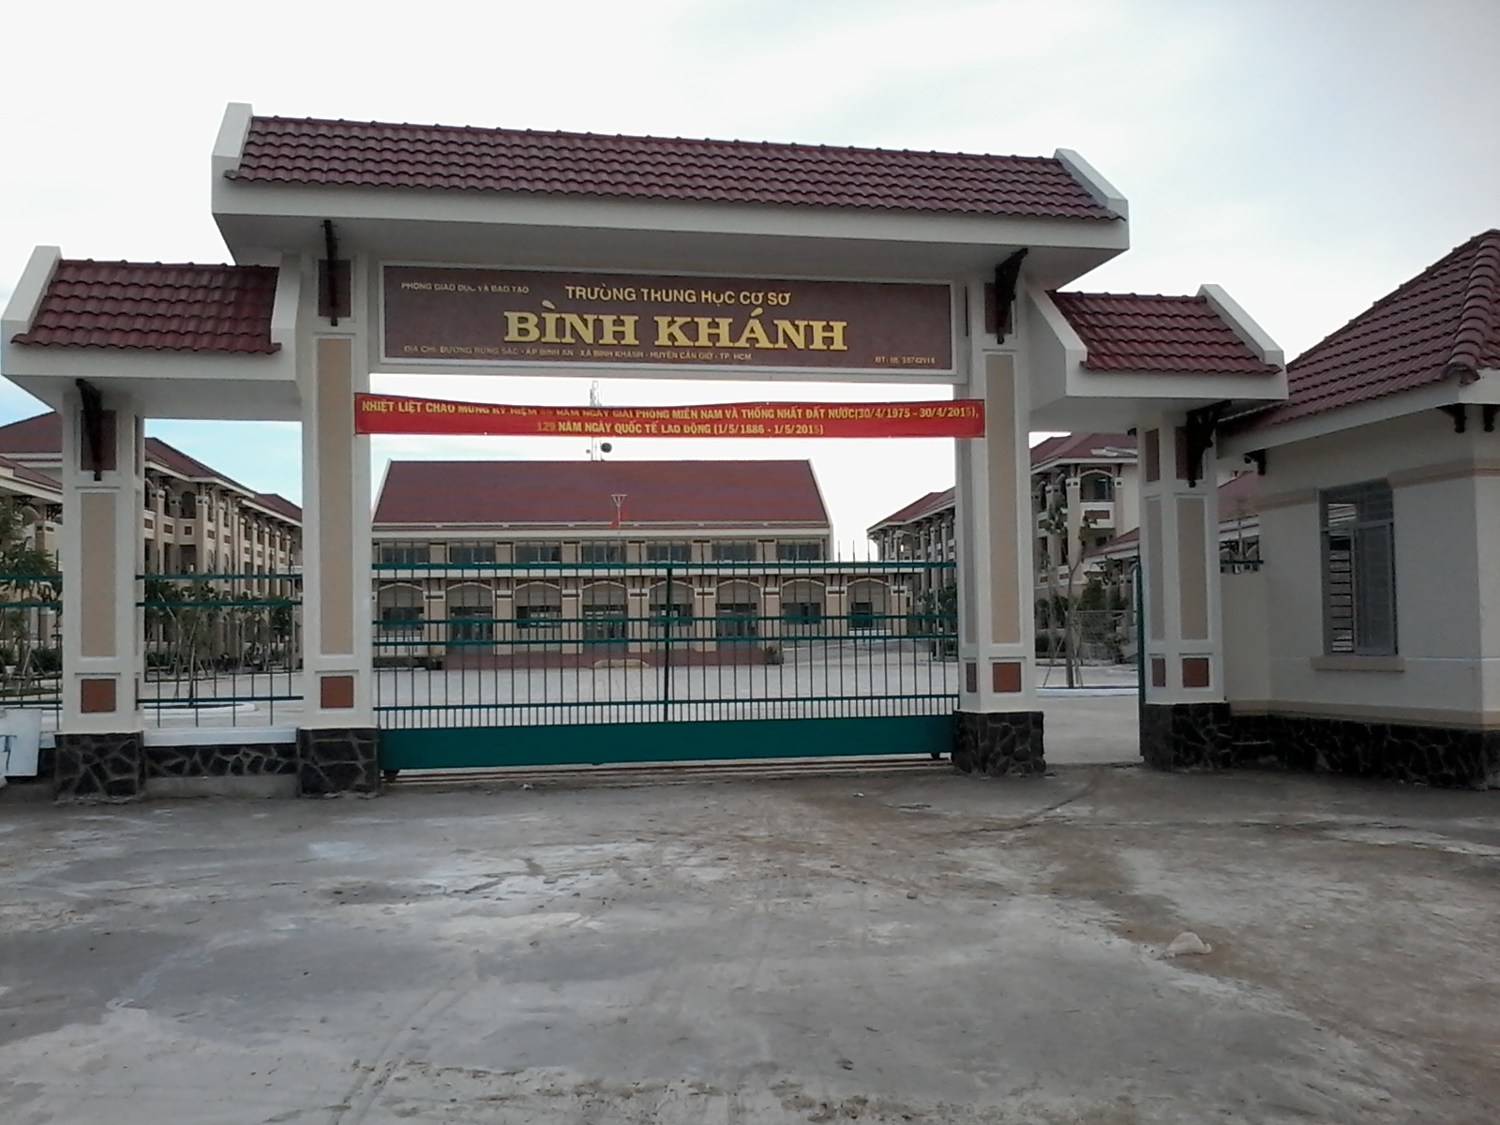
BINH KHANH SECONDARY SCHOOL
ENGLISH 8

Slide 2
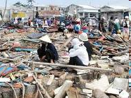
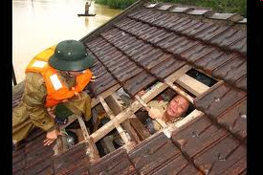
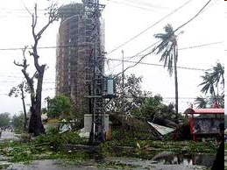
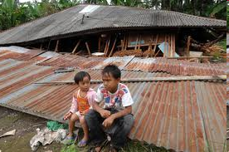
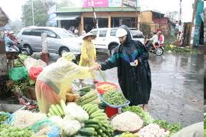
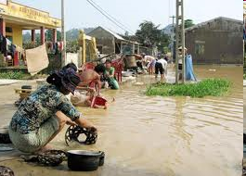
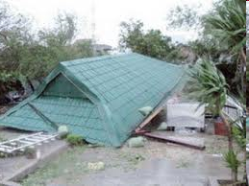
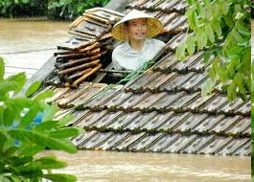
Life after a Typhoon

Slide 3
Buy food
Cut some branches
Buy oil
Preparation for a typhoon
Buy gas
Check the roof
Buy candles
Check the door

Slide 4
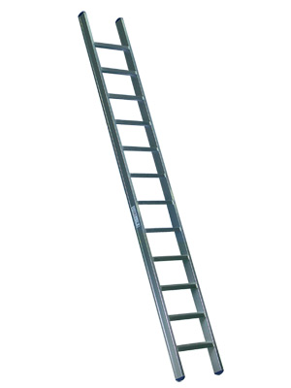
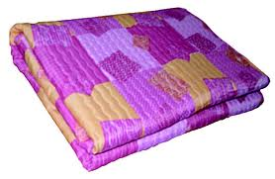
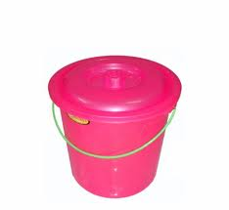
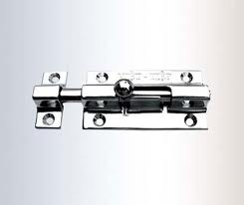
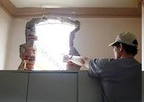
Period: 58 UNIT 9: NATURAL DISASTERS
Lesson 2: Speaking and listening
1. Vocabulary
- a bucket (n)
- a ladder (n)
- fixing a leak (v)
latch (n)
- a blanket (n)
- available (adj)

Slide 5
2. Check (٧) what preparations you think should be made a typhoon.
٧
Buying some canned food
Painting the house
Buying a dog
Buying candles
Buying matches
Hiring some video movies
Filling all buckets with water
Buying a ladder
Washing your blanket
Fixing the leak in the roof
Tying the roof to the ground with pegs and ropes
Inviting some friends and door latches
Checking all the window and door latches
٧
٧
٧
٧
٧
٧
٧

Slide 6
3.Match the preparations with reasons
Preparations
Reasons
1. Buying some canned food
a. There may be a power cut.
2. Buying candles, matches
b. The roof may be damaged by the typhoon.
3. Filling all buckets with water
c. There must be strong wind blowing.
4. Buying a ladder
d. The water pipes may be damaged by the typhoon.
5. Tying the roof to the ground with pegs and ropes
e. Just in case we need to fix the roof.
f. The market may be closed and no food will be available.
6. Checking all the window and door latches

Slide 7
4. Model dialogue
Ba
Mai
I think we should buy some canned food before a typhoon.
Yes, I think so.
The market will be closed and no food will be available
What about buying a ladder?
What for?
Why?
Just in case we need to fix the roof.
Yes. That’s good idea!

Slide 8
Ba
Mai
I think we should buy some canned food before a typhoon.
Yes, I think so. The market will be closed and no food will be available
What about buying a ladder?
What for?
Why?
Just in case we need to fix the roof.
Yes, that’s good idea!
Word cues
Buy candles/ matches/ there may be power cut.
Fill buckets/ water/ the water pipes may be damaged by the typhoon.
2. Check window/ door latches/ There must be strong wind blowing
Tie roof/ ground/ pegs/ ropes/ roof/ damage/ typhoon

Slide 9
Period: 58 UNIT 9: NATURAL DISASTERS
Lesson 2: Speaking and listening
5. Listening: Answer the questions
1.In which countries do earthquakes usually occur?
Earthquakes usually occur in Japan, China, Indonesia…
2.Are they dangerous?
Yes,they are.
3.What happens if there is an earthquake?
A large number of people are killed, houses and buildings are damaged.
4.When there is an earthquake should we:
- stay inside.
- stay inside?
- go out of the house?
- play games?

Slide 10
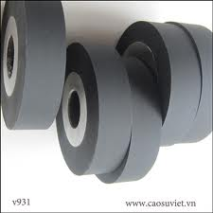
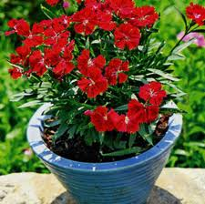
Tuesday, March 20th, 2012
Period: 58 UNIT 9: NATURAL DISASTERS
Lesson 2: Speaking and listening
A. vocabulary
-potted plant (n)
- roller (n)
- fixture (n)
- block (v)

Slide 11
ENGLISH 9
B. Choose the best answer
Living with earthquakes.
Heavy fixtures, furniture, and appliances:
*Place heavy books on the…………………
a.Top shelf of the bookshelf.
b.Bottom shelf of the bookshelf.
Earthquakes drill: *Stay ………………………….
a.Inside
b.In bed
*Sit ……………………………
A.Under a table or doorway
B.On the table or chair.
*Stand in the…………………
a.Middle of the room.
b.In the corner of the room.
Block the rollers on your………….............
a.Fridge / washing machine.
b.T.V set / table.
Flying glass:
*Check the………………………………........
a.Mirrors
b.doors.
*Don’t put your bed near …………………..
a. A window
b. A table

Slide 12
C. COMPLETE THE TABLE
Living with earthquakes
Heavy fixtures, furniture, and appliances.
* Place heavy books on the………………………………………
* Block the rollers on your………………………………………..
Flying glass:
* Check the …………………………………………………………
*Don’t put your bed near ………………………………………..
Earthquakes drill:
* Stay ……………………………………………………………….
*Sit ………………………………………………………………….
*Stand in the………………………………………………………
bottom shelf of the bookshelf
fridge and washing machine
mirrors
a window
inside
under a strong table or doorway
corner of the room

Slide 13
How live with earthquakes
You should/ shouldn't............
- Place heavy books on the top shelf of the bookshelf
-Check the mirrors
- Don’t put your bed next to widown
...........................

Slide 14
Good bye
See you again

