Slide 1
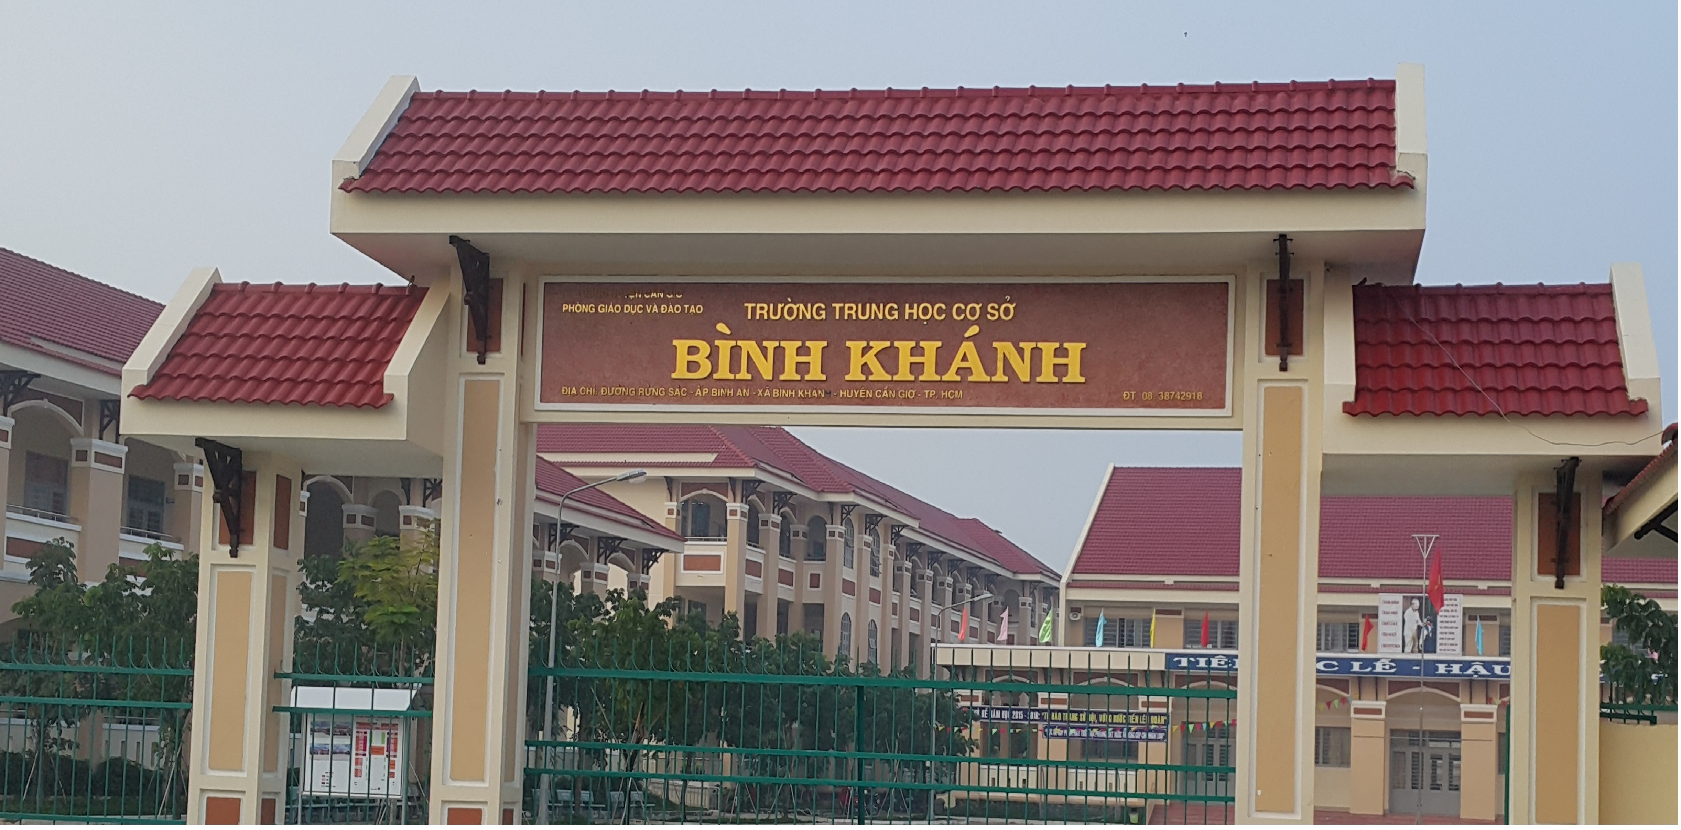
ENGLISH 9
BINH KHANH SECONDARY SCHOOL

Slide 2

Unit 7: SAVING ENERGY
5-READ

Slide 3
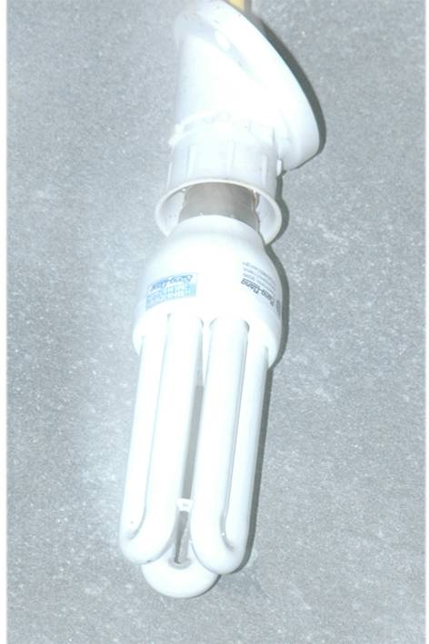

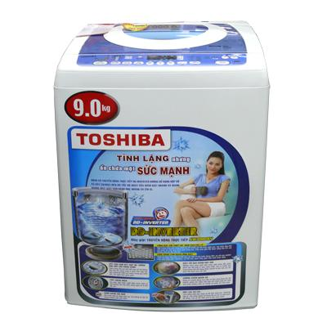
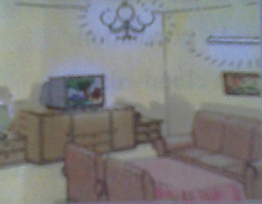
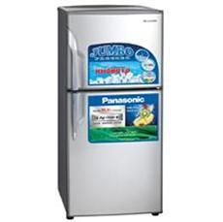

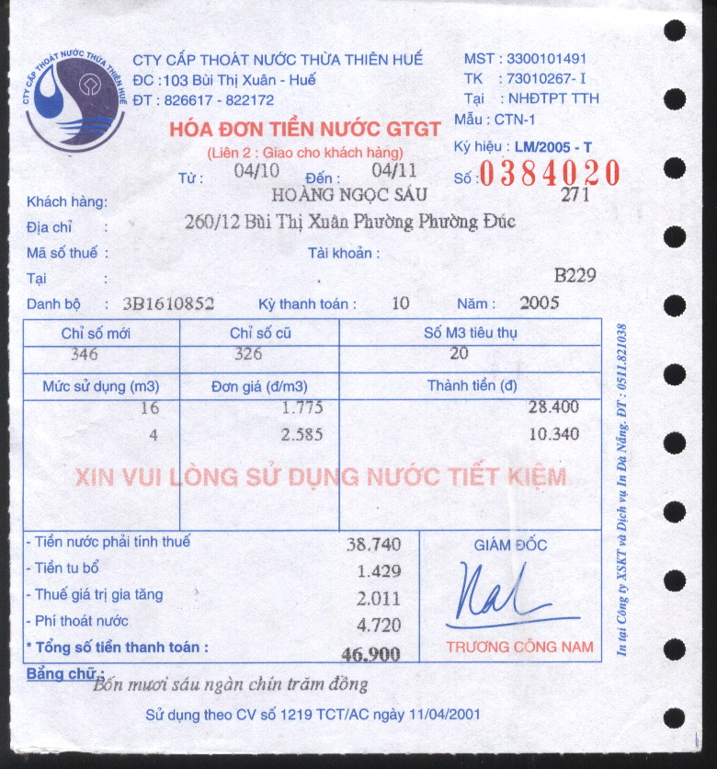
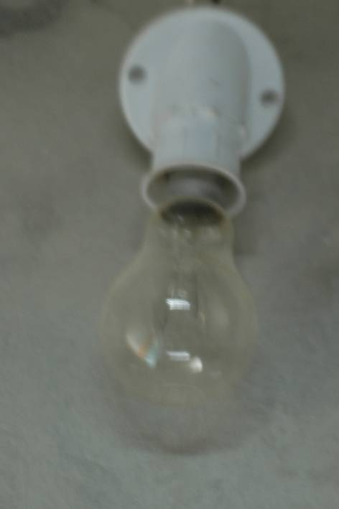
Unit 7: Saving energy
5. READ
* Vocabulary
- Consumer (n):
Người tiêu dùng
Chiếm
- Energy-saving (adj)
Tiết kiệm năng lượng
an energy-saving
bulb
energy-saving
- Bulb (n)
Bóng điện
bulb
Loại, hạng
- Label (n/v):
Nhãn / dán nhãn
- Innovation (n):
Công cuộc đổi mới
- Conserve (v):
Save (v)
an ordinary
bulb
We should turn off the lights and television to save electricity. Therefore, we can conserve natural resources.
Mr. Sau has to pay 94,000 VND for the elecrticity bill and water bill.
bulb
Label (n/v):
These two bulbs are the same category.
The water bill accounts for 50 % of the two bills.
- Category (n):
- Account for (v):

Slide 4

In Western countries, electricity, gas, and water are not luxuries but necessities. Companies now realize that consumers want products that will not only work effectively, but also save money.
For most North American households, lighting accounts for 10 percent to 15 percent of the electricity bill. However, this amount can be reduced by replacing an ordinary 100-watt light bulb with an energy-saving bulb. These bulbs use a quarter of the electricity of standard bulbs and last eight times longer. Therefore consumers can save about US$7 to US$21 per bulb.
In Europe, there is a labeling scheme for refrigerators, freezers, washing machines and tumble dryers. The label tells the consumers how much energy efficiency each model has, compared with other appliances in the same category.
Ultimately, these innovations will save money as well as conserve the Earth’s resources.

Slide 5


Unit 7: Saving energy
5. READ
Guess | After reading
*True or False? Check (v) the boxes. Then correct the false sentences and write them in your exercise book
T
1. Electricity, gas, and water are necessities in Western countries.
F
a quarter
2. An energy-saving bulb uses half of the electricity of a standard bulb.
T
3. In Europe, there is a labeling scheme for some household appliances.
can
F
4. We can’t conserve natural resources by saving energy.

Slide 6
In Western countries, electricity, gas, and water are not luxuries but necessities. Companies now realize that consumers want products that will not only work effectively, but also save money.
For most North American households, lighting accounts for 10 percent to 15 percent of the electricity bill. However, this amount can be reduced by replacing an ordinary 100-watt light bulb with an energy-saving bulb. These bulbs use a quarter of the electricity of standard bulbs and last eight times longer. Therefore consumers can save about US$7 to US$21 per bulb.
In Europe, there is a labeling scheme for refrigerators, freezers, washing machines and tumble dryers. The label tells the consumers how much energy efficiency each model has, compared with other appliances in the same category.
Ultimately, these innovations will save money as well as conserve the Earth’s resources.
In Western countries, electricity, gas, and water are not luxuries but necessities. Companies now realize that consumers want products that will not only work effectively, but also save money.
For most North American households, lighting accounts for 10 percent to 15 percent of the electricity bill. However, this amount can be reduced by replacing an ordinary 100-watt light bulb with an energy-saving bulb. These bulbs use a quarter of the electricity of standard bulbs and last eight times longer. Therefore consumers can save about US$7 to US$21 per bulb.
In Europe, there is a labeling scheme for refrigerators, freezers, washing machines and tumble dryers. The label tells the consumers how much energy efficiency each model has, compared with other appliances in the same category.
Ultimately, these innovations will save money as well as conserve the Earth’s resources.
In Western countries, electricity, gas, and water are not luxuries but necessities. Companies now realize that consumers want products that will not only work effectively, but also save money.
For most North American households, lighting accounts for 10 percent to 15 percent of the electricity bill. However, this amount can be reduced by replacing an ordinary 100-watt light bulb with an energy-saving bulb. These bulbs use a quarter of the electricity of standard bulbs and last eight times longer. Therefore consumers can save about US$7 to US$21 per bulb.
In Europe, there is a labeling scheme for refrigerators, freezers, washing machines and tumble dryers. The label tells the consumers how much energy efficiency each model has, compared with other appliances in the same category.
Ultimately, these innovations will save money as well as conserve the Earth’s resources.

Slide 7
Unit 7: Saving energy
5. READ
a) Which of the following is the best summary of the passage ?

1. Energy-saving bulbs should be used to save electricity.

2. In Western countries electricity, gas, and water
are necessities.
3. North American and European countries are interested
in saving money and natural resources.
3. North American and European countries are interested
in saving money and natural resources.

4. Labeling schemes help save energy.
?What should Vietnamese people do to save money and natural resources ?

Slide 8
3- Answer these questions. Write the answer in your exercise book.
1. What are Western consumers interested in?
-> They are interested in products that will not only work effectively but also save moneys.
2. What can we do to spend less on lighting?
-> We can replace ordinary 100 watt light bulbs with energy-saving bulbs.
3. Mrs. Jones uses only two ordinary bulbs and she
pays US$8 for lighting. How much will she pay if
she uses two energy-saving bulbs instead ?
-> She will pay US$2 for lighting.
4. What is the purpose of labeling schemes?
-> The labeling scheme tells the consumers how much energy efficiency each model has, compared with other appliances in the same category.
5. Why should we save energy?
-> We should save energy to save money and conserve /save our natural resources.

Slide 9

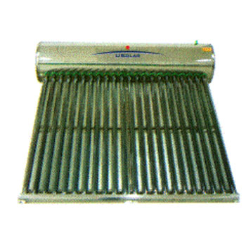
We / use solar energy instead / electricity.
We should use solar energy instead of electricity.

Slide 10
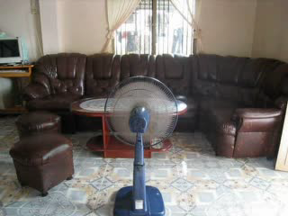
We / turn / the fan when noboby uses.
We should turn off the fan when nobody uses.

Slide 11
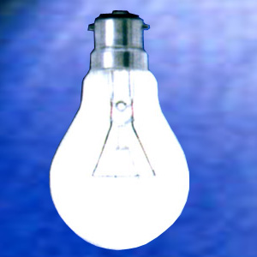
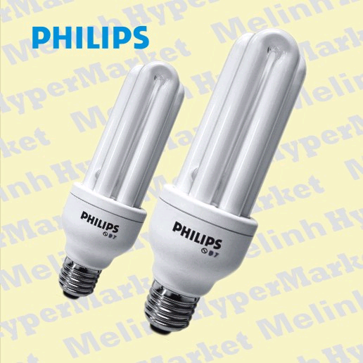
We /use energy - saving bulbs instead of /bulbs.
We should use energy - saving bulbs instead of ordinary bulbs.

Slide 12
Gap filling
Electricity
accounts for
energy-saving
category
…………., gas and water are not luxuries in Western countries.
2. People now use…………………bulbs to save money.
3. The water bill…………….... 5% of his salary.
4. A Vietnamese - English dictionary and an English –
Vietnamese one are the same………….

Slide 13
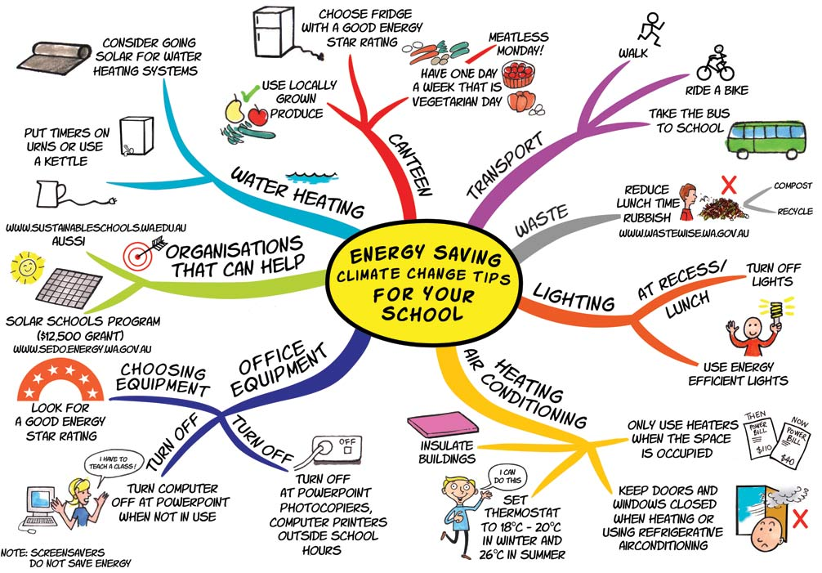
Saving energy

Slide 14

Consolidation
  *Vocabulary:
1. consumer (n) :
Ngư­êi tiªu dïng
2. account for (v):
ChiÕm
3. energy- saving (adj):
Tiết kiệm năng lượng
4. bulb (n) :
Bãng ®Ìn trßn
5. category (n):
Lo¹i, h¹ng
6. label (v/n):
D¸n nh·n m¸c
7. innovation (n):
Sù ®æi míi
8. conserve (v):
Save (v)
  *Saving energy:
-We should use solar energy instead of electricity.
-We should use energy - saving bulbs instead of ordinary bulbs.
- We should turn off the appliances when nobody uses.
- …

Slide 15


Slide 16

HOMEWORK
- Learn new words by heart.
- Read the passage then answer the questions again.
- Prepare for “Write”.

Slide 17







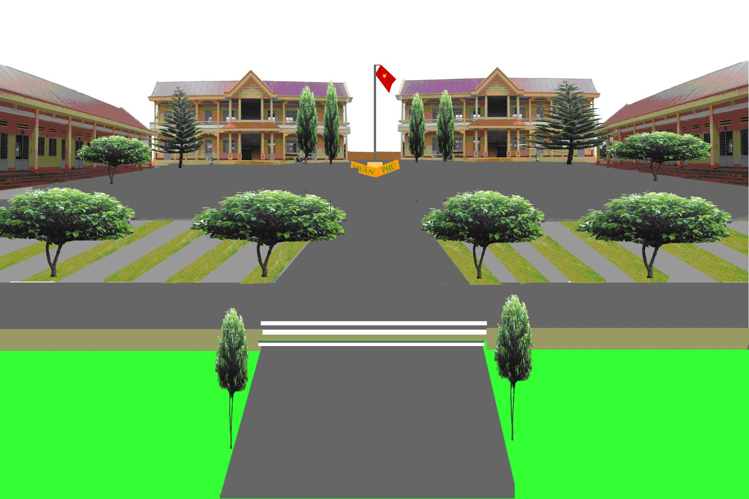




Good bye!
Thank for your attention!

