Slide 1
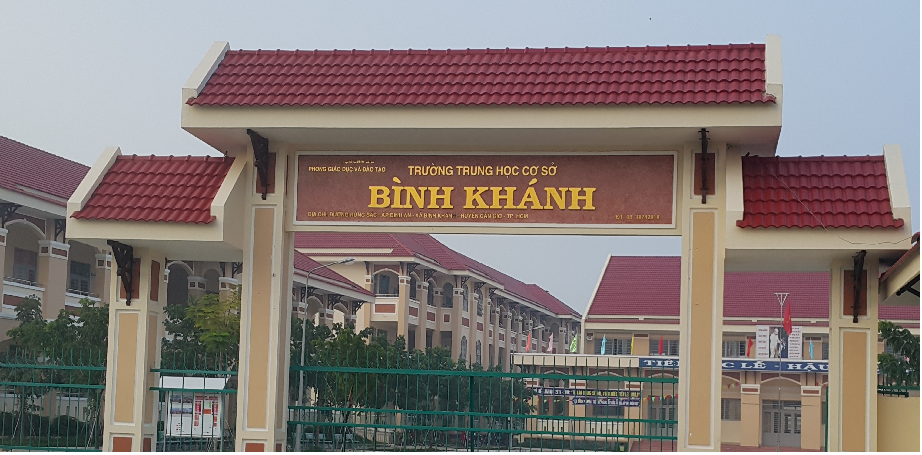
ENGLISH 9
BINH KHANH SECONDARY SCHOOL

Slide 2


Unit 6 : The environment
Period 40 : Lesson 4 : Write

Slide 3


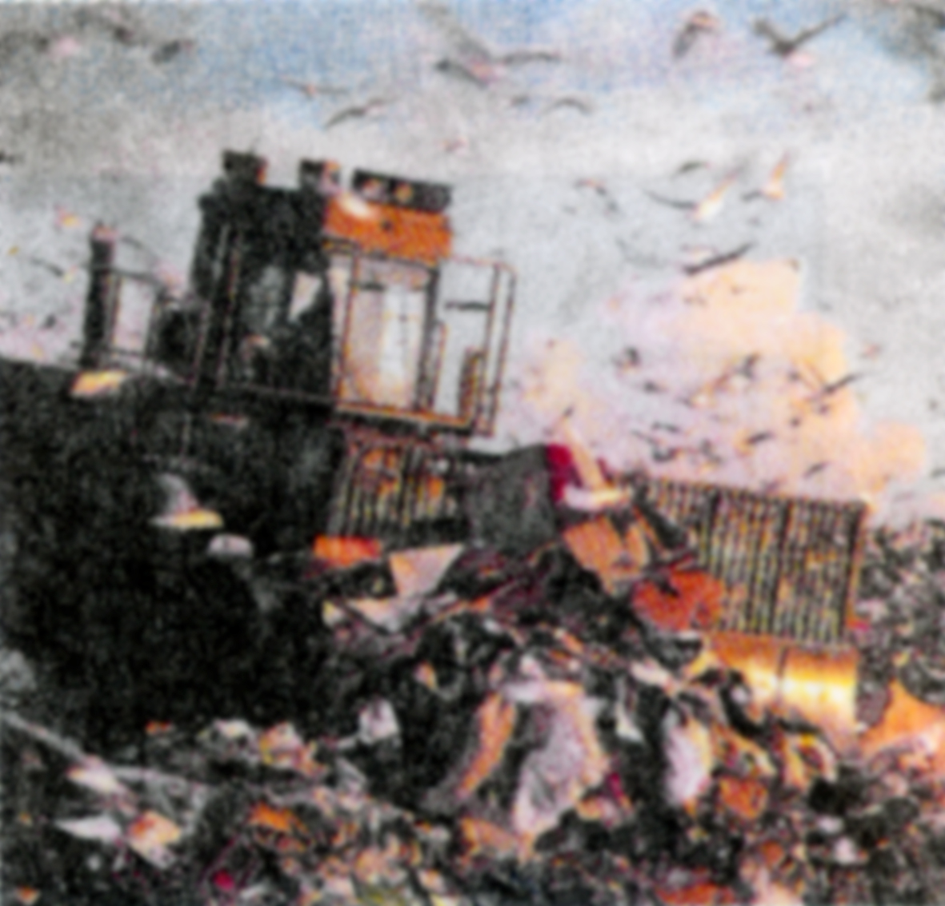
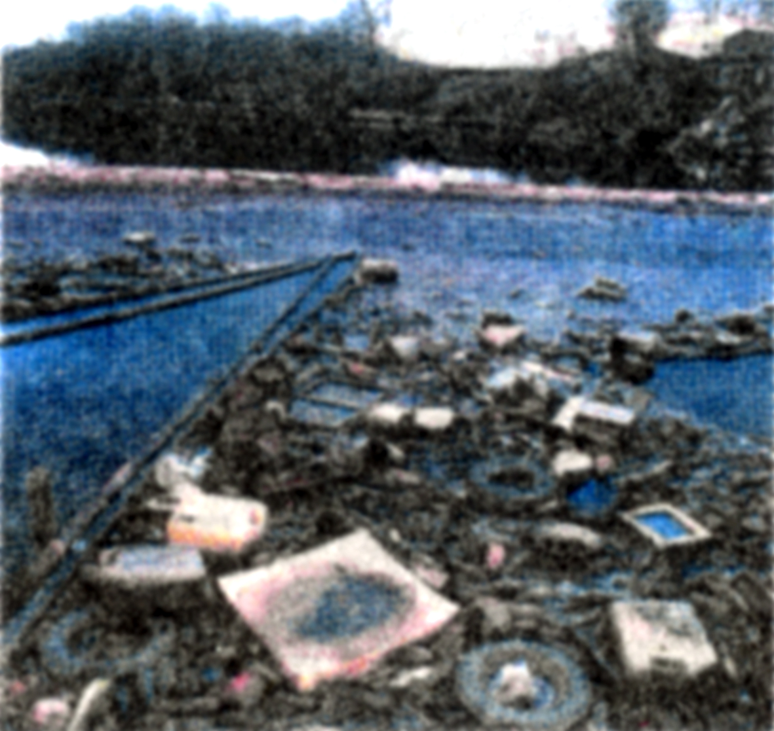
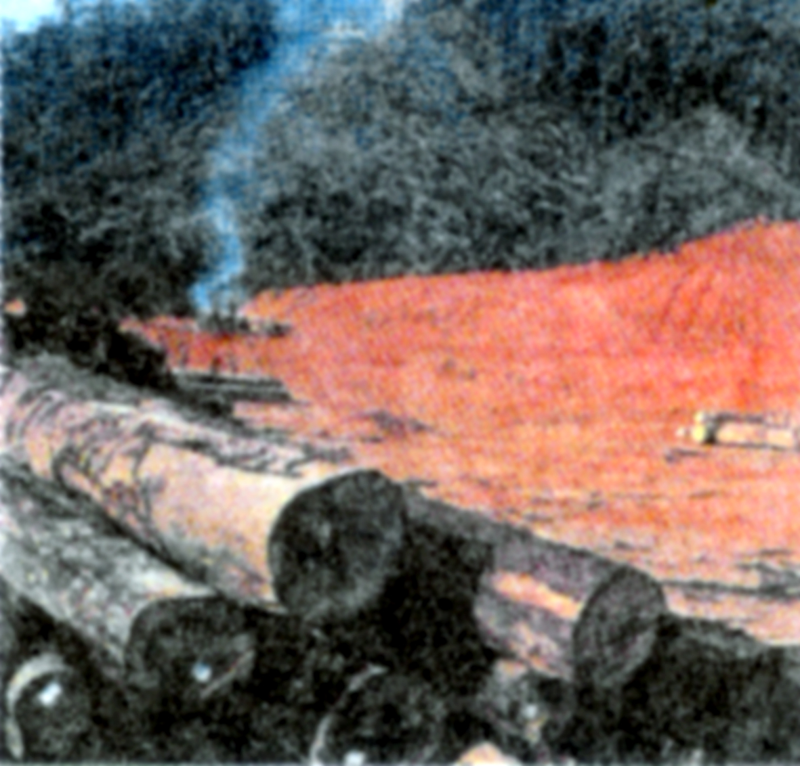
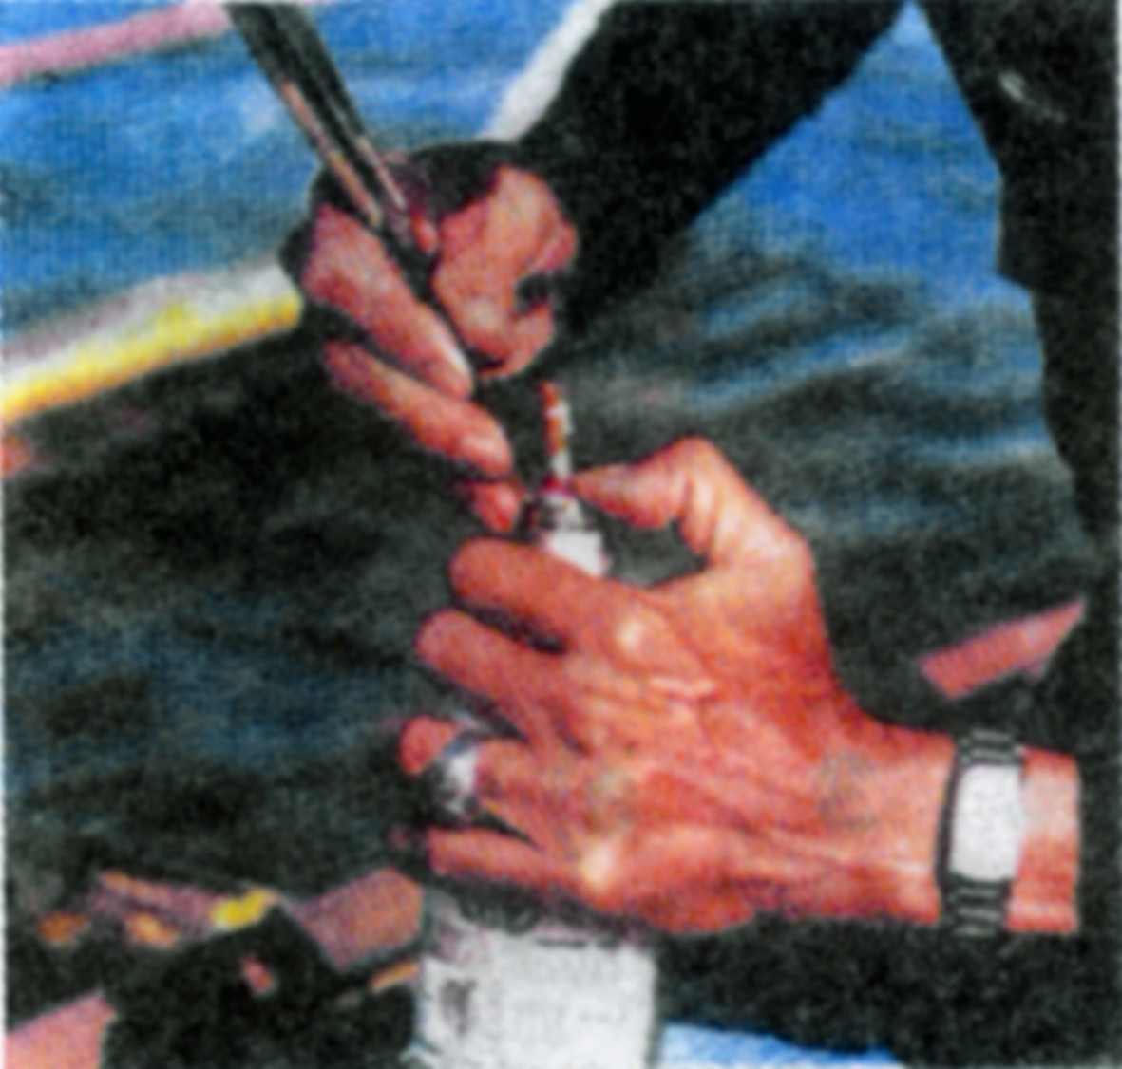
Unit 6 : The environment
Lesson 4 : Write
Match these environmental problems to the pictures
garbage dump
air pollution
water pollution
deforestation
dynamite fishing
spraying pesticides
a
b
c
d
e
f

Slide 4


Unit 6 : The environment
Warm-up : Brainstorming
SOME CAUSES OF
ENVIRONMENTAL POLLUTION
DIRTY STREET

Slide 5

I. Pre- writing :
Congratulation letter
Thank you letter
Types of letters
Invitation letter
Complaint letter

Slide 6




thi ®ua d¹y tèt - häc tèt
GD
Mr Nhat wrote a complaint letter to the director of L&P Company in Ho Chi Minh City . The five sections of the letter are not in the right order . Rearrange them in the right order.

Slide 7
26 tran Phu Street
Hanoi
October 9, 2003.
The director
L&P Transport Company
431 Le Loi Boulevard
HCMC
Dear Sir / Madam ,
I would suggest that your company should your drivers to clear up all
the trash on the ground before leaving .
I am writing to you about the short stop of your trucks around my house
On their way to the north .
I look forward to hearing from you and seeing good response from your company .
When the trucks of your company have a short break on the streets around
my house , the drivers have left lots of garbage on the ground after their
Refreshment . When the trucks leave the place ,the ground is covered
With trash and a few minutes later there is smell and flies .
Your faithfully,
Tran Vu Nhat

Slide 8
26 tran Phu Street
Hanoi
October 9, 2003.
The director
L&P Transport Company
431 Le Loi Boulevard
HCMC
Dear Sir / Madam ,
I am writing to you about the short stop of your trucks around my house
On their way to the north .
When the trucks of your company have a short break on the streets around
my house , the drivers have left lots of garbage on the ground after their
Refreshment . When the trucks leave the place ,the ground is covered
With trash and a few minutes later there is smell and flies .
I would suggest that your company should your drivers to clear up all
the trash on the ground before leaving .
I look forward to hearing from you and seeing good response from your company .
Your faithfully,
Tran Vu Nhat

Slide 9




How many sections are there ?
5 sections
What are they ?
Situation
Complication
Resolution
Action
Politeness

Slide 10

1.Format of a complaint letter
A complaint letter has five sections
Situation state the reason for writing
Complication mention the problem
Resolution make a suggestion
Action talks about future action
Politeness ends the letter politely

Slide 11
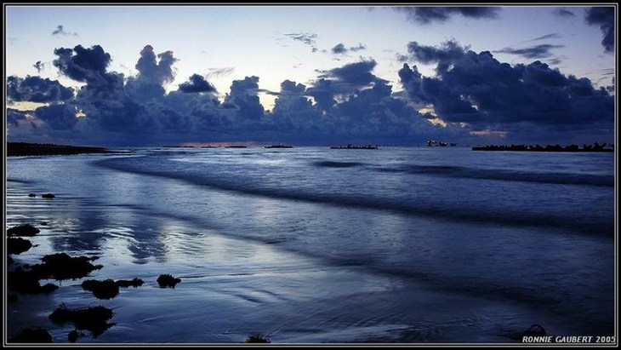
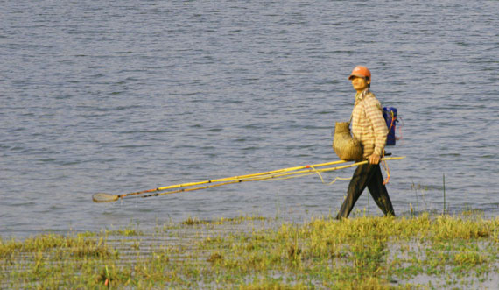
These days, many people begin to catch fish in the lake behind your house . What make you worried most is they use electricity to catch fish . A lot of small fish died …………….

Slide 12


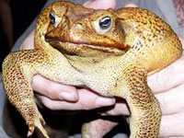
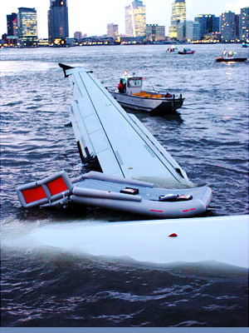
2. Vocabulary :
frog
Toad
float
Electric shock waves
authority
Nhµ chøc tr¸ch
prohibit
cÊm ®o¸n
Fine (v)
TiÒn ph¹t

Slide 13
Check voc. : Matching
frog
Fine (v)
Electric shock
waves
float
authority
Nhµ chøc tr¸ch
Toad
cÊm ®o¸n
prohibit
TiÒn ph¹t

Slide 14
* PRE-Questions:
a. What do people do in the lake behind your house these days?
( They begin to catch fish)
b. What makes you worried?
( They use electricity to catch fish)
c. To whom do you write the letter to?
(We write to the head of the local authorities)
d. What suggestion do you want to make?
(We suggest the local authorities should prohibit and fine heavily any one using electricity to catch fish).
e. Any future plant you want to make?
( We look forward to seeing the protection of environment from the local authorities)

Slide 15

Unit 6 : The environment
Lesson 4 : Write
I. Pre- writing :
II . While- writing :
1.Format of a complaint letter
A complaint letter has five sections
Situation state the reason for writing
Complication mention the problem
Resolution make a suggestion
Action talks about future action
Politeness ends the letter politely
Write a letter to the head of the local authorities to complain about the way of catching fish in the lake behind your house .
Suggested ideas :
Dear Mr President ,
I / write / you about / catching of fish / lake behind / house.
I / worried because they / not / use / fishing rod or net but use electricity / catch fish . After / short time they leave / lake , a lot / small fish died and float / water surface . Other animal such / frogs , toads ,/ even birds also die / from electric shock waves .
I / suggest / local authorities / prohibit / fine heavily anyone using this way / catching fish .
I / look forward to /hear/ you and see / the actions taken/ protect / environment /the local authorities .
Sincerely,
Hoang Thu Huong
2. Vocabulary :
frog
prohibit
float
Electric shock waves
Toad
Fine (v)
authority
II . While- writing :

Slide 16
Suggested ideas :
Dear Mr President ,
I / write / you about / catching of fish / lake behind / house.
I / worried because they / not / use / fishing rod or net but use electricity / catch fish . After / short time they leave / lake , a lot / small fish died / float / water surface . Other animal such / frogs , toads ,/ even birds also die / from electric shock waves .
I / suggest / local authorities / prohibit / fine heavily anyone using this way / catching fish .
I / look forward to /hear/ you and see / the actions taken/ protect / environment / local authorities .
Sincerely,
Hoang Thu Huong

Slide 17
Suggested writing:
Dear Mr President ,
I am writing to you about the catching of fish in the lake behind my house.
I am very worried because they don’t use the fishing rod or net but use electricity to catch fish . After a short time they leave the lake , a lot of small fish died and float on the water surface . Other animal such as frogs , toads ,and even birds have also died from electric shock waves .
I would suggest the local authorities should prohibit and fine heavily anyone using this way of catching fish .
I am looking forward to hearing from you and seeing the actions taken to protect the environment from the local authorities .
Sincerely,
Hoang Thu Huong .

Slide 18





III . Post- writing :
-Move around the class and help students
- Call on some students to read aloud their letter.
- Give feedback, correct some letters before the class. T can write the mistakes (spelling; grammar…) on the board.

Slide 19
IV . Consolidation :
* Format of a complaint letter
A complaint letter has five sections
Situation state the reason for writing
Complication mention the problem
Resolution make a suggestion
Action talks about future action
Politeness ends the letter politely

Slide 20
Unit 6 : The environment
Lesson 4 : Write
I . Pre- writing :
1.Format of a complaint letter
A complaint letter has five sections
Situation state the reason for writing
Complication mention the problem
Resolution make a suggestion
Action talks about future action
Politeness ends the letter politely
2. Vocabulary :
frog
prohibit
float
Electric shock waves
Toad
Fine (v)
authority
II . While- writing :
III . Post- writing :
IV . Consolidation :
V . Homework :

Slide 21




Homework
Learn new words by heart .
Write a complaint letter about wasting water .

Slide 22
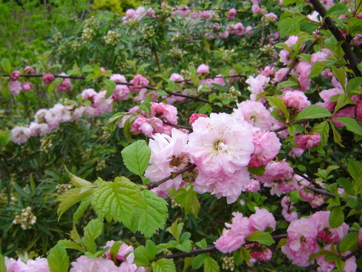
Goodbye and Have a good time !

