Slide 1
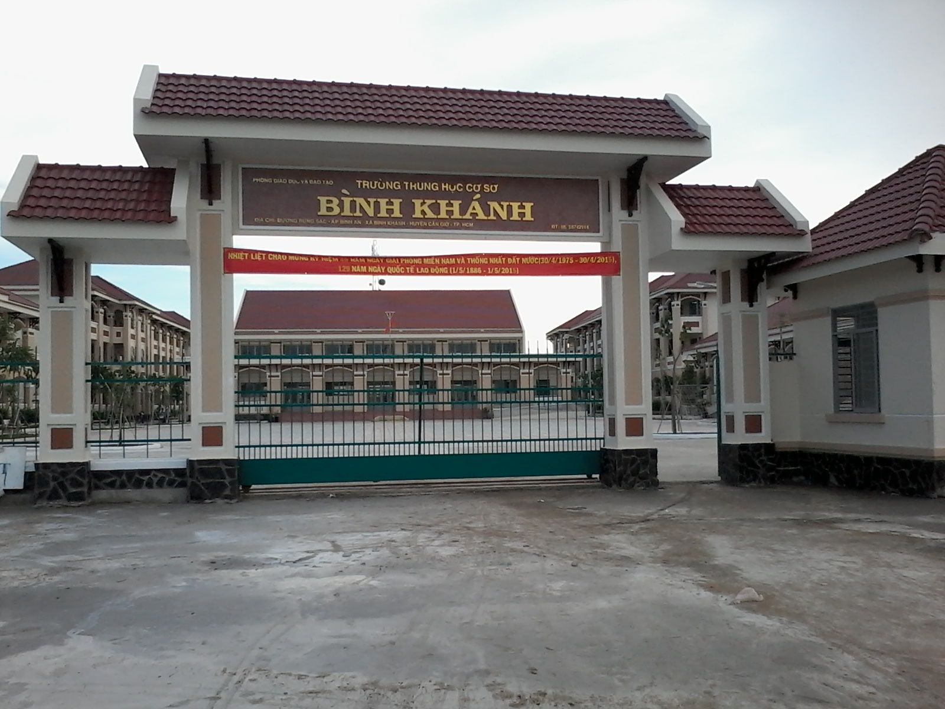









BINH KHANH SECONDARY SCHOOL

Slide 2


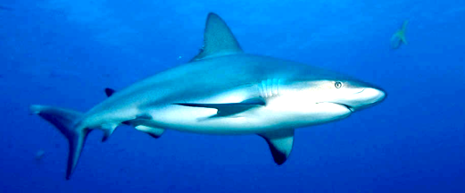

Shark attack
Guess the word that has five letters
J
E
A
N
S

Slide 3
What do you want to know about jeans?
a) Who loves wearing jeans?
b) What was jean cloth made from?
c) Have jeans never been out of fashion ?

Slide 4
Newwords :
-named after : đặt tên
- sailor (n): thủy thủ
- cloth (n): vải
- wear out (v): mòn, rách
-unique (a): độc đáo
- subject (n): chủ đề, đề tài
- embroider (v): thêu
+embroidered (a):được thêu
- label (n): nhãn hiệu
- sale (n) : doanh thu
- go up = increase (v) : tăng lên

Slide 5
economy (n): nền kinh tế
+ economic (a): thuộc về kinh tế
+ economical (a): tiết kiệm
- worldwide (a) = all over the world: rộng khắp thế giới
- out of fashion: lỗi thời
- generation (n): thế hệ
- (be) fond of = like (v) thích
- hardly (adv): hầu như không
- put on = wear (v) mặc vào
- (be) proud of (v) = take pride in : tự hào về

Slide 6
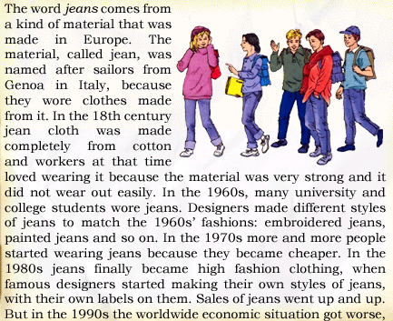



Slide 7

Unit 2:Clothing
Lesson 4 : Read
A. New words
Out of fashion (phase)
Lçi mèt ⬄ In fashion
Checking new words
cotton (n)
B«ng, sîi b«ng
wear out (v-phrase):
R¸ch
1- In the 18th century Jeans cloth was made completely from………..
style (n)
KiÓu d¸ng
cotton
embroider (v)
Thªu
wear out
2-Jeans cloth was very strong and it didn’t. …………. easily
embroidered
3-The 1960’s fashion were ………………..jeans and painted jeans
4-Jeans have never been………………………..
out of fashion

Slide 9
Unit 2: Clothing
Lesson 4 : Read
B- Filling in the missing dates and words
1……………..:Workers liked to wear ..…….…because the material made from cotton was very strong and could hardly wear out.
2…………:A lot of university and college …..…..wore jeans.
3…………:Jeans became ………., so many, many people began wearing jeans
4 ……….: Jeans became high ……………clothing.
5. ……….: The ………..of jeans stopped going up.

Slide 10
B- Filling the missing dates and words.
18th century
jean cloth
…………...: Workers like to wear …………..…….…because the material
made from cotton was very strong and could hardly wear out.
2. ………….: A lot of university and college ………………..…..wore jeans.
1960s
students
3. …………..Jeans became ………., so many, many people began wearing
jeans.
1970s
cheaper
4. ………….: Jeans became high ……………clothing.
1980s
fashion
5. ………….: The …………..of jeans stopped going up.
1990s
sale

Slide 11
Unit 2:Clothing
Lesson 4 : Read
C- Answer. Then write the answers in your exercise book.
1. Where does the word Jeans come from?
2. What were the 1960s’ fashions?
3. Why did more and more people begin wearing jeans in the 1970s?
4. When did jeans at last become high fashion clothing?
5. Why did the sale of jeans stop growing?

Slide 12
C- Answer. Then write the answers in
your exercise book.
1 .Where does the word Jeans come from?
2 . What were the 1960s’ fashions?
3. Why did more and more people begin wearing jeans
in the 1970s?
4. When did jeans at last become high fashion clothing?
5. Why did the sale of jeans stop growing?

Slide 13





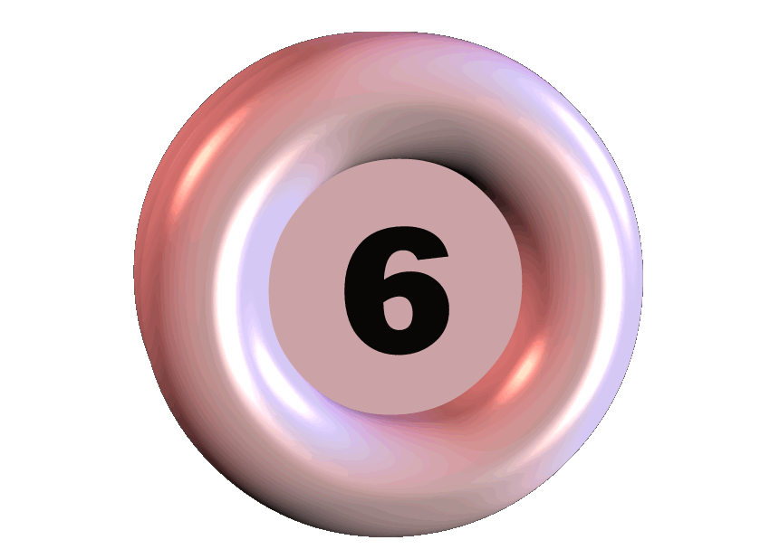

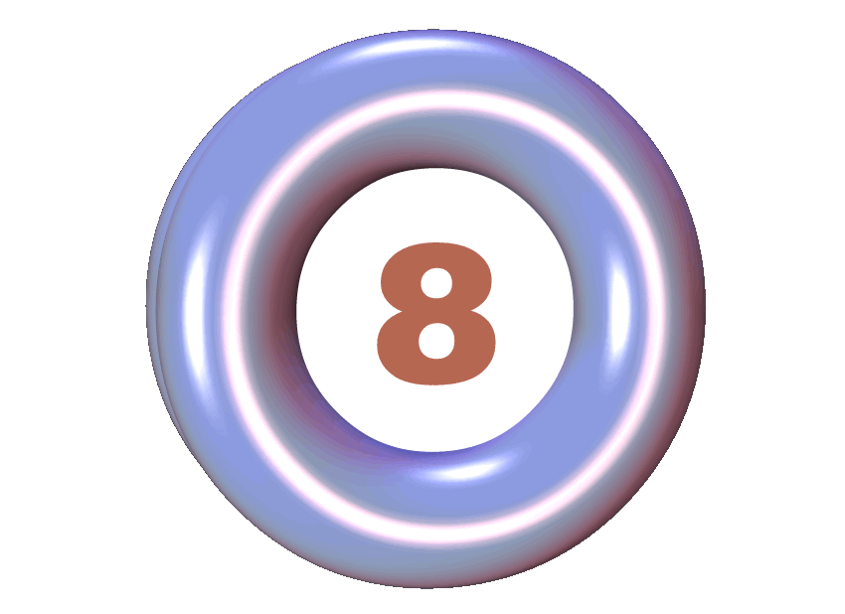


Lucky numbers
Why did more and more people begin wearing jeans in the 1970s?
Have jeans never been out of fashion ?
What were the 1960'sfashions?
Are people font of wearing jeans today?
Where does the word jeans come from?
When did jeans at last become high fashion clothing?
Why did the sale of jeans stop growing ?
LUCKY NUMBER
LUCKY NUMBER
LUCKY NUMBER
LUCKY NUMBER
Jeans at last became high fashion clothing in the 1980s
The 1960’sfashions were embroidered jeans, painted jeans and so on
The sale of jeans stopped growing because the worldwide economic situation got worse in the 1990s
The word jeans comes from a kind of material that was made in Europe.
Yes ,They are
Yes, they have.
Because jeans became cheaper.

Slide 14
C- Answer. Then write the answers in your exercise book.
1. Where does the word Jeans come from?
The word jeans comes from a kind of material that was
made in Europe.
2. What does the 1960s’ fashions?
The 1960s’ fashions were embroidered jeans, painted
jeans and so on…
3. Why did more and more people begin wearing jeans
in the 1970s?
because they became cheaper.
4. When did jeans at least become high fashion clothing?
Jeans at last became high fashion clothing in the 1980s.
5. Why did the sale of jeans stop growing?
The sale of jeans stopped growing because the
worldwide economic situation got worse in the 1990s.

Slide 15
Discussion:
1. Do you like wearing jeans? Why? Why not?
2. What type of jeans do you love wearing?
3. Do you think jeans are in fashion?

Slide 16
Unit 2:Clothing
Lesson 4 : Read
Home work
Learn by heart new words.
Read the text and answer
Prepare WRITE.

Slide 17


