Slide 1
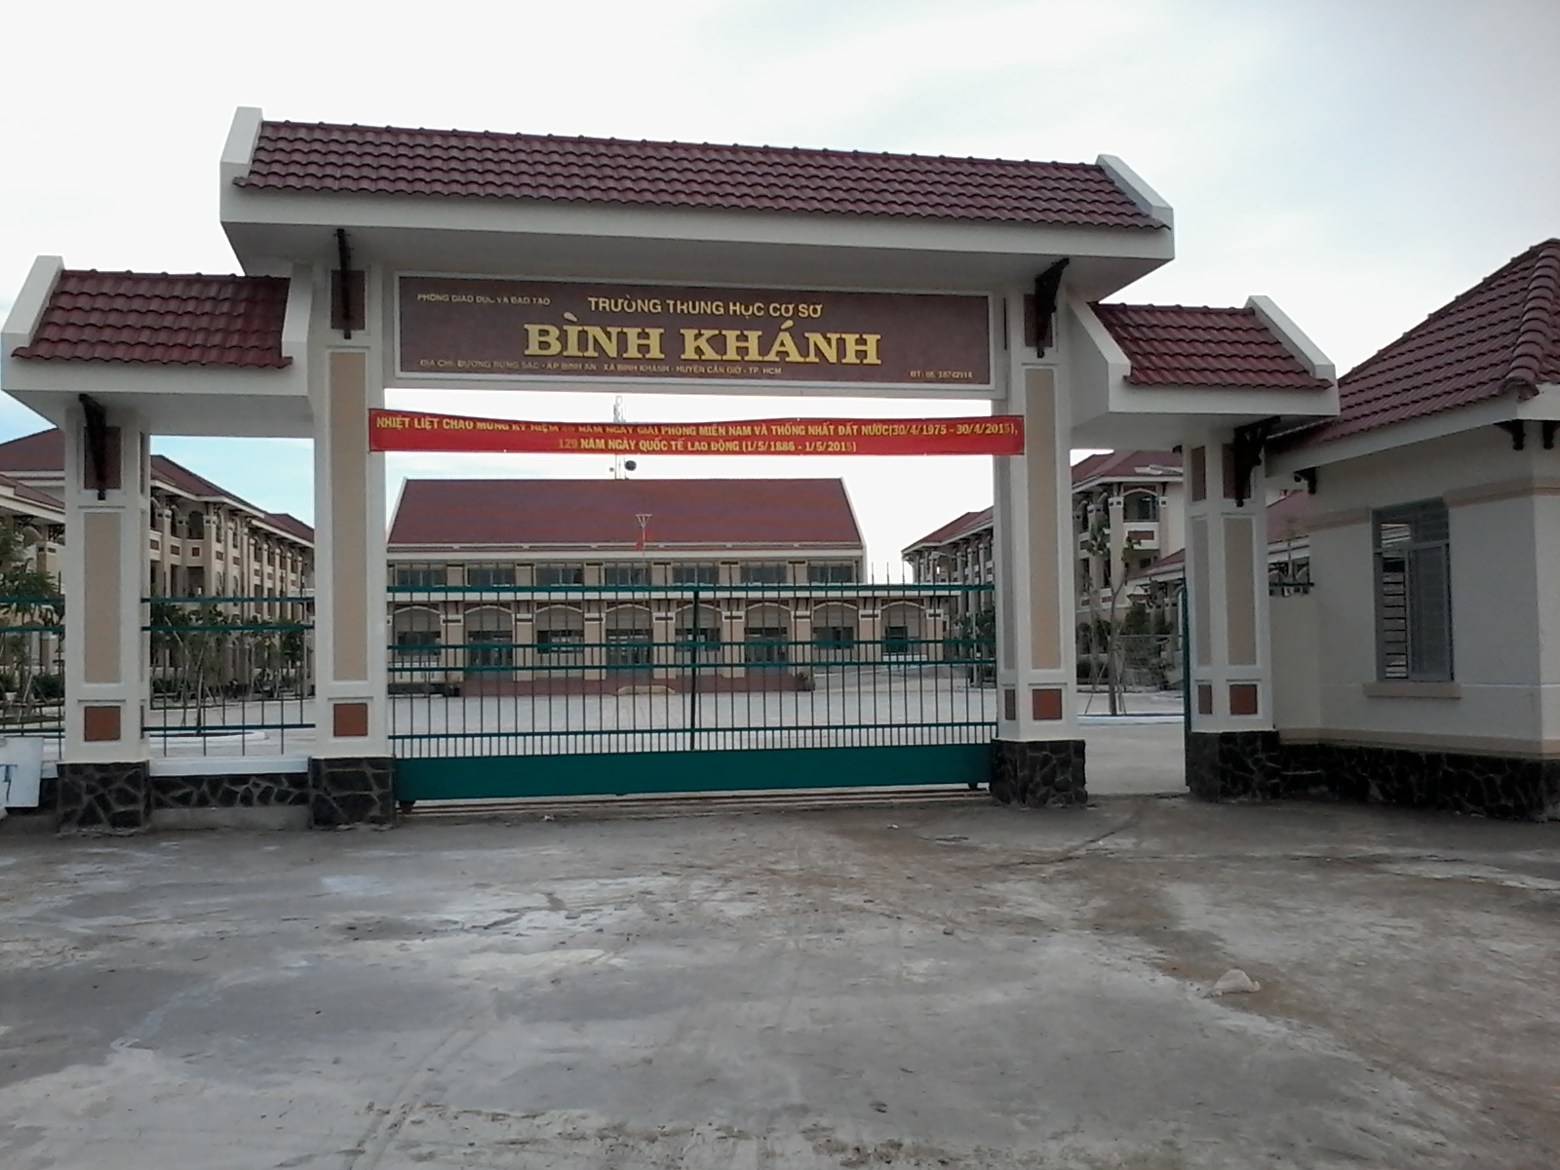
BINH KHANH SECONDARY SCHOOL

Slide 2
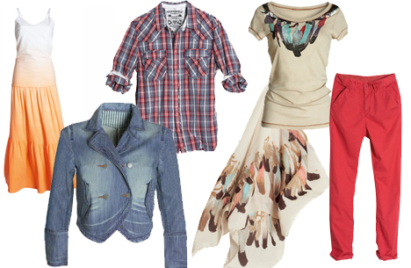
Unit 2
CLOTHING
Speak - Listen

Slide 3
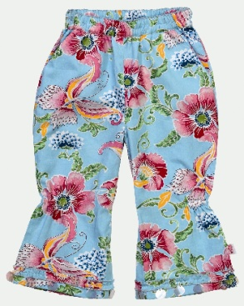
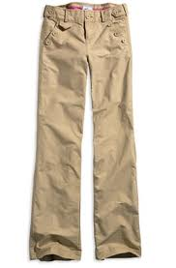
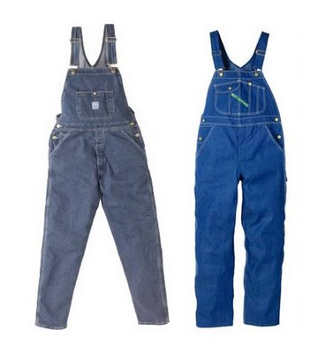
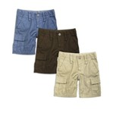
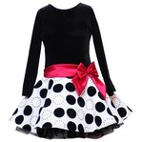
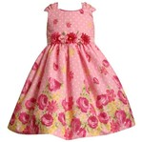
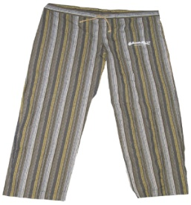
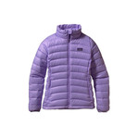
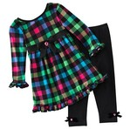
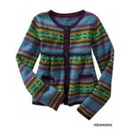
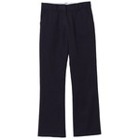
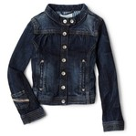
3
4
5
1
2
flowered pants
kaki pants
overalls
Gray hoodie
a long-sleeved white T-shirt
6
7
8
9
10
striped pants
Black & white dress
Tank top
Floral dress
Cargo shorts
13
14
15
11
12
a purple coat
Checked dress and leggings
a cardigan
A denim jacket
black pants

Slide 4
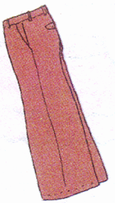
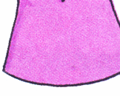
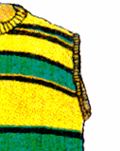
Unit 2 : CLOTHING
I/ SPEAK
NEW WORDS
1. Plaid (adj):
kẻ ca rô
2. striped (adj):
kẻ sọc
3. sleeve (n) / sleeveless (adj):
tay áo / không có tay
4. baggy (adj):
rộng thùng thình, thụng
5. plain (adj):
trơn
6. suit (n):
bộ com lê
7. sweater (n):
áo len

Slide 5
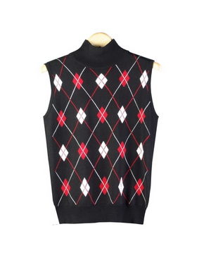
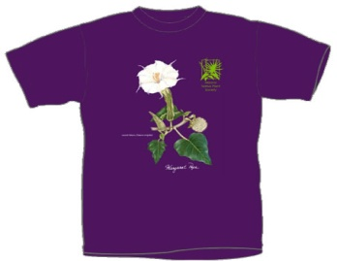
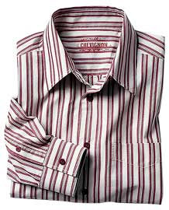
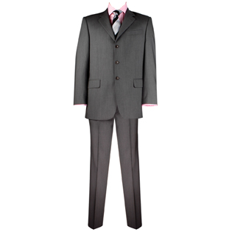
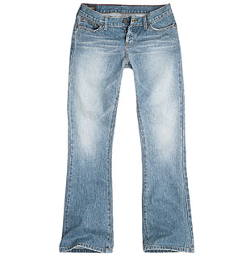
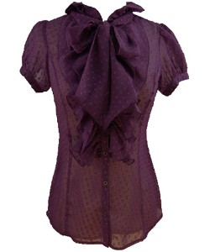
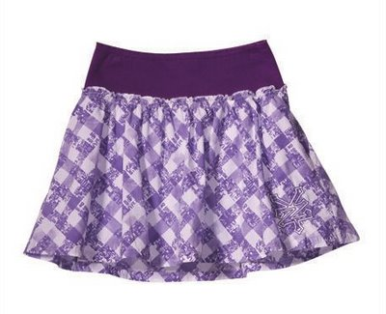
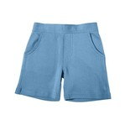
*a/ Match the phrases to the pictures
1. A colorful T - shirt
2. A plaid skirt
b
c
a
3. A plain suit
4. A short- sleeved blouse
5. A sleeveless sweater
d
e
f
A striped shirt
7. Baggy pants
8. Faded jeans
g
h
i
9. Blue shorts

Slide 6
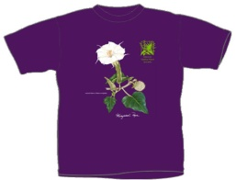
*b/Work in small groups .
Casual clother
1. What do you usually wear on the weekend?
2. Why do you wear these clothes?
Favorite clother
3. What is your favorite type of clothing? Why?
4. Do you like your uniform? Is it comfortable?
School uniform
Clothes for special occasions
5. What do you wear to the party/ wedding/
on Tet holidays?
6. Do you wear traditional dress?/
Do you want to wear your favorite clothing at school/
at home?

Slide 7
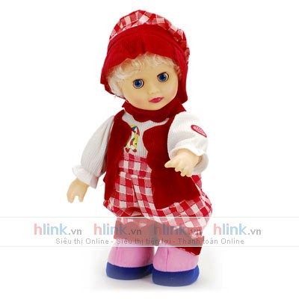
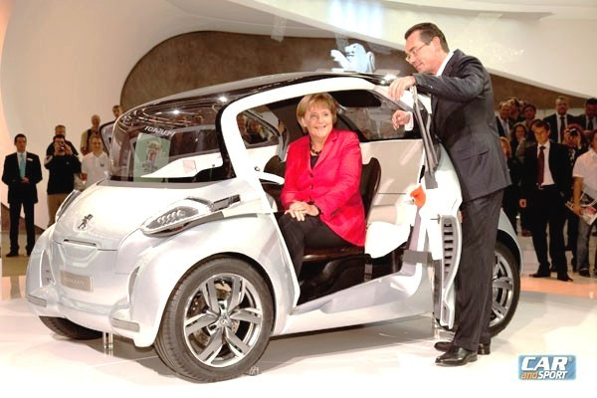
NEW WORDS
Unit 2 : CLOTHING
II/ Listen
1. announcement (n):
lời thông báo
2. lost (adj.): missing
mất tích
3. car fair (n):
hội chợ xe hơi
4. carry (v):
mang
5. doll (n):
Búp bê
Ngày mai các lớp làm tổng vệ sinh
Ban GH

Slide 8
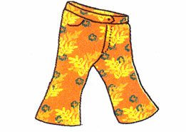
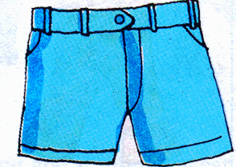
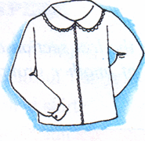
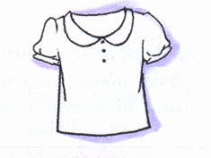
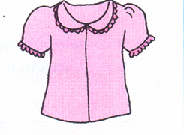
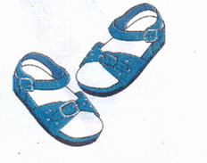
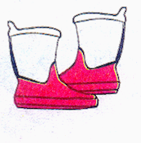
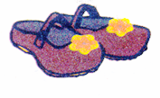
Label these pictures:
A B C
flowered pants
blue shorts
pink skirt
A B C
long-sleeved
white blouse
short-sleeved
white blouse
short-sleeved
pink blouse
A B C
sandals
boots
brown shoes

Slide 9
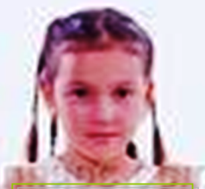
You are going to hear a public announcement about a lost little girl called Mary.
A B C
flowered pants
blue shorts
pink skirt
blue shorts
A B C
long-sleeved
white blouse
short-sleeved
pink blouse
long-sleeved
white blouse
short-sleeved
white blouse
A B C
sandals
boots
brown shoes
brown shoes

Slide 10
Choose the best answer:
1. Mary is years old.
a. 5 b. 6 c.
2. She was last seen minutes ago.
a. b. 15 c. 30
3. Mary has hair.
a. long dark b. c. brown
4. She may be carrying a ( an )
a. bag b. c. umbrella
5. If you see Mary, please bring her to the
a. Car fair b. main entrance c.
6. Her is waiting for her.
a. b. mom c. sister
3
20
short dark
doll
information desk
dad

Slide 11
Listen to the tape then answer the question:
Announcer (on Public Announcement)
Attention, please. Here is a special announcement. A little girl is reported missing. She was last seen 20 minutes ago near the main entrance to the Car Fair. Her name’s Mary and she is 3 years old. She has short dark hair. She’s wearing shorts - blue shorts and a long - sleeved white blouse. She’s wearing a pair of shoes - brown shoes. She may be carrying a large doll.
If you see Mary, please bring her to the Information Desk. Her father’s waiting for her there. Thank you.

Slide 12
Homework:
Learn by heart vocabulary.
Prepare : Read

Slide 13
THANK YOU FOR ATTENTION!
the end
GOOD BYE!

Slide 14
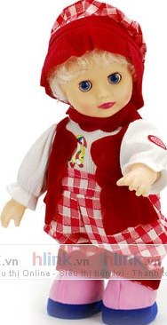
What is Mary wearing?
long-sleeved
white blouse
blue shorts
brown shoes

Slide 15
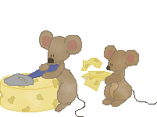
ANSWER THE QUESTIONS :
Lucky animals
5
6
7
8
TEAM A
TEAM B
e. What is your favorite type of clothing ?
a/ What’s our traditional dress ?
c/ What ‘s Japanese ‘s traditional dress ?
b/What is the aodai described as ?
d/What is your school uniform ?
Lucky animal
It’s describled as a long silk tunic with slit on the sides and worn over loose pants.
Our school uniform is white shirt and blue pants .
It’s Kimono .
It’s …………………..
It’s Ao dai.

