Slide 1
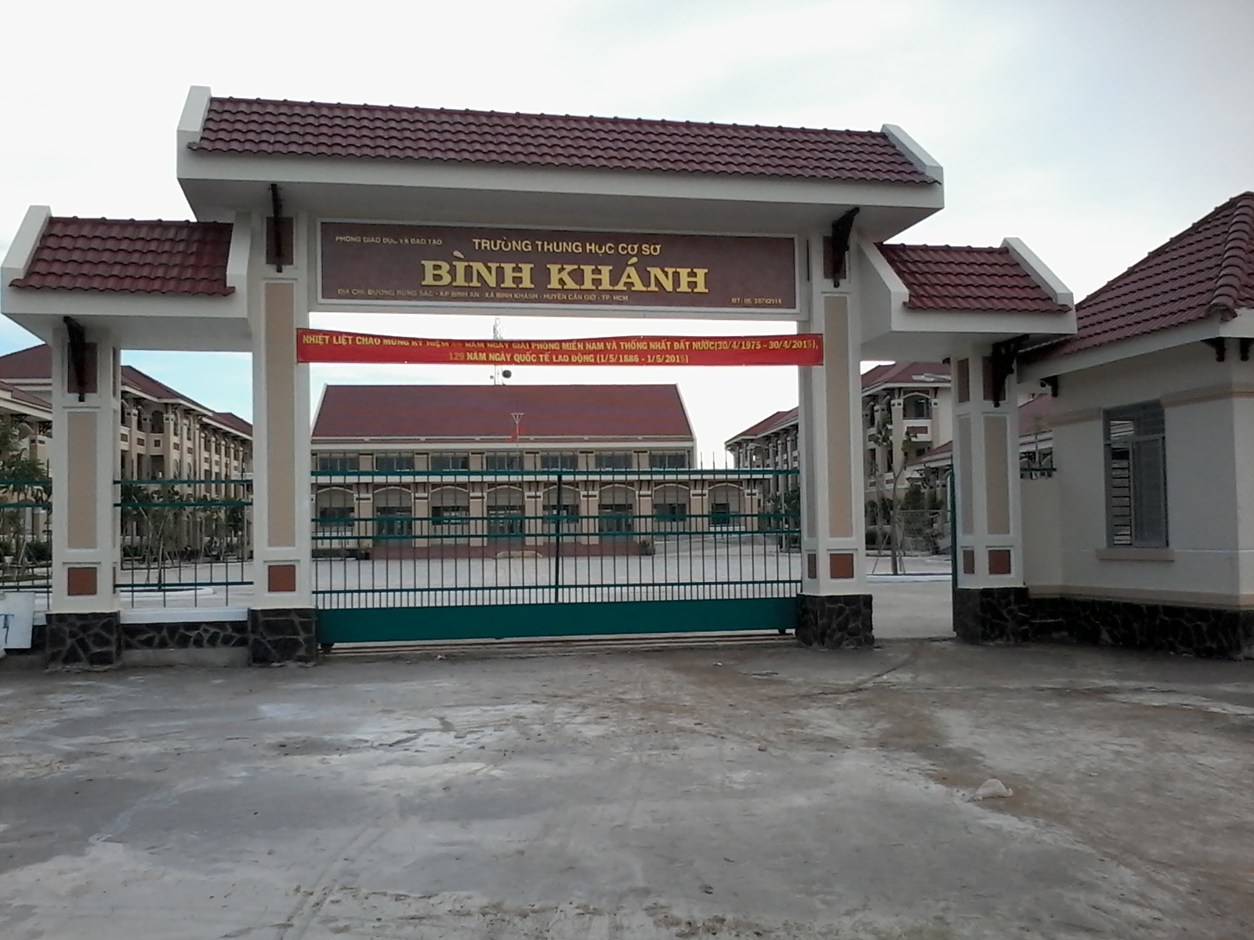
BINH KHANH SECONDARY SCHOOL
FRIENDS PLUS 6

Slide 2
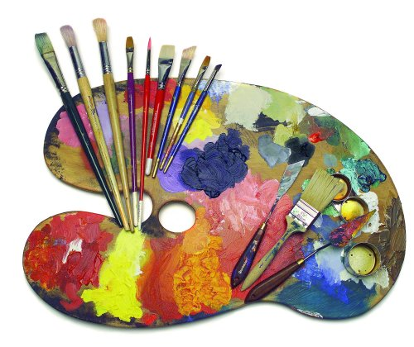
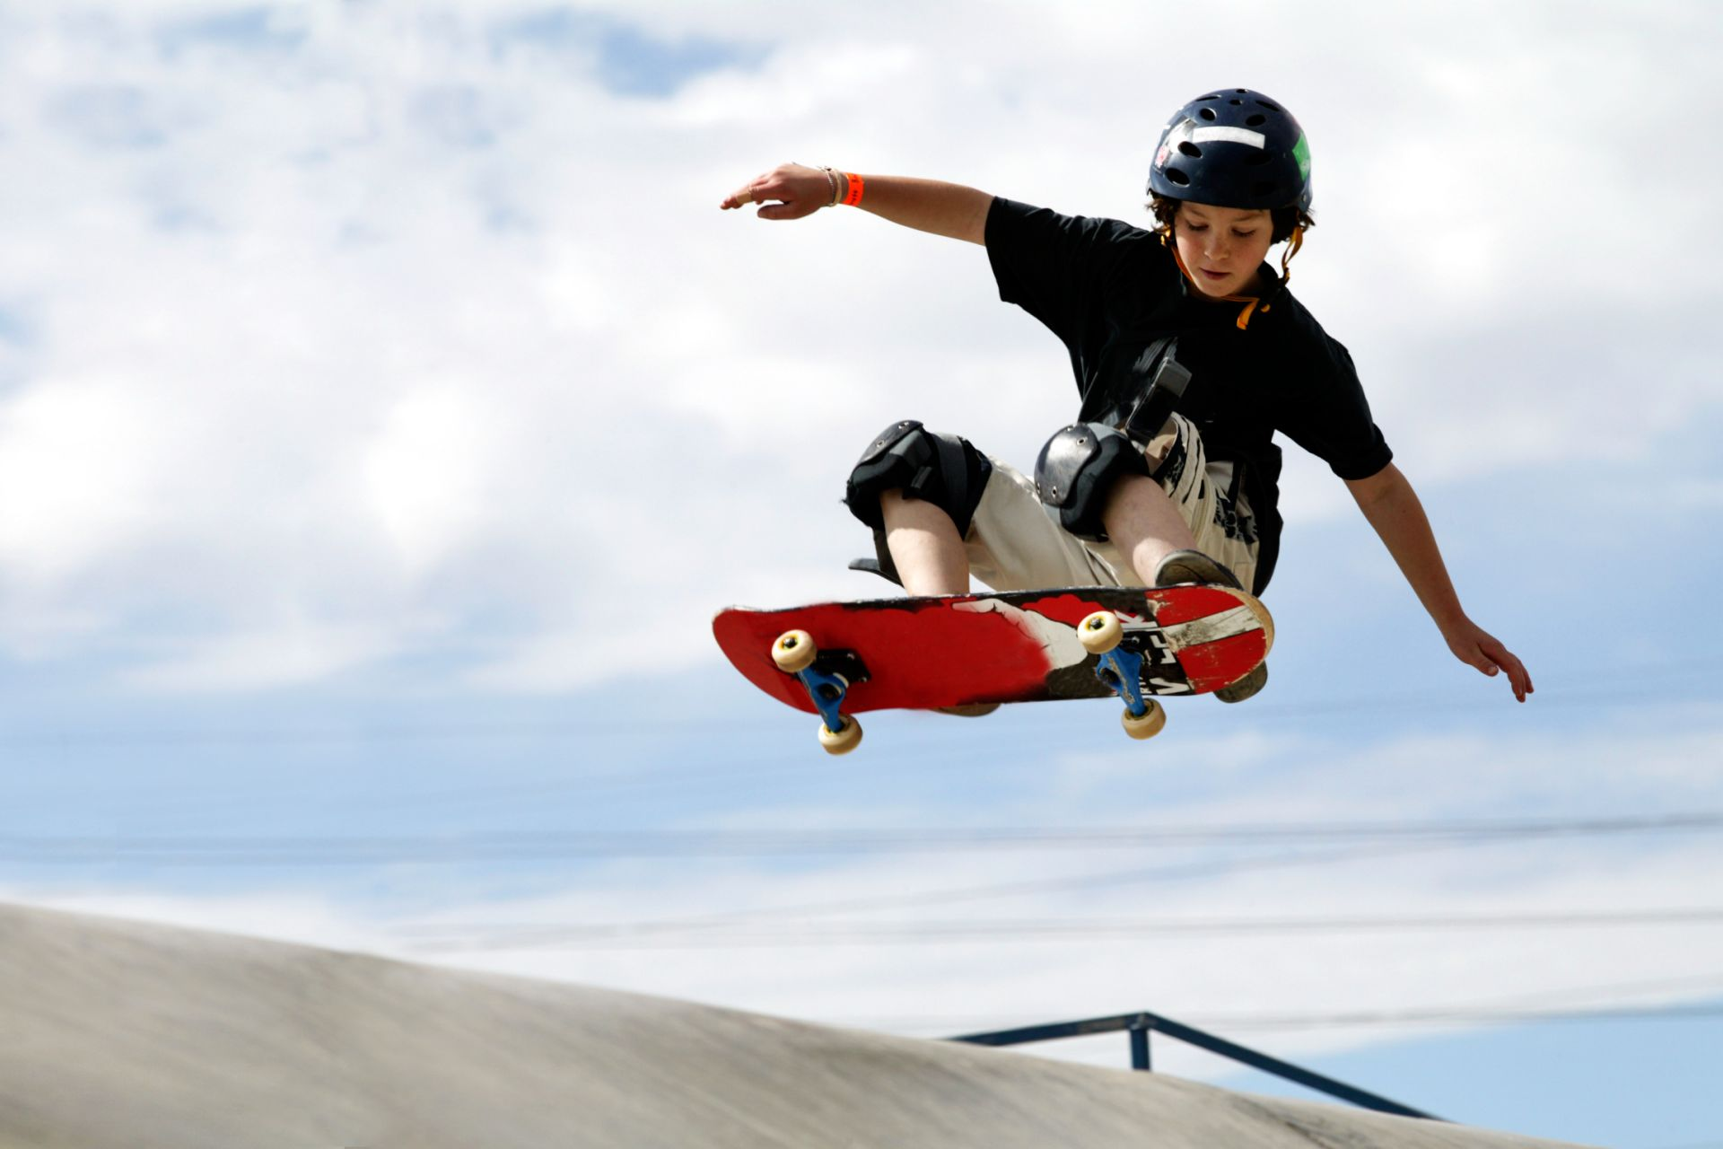
STARTER UNIT
Lesson 1
Vocabulary – Free time

Slide 4
What do you do
in your free time?

Slide 5
New words
Skateboarding (n)

Slide 6
photography(n) /fəˈtɑː.ɡrə.fi/
Ex: She's taking an evening class in photography.
art (n) /ɑːrt/
cycling (n) /ˈsaɪ.klɪŋ/
the sport of riding
a bike-show picture

Slide 7
Exercise 1 (P.6)
chatting online
reading
meeting friends
art
photography
cycling

Slide 8
sport
animals
music
video games
watching TV
films

Slide 9
skateboarding
cooking
shopping

Slide 10
New words
Be good at:
Ex: My mother is good at cooking.
Be interested in:
Ex: I am interested in playing video games.

Slide 12
New words
Be good at:
Ex: My mother is good at cooking.
Be interested in: /ˈɪn.trɪ.stɪd/
Ex: I am interested in playing video games.
favorite (n) /ˈfeɪ.vər.ət/
a person or thing that is best liked

Slide 13
Exercise 2 (P.6)
Hi! I’m Kate. I’m twelve and I’m from Oxford in the UK. I’m into sport and I’m good at basketball. Apart from sport, I like 1…………. and 2……………. online. I’m not interested in shopping. This is my brother Jack. Jack isn’t into sport. He’s into 3………………… and his favourites are football games. Jack isn’t on his computer twenty-four hours a day – he and his friends like 4…………………. , but they aren’t very good!
music
chatting
video games
skateboarding

Slide 14
Our parents, Jen and Ed, like books and they’re into 5…………….My mum is interested in 6…………………and her photos are really good. Our mum and dad are good at 7……………….. . Italian food is their favourite.
And you and your family? What are your hobbies and interests?
reading
photography
cooking

Slide 15
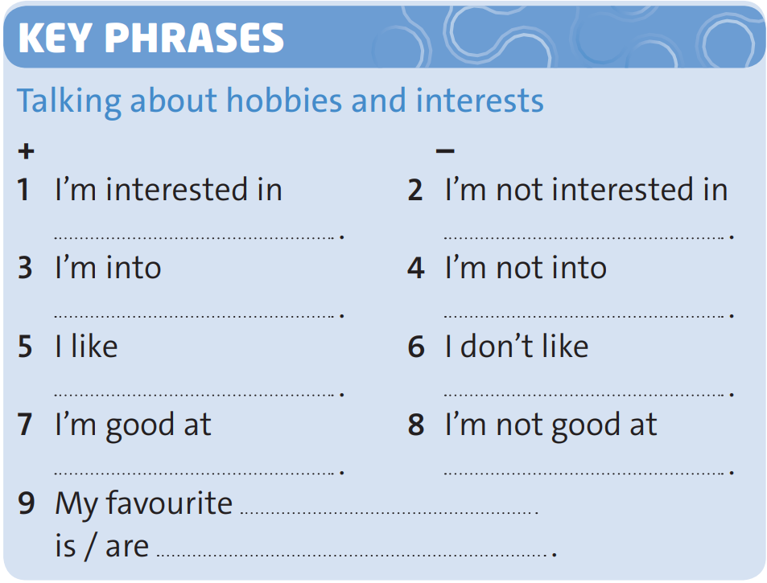
Exercise 3 (P.6)
music
cycling
films and watching TV
reading
shopping and meeting friends
chatting online
skateboarding
art
animals, dogs

Slide 16
Exercise 4 (P.6)
Talking about hobbies and interests.
1. What is your hobby?
2. What do you like doing?
3. Do you play any sports?
4. What sort of hobbies do you have?

Slide 17
Homework
Learn new words and grammar of the today lesson.
Finish the exercise.
Prepare for the next lesson - Language focus: the Verb " To be“
What are the 3 forms of the verb to be in present?

