Slide 1
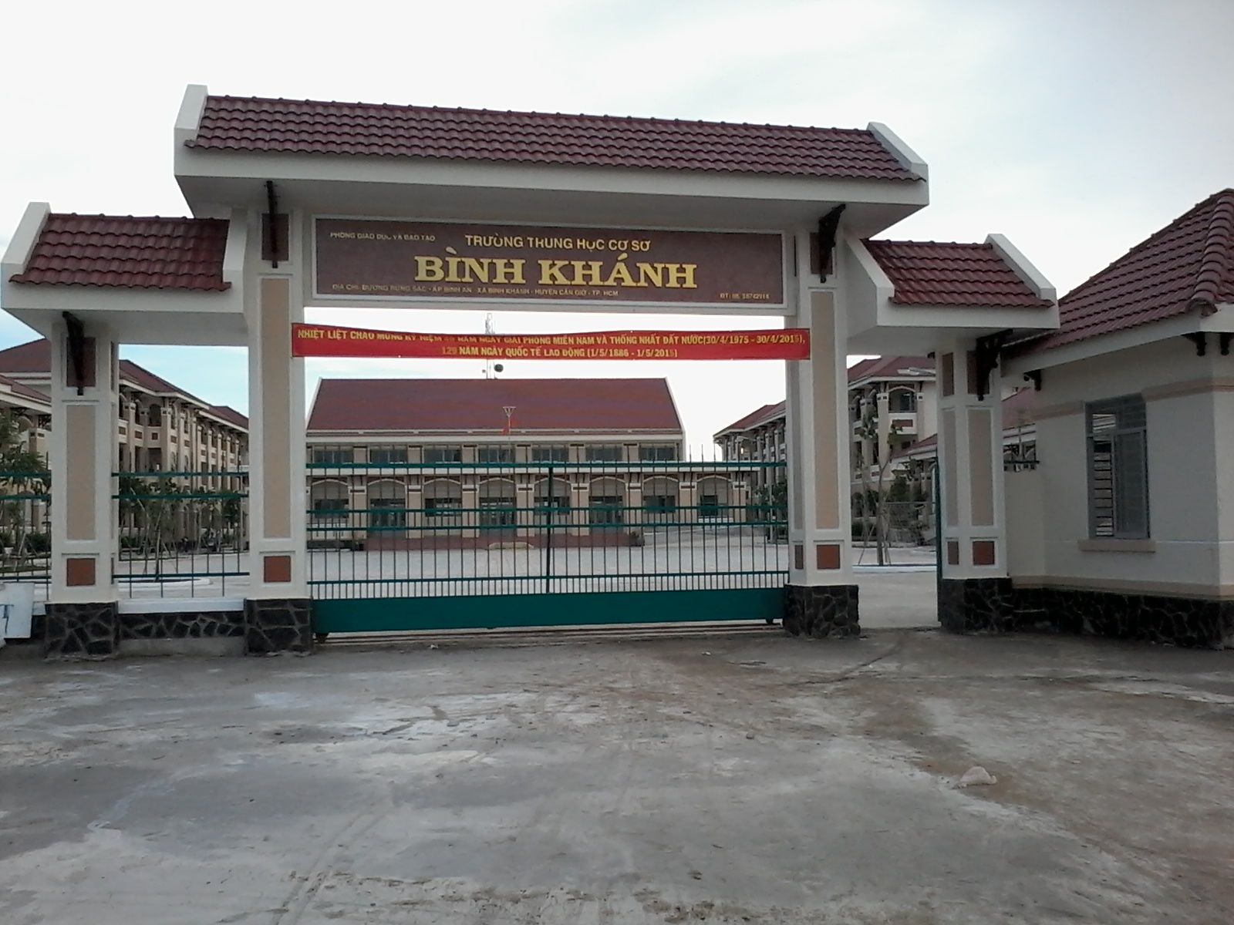



BINH KHANH SECONDARY SCHOOL
FRIENDS PLUS 6

Slide 2
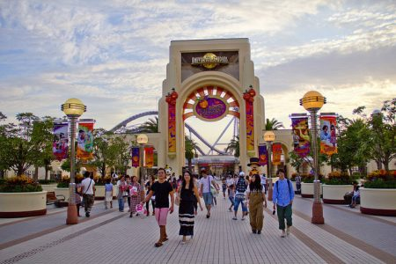
UNIT 8: GOING AWAY
CULTURE - THEME PARKS IN JAPAN

Slide 3

C
E
X
E
D
T
I
EXCITED

Slide 4
S
E
A
O
W
M
E
AWESOME

Slide 5

S
N
U
N
Y
SUNNY

Slide 6
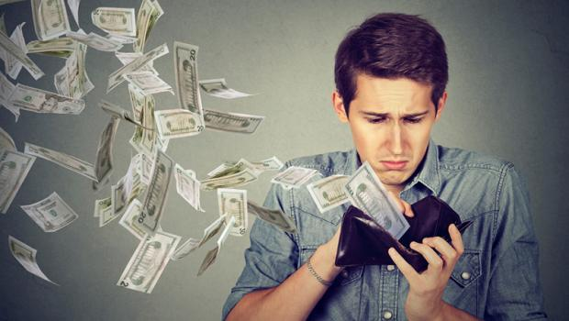
X
E
P
I
V
N
E
S
E
EXPENSIVE

Slide 7

M
A
F
G
C
N
I
I
T
N
E
MAGNIFICENT

Slide 8
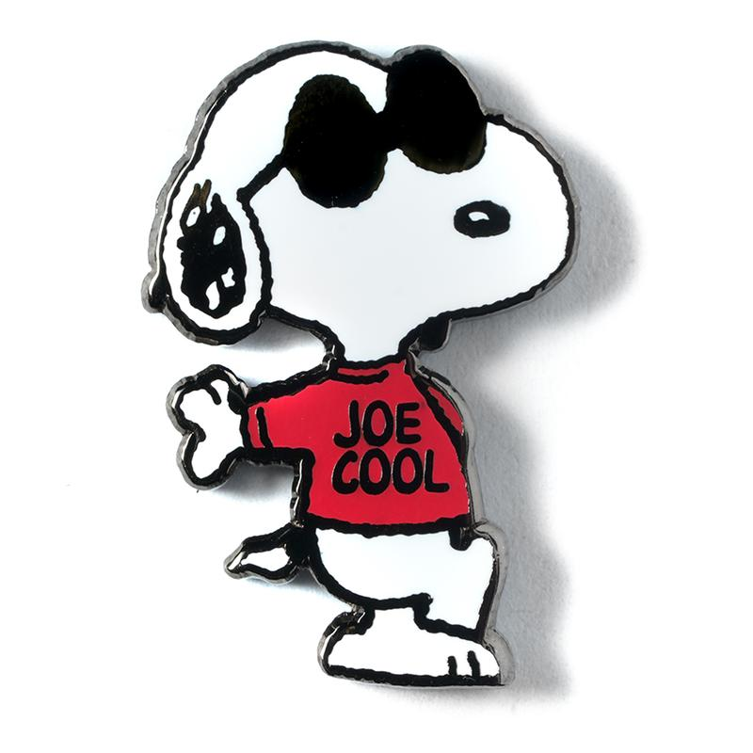
O
O
C
L
COOL

Slide 9
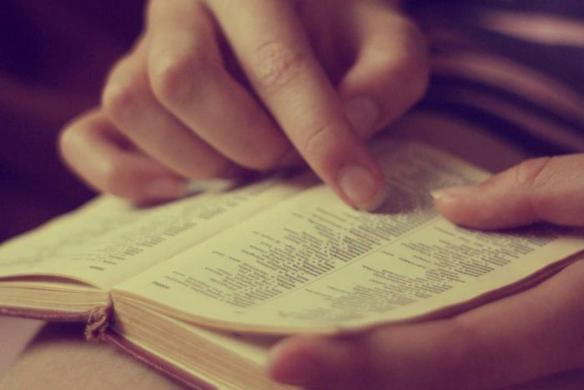
1/ Check the meanings of the words in the box
cosplay, thrill ride, water ride, rollercoaster

Slide 10
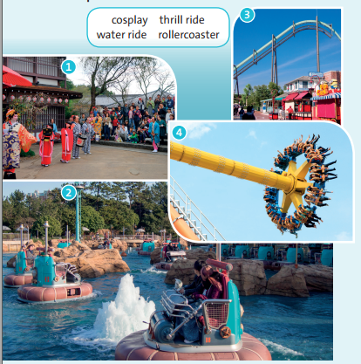
1/ Look at photos 1-4. What can you see in the photos?
rollercoaster
cosplay
thrill ride
water ride

Slide 11
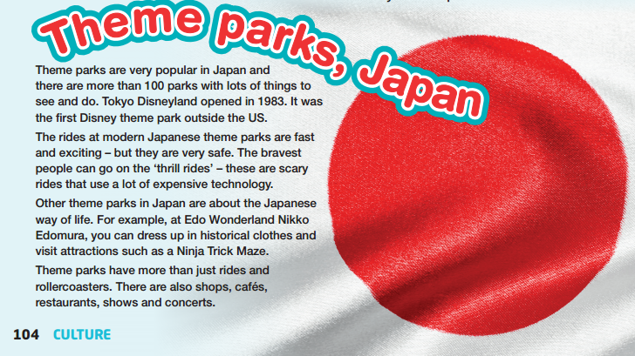
2/ What places can you find in a theme park? Read the text and check your answers.

Slide 12

3/ Read and listen to the text and answer the questions:
1/ How many theme parks are there in Japan?
-> More than 100.
2/ When did Tokyo Disneyland open?
-> 1983
3/ Are theme park rides dangerous?
-> No, they are very safe.
4/ What kind of ride can be scary?
-> A thrill ride
5/ What can you do at Edo Wonderland?
-> You can dress up in historical costumes and visit attractions.
6/ What other things can you do at theme parks?
-> You can go shopping, have a drink or a meal.

Slide 13

4/ YOUR CULTURE! Write about a theme park in your country. Use the Internet to help you find the information you need.
Name of theme park
Location
Opening hours
Best part
Other things you can do

Slide 14
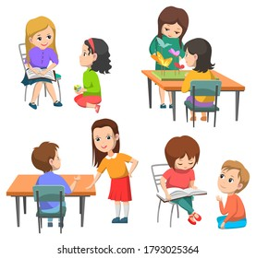
5/ USE IT! Work in pairs. Tell your partner about your theme park in exercise 4.
Let me tell you cabout my theme park.
This theme park is ....
Can you tell me about
your theme park?

Slide 15
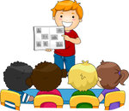
Please tell me about your theme park!

Slide 16

* Homework: - Learn by heart all the new words. - Complete “Activity 4”. - Prepare the next lesson “ Puzzles and games”.

