Slide 1
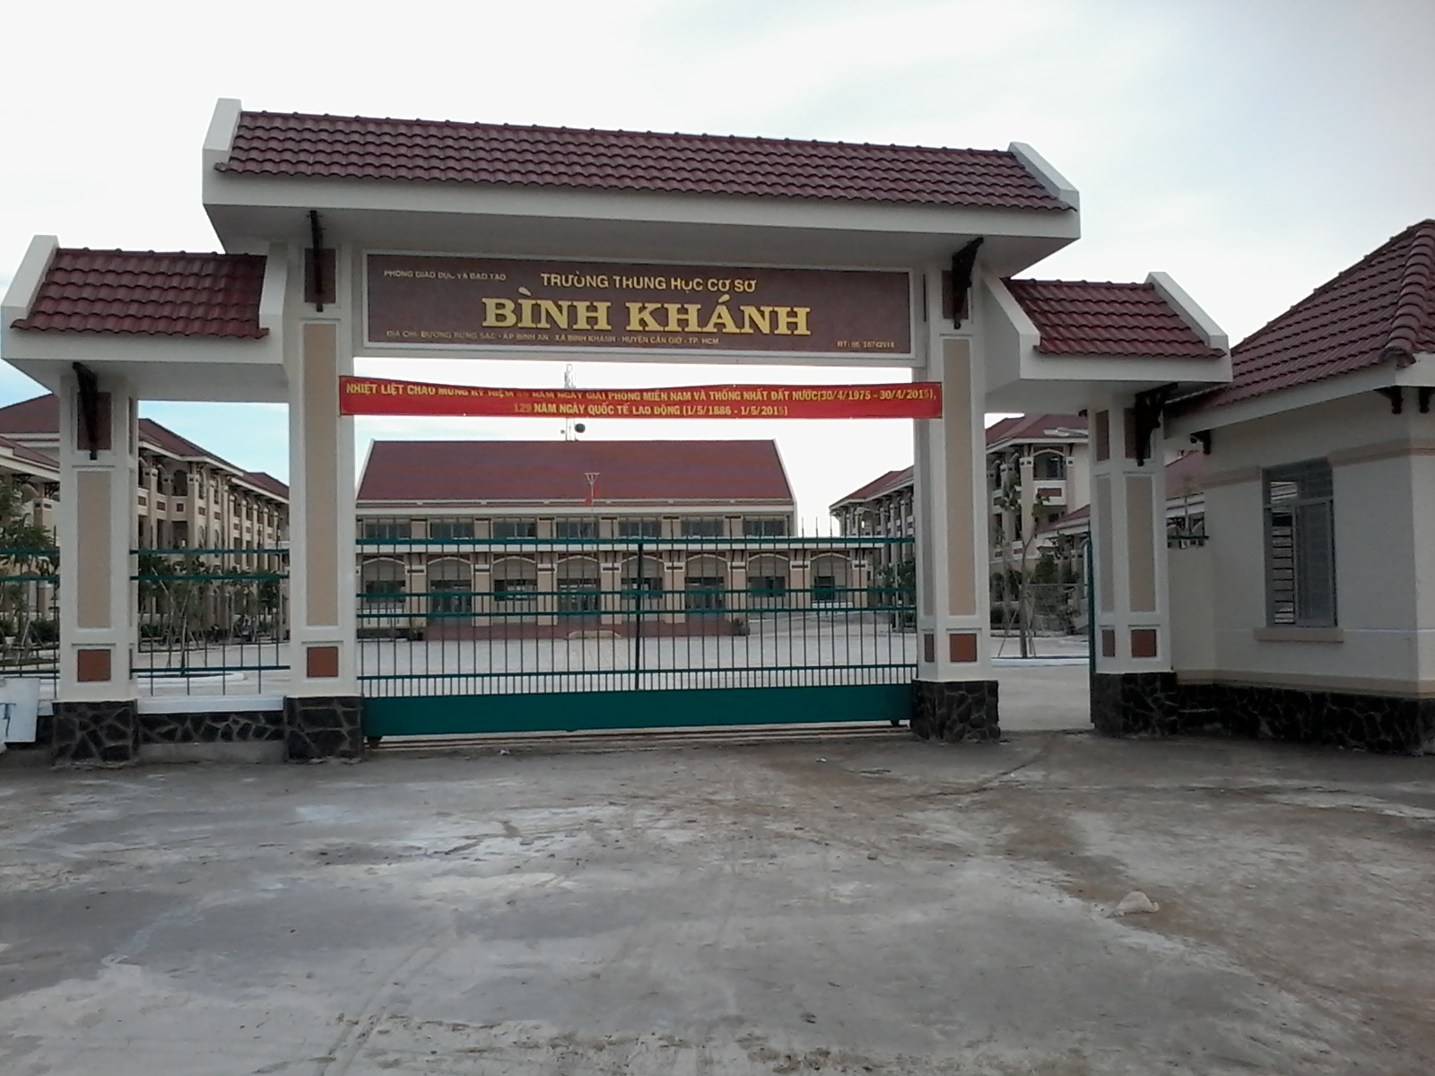
BINH KHANH SECONDARY SCHOOL
FRIENDS PLUS 6

Slide 2
Describe and Draw

Slide 3
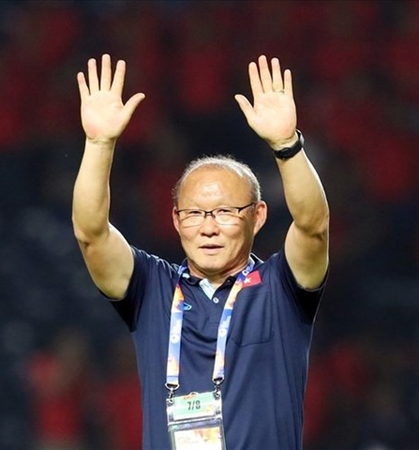
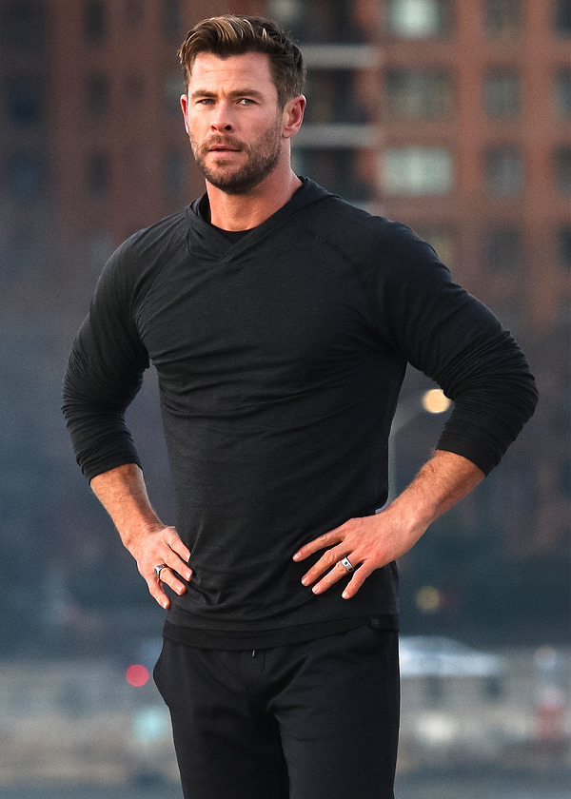

Slide 4
Who is your Favourite celebrity?
Can you describe him / her?

Slide 5
UNIT 7
Lesson 7 - Writing

Slide 6
To describe a person’s physical appearance and behavior.
Tall, strong, good-looking, fair hair, blue eyes, a beard and a moustache, busy, spends lots of time outdoors

Slide 7
KEY PHRASES
A description of a person
1. He / She is a _________ actor.
2. He / She is ____________for _______________
3. He / She is_____,________ and ____________
4. He / She’s got ___________________________
5. He / She is _______ but he / she ____________
_________________
6. He / She becomes a ___________
famous
best-known the role(s) in …
tall strong good-looking
fair hair, blue eyes, a beard and a moustache.
busy spends a lot of time outdoors with …
superhero

Slide 8
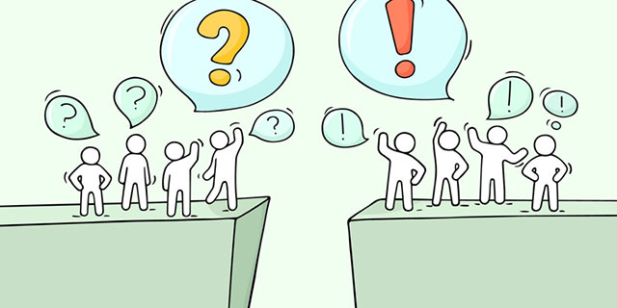
Punctuation

Slide 9
!
?
,
A, B, C..
exclamation
mark
question
mark
capital letter
comma
.
‘
Thor, Coco
Click
Click
1,2,3,4
5,6,7
words
in italics
full stop
apostrophe

Slide 10
Jennifer Lawrence is an American actor. She was born in Kentucky. She is tall and she’s got blonde hair and blue eyes. Jennifer’s most famous role was a girl called Katniss Everdeen in The Hunger Games.

Slide 11
WRITING TIME

Slide 12
Write a description of your favourite celebrity.
1. Which person do you want to describe?
2. Who is he / she? What is he / she famous for?
3. What does he / she look like?
4. How does he / she behave?

Slide 13
CHECKING
word order in descriptions
meanings of adjectives, nouns and verbs
punctuation

Slide 14
🍀 Learn by heart all structures.
🍀 Workbook: Exercises page 53.

Slide 15
F - for an exclamation or an imperative.
D - at the end of a question.
A - at the beginning of a sentence and with names, countries, nationalities and names of books, films and songs.
B - in lists and for pauses.

Slide 16
G - in short forms and to show possession.
C - at the end of a sentence.
E - when we say the title of a book, film or song.

