Slide 1
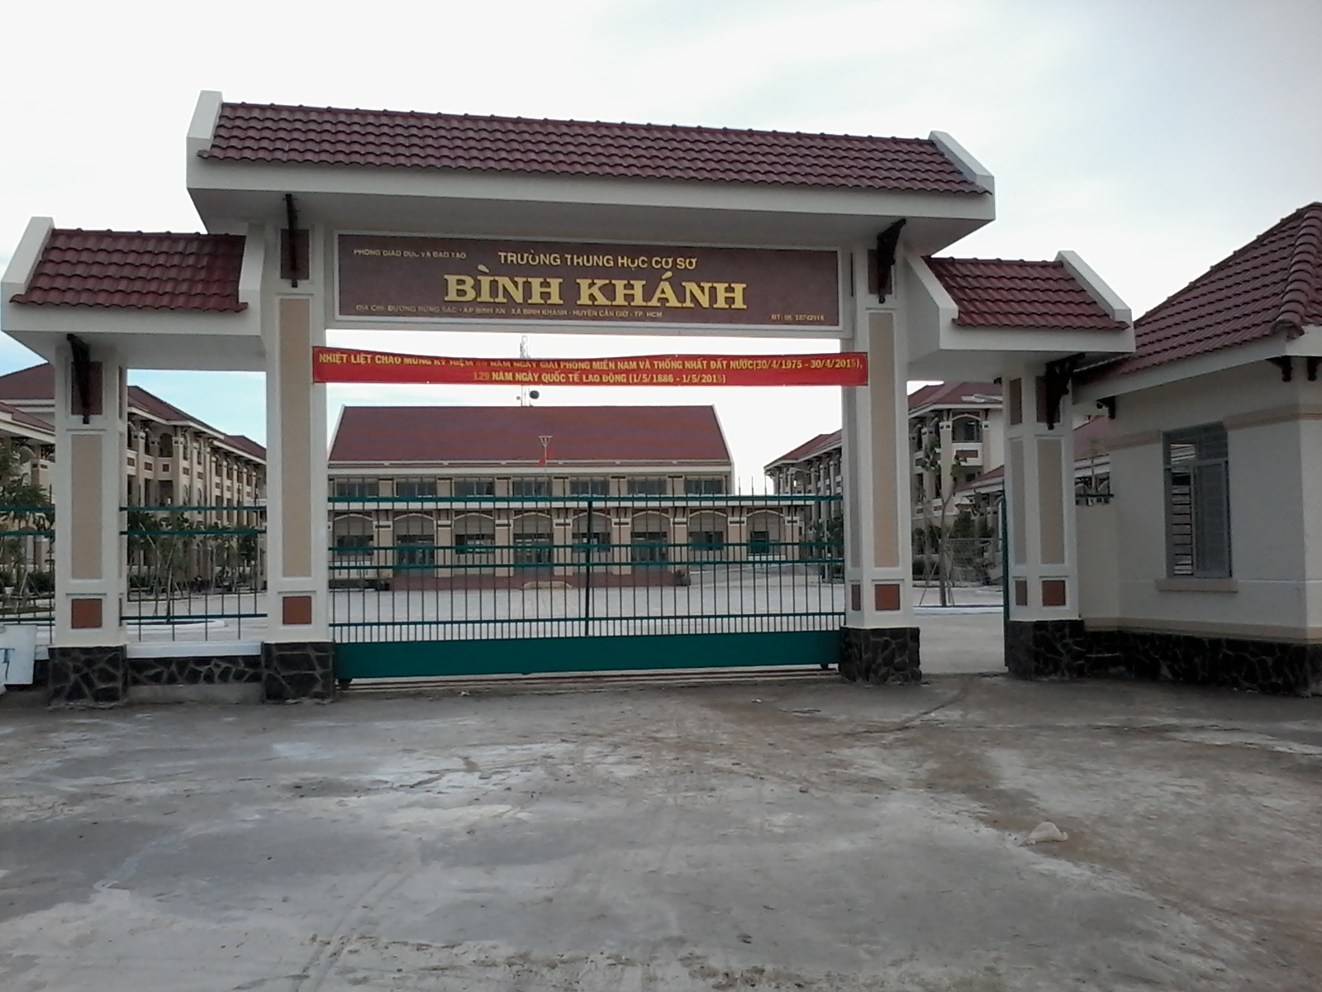
BINH KHANH SECONDARY SCHOOL
FRIENDS PLUS 6

Slide 2
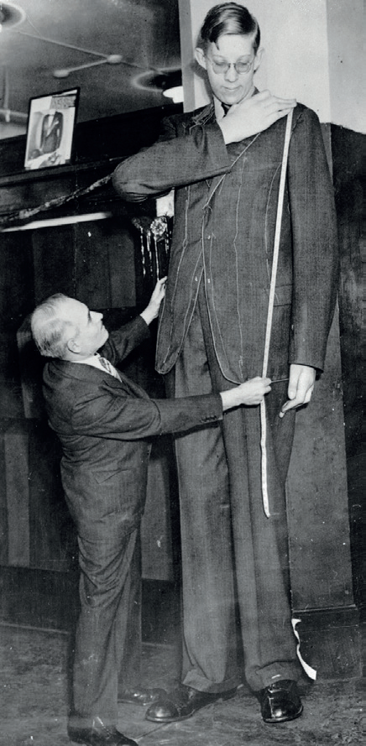
Robert Wadlow : The Gentle Giant

Slide 3
UNIT 7
Growing up
Lesson 4: vocabulary and listening

Slide 4
Read the text about Robert Wadlow and check the meanings of the phrases in blue.

Slide 5
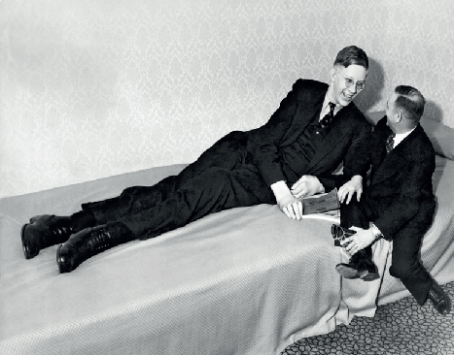

Slide 6
Verb phrases
- to grow up :
to change from being a child to being an adult.
- to go to school :
to leave home for school.
- to leave school :
to finish school.
- to go to university :
to study at a university.
- to get a qualification :
to pass an exam, to complete a course of training or to reach the standard necessary to do a job.
- to get a job :
to do something to earn money.
- to get married :
to become husband and wife.
- to have children :
to be or become parents.
- to travel :
to go from one place to another, or to several places.
- to die :
to stop living.

Slide 7
Read the text about Robert Wadlow and write the past simple form of the verbs. Listen and check.
grow up
go to school
leave school
go to university
get a qualification
get a job
get married
have children
travel
die
grew up
went to school
left school
went to university
got a qualification
got a job
got married
had children
travelled
died

Slide 8
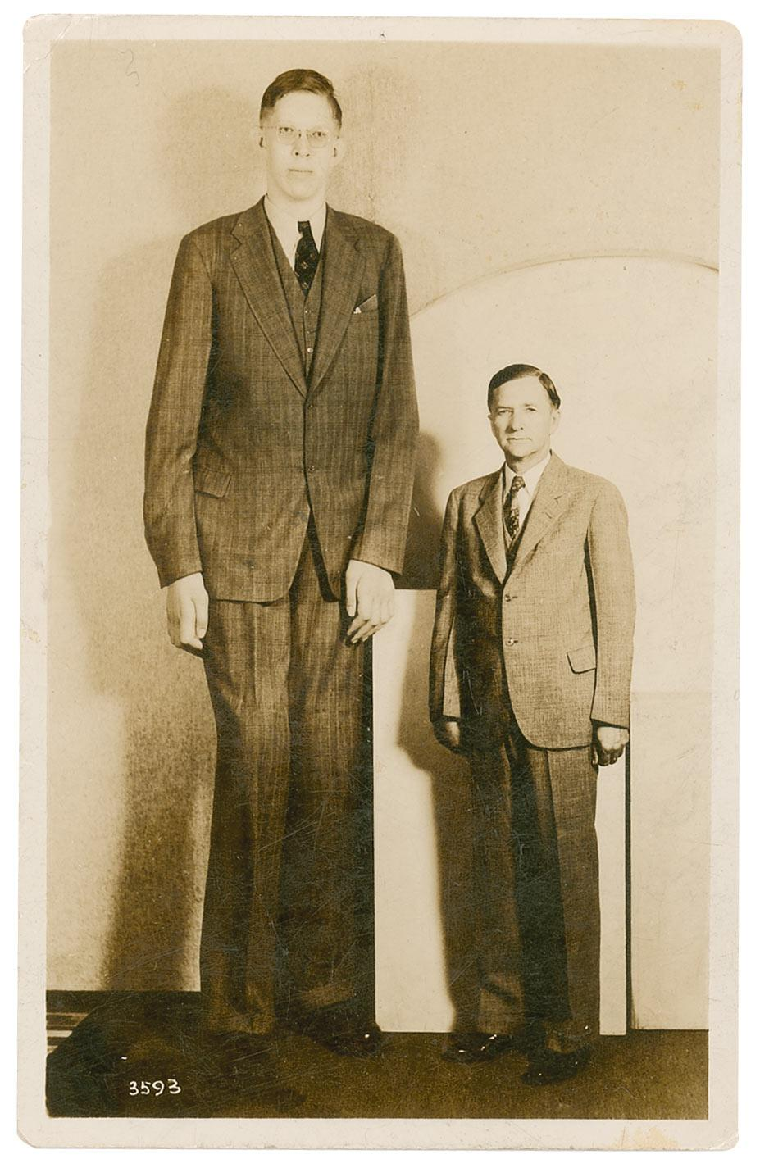
Do you think people in the USA liked or disliked Robert? Listen to a podcast about him and check your answer.
People liked him.

Slide 9
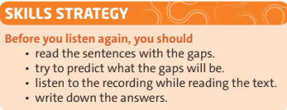
READ THE SKILLS STRATEGY

Slide 10
Listen again and complete 1–9 in the text

Slide 11
When was he born? In February (1) _________ in Alton, Illinois, in the USA. Where did he grow up and go to school? In Alton. Did he have any brothers and sisters? Yes, he did. He was the oldest of five children. He had (2) ____________ and (3) ___________. They were all a (4) _____________ height. At what age did he leave school? He left school when he was (5) ______________.
Did he go to university? Yes, he did, but he left and he didn’t get a qualification. How did he become famous? He appeared in a circus. What did people call him? People called him the Giant of Illinois or the Gentle Giant because he (6) _______ very quietly.
Where did he get a job? He got a job with the shoe company that made his special shoes. Did he get married and have children? No, he didn’t. Did he travel much? Yes, he did. He visited (7) __________ different towns in the USA when he travelled for the shoe company. When did he die? He died at the age of (8) _____________ because of a problem with one of his (9) ________________.
1918
two brothers
two sisters
normal
seventeen
spoke
800
twenty-two
feet

Slide 12
OPTIONAL ACTIVITY: LISTENING

Slide 13
Listen again and correct these sentences.
Robert was taller than his father by the age of
six.
eight.
2) At school, they made a special for him.
desk
chair
3) Robert left university because
it was difficult for him.
he didn’t enjoy it.
never stopped growing.
4) Robert
stopped growing when he was 18.

Slide 14
Write sentences about a person in your family. Use the past simple form of the verbs in the text.

Slide 15
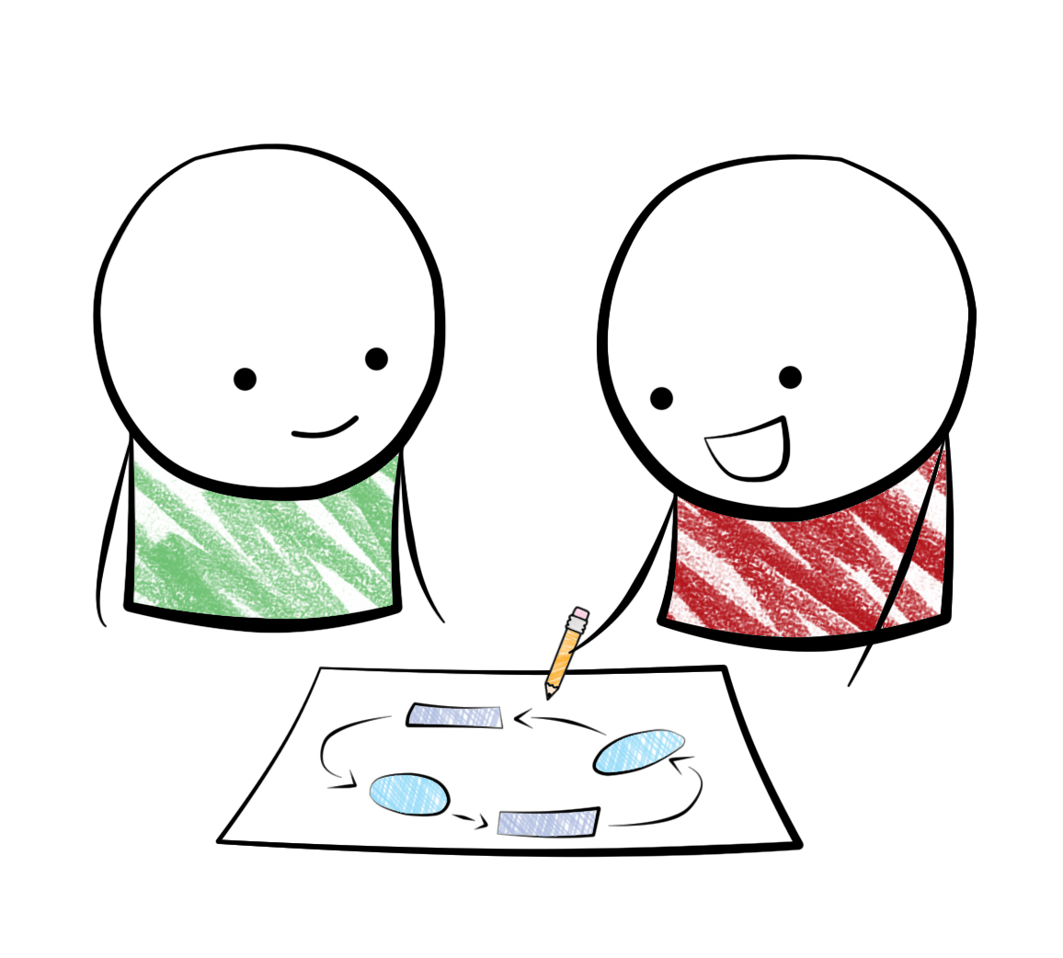
Work in pairs. Compare your sentences in exercise 4

Slide 16
Example:

Slide 17
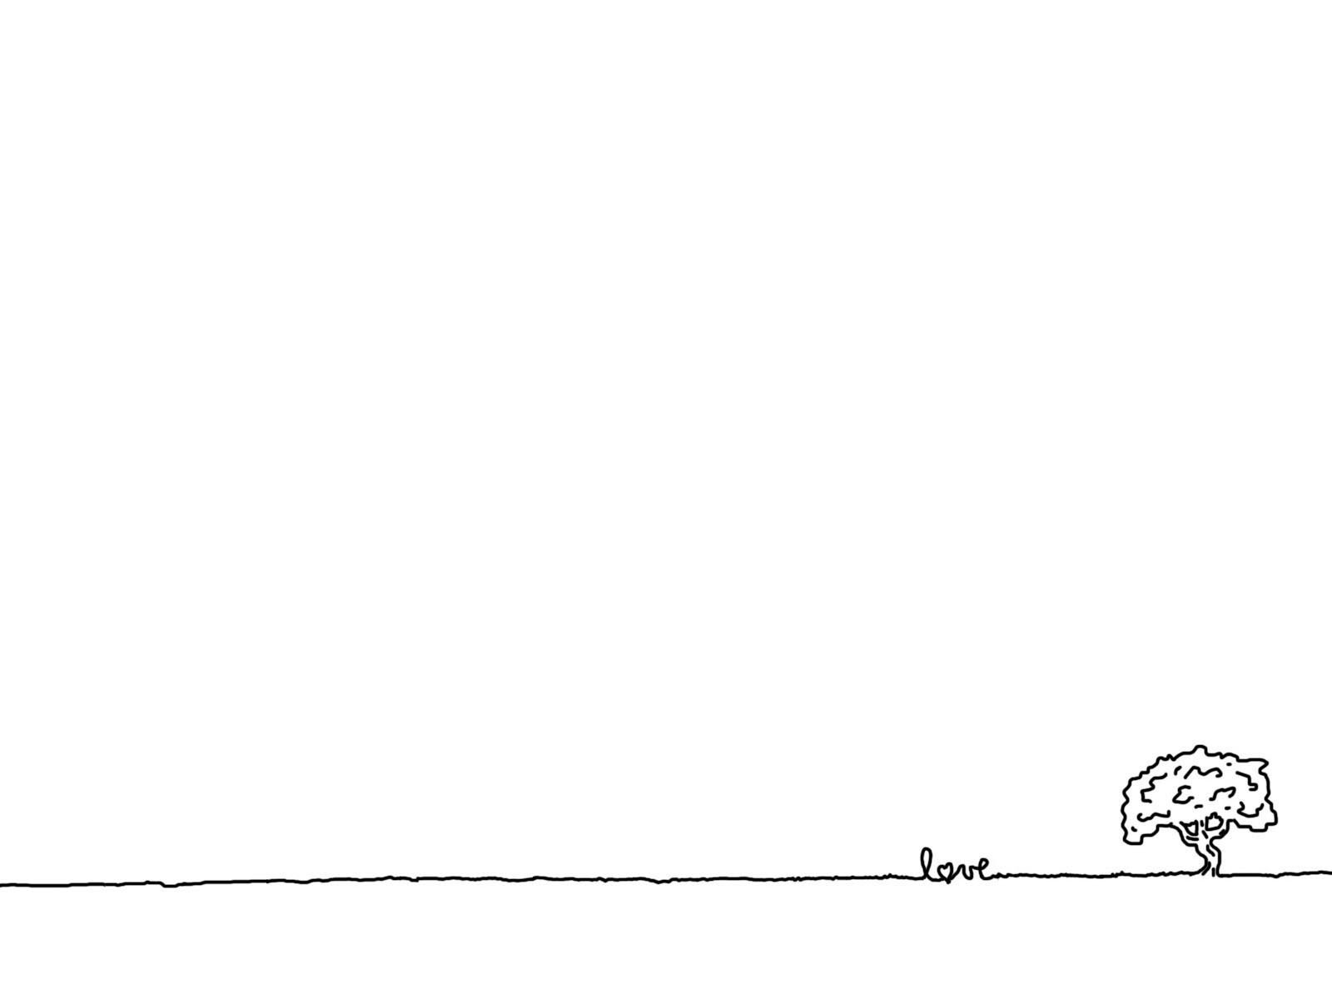
Homework
Learn by heart all the phrases.
Workbook: Exercises page 50.
Prepare the next lesson: LANGUAGE FOCUS.

