Slide 1
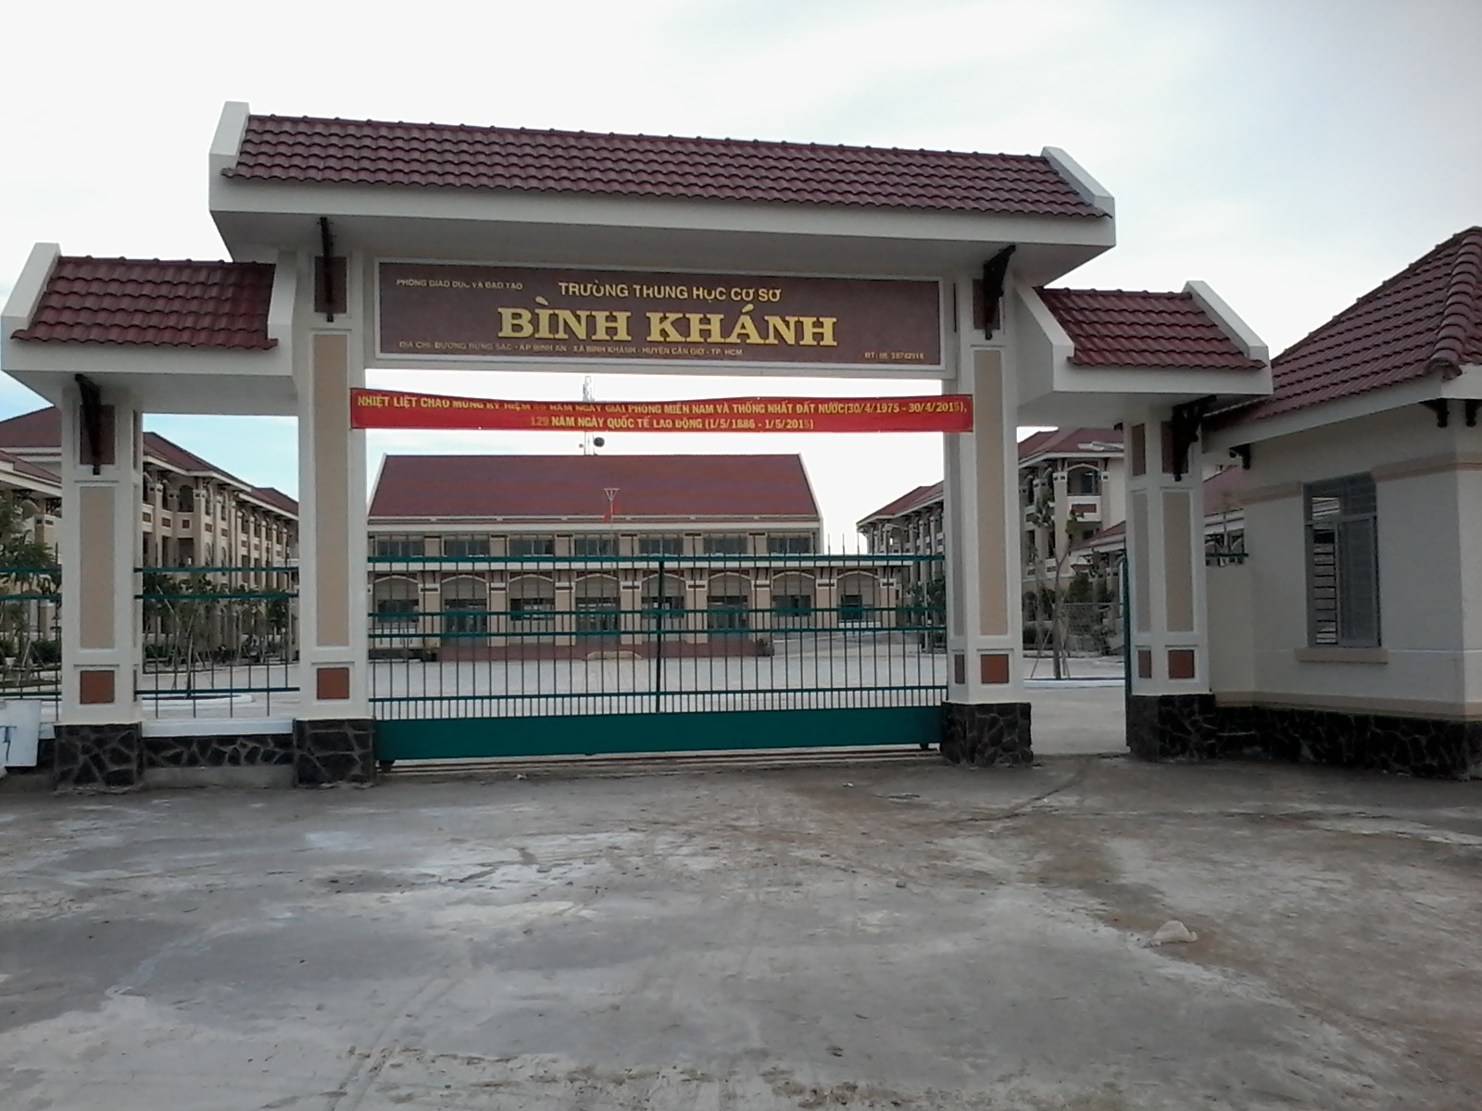
BINH KHANH SECONDARY SCHOOL
FRIENDS PLUS 6

Slide 2
UNIT 6: SPORTS
LESSON 3: LANGUAGE FOCUS

Slide 3
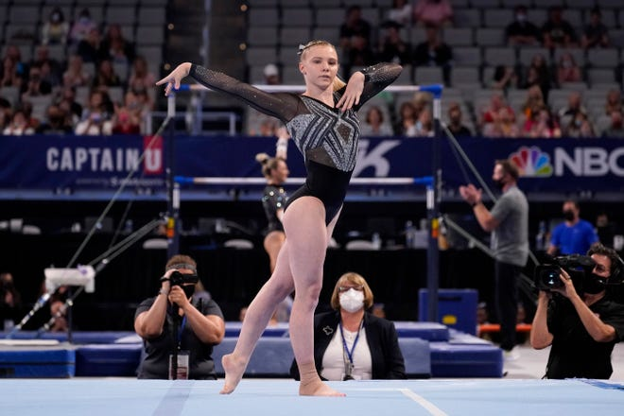
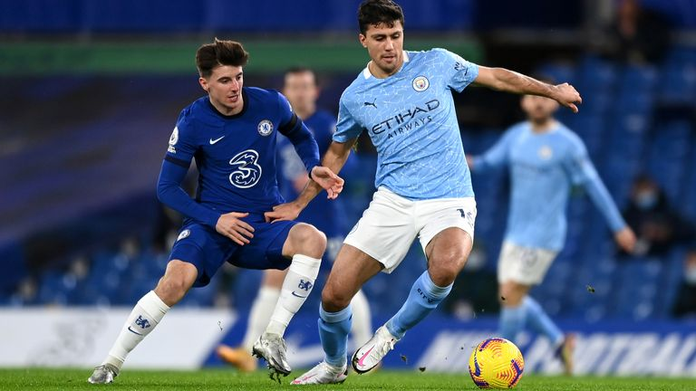
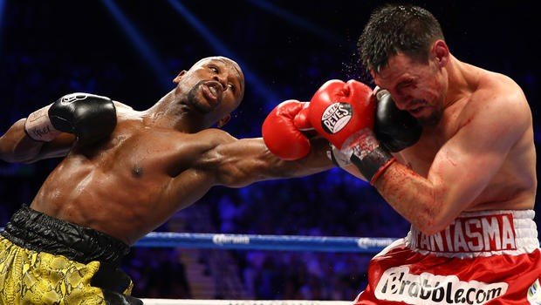
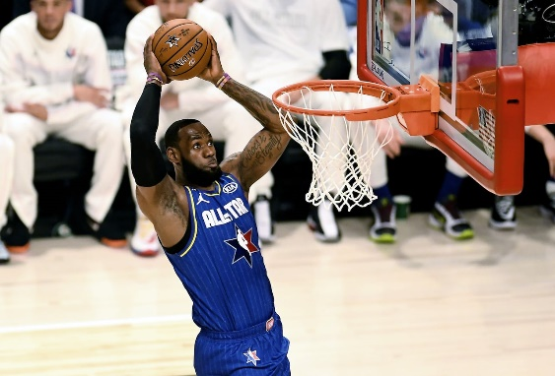
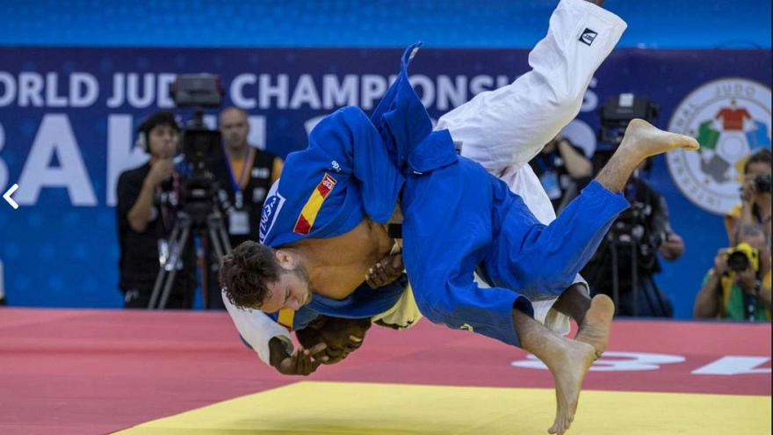
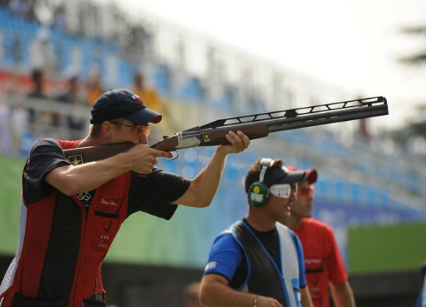
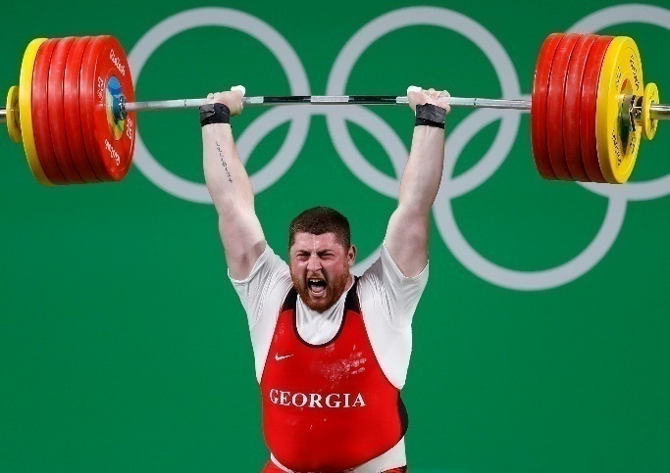
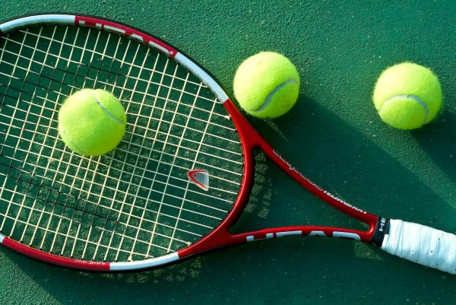
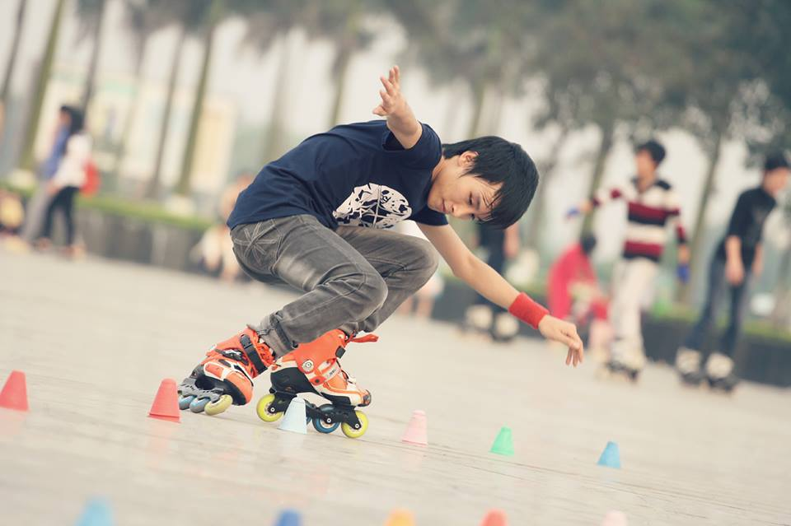
OPEN, SESAME
Football
Gymnastics
Boxing
Basketball
Judo
Shooting
Tennis
Weightlifting
Rollerblading

Slide 4
OPEN, SESAME
Gymnastics
Boxing
Football
What sports are played in the Olympics?
Shooting
Basketball
Judo
Weightlifting
Tennis

Slide 5
OPEN, SESAME
What sports are not played in the Olympics?
Rollerblading

Slide 6
EXERCISE 1: Complete the examples from the text. Then choose the correct words in the Rules.
There were
There wasn't

Slide 7
GRAMMAR POINTS
THERE WAS / THERE WASN'T...
(+)There was + a /an + singular Noun
Eg: There was a fire in the town center.
(-) There wasn't + a/an + singular Noun
Eg: There wasn't a good film on TV last night.
THERE WERE/ THERE WEREN'T...
(+) There were + some + plural Noun
Eg: There were some people here.
(-) There weren't + any + plural Noun
Eg: There weren't any books there.

Slide 8
EXERCISE 2: Work in pairs. Complete the text with affirmative and negative form.
there was
there were
There was
there wasn't
there weren't
There weren't

Slide 9
EXERCISE 3: Complete the text with affirmative and negative forms of There was and there were. Use Many/any or a/an.
2,500 years ago …
…..............................rich footballers.
…..............................chariot races.
….....................country called Persia.
….........................sport called skateboarding.
…..............................messengers.
…..............................iPads.
there weren't any
there were many
there was a
there wasn't a
there were many
there weren't any

Slide 10
EXERCISE 4: USE IT! .Work in pairs. Compare your sentences in Ex 3.

Slide 11
EXERCISE 5: Complete the sentences about Olympics timeline text. Then complete the Rule.
were
was
was
wasn't
weren't
is and are
wasn't
weren't

Slide 12
GRAMMAR POINTS
The simple past tense of the verb to be:
The affirmative form:
Eg:
I was in London in 1999.
Pam was in London in 1999, too.
We were together.
The negative form:
Eg:
I wasn't in Paris in 1999.
Pam wasn't in Paris in 1999.
We weren't in Paris.
I, he, she, it | was.
you, we, they | were.
I, he, she, it | was not.
 | wasn't.
You, we, they | were not.
 | weren't.

Slide 13
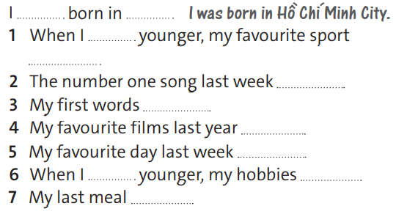
EXERCISE 6: Complete the sentences with was and were and your own ideas.

Slide 14
EXERCISE 7: Work in groups. Compare your sentences in EX 6

Slide 15
Think of more differences life 100 years ago and now. Use there was/wasn't, there were/weren't.
Eg:
- There weren't a lot of cinemas 100 years ago.
- There weren't supermarkets 100 years ago.
......

Slide 16
- Learn by heart all structures.
- Workbook: Exercises page 43.

